Slide 1
Introduction to Decision Trees

Slide 2
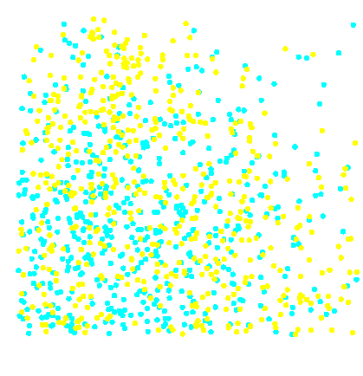
Simple Prediction Illustration
Training Data
1.0
0.9
Predict dot color for each x₁ and x₂.
0.8
0.7
0.6
x₂
0.5
0.4
0.3
0.2
0.1
0.0
0.0
0.1
0.2
0.3
0.4
0.5
0.6
0.7
0.8
0.9
1.0
x₁
...

Slide 3
Simple Prediction Illustration
Training Data
1.0
0.9
Predict dot color for each x₁ and x₂.
0.8
0.7
0.6
x₂
0.5
0.4
0.3
0.2
0.1
0.0
0.0
0.1
0.2
0.3
0.4
0.5
0.6
0.7
0.8
0.9
1.0
x₁
...

Slide 4
Decision Tree Prediction Rules
root node
x₂
1.0
<0.63
≥0.63
0.9
0.8
interior node
0.7
x₁
x₁
0.6
<0.52
≥0.52
<0.51
≥0.51
x₂
0.5
0.4
0.3
70%
0.2
40%
0.1
leaf node
55%
60%
0.0
0.0
0.1
0.2
0.3
0.4
0.5
0.6
0.7
0.8
0.9
1.0
x₁
...

Slide 5
Decision Tree Prediction Rules
Predict:
root node
x₂
1.0
<0.63
≥0.63
0.9
0.8
interior node
0.7
x₁
x₁
0.6
<0.52
≥0.52
<0.51
≥0.51
x₂
0.5
0.4
0.3
70%
0.2
40%
0.1
leaf node
55%
60%
0.0
0.0
0.1
0.2
0.3
0.4
0.5
0.6
0.7
0.8
0.9
1.0
x₁
...

Slide 6
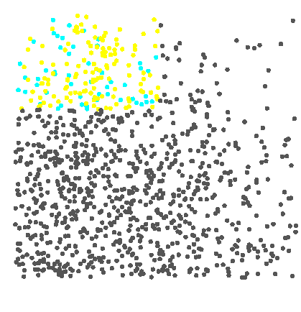
Decision Tree Prediction Rules
Predict:
Decision =
Estimate = 0.70
x₂
1.0
<0.63
0.9
<0.63
≥0.63
0.8
0.7
x₁
0.6
x₁
x₁
<0.52
x₂
<0.52
≥0.52
≥0.52
<0.51
≥0.51
≥0.51
0.5
0.4
0.3
70%
0.2
40%
40%
0.1
55%
55%
60%
0.0
60%
0.0
0.1
0.2
0.3
0.4
0.5
0.6
0.7
0.8
0.9
1.0
x₁
...

Slide 7
Decision Tree Prediction Rules
Predict:
Decision =
Estimate = 0.70
x₂
1.0
<0.63
≥0.63
0.9
0.8
0.7
x₁
x₁
0.6
<0.52
≥0.52
<0.51
≥0.51
x₂
0.5
0.4
0.3
70%
0.2
40%
0.1
55%
60%
0.0
0.0
0.1
0.2
0.3
0.4
0.5
0.6
0.7
0.8
0.9
1.0
x₁
...

Slide 8
Decision Tree Split Search
left
right
1.0
0.9
0.8
0.7
Confusion Matrix
0.6
x₂
0.5
0.4
Calculate the logworth of every partition on input x₁.
0.3
0.2
0.1
0.0
0.0
0.1
0.2
0.3
0.4
0.5
0.6
0.7
0.8
0.9
1.0
x₁
...

Slide 9
Decision Tree Split Search
left
right
0.52
1.0
0.9
0.8
0.7
Confusion Matrix
0.6
x₂
0.5
0.4
Calculate the logworth of every partition on input x₁.
0.3
0.2
0.1
0.0
0.0
0.1
0.2
0.3
0.4
0.5
0.6
0.7
0.8
0.9
1.0
x₁
...

Slide 10
Decision Tree Split Search
left
right
0.52
53%
42%
1.0
max
logworth(x₁)
0.95
0.9
47%
58%
0.8
0.7
0.6
x₂
0.5
0.4
Select the partition with the maximum logworth.
0.3
0.2
0.1
0.0
0.0
0.1
0.2
0.3
0.4
0.5
0.6
0.7
0.8
0.9
1.0
x₁
...

Slide 11
Decision Tree Split Search
left
right
53%
42%
1.0
max
logworth(x₁)
0.95
0.9
47%
58%
0.8
0.7
0.6
x₂
0.5
0.4
0.3
Repeat for input x₂.
0.2
0.1
0.0
0.0
0.1
0.2
0.3
0.4
0.5
0.6
0.7
0.8
0.9
1.0
x₁
...

Slide 12
Decision Tree Split Search
left
right
53%
42%
1.0
max
logworth(x₁)
0.95
0.9
47%
58%
0.8
0.7
0.6
x₂
0.5
bottom
top
0.4
0.3
0.2
0.1
0.0
0.0
0.1
0.2
0.3
0.4
0.5
0.6
0.7
0.8
0.9
1.0
x₁
...

Slide 13
Decision Tree Split Search
left
right
53%
42%
1.0
max
logworth(x₁)
0.95
0.9
47%
58%
0.8
0.7
0.63
0.6
x₂
0.5
bottom
top
0.4
54%
35%
max
logworth(x₂)
4.92
0.3
0.2
46%
65%
0.1
0.0
0.0
0.1
0.2
0.3
0.4
0.5
0.6
0.7
0.8
0.9
1.0
x₁
...

Slide 14
Decision Tree Split Search
left
right
53%
42%
1.0
max
logworth(x₁)
0.95
0.9
47%
58%
0.8
0.7
0.6
Compare partition logworth ratings.
x₂
0.5
bottom
top
0.4
54%
35%
max
logworth(x₂)
4.92
0.3
0.2
46%
65%
0.1
0.0
0.0
0.1
0.2
0.3
0.4
0.5
0.6
0.7
0.8
0.9
1.0
x₁
...

Slide 15
Decision Tree Split Search
left
right
53%
42%
1.0
max
logworth(x₁)
0.95
0.9
47%
58%
0.8
0.7
0.63
0.6
x₂
0.5
bottom
top
0.4
54%
35%
max
logworth(x₂)
4.92
0.3
0.2
46%
65%
0.1
0.0
0.0
0.1
0.2
0.3
0.4
0.5
0.6
0.7
0.8
0.9
1.0
x₁
...

Slide 16
Decision Tree Split Search
1.0
x₂
0.9
<0.63
≥0.63
0.8
0.7
0.63
0.6
x₂
0.5
0.4
Create a partition rule from the best partition across all inputs.
0.3
0.2
0.1
0.0
0.0
0.1
0.2
0.3
0.4
0.5
0.6
0.7
0.8
0.9
1.0
x₁
...

Slide 17
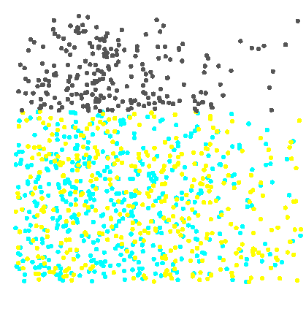
Decision Tree Split Search
1.0
x₂
0.9
<0.63
≥0.63
0.8
0.7
0.6
x₂
0.5
0.4
Repeat the process in each subset.
0.3
0.2
0.1
0.0
0.0
0.1
0.2
0.3
0.4
0.5
0.6
0.7
0.8
0.9
1.0
x₁
...

Slide 18
Decision Tree Split Search
left
right
1.0
0.9
0.8
0.7
0.6
x₂
0.5
0.4
0.3
0.2
0.1
0.0
0.0
0.1
0.2
0.3
0.4
0.5
0.6
0.7
0.8
0.9
1.0
x₁
...

Slide 19
Decision Tree Split Search
left
right
61%
55%
1.0
max
logworth(x₁)
5.72
0.9
39%
45%
0.8
0.7
0.52
0.6
x₂
0.5
0.4
0.3
0.2
0.1
0.0
0.0
0.1
0.2
0.3
0.4
0.5
0.6
0.7
0.8
0.9
1.0
x₁
...

Slide 20
Decision Tree Split Search
left
right
61%
55%
1.0
max
logworth(x₁)
5.72
0.9
39%
45%
0.8
0.7
0.6
x₂
0.5
bottom
top
0.4
0.3
0.2
0.1
0.0
0.0
0.1
0.2
0.3
0.4
0.5
0.6
0.7
0.8
0.9
1.0
x₁
...

Slide 21
Decision Tree Split Search
left
right
61%
55%
1.0
max
logworth(x₁)
5.72
0.9
39%
45%
0.8
0.7
0.6
x₂
0.5
bottom
top
0.4
38%
55%
max
logworth(x₂)
-2.01
0.3
0.2
62%
45%
0.1
0.0
0.02
0.0
0.1
0.2
0.3
0.4
0.5
0.6
0.7
0.8
0.9
1.0
x₁
...

Slide 22
Decision Tree Split Search
left
right
61%
55%
1.0
max
logworth(x₁)
5.72
0.9
39%
45%
0.8
0.7
0.6
x₂
0.5
bottom
top
0.4
38%
55%
max
logworth(x₂)
-2.01
0.3
0.2
62%
45%
0.1
0.0
0.0
0.1
0.2
0.3
0.4
0.5
0.6
0.7
0.8
0.9
1.0
x₁
...

Slide 23
Decision Tree Split Search
left
right
61%
55%
1.0
max
logworth(x₁)
5.72
0.9
39%
45%
0.8
0.7
0.52
0.6
x₂
0.5
bottom
top
0.4
38%
55%
max
logworth(x₂)
-2.01
0.3
0.2
62%
45%
0.1
0.0
0.0
0.1
0.2
0.3
0.4
0.5
0.6
0.7
0.8
0.9
1.0
x₁
...

Slide 24
Decision Tree Split Search
1.0
x₂
0.9
<0.63
≥0.63
0.8
0.7
x₁
0.6
<0.52
≥0.52
x₂
0.5
0.4
0.3
0.2
Create a second partition rule.
0.1
0.0
0.0
0.1
0.2
0.3
0.4
0.5
0.6
0.7
0.8
0.9
1.0
x₁
...

Slide 25
Decision Tree Split Search
1.0
x₂
0.9
<0.63
≥0.63
0.8
0.7
x₁
0.6
<0.52
≥0.52
x₂
0.5
0.4
0.3
0.2
Create a second partition rule.
0.1
0.0
0.0
0.1
0.2
0.3
0.4
0.5
0.6
0.7
0.8
0.9
1.0
x₁
...

Slide 26
Decision Tree Split Search
1.0
0.9
0.8
0.7
0.6
x₂
0.5
0.4
0.3
0.2
0.1
0.0
0.0
0.1
0.2
0.3
0.4
0.5
0.6
0.7
0.8
0.9
1.0
Repeat to form a maximal tree.
x₁
...

Slide 27
Selecting the Best Tree
Training Data
Validation Data
inputs
target
inputs
target
Compare validation assessment between tree complexities.
Model
Complexity
Validation
Assessment
...

Slide 28
Selecting the Best Tree
Training Data
Validation Data
inputs
target
inputs
target
Which subtree should be selected as the best model?
Model
Complexity
Validation
Assessment
...

Slide 29
Validation Assessment
Training Data
Validation Data
inputs
target
inputs
target
Choose the simplest model with the highest validation assessment.
Model
Complexity
Validation
Assessment
...

