Slide 1
Fantasy Football
By Xavier Weisenreder, Nik Oza, Ching-Hao Hu, Troy Holland, and Chris Balthazard

Slide 2
How has the NFL Changed?

Slide 3
Correlations of Offensive Trends
QB Pass Yds
RB Rush Yds
WR Yds
TE Yds
Avg Game Score

Slide 4
How Have These Trends Affected Positions?

Slide 5
Is it Plausible to Use This Information?

Slide 6
Marginal Utility Curves By Position

Slide 7
Positional Breakdown by Fantasy Draft Round

Slide 8
Fantasy Draft Adjustments

Slide 9
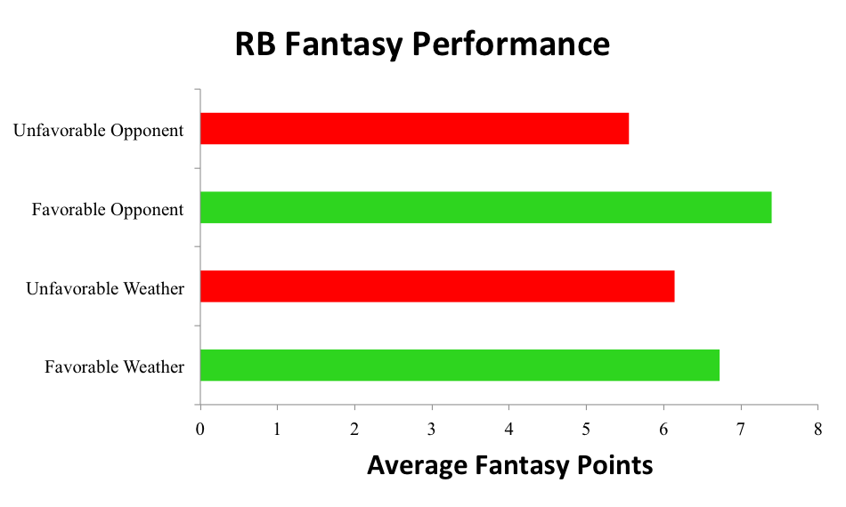
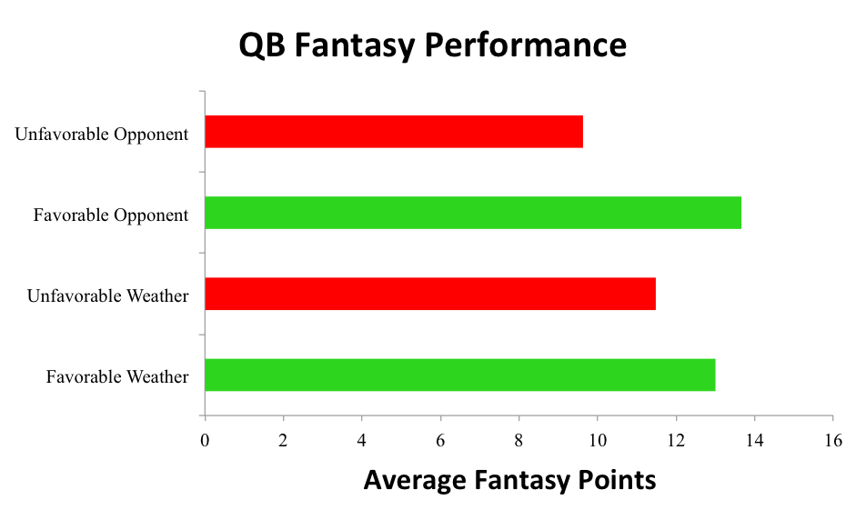
Does Weather Affect Fantasy Performance?

Slide 10
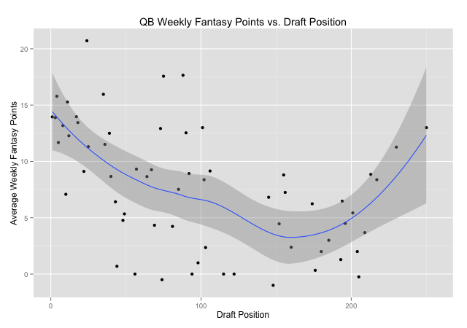
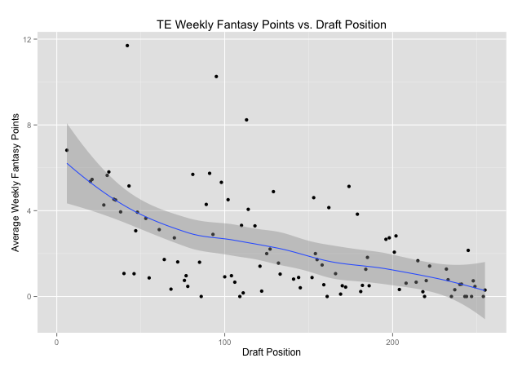
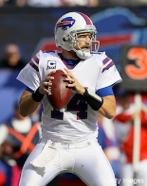
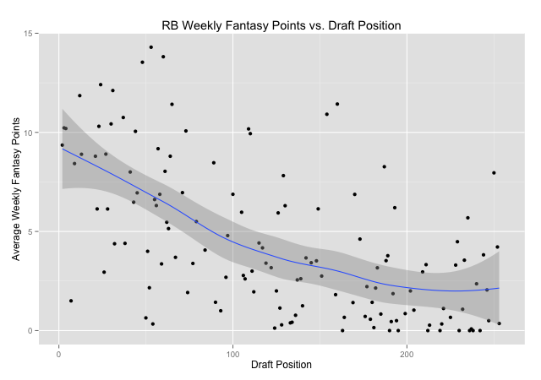
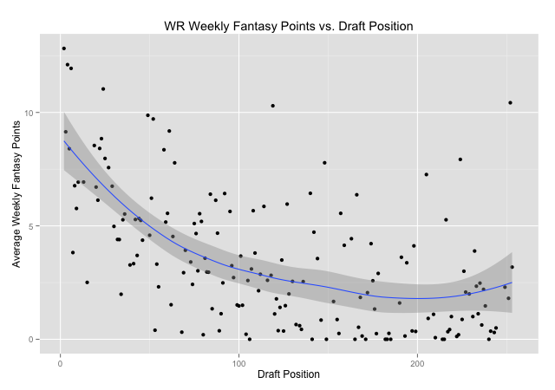
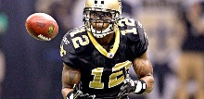
Does the Actual NFL Draft Affect Fantasy?

Slide 11
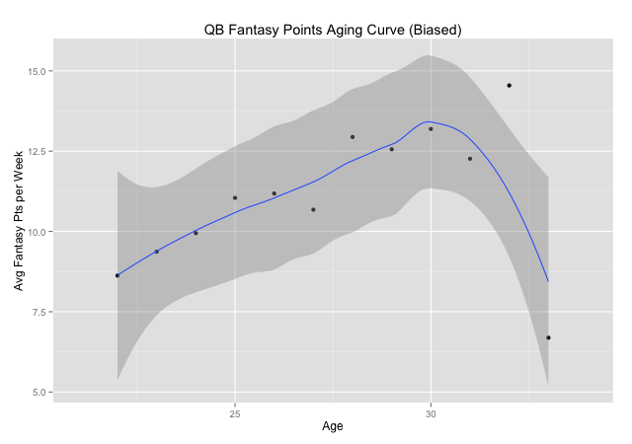
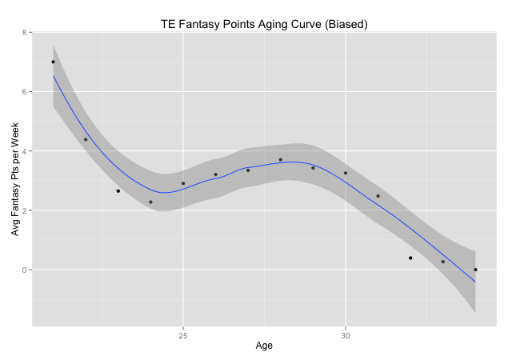
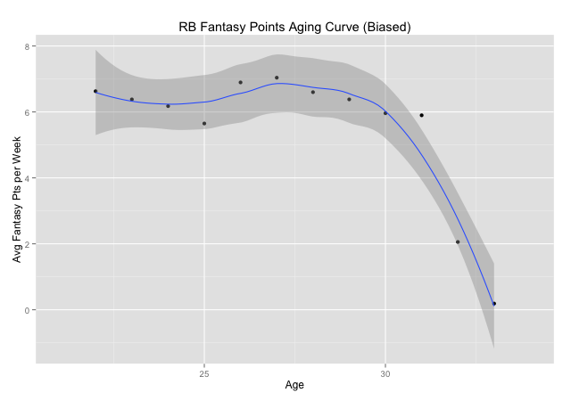
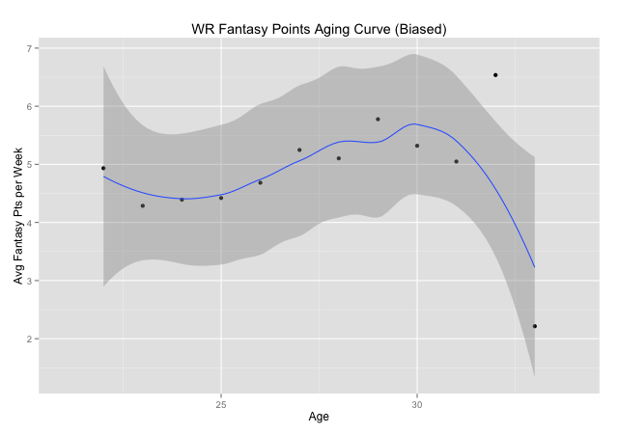
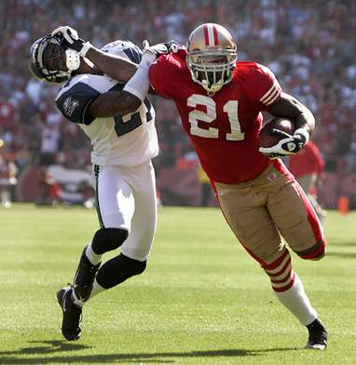
How Does Age Affect Fantasy?

Slide 12
Thank you!

