Slide 1
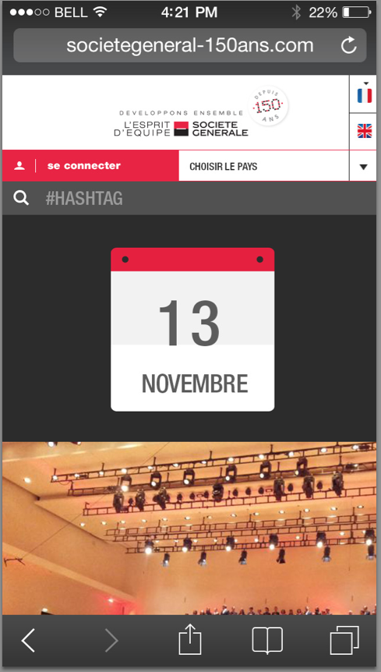
The icon is too small, we suggest just display one icon represent current country.
When user click the icon, display a select dialog to switch country.
When user click searchbar the textbox will expand.

Slide 2
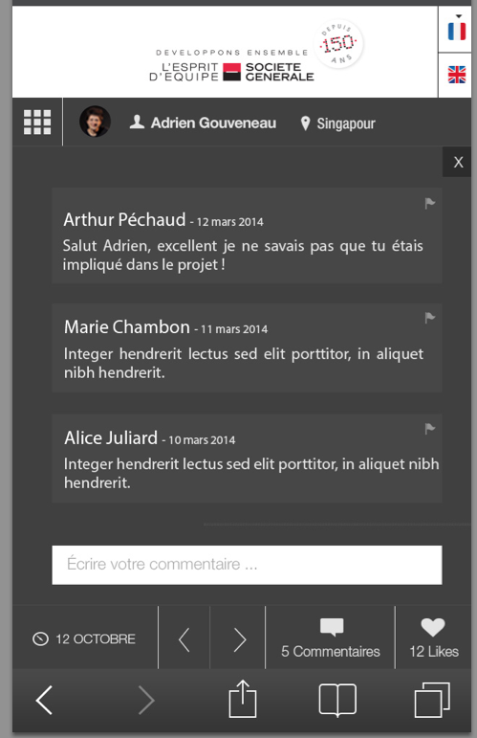
1) Missing “Submit” button
2) This text box is take too much space, it no space to place error message. We checked other APP, most of them leave a button say “Write comment”, when user click the button, it will popup a layer, there is a more space to place error message and submit button.

Slide 3
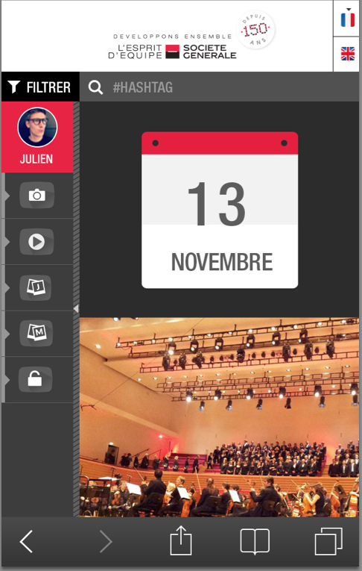
The “Filter” button is too small. It can be move to right column side by the “search” text box. When user click the “search” text box, the text box expand, and the filter button will shrink.

Slide 4
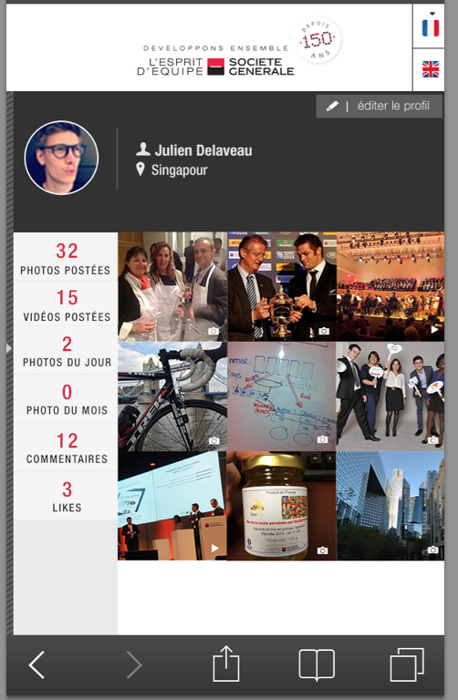
The thumbnail looks too small, suggest three thumbnail in one row.

