Slide 1
FRED & FARID FOR CARAMBAR
GOODLUCKCARAMBAR.COM WEBSITE BRIEF & MOCKUPS
PARIS, LE 21.02.14

Slide 2
THE OPERATION
LAST YEAR, TO RALLY THE ENTIRE COUNTRY TOGETHER, WE THREATHENED TO REMOVE WHAT EVERYBODY LOVE: THE CARAMBAR JOKE
THIS YEAR, WE’LL USE AN OTHER INSIGHT:
THE BEST THING TO GET PEOPLE TOGETHER IS TO HAVE A COMMON BATTLE
MAKE AMERICA LAUGH

Slide 3
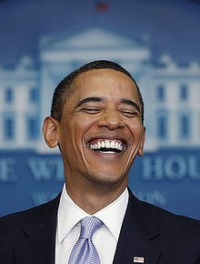
THE OPERATION
WE’LL SET UP A SERIE OF CRAZY CHALLENGES
WITH A CRESCENDO OF DIFFICULTY TO RAISE EXCITEMENT
THE FINAL CHALLENGE WILL BE CHOSEN BY OUR FANS AMONG 3 PROPOSITIONS :
CHALLENGE 1
CHALLENGE 2
CHALLENGE 3
?
?
MAKE BARACK OBAMA LAUGH TO ONE OF OUR JOKES

Slide 4
THE OPERATION
A QUEST WITH ONE SIMPLE GOAL,
CHOSEN BY OUR FANS :
WE’LL TRY TO MAKE BARACK OBAMA LAUGH
TO A TYPICALLY-FRENCH CARAMBAR JOKE

Slide 5
THE OPERATION
…A NATIONAL SUPPORT…
FRENCH PEOPLE WILL BE INVITED TO FOLLOW OUR AMBASSADOR JOURNEY AND SHOW THEIR SUPPORT FOR THIS IMPOSSIBLE QUEST:
TO MAKE ALL AMERICA LAUGH AT CARAMBAR “PETITES BLAGUES”
THE MOST PESSIMISTIC ONES WOULD SEE IT AS A LOST CAUSE, BUT MAYBE SOME OPTIMISTIC ONES WILL BELIEVE THAT: YES, WE CAN ☺
EITHER WAY, THE ONLY THING WE’LL ASK FROM THEM IS A SIMPLE “GOOD LUCK”

Slide 6
THE OPERATION
WHILE WE WILL BE TRYING TO MAKE AMERICA LAUGH, THE PROGRESSION WILL BE FILMED, EDITED AND BROADCASTED ON A DEDICATED PLATFORM.
AND WE WILL INVITE THE USERS TO SHARE THEIR SUPPORT TO THE QUEST BY POSTING ON A WALL SIMILAR TO THE FF BRIDGE, USING THE HASHTAG
#GOODLUCKCARAMBAR

Slide 7
GLOBAL DESCRIPTION OF THE PLATFORM
DEDICATED WEBSITE, RESPONSIVE STEP BY STEP FEATURING A MOBILE LIGHT VERSION.
Compatible with all browsers, LATER THAN IE 9.
THE FIRST VERSION HAS TO BE ONLINE ON MARCH 25TH.
Website constitued of 2 different parts :
  The EDITORIAL FRONT PAGE
  THE SUPPORT WALL
AND EVOLVING THROUGH 5 DIFFERENT PHASES
  PHASE 1 - PRESENTATION-TEASING PHASE
  PHASE 2 - PRESENTATION-REVEAL PHASE
  PHASE 3 - ON GOING PHASE
  PHASE 4 - ULTIMATE CHALLENGE PHASE
SCOPE OF INTERVENTION IN RED IN THE FOLLOWING SLIDES

Slide 8
PR
DAILY ADS
OFF & ONLINE
SOCIAL SHARES
GOODLUCKCARAMBAR.COM
CARAMBAR
FACEBOOK AND TWITTER PAGE
AMBASSADOR
+ FILM CREW COMPLETE CHALLENGES
BET
OPTIMISTIC/PESSIMISTIC
+ #GOODLUCKCARAMBAR
WATCH DAILY CONTENT
SEND ENCOURAGEMENT
GET YOUR SUPPORT KIT

Slide 9
PHASING OVERVIEW (WEEK 1)
MARCH 24th
MARCH 25th
MARCH 26th
MARCH 27th
MARCH 28th
PR KICKOFF
MEDIA KICKOFF
PR REINFORCEMENT
PUSH
PR / MEDIA
VIDEO PRESENTATION & CHALLENGE 1
REVEAL OF THE ULTIMATE CHALLENGE
PUBLICATION
ON WEBSITE
INVITATION TO VOTE FOR THE ULTIMATE CHALLENGE
VOTE
VOTE
INVITATION TO SUPPORT #GLC
CALL TO ACTION
PHASE 1
PHASE 1
PHASE 1
PHASE 2

Slide 10
PHASING OVERVIEW (WEEK 2)
MARCH 31st
APRIL 1st
APRIL 2nd
APRIL 3rd
APRIL 4th
MEDIA REINFORCEMENT
PUSH
PR / MEDIA
(BACKUP VIDEO 1)
VIDEO 1
(BACKUP VIDEO 2)
PUBLICATION
ON WEBSITE
INVITATION TO SUPPORT #GLC
INVITATION TO SUPPORT #GLC
INVITATION TO SUPPORT #GLC
INVITATION TO SUPPORT #GLC
INVITATION TO SUPPORT #GLC
CALL TO ACTION
PHASE 3
PHASE 3
PHASE 3
PHASE 3
PHASE 3

Slide 11
PHASING OVERVIEW (WEEK 3)
APRIL 7th
APRIL 8th
APRIL 9th
APRIL 10th
APRIL 11th
MEDIA AND RP REINFORCEMENT
PUSH
PR / MEDIA
VIDEO 2
(BACKUP VIDEO 3)
VIDEO 3
LAST CHANCE VIDEO/ULTIMATE CHALLENGE VIDEO
END OF QUEST VIDEO
PUBLICATION
ON WEBSITE
INVITATION TO SUPPORT #GLC
INVITATION TO SUPPORT #GLC
INVITATION TO SUPPORT #GLC
INVITATION TO SUPPORT #GLC
CALL TO ACTION
PHASE 3
PHASE 3
PHASE 3
PHASE 3
PHASE 4

Slide 12
INTERACTION WITH USERS
USERS WILL BE INVITED TO VOTE FOR THE ULTIMATE CHALLENGE THEY WANT TO SEE IN THE END OF THE QUEST, AND VOTE RESULTS WILL BE DISPLAYED ON THE PLATEFORM ON PHASE 1 (BY CLICKING ON A BUTTON) AND 2 (AUTOMATICALLY).
A CONTEST BETWEEN USER WILL BE ORGANIZED ON THE PLATFORM TO REWARD THE BEST ENCOURAGEMENT AND SUPPORT POSTS AUTHORS WITH A COLLECTOR CARAMBAR FAN KIT. 20 USERS WILL BE SELECTED AND REWARDED BY A JURY EVERY DAY DURING PHASE 3. A RIBBON WILL BE DISPLAYED ON THE WALL, FOR THE USER WHO HAVE MADE AWARDED SUPPORT/ENCOURAGEMENT POSTS.

Slide 13
BACK OFFICE
THE WALL, INSPIRED FROM THE FF9263 BRIDGE, WILL NEED PRE-PUBLICATION MODERATION, AND A BACK OFFICE INTERFACE WILL BE PROVIDED TO OUR COMMUNITY MANAGERS IN CHARGE OF THE MODERATION.
THE FRONT PAGE WILL NEED A VIDEO MANAGEMENT MODULE TO LOAD VIDEO EMBEDS PROGRESSIVELY AND TURNING FROM A SPECIFIC PHASE TO ANOTHER.
THIS BACK OFFICE WILL ALLOW THE WEBMASTER TO MANUALLY PUSH SEVERAL SUPPORT/ENCOURAGEMENT POSTS ON THE FRONT PAGE.

Slide 14
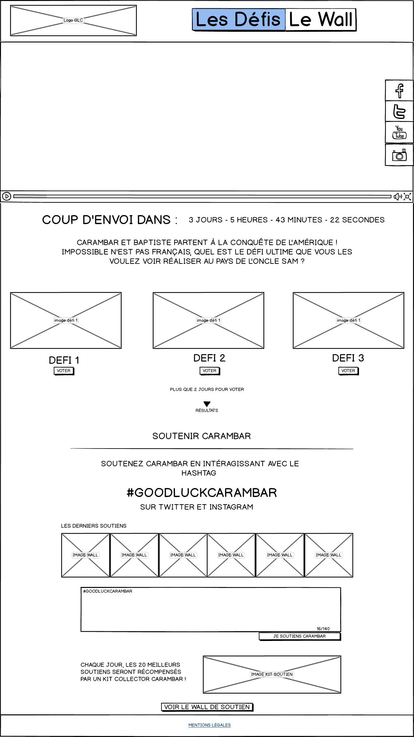
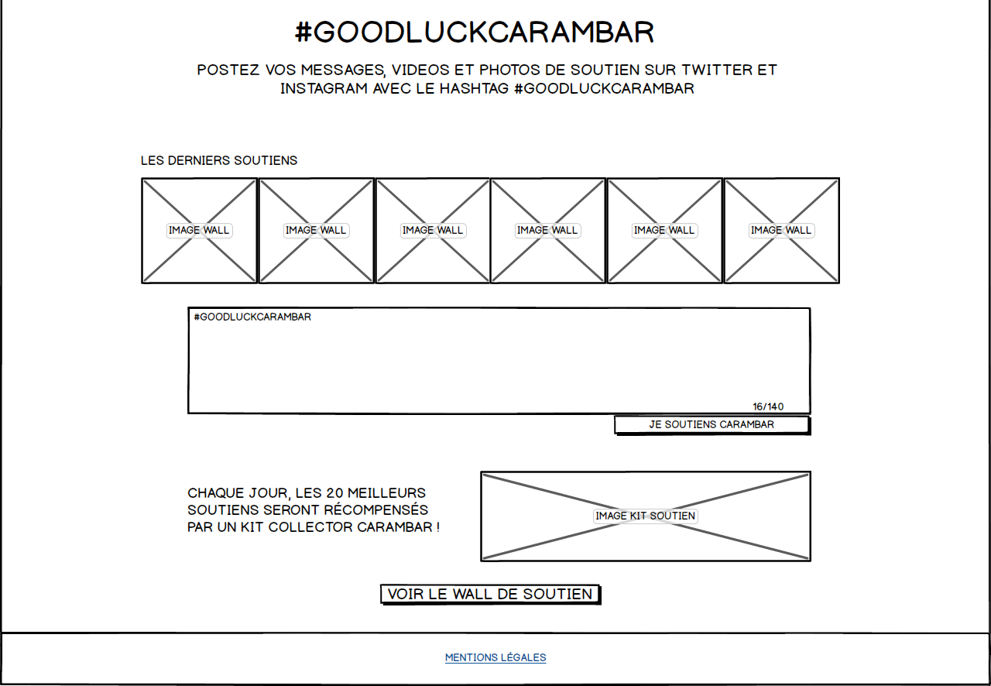
WEBSITE MOCKUP PHASE 1 (MARCH 25 - 27) > PRÉSENTATION + INVITATION TO VOTE FOR THE ULTIMATE CHALLENGE
VIDÉO + PRESENTATION TEXT
COUNTDOWN UNTIL THE RELEASE OF THE PHASE 2
INVITATION TO VOTE FOR ONE OF THE 3 ULTIMATE CHALLENGES
INVITATION TO SHARE SUPPORT POSTS ON SOCIAL NETWORKS WITH THE HASHTAG #GOODLUCKCARAMBAR, WHICH ARE GONNA BE DISPLAYED ON THE WALL.
PREVIEW GALLERY OF THE LATEST SUPPORT POSTS WITH THE HASHTAG.
TWITTER TEXT AREA TO PUBLISH A SUPPORT POST DIRECTLY FROM PLATFORM (TEXT ONLY).
TEXT AND IMAGE TO INTRODUCE THE SUPPORTER KIT WHICH WILL BE GIVEN TO 20 FANS A DAY.
LINK TO THE SUPPORT WALL.
SOCIAL BUTTONS DISPLAYED ON A FLOATING TRAIN, ON THE RIGHT SIDE OF THE PAGE.

Slide 15
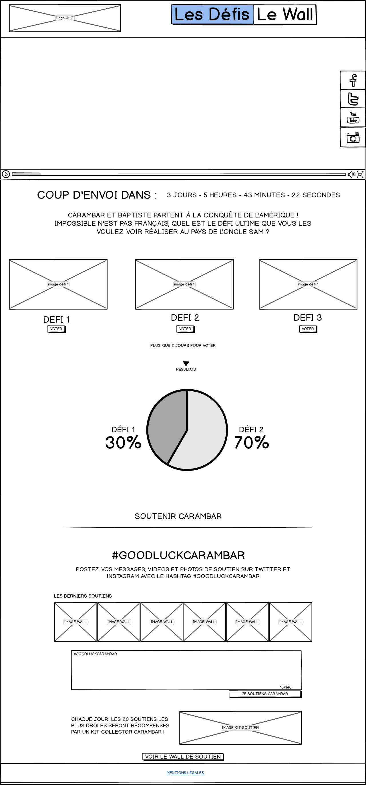
WEBSITE MOCKUP PHASE 1 (MARCH 25 - 27) > PRÉSENTATION + INVITATION TO VOTE FOR THE ULTIMATE CHALLENGE
POSSIBILITY TO DISPLAY THE VOTE TRENDS BY CLICKING ON THE RESULT BUTTON. THE RESULT WILL BE DISPLAYED AND PUSH DOWN THE « SUPPORT BLOCK ».

Slide 16
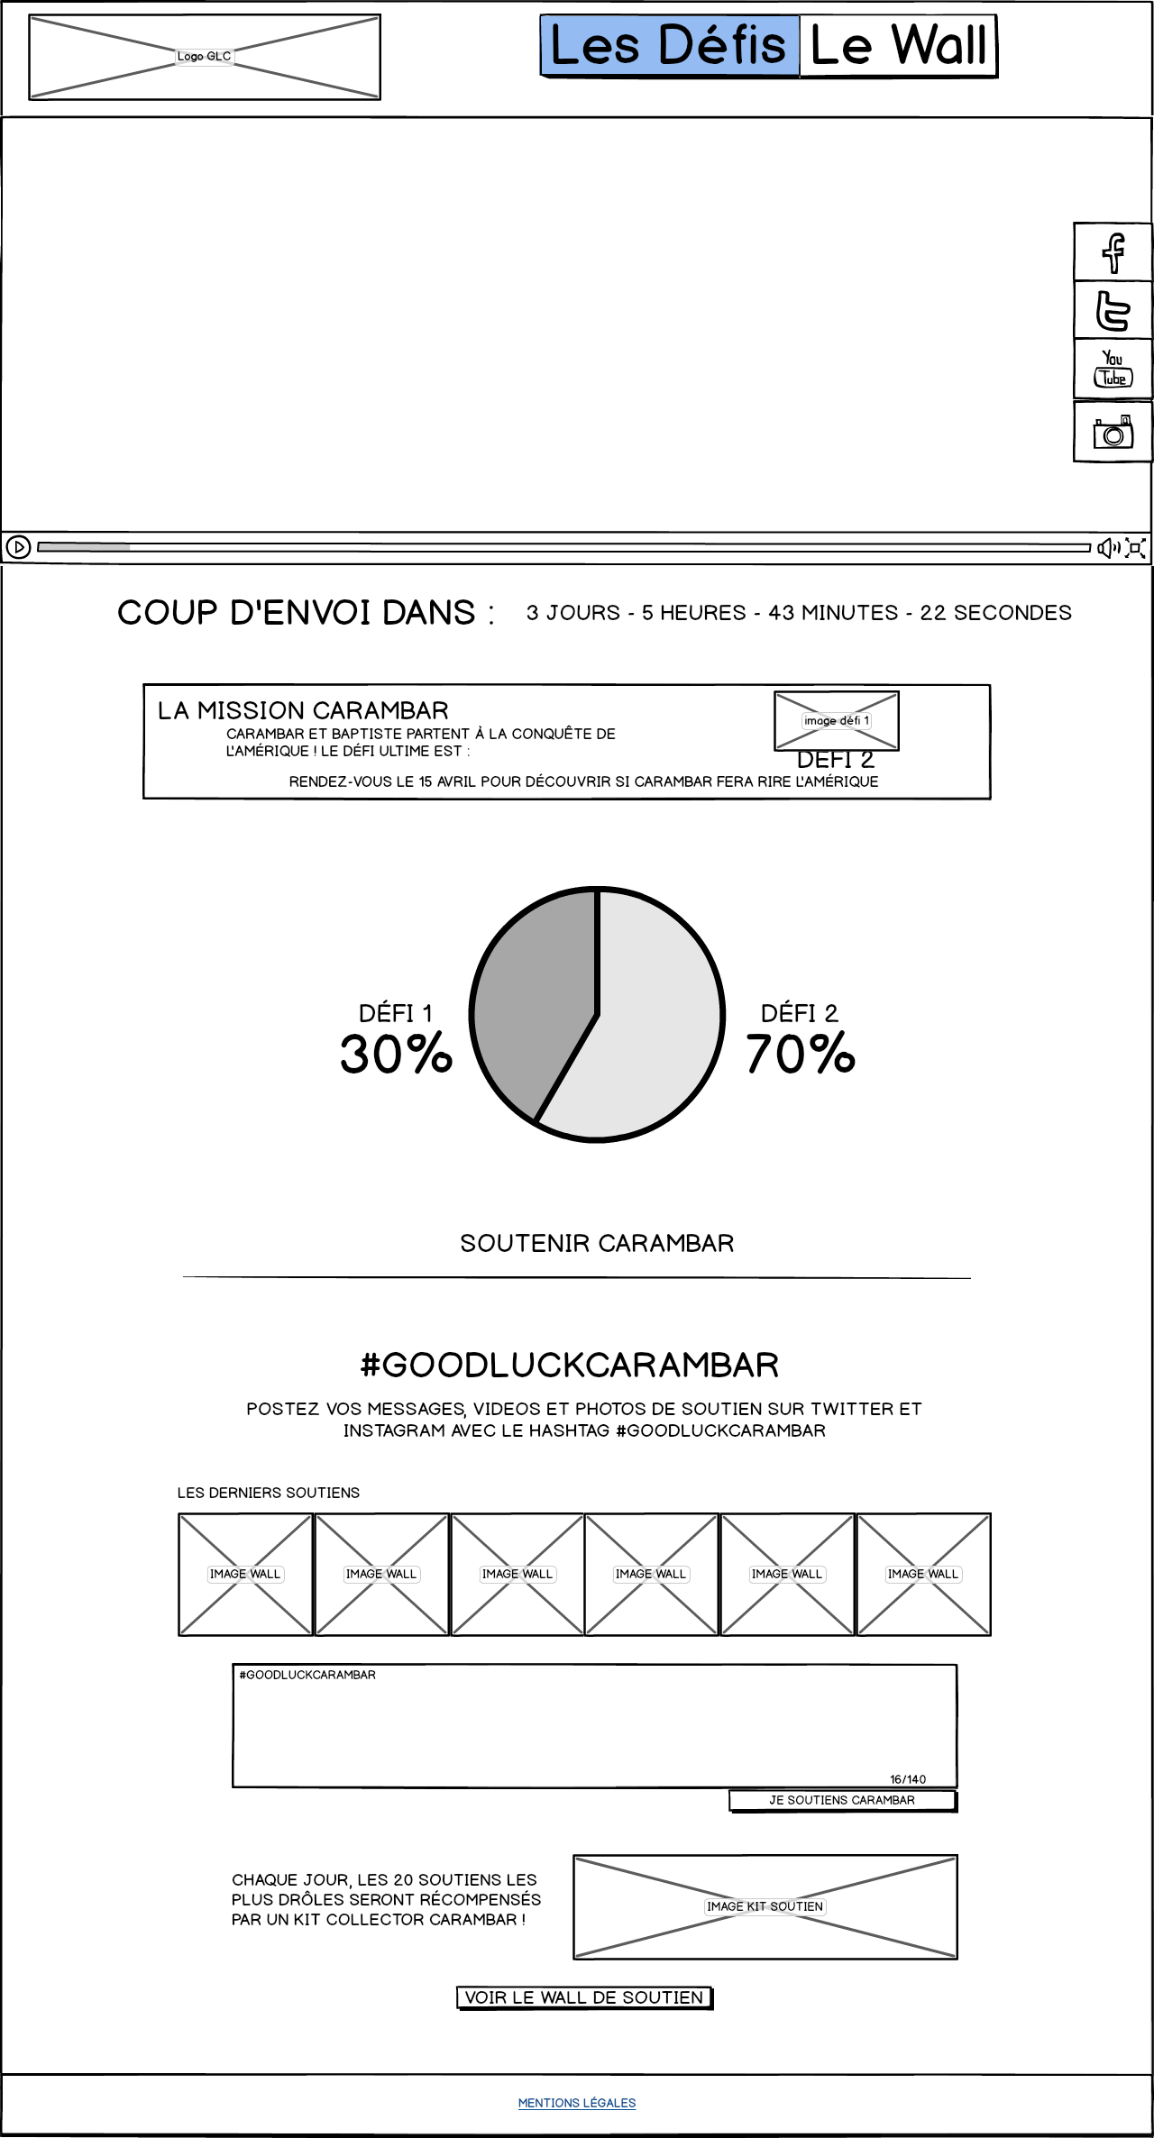
WEBSITE MOCKUP PHASE 2 : MARCH 28 > PUBLICATION OF THE VOTE RESULTS
PRESENTATION VIDEO
COUNTDOWN BEFORE THE CHALLENGES PUBLISHING
REVEAL OF THE ULTIMATE CHALLENGE ELECTED BY THE USERS WITH THE RESULTS OF THE VOTES
INVITATION TO SHARE SUPPORT POSTS ON SOCIAL NETWORKS WITH THE HASHTAG #GOODLUCKCARAMBAR
PREVIEW GALLERY OF THE LATEST SUPPORT POSTS WITH THE HASHTAG.
TWITTER TEXT AREA TO PUBLISH A SUPPORT POST DIRECTLY FROM PLATFORM (TEXT ONLY).
TEXT AND IMAGE TO INTRODUCE THE SUPPORTER KIT WHICH WILL BE GIVEN TO 20 FANS A DAY.
LINK TO THE SUPPORT WALL.
SOCIAL BUTTONS DISPLAYED ON A FLOATING TRAIN, ON THE RIGHT SIDE OF THE PAGE.
31/03

Slide 17
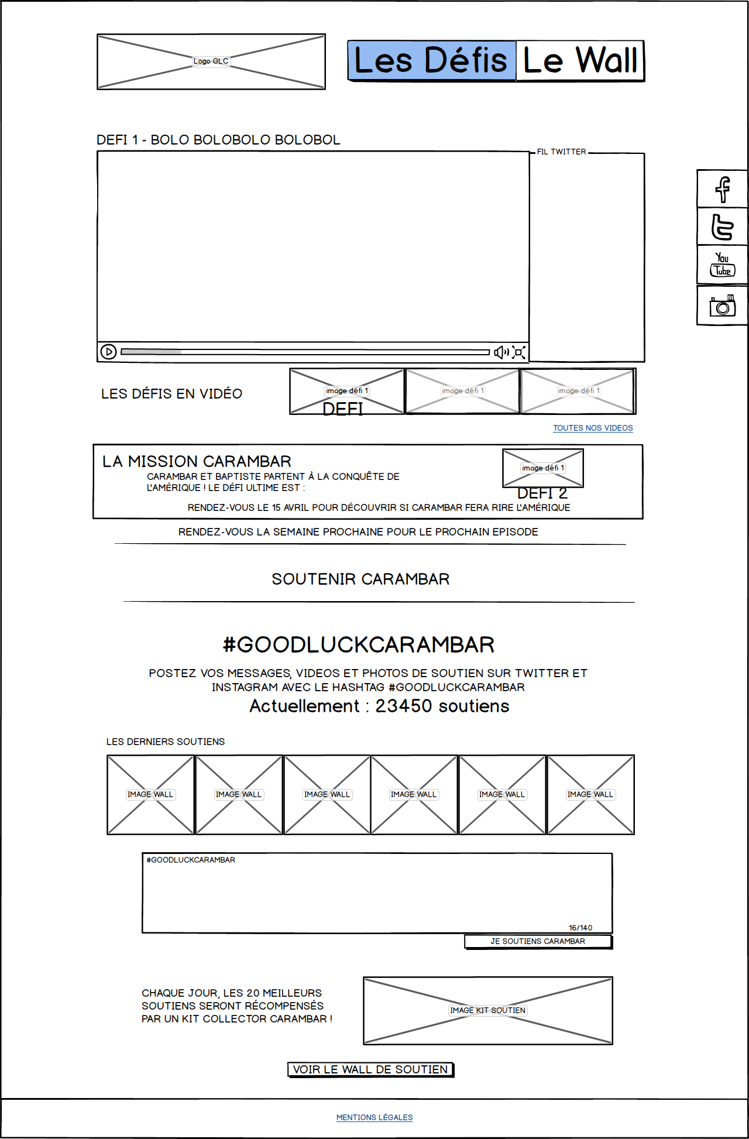
WEBSITE MOCKUP PHASE 3 : MARCH 31 – APRIL 10 > INTERMEDIATE CHALLENGE PUBLISHING.
PUBLISHING/RELEASE OF THE INTERMEDIATE CHALLENGE EPISODES
TWITTER FEED FROM THE OFFICIAL BRAND ACCOUNT.
POSSIBILITY TO SHARE ON SOCIAL NETWORKS
ACCESS TO THE OTHER VIDEOS PUBLISHED
INFORMATIONS ABOUT THE ELECTED ULTIMATE CHALLENGE.
INVITATION TO SHARE SUPPORT POSTS ON SOCIAL NETWORKS WITH THE HASHTAG #GOODLUCKCARAMBAR
PREVIEW GALLERY OF THE LATEST SUPPORT POSTS WITH THE HASHTAG.
TWITTER TEXT AREA TO PUBLISH A SUPPORT POST DIRECTLY FROM PLATFORM (TEXT ONLY).
TEXT AND IMAGE TO INTRODUCE THE SUPPORTER KIT WHICH WILL BE GIVEN TO 20 FANS A DAY.
LINK TO THE SUPPORT WALL.
SOCIAL BUTTONS DISPLAYED ON A FLOATING TRAIN, ON THE RIGHT SIDE OF THE PAGE.

Slide 18
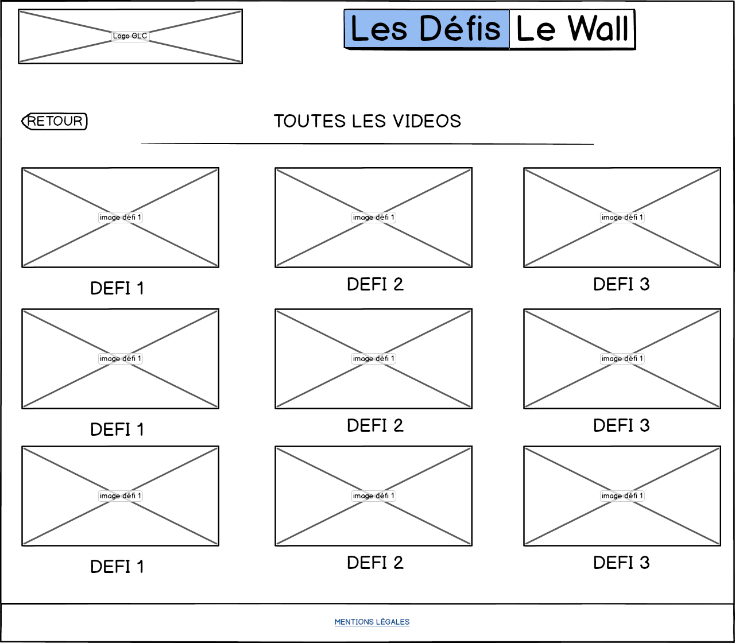
WEBSITE MOCKUP PHASE 3 : MARCH 31 – APRIL 10 > INTERMEDIATE CHALLENGE PUBLISHING.
VIDEO GALLERY FEATURING ALL THE PUBLISHED VIDEOS ON THE PLATFORM, RETURN/BACK BUTTON TO HOMEPAGE, VIDEOS ARE GONNA BE DISPLAYED WITH A DEDICATED LIGHTBOX.

Slide 19
THE WALL
THE WALL IS COMPATIBLE WITH TWITTER (TEXT, PHOTO, VIDEO), INSTAGRAM (PHOTO, VIDEO) and MANUAL picture UPLOADS FROM A FACEBOOK CONNECT form linked ON THE HOMEPAGE (not designed yet).
Twitter text will be displayed as colored box (blue, red or yellow) with the text written. It has to fit with 140 characters.
Moderation will be done by community managers before any publication or comment on a post.

Slide 20
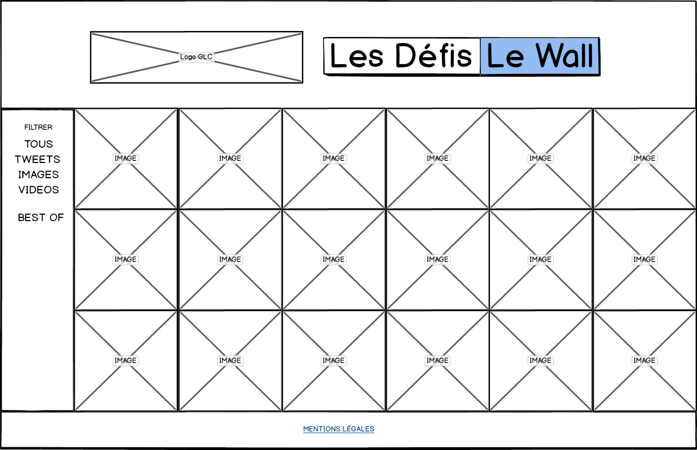
WEBSITE MOCKUP > ALL PHASES THE SUPPORT WALL
ACCESS TO THE COMPLETE SUPPORT GALLERY, IDENTICAL TO THE FF9263 BRIDGE.
FILTER AVAILABLE BY TYPE OF FILE PUBLISHED (PICTURE, VIDEO, TWEETS) AND REWARDED POSTS.
REWARDED POSTS WILL BE FEATURED WITH A SPECIAL RIBBON ON THEM
MODERATION WILL BE OPERATED BEFORE PUBLISHING.
POSTS WILL BE DISPLAYED WITH INFINITE SCROLL AND PROGRESSIVE LOADING.

Slide 21
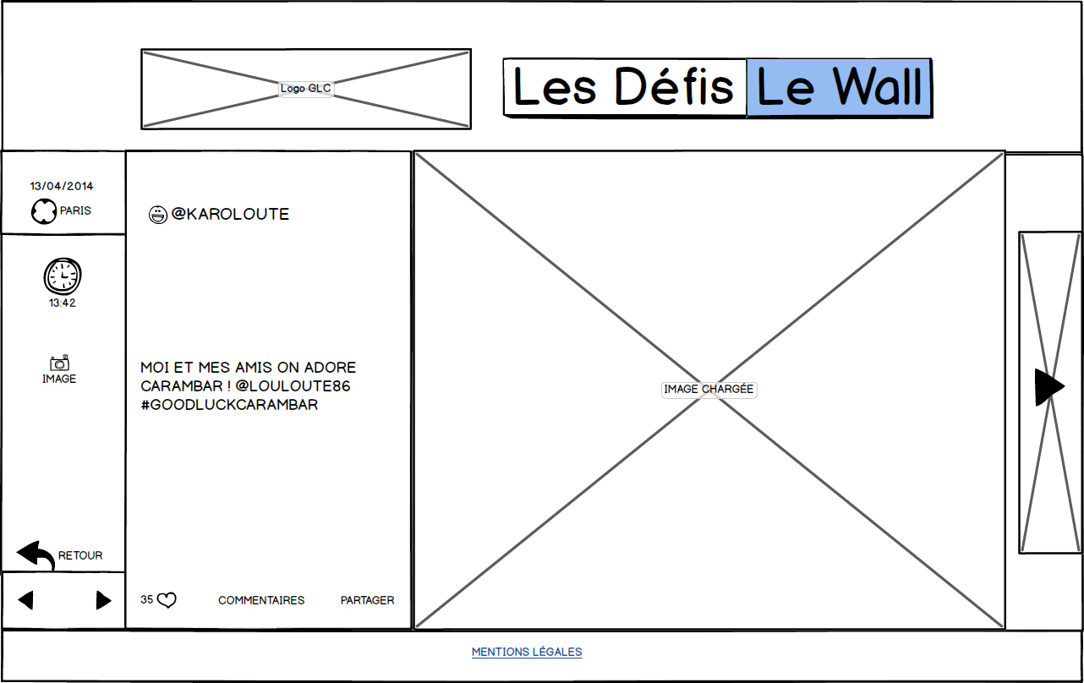
WEBSITE MOCKUP > ALL PHASES THE SUPPORT WALL
DETAIL OF A SUPPORT MESSAGE
POSSIBILITY TO « LIKE » (NOT FACEBOOK LIKE) POSTS, AND COMMENT THEM
POSSIBILITY TO SHARE THE SUPPORT POST ON SOCIAL NETWORKS

Slide 22
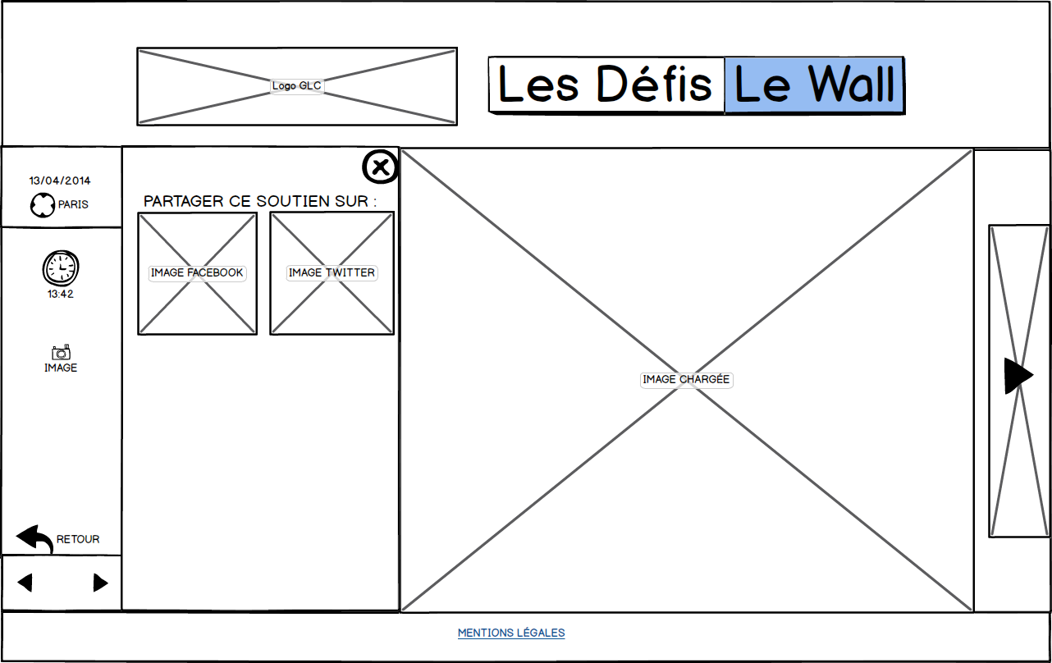
WEBSITE MOCKUP > ALL PHASES THE SUPPORT WALL
POSSIBILITY TO SHARE THE SUPPORT POST ON SOCIAL NETWORKS
- MODERATION WILL HAPPEN BEFORE PUBLICATION OF A COMMENT.

Slide 23
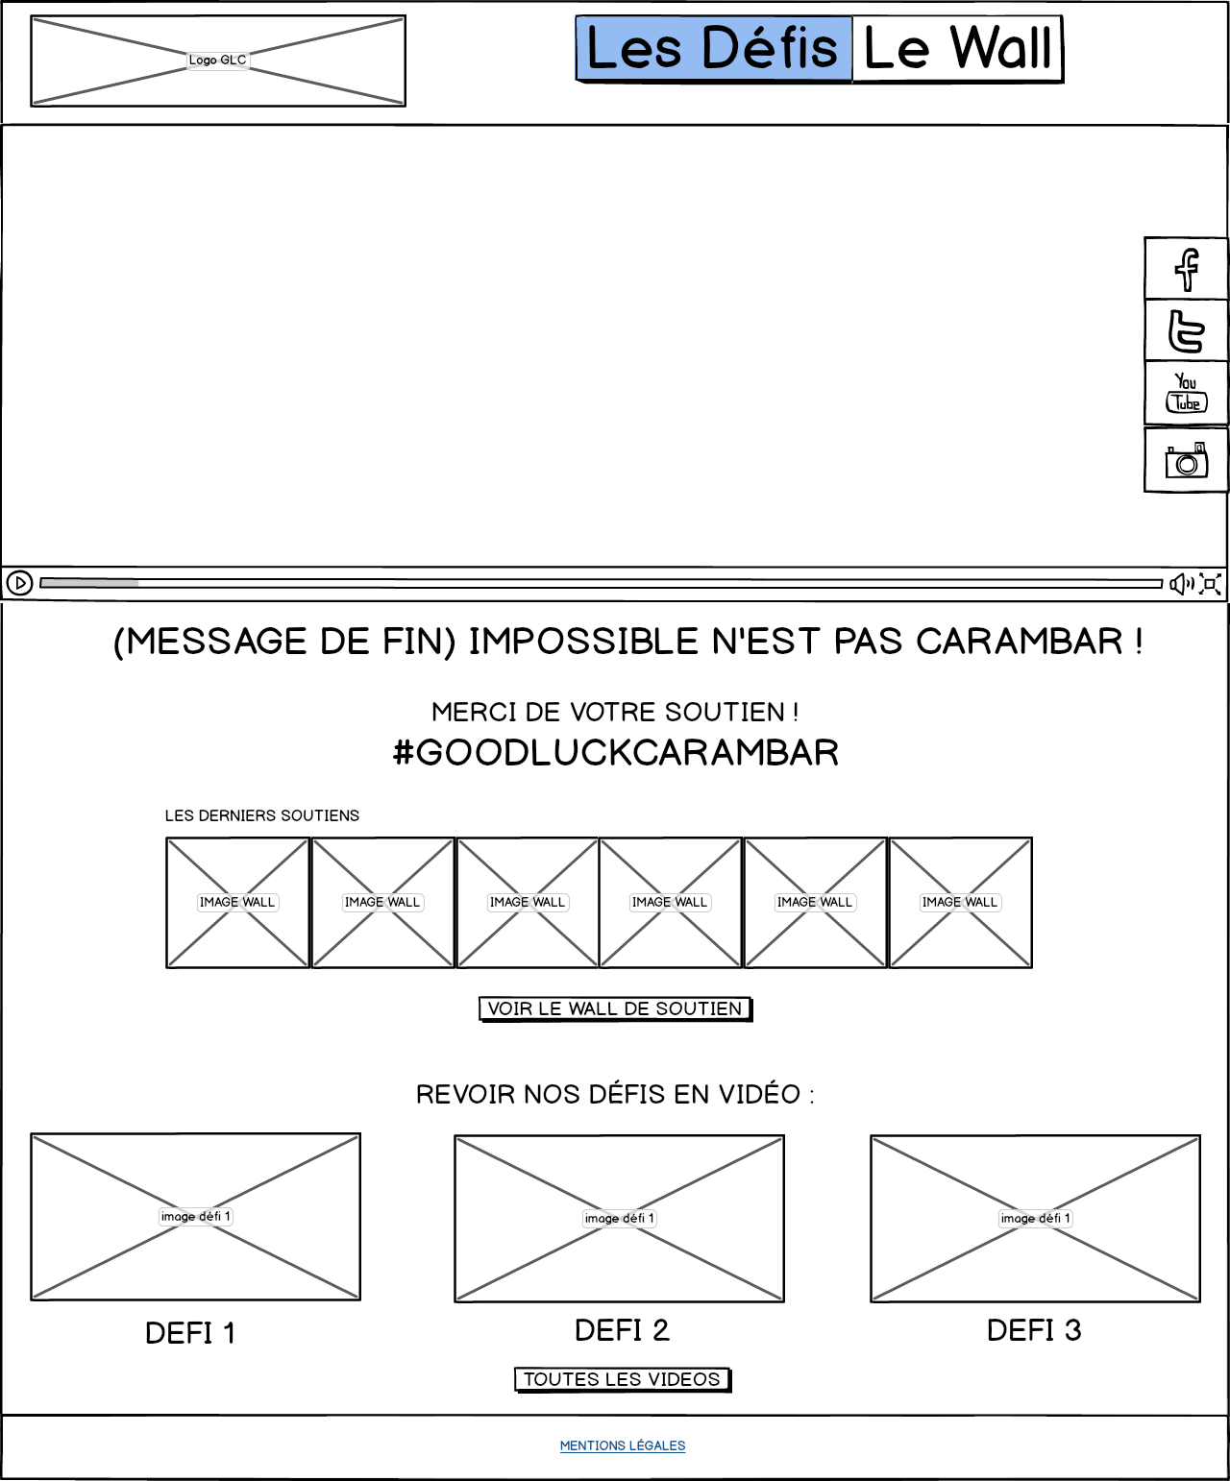
WEBSITE MOCKUP PHASE 4 : MARCH 31 – APRIL 10 > INTERMEDIATE CHALLENGE PUBLISHING.
END OF QUEST VIDEO AND MESSAGE
PREVIEW GALLERY OF THE LATEST SUPPORT POSTS WITH THE HASHTAG.
TEXT AND IMAGE TO INTRODUCE THE SUPPORTER KIT WHICH WILL BE GIVEN TO 20 FANS A DAY.
LINK TO THE SUPPORT WALL.
SOCIAL BUTTONS DISPLAYED ON A FLOATING TRAIN, ON THE RIGHT SIDE OF THE PAGE.
LINK TO THE VIDEO GALLERY, AND PREVIEW OF SEVERAL INTERMEDIATE CHALLENGE VIDEOS.

