Slide 1


IPL
计算机学院
第八章 人工神经网络
竞争学习、自组织特征映射
孔万增 Kong Wanzeng, Ph.D
Tel: 15967146928
Email: kongwanzeng@hdu.edu.cn

Slide 2
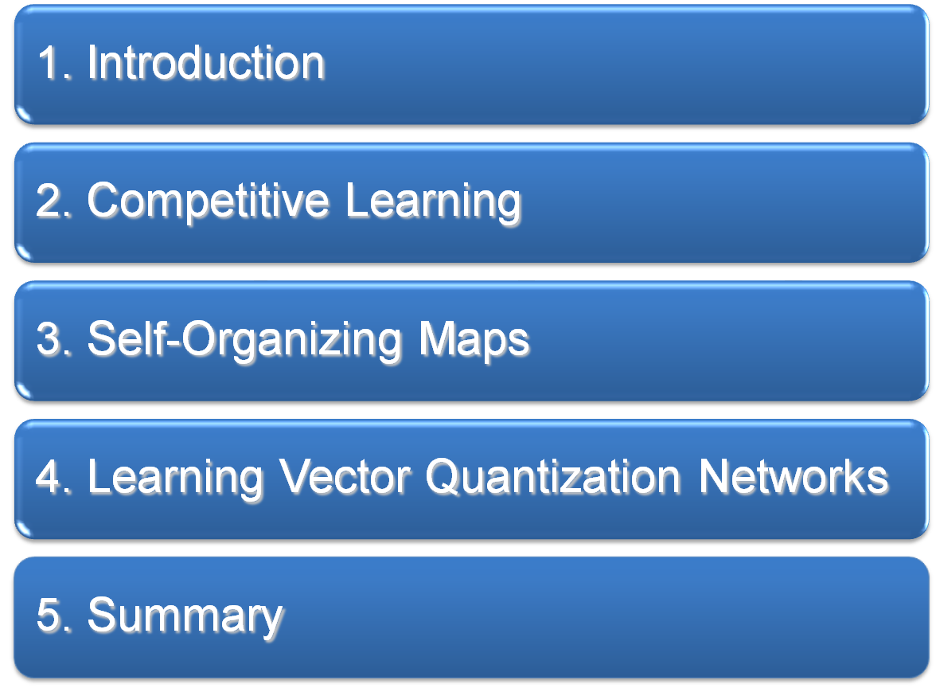
Table of Contents

Slide 3
1. Introduction
Self-organizing in networks is one of the most fascinating topics in the neural network field. Such networks can learn to detect regularities and correlations in their input and adapt their future responses to that input accordingly.
The neurons of competitive networks learn to recognize groups of similar input vectors (clustering).

Slide 4

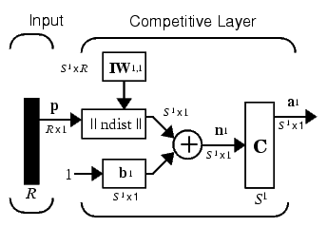
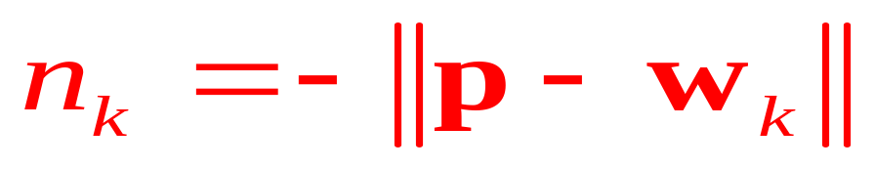

2. Competitive networks
竞争网络
w_{kj}
k
j
The compet transfunc.
The ||dist|| box:

Slide 5
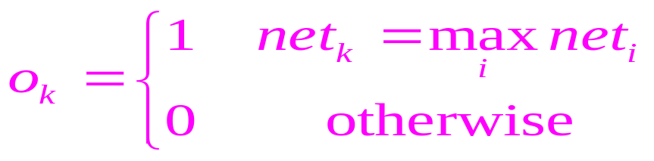
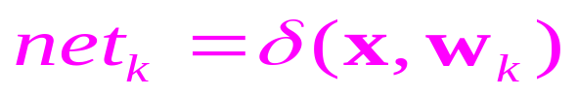
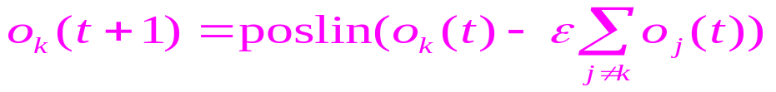
侧向抑制性连接
竞争网络
输出神经元之间有侧向抑制性连接，较强单元获胜并抑制其他单元，独处激活状态（Winner takes all, WTA）
x
w_{kj}
o_{k}
net_{k}
j

Slide 6
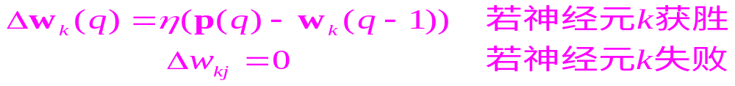
权值的学习规则
竞争网络
Demo: nnd14cl
Kohonen Learning Rule (learnk) :
Every cluster of similar input vectors will have a neuron that outputs 1 when a vector in the cluster is presented.
The competitive network learns to categorize the input vectors.

Slide 7
Bias Learning Rule
竞争网络
Dead neurons： some neurons may never win the competition. These unfortunate neurons never perform a useful function.
Bias Learning Rule (learncon)：biases of neurons that haven’t responded very frequently will increase versus biases of neurons that have responded frequently.
Biases give neurons that only win the competition rarely an advantage over neurons that win often.

Slide 8
竞争网络举例
竞争网络
Suppose we want to divide the following four two-element vectors into two classes.
p = [.1 .8 .1 .9; .2 .9 .1 .8]
p = 0.1000 0.8000 0.1000 0.9000
0.2000 0.9000 0.1000 0.8000
create a network：
net = newc([0 1; 0 1],2);
Training：
net.trainParam.epochs = 500
net = train(net,p);
During each epoch, a single vector is chosen randomly and presented to the network and weight and bias values are updated accordingly.

Slide 9
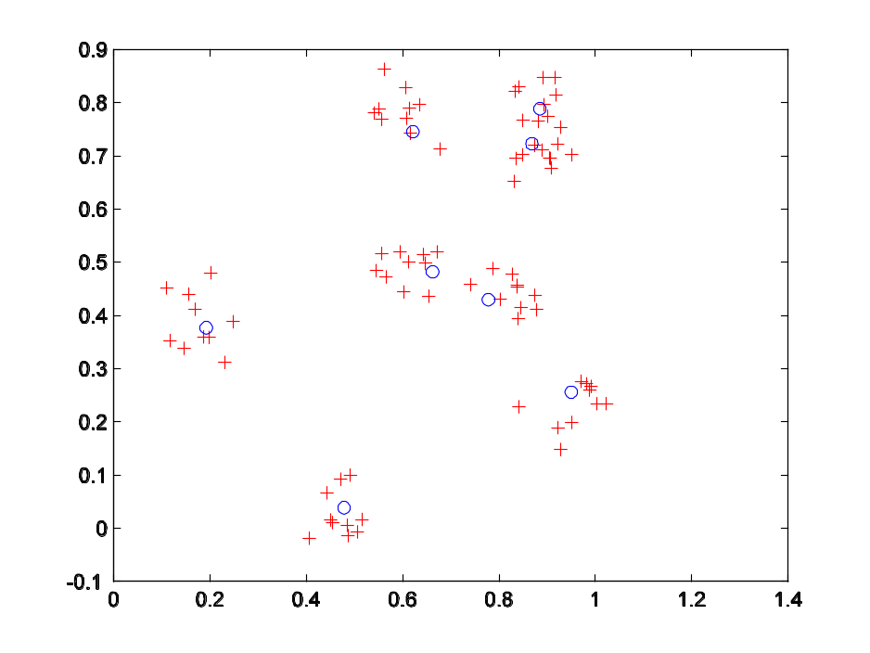
竞争网络举例
竞争网络
Simulate the network, and finally convert its output vectors to class indices.
a = sim(net,p);
ac = vec2ind(a)
ac = 1 2 1 2
Graphical example: democ1

Slide 10
3. Self-Organizing Maps
Self-organizing feature maps (SOFM) learn to classify input vectors. They differ from competitive layers in that neighboring neurons in SOM learn to recognize neighboring sections of the input space. Thus, self-organizing maps learn both the distribution and topology of the input vectors.

Slide 11
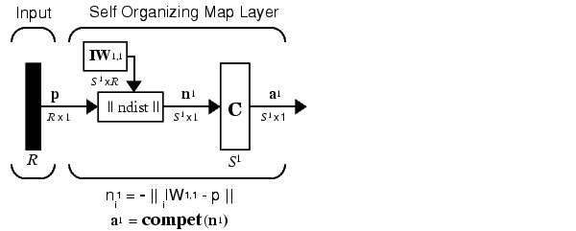
SOFM
The ||dist|| box:
Here a self-organizing feature map network identifies a winning neuron i* using the same procedure as employed by a competitive layer.

Slide 12
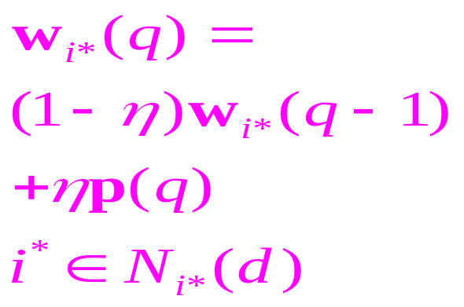
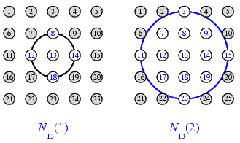
Learning rule of SOFM
Instead of updating only the winning neuron, all neurons within a certain neighborhood Ni* (d) of the winning neuron are updated, using the Kohonen rule. Specifically, all such neurons i in Ni*(d) are adjusted as follows:

Slide 13
SOFM网络举例
竞争网络
Suppose we want to divide the following two-element vectors into 6 classes.
P = [.1 .3 1.2 1.1 1.8 1.7 .1 .3 1.2 1.1 1.8 1.7;…
0.2 0.1 0.3 0.1 0.3 0.2 1.8 1.8 1.9 1.9 1.7 1.8]
create a network：
net = newsom([0 2; 0 1],[2 3]);
Training：
net.trainParam.epochs = 1000;
net = train(net,P);

Slide 14
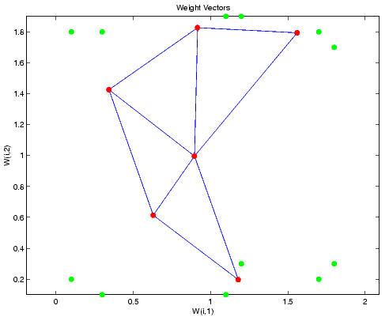
SOFM举例
竞争网络
Simulate the network, and finally convert its output vectors to class indices.
a = sim(net,p);
ac = vec2ind(a)
Graphical example: demosm1& demosm2

Slide 15
讨论
人工神经网络是由大量神经元经广泛互联组成的非线性网络，单元间的连接强度从样本中学习
神经网络模型决定于神经元类型，神经元间的连接方式和学习算法
MLP、RBF和SOFM是模式识别中应用最多的几种模型

