Slide 1

Procrastination
演讲人：邱磊磊
学 号：202050228
June 7th，2021

Slide 2
CONTENTS
1.
What is procrastination?
2.
Characteristics of procrastination
3.
Reasons for procrastination.
4.
The harm of procrastination
5.
How to overcome procrastination.

Slide 3

PART ONE
What is procrastination?

Slide 4
What is procrastination?
Procrastination
Procrastination refers to the behavior of self-regulation failure, putting off the planned tasks even when the consequences can be expected to be harmful.
拉丁字源：pro - (forward, util, 向前)，
crastinus - (tomorrow, 明天)。
"The Psychology of Procrastination" : It is neither malignant nor moral, but a psychological syndrome caused by fear.
Notes:
Procrastination is an act of unnecessary delay. In most cases, people who procrastinate know that they will not benefit from this delay or postponement, but they do it anyway.
拖延是一种不必要的拖延行为。在大多数情况下，拖延的人知道他们不会从这种延迟或推迟中受益，但他们还是会这样做。
It acts as a barrier to achieving important, meaningful tasks and instead leads us to “waste time” on activities that are trivial or have little value.
它是实现重要的、有意义的任务的障碍，反而导致我们“浪费时间”在琐碎或没有价值的活动上。

Slide 5
PART TWO
Characteristics of procrastination

Slide 6
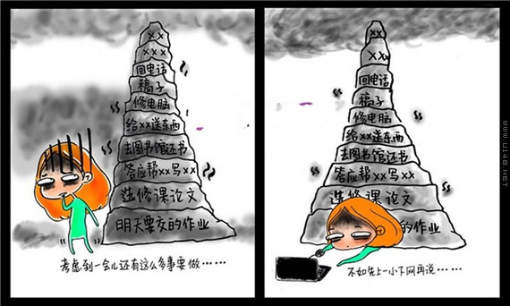
Characteristics of procrastination
Universality: Everyone has a problem with procrastination at least a little. Some people procrastinate slightly, some severely, some occasionally, some often.
Habituality: Procrastination is a kind of solid psycho-logical habit and behavior.
Notes:
普遍性：每个人或多或少都会有一点拖延的毛病，有些人轻微，有些人严重，有些人偶尔发生，有些人经常发生。
Common: Everyone has a problem with procrastination at least a little. Some people procrastinate slightly, some severely, some occasionally, some often.
习惯性：拖延症是人的一种牢固的心理习惯和行为
Habituality: Procrastination is a kind of solid psycho-logical habit and behavior.

Slide 7

Characteristics of procrastination
Harmfulness: The harm of procrastination is widespread and serious.
Notes:
危害性：拖延症的危害是广泛而严重的
Harmfulness: The harm of procrastination is widespread and serious
图中显示的是胡适的日记内容，他是中国著名的思想家、文学家、哲学家
内容不完全真实，只是把它当成一个例子
The picture shows the content of Hu Shi’s diary. He is a famous thinker, writer and philosopher in China。the content is not completely true. I just take it as an example.

Slide 8
PART THREE
The harm of procrastination

Slide 9

The harm of procrastination
Self-doubt
Bring more stress
Can't live up to your ideas

Slide 10

The harm of procrastination
Depression
Anxiety
Psychological distortion
Notes:
严重的拖延症会对个体的身心健康带来消极影响，如出现强烈的自责情绪、负罪感，不断的自我否定、贬低，并伴有焦虑症、抑郁症等心理疾病。
Serious procrastination will have a negative impact on the physical and mental health of individuals, such as strong feelings of self-blame, guilt, constant self-denial, belittle, accompanied by anxiety, depression and other psychological diseases.

Slide 11
PART FOUR
Reasons for procrastination.

Slide 12
Reasons for procrastination.
Shallow reason
deeper reason
Too hard
Perfectionism
Fear of failure
Resistance and hostility
No interest
Just thinking and not to do
Don't care
Self-deprecating
Notes:
完美主义：完美主义可分为积极完美主义和消极完美主义，积极完美主义者会积极寻找方法完成学习任务以达到理想的成绩，而消极完美主义者则更多采用拖延来逃避失败。
Perfectionism can be divided into positive perfectionism and negative perfectionism. Positive perfectionists will actively find ways to complete learning tasks to achieve the desired results, while passive perfectionists will use procrastination to avoid failure.
抵制与敌意：这个老师太凶，所以很不高兴去完成他布置的作业，或者不喜欢做某件事。
This teacher is too fierce, so he is very unhappy to finish his homework, or doesn't like to do something.
只想不做：有些人对工作任务规划充满幻想，但不愿意付诸实践行动。
Just wanting not to do it: Some people are full of illusions about task planning, but are unwilling to put them into practice.
自我贬低：觉得自己不能很好的完成任务，因此对自己的能力产生怀疑。
Feeling that I can't complete the task well, so I have doubts about my ability.
环境因素，不懂自我控制，比如，在写年度计划的时候，停下来吃点夜宵，然后觉得冰箱有点脏，想清理一下，最后把整个厨房打扫了。
Environmental factors, I don’t know how to control myself. For example, when I was writing my annual plan, I stopped for a late night snack, then I felt that the refrigerator was a bit dirty and I wanted to clean it up. Finally, I cleaned the entire kitchen.
造成拖延症的原因还有很多，图中只是列举了几个

Slide 13
PART FIVE
How to overcome procrastination.

Slide 14
How to overcome procrastination.
Create a task list
Set focus time
Learn to decompose tasks
Notes:
创建任务列表：让你清楚你需要去完成哪些任务。
Create a task list: let you know what tasks you need to complete.
设定专注时间，找出自己工作效率最好的时间段进行巧妙利用，有助于顺利摆脱拖延症。
Set focus time， find out the time period when you work best, and use it smartly, which will help you get rid of procrastination smoothly.
学会分解任务，当任务量很大的时候，你可以将任务分解为很多个子任务，每次只完成一个任务，这样可以避免你对它产生恐惧。
Learn to decompose tasks. When the amount of tasks is large, you can divide the task into many sub-tasks, and only complete one task at a time, so as to avoid your fear of it.

Slide 15
How to overcome procrastination.
Cut off the source of interference
Don't pursue perfection too much
Notes:
https://www.bilibili.com/video/BV1rv41117Pb?from=search&seid=2253940568515125112
拖延者容易受环境因素影响，从而导致拖延行为，因此切断干扰源，让自己更加专注于学习或者工作中。
Procrastinators are susceptible to environmental factors, leading to procrastination behavior, so cut off the source of interference and allow themselves to focus more on study or work.
别过于追求完美：意识到一点错误不犯是不可能的，过于追求完美，将会拖延你完成任务的时间
Don't pursue perfection too much
Realize that it is impossible not to make a mistake, too much pursuit of perfection will delay your time to complete the task
总之：procrastination is the thief of time
Overcoming procrastination will do you a great favor in terms of study and life

Slide 16
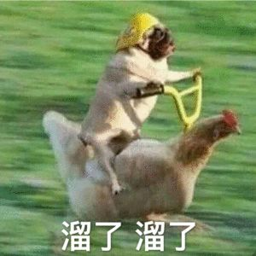
Thank you for your watching

