Slide 1

March 2019
Canvas Project
Kenny, Mike, Willy

Slide 2
Objective
Create a online drawing web page for user to draw anything. We use the Canvas in HTML to achieve this objective
*most conservative strategy
2￼

Slide 3

Wireframe

Slide 4
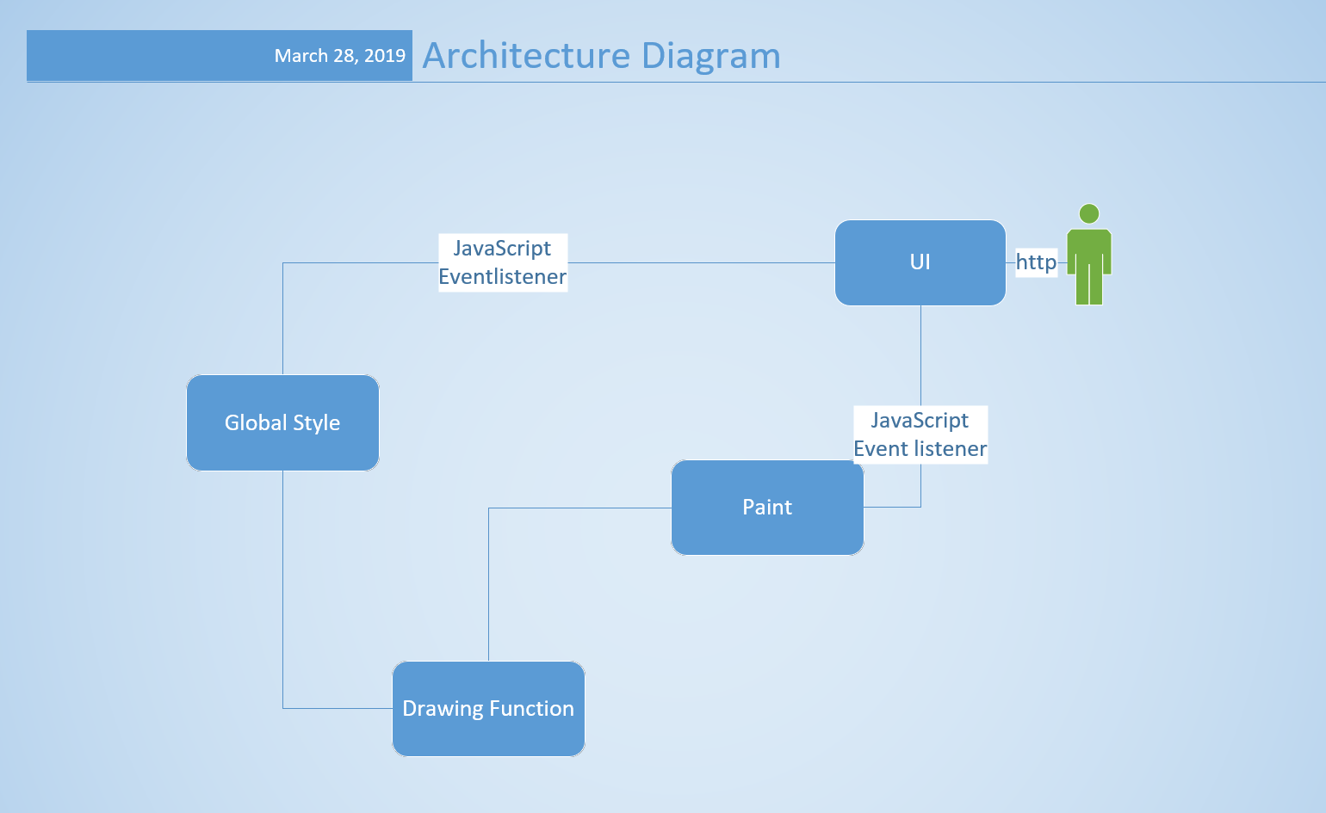
Architecture and Technologies Used

Slide 5
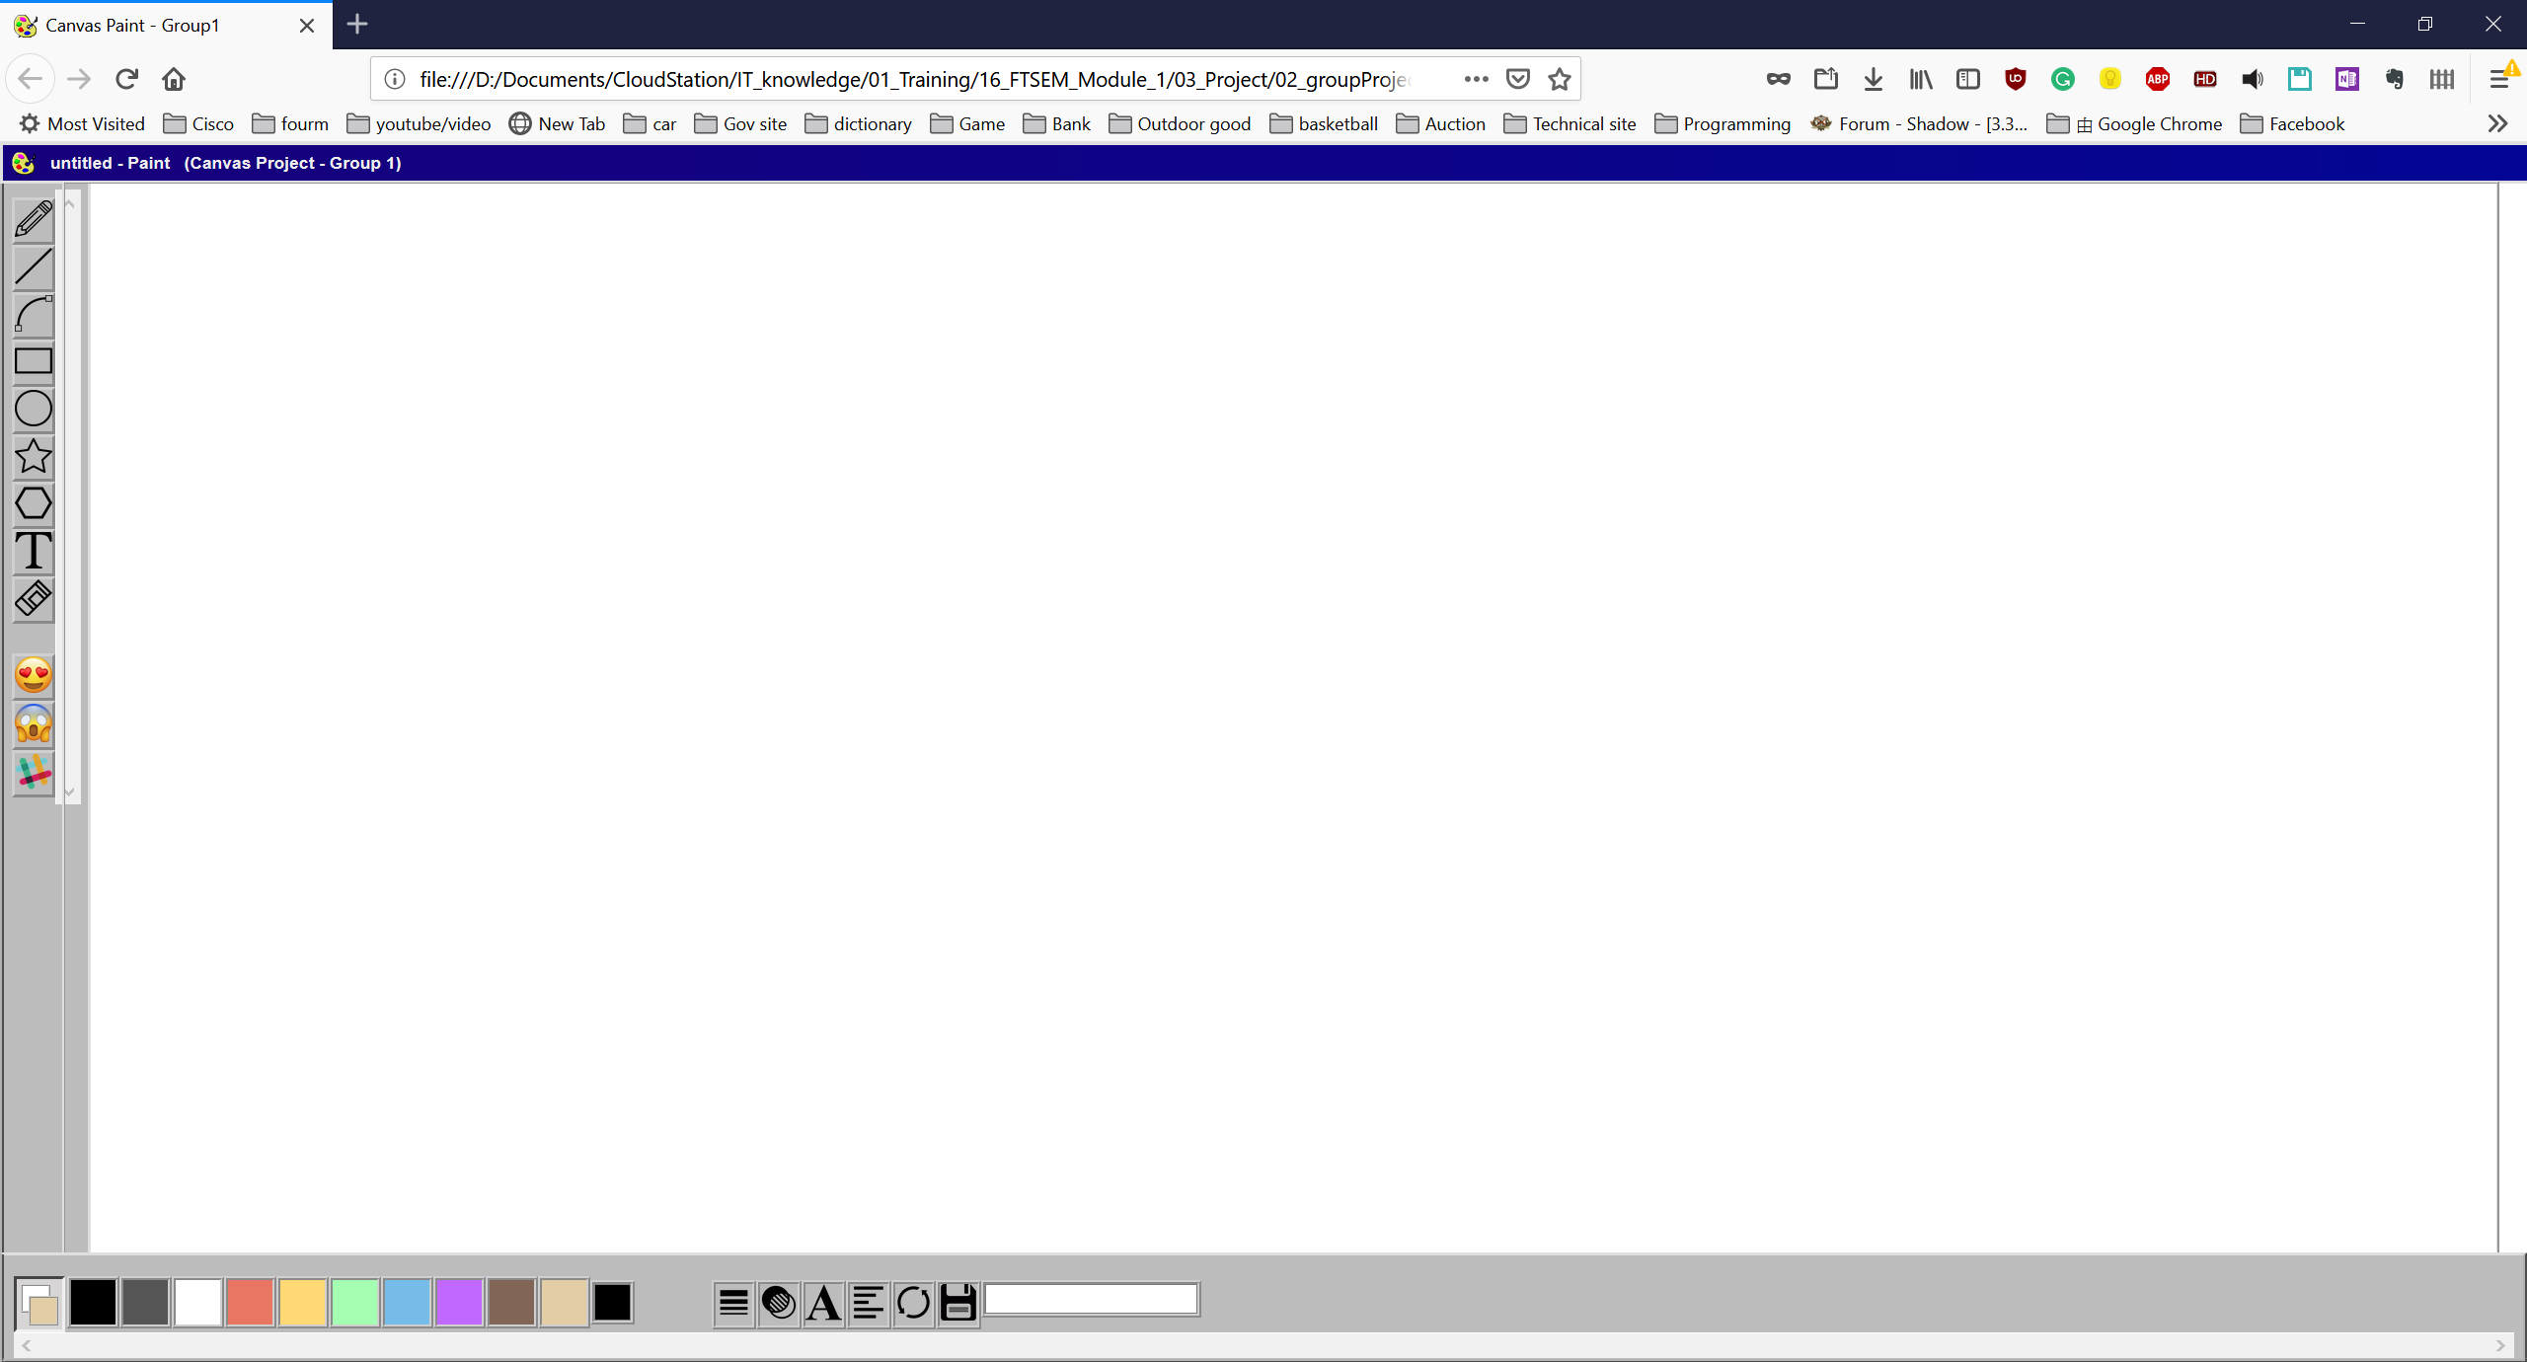
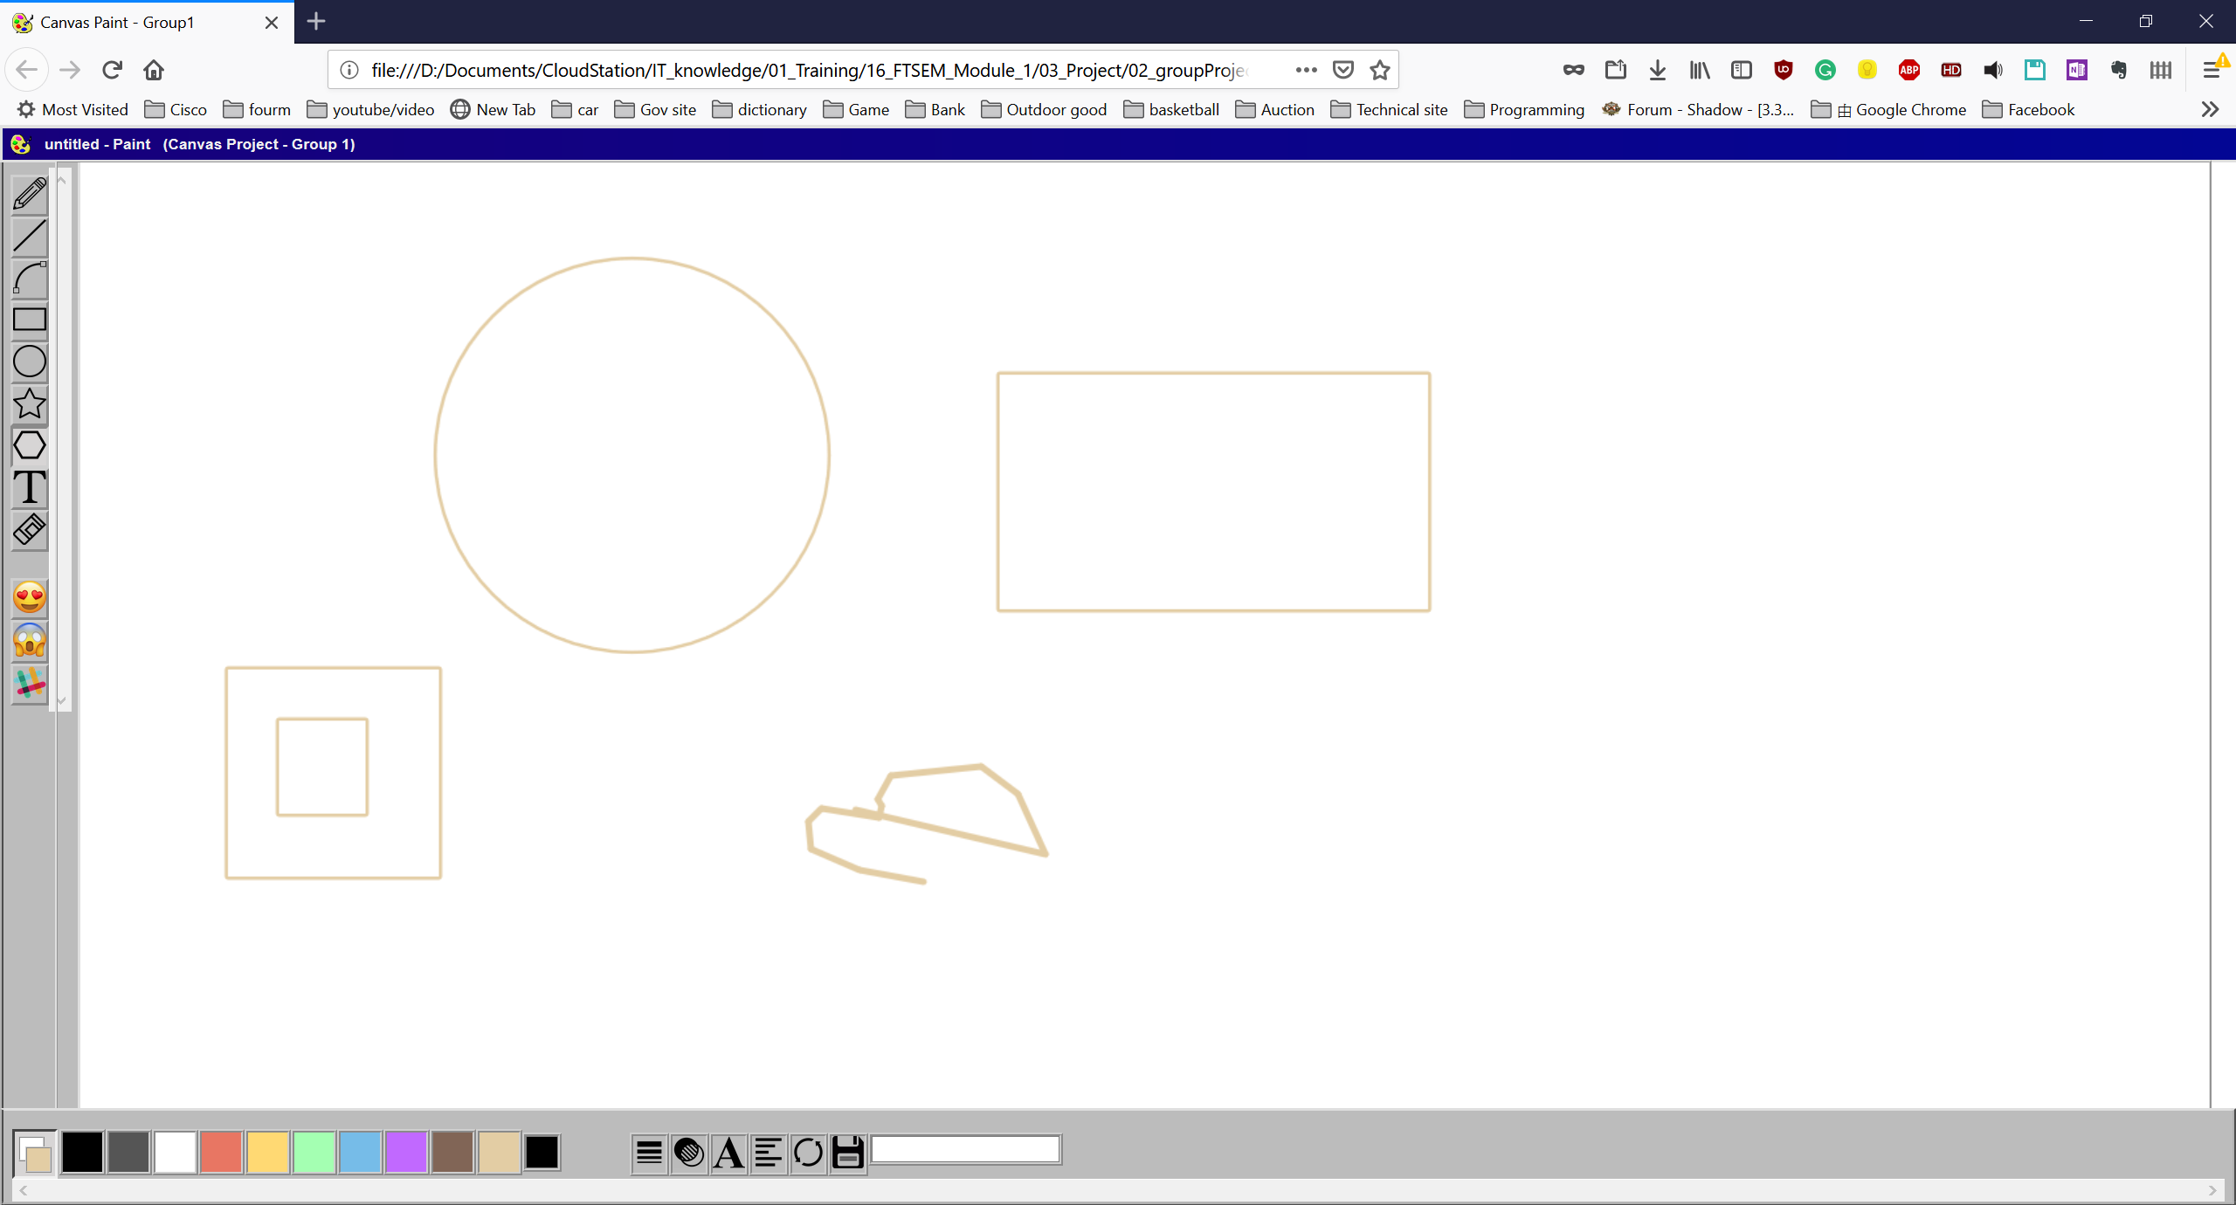
Screenshots - 1

Slide 6
Demonstration

Slide 7
Team Members
Kenny
Function in Canvas
Documentation
Mike
UI Design
Function in Canvas
Willy
Code Architecture design
Code integration
function in Canvas
Code improvement

Slide 8
February 2019
Thank You

