Slide 1
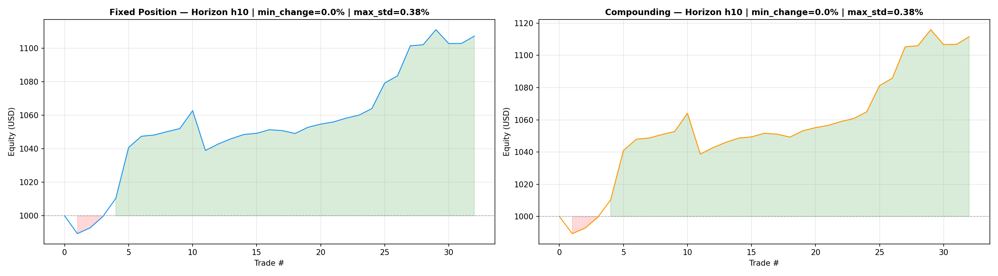
2026-03-11_SMALL_BTCUSDT_1h_2021-01-01_2025-12-01_LB512_PRED20 SOURCE: POWERSTATION "PRED_HORIZON": 10, "MIN_CHANGE_PCT": 0.0, "MAX_STD_PCT": 0.38, UPSIDE: 0
--- Fixed Position ---
Num Trades : 32
Win Rate : 84.38%
Total PnL : $107.16
Final Equity : $1107.16
Max Drawdown : $-23.73
Return/DD Ratio : 4.52
Sharpe Ratio : 2.19
Profit Factor : 3.39
--- Compounding ---
Num Trades : 32
Win Rate : 84.38%
Total PnL : $111.59
Final Equity : $1111.59
Max Drawdown : $-25.25
Return/DD Ratio : 4.42
Sharpe Ratio : 2.18
Profit Factor : 3.35

Slide 2
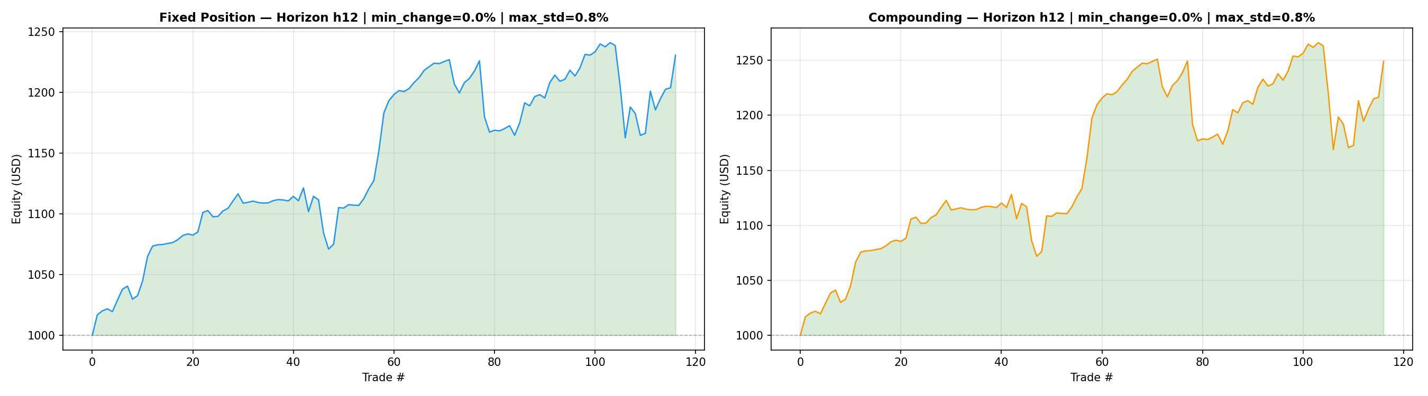
2026-03-11_SMALL_BTCUSDT_1h_2021-01-01_2025-12-01_LB512_PRED16 Source: Lenovo Legion
--- Fixed Position ---
Num Trades : 116
Win Rate : 68.10%
Total PnL : $230.75
Final Equity : $1230.75
Max Drawdown : $-78.47
Return/DD Ratio : 2.94
Sharpe Ratio : 1.82
Profit Factor : 1.70
--- Compounding ---
Num Trades : 116
Win Rate : 68.10%
Total PnL : $249.17
Final Equity : $1249.17
Max Drawdown : $-97.32
Return/DD Ratio : 2.56
Sharpe Ratio : 1.67
Profit Factor : 1.64

Slide 3
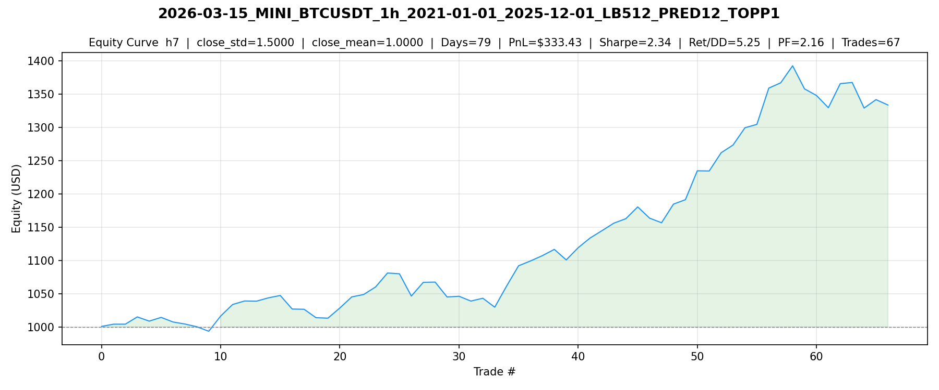

Slide 4
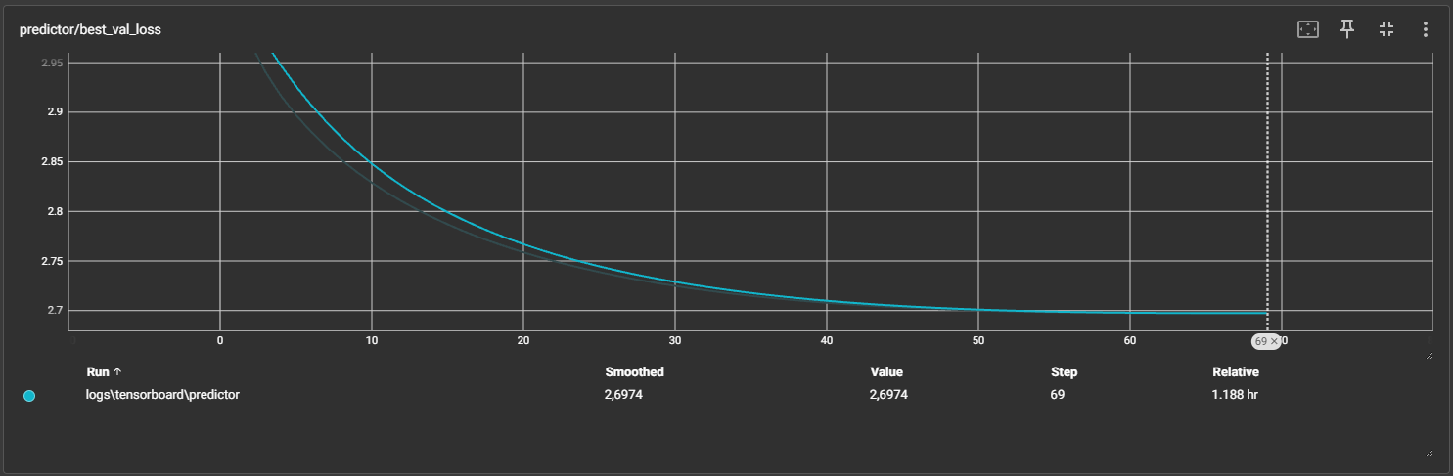
2026-03-19_MINI_BTCUSDT_1h_2021-01-01_2025-12-01_LB300_PRED12

Slide 5
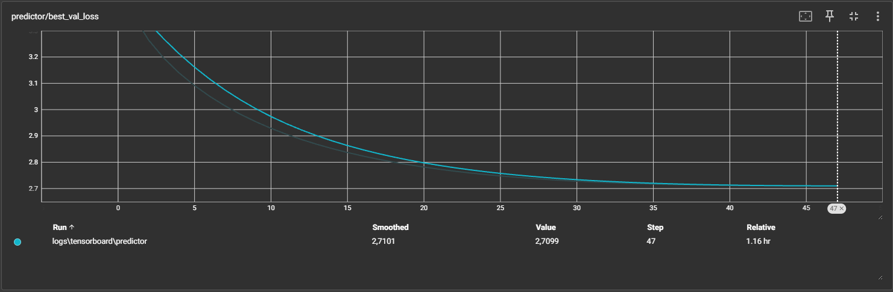
2026-03-13_MINI_BTCUSDT_1h_2021-01-01_2025-12-01_LB400_PRED12

Slide 6
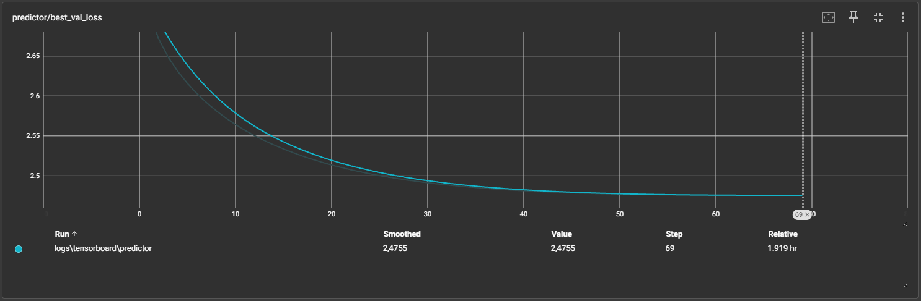
2026-03-15_MINI_BTCUSDT_1h_2021-01-01_2025-12-01_LB512_PRED12

Slide 7
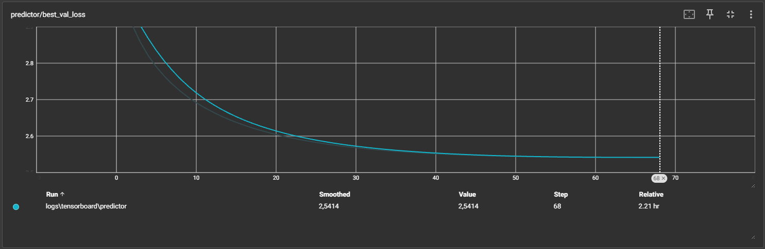
2026-03-15_MINI_BTCUSDT_1h_2021-01-01_2025-12-01_LB612_PRED12

Slide 8
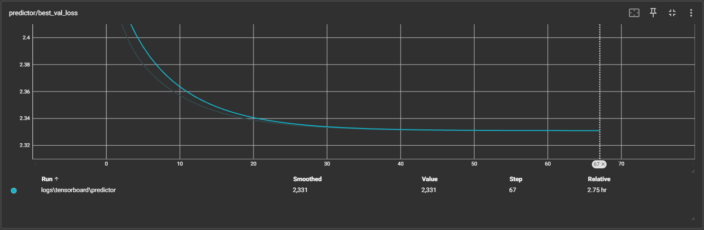
2026-03-15_MINI_BTCUSDT_1h_2021-01-01_2025-12-01_LB712_PRED12

Slide 9
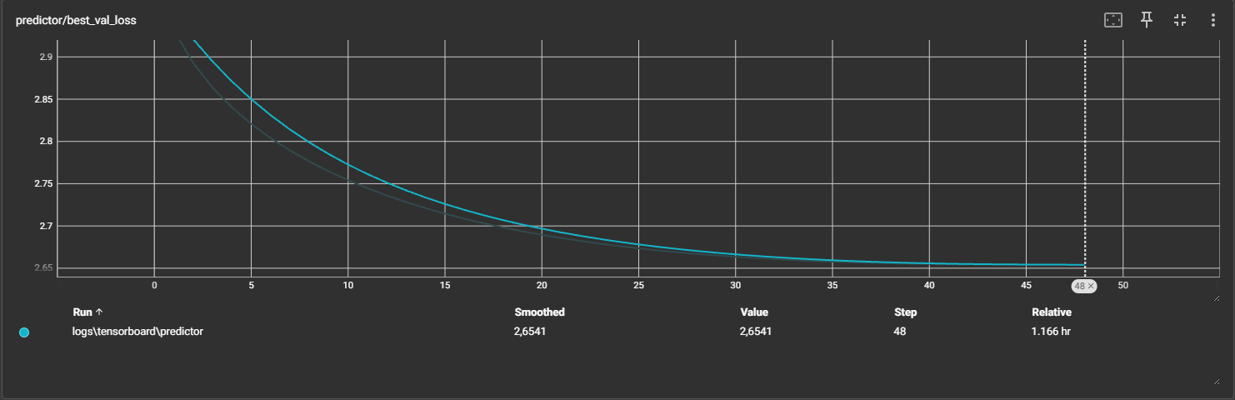
2026-03-17_MINI_BTCUSDT_1h_2021-01-01_2025-12-01_LB400_PRED07

Slide 10
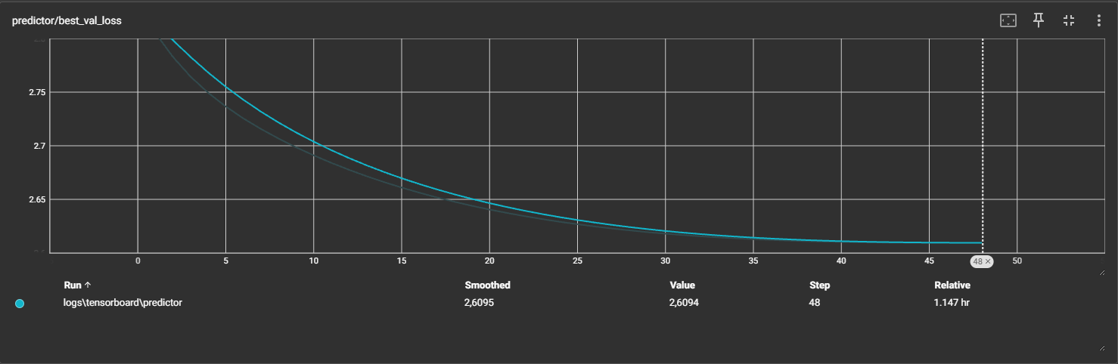
2026-03-16_MINI_BTCUSDT_1h_2021-01-01_2025-12-01_LB400_PRED12_BATCH64

Slide 11
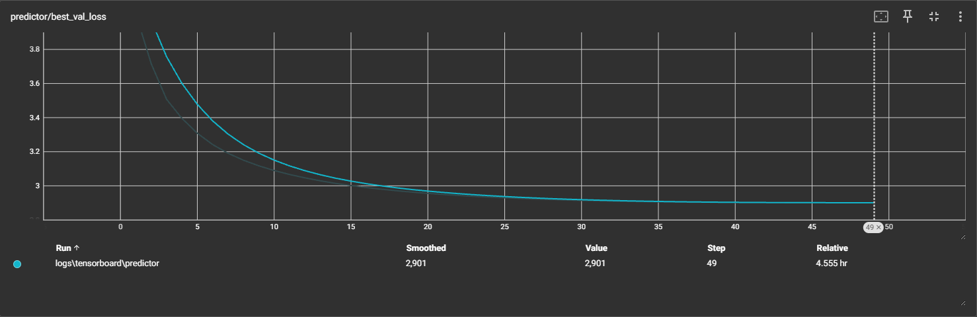
2026-03-14_SMALL_BTCUSDT_1h_2024-01-01_2026-01-14_LB512_PRED12

Slide 12
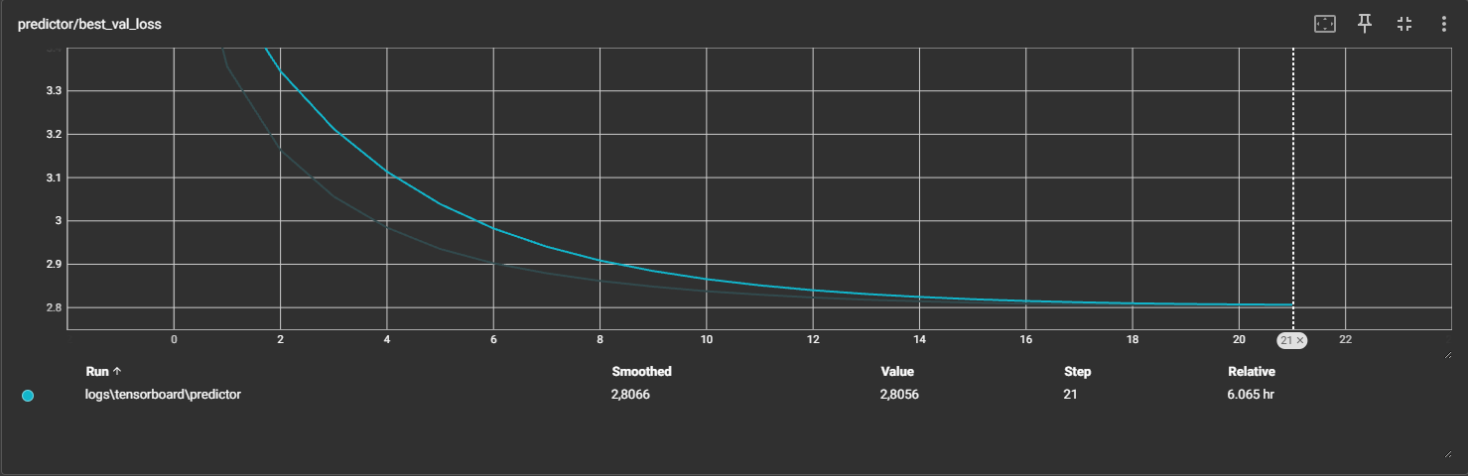
2026-03-13_BASE_BTCUSDT_1h_2021-01-01_2025-12-01_LB512_PRED12

