Slide 1



Improving Multi-hop Knowledge Base Question Answering by Learning Intermediate Supervision Signals
Gaole He, Yunshi Lan, Jing Jiang,
Wayne Xin Zhao and Ji-Rong Wen
Notes:
Hello, everyone! I’m Gaole He, from Renmin University of China.
In this talk, I’ll introduce our paper about improving multi-hop knowledge base question answering by learning intermediate supervision signals. This work was done when I visited Singapore Management University.

Slide 2
Outline
Introduction
Background
Motivation
Task Definition
Related Work
Proposed Method
Experiment
Conclusion
Notes:
First, let's look at the background and motivation of this paper.

Slide 3
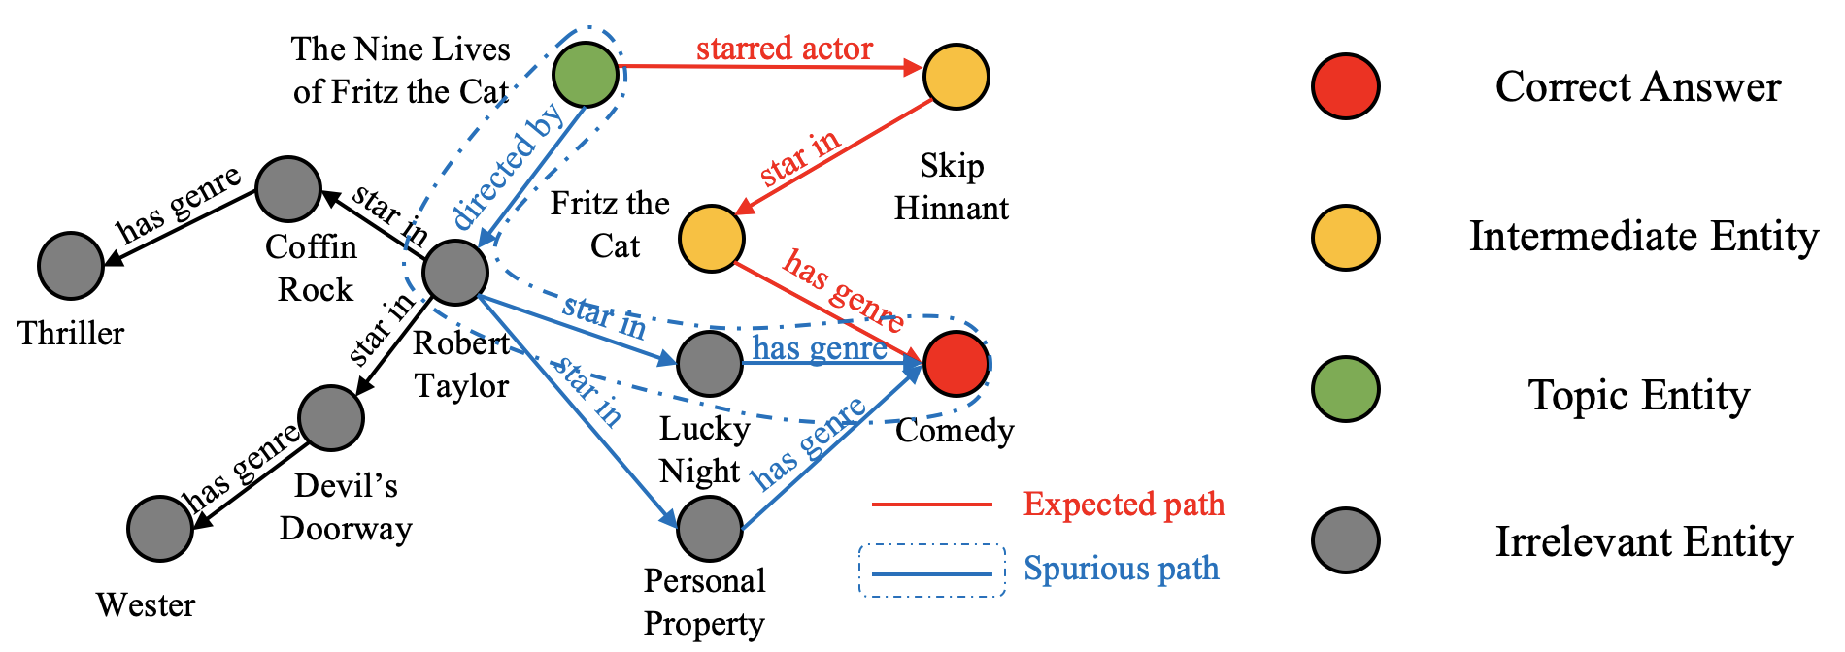
Background: multi-hop KBQA
Multi-hop Knowledge Base Question Answering (KBQA)
Weak supervision and spurious reasoning
what types are the films starred by actors in the nine lives of fritz the cat?
Notes:
Multi-hop Knowledge Base Question Answering (KBQA) aims to find the answer entities that are multiple hops away in the Knowledge Base (KB) from the entities in the question. A major challenge is the lack of supervision signals at intermediate steps. Therefore, multi-hop KBQA algorithms can only receive the feedback from the final answer, which makes the learning unstable or ineffective.
Look at this example, for question “what types are the films starred by actors in the nine lives of fritz the cat?”, the expected reasoning path is the red one, however the blue one can also reach answer entities “Comedy”. With only final answer “Comedy” as the supervision signal, our model may learn to follow spurious path to reason the question. This is called spurious reasoning.

Slide 4
Motivation
Can we learn intermediate supervision signals for multi-hop KBQA?
Auxiliary model: infer important entities at the intermediate steps
Main model: get improved with these entities as intermediate supervision signals
what types are the films starred by actors in the nine lives of fritz the cat?
Notes:
To our motivation, we try to provide intermediate supervision signals for multi-hop KBQA task. Our idea is to set up two models with different purposes for multi-hop KBQA. The main model aims to find the correct answer to the query, while the auxiliary model tries to learn intermediate supervision signals for improving the reasoning capacity of the main model. Specifically, the auxiliary model infers which entities at the intermediate steps are more relevant to the question, and these entities are considered as intermediate supervision signals.
Look at this figure, if we can obtain the relevant entities in the intermediate steps (for example, if we know Skip Hinnant is relevant while Robert Taylor is irrelevant), we can alleviate the spurious reasoning.

Slide 5
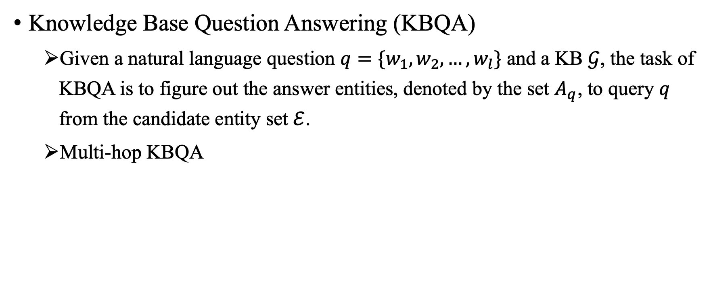
Task Definition
Knowledge Base Question Answering (KBQA)
Given a natural language question $q=\{w_{1},w_{2},…,w_{l}\}$ and a KB $𝒢$, the task of KBQA is to figure out the answer entities, denoted by the set $A_{q}$, to query $q$ from the candidate entity set $ℰ$.
Multi-hop KBQA
Notes:
For the task knowledge base question answering, we focus on factoid question answering over a knowledge base. We assume that a KB G is given as the available resource and the answers will be the entities in G.
Formally, given a natural language question q and a KB G, the task of KBQA is to figure out the answer entities, denoted by the set A_q, to query q from the candidate entity set E. The entities mentioned in a question are called topic entities. Specially, we consider solving complex questions where the answer entities are multiple hops away from the topic entities in the KB, called multi-hop KBQA.

Slide 6
Related Work
Methods to address spurious reasoning for Multi-hop KBQA
Reward shaping. Qiu et al. WSDM 2020
Action dropout. Lin et al. EMNLP 2018
Drawback:
Require expert experience
Lack effective supervision signals at intermediate steps
Our idea:
Learn intermediate supervision signals to improve multi-hop KBQA
Multi-Hop Knowledge Graph Reasoning with Reward Shaping. In EMNLP 2018. Xi Victoria Lin, Richard Socher, and Caiming Xiong. In EMNLP 2018.
Stepwise Reasoning for Multi-Relation Question Answering over Knowledge Graph with Weak Supervision. Yunqi Qiu, Yuanzhuo Wang, Xiaolong Jin, and Kun Zhang. In WSDM 2020.
Notes:
To prevent spurious paths in the search, several studies formulate multi-hop KBQA as a reinforcement learning (RL) task. Reward shaping and action dropout strategies have been proposed to improve the model learning. However, these solutions either require expert experience or still lack effective supervision signals at intermediate steps.
Different from previous studies, our idea is to automatically learn intermediate supervision signals to improve mult-hop KBQA task.

Slide 7
Outline
Introduction
Proposed Method
Overview
Part 1: Student Network: Neural State Machine for KBQA
Part 2: Teacher Network: Bi-directional Reasoning
Part 3: Training with teacher-student Framework
Experiment
Conclusion
Notes:
Then, we will introduce the proposed method.

Slide 8
Overview
Challenge: Weak supervision
Lack of supervision signals at intermediate reasoning steps
Solution: Teacher-student framework
Teacher: trained to provide intermediate supervision signals, bidirectional reasoning
Student: focuses on KBQA task, and gets improved with intermediate supervision signals from teacher
Notes:
As previously mentioned, the major challenge for multi-hop KBQA is that it usually lacks supervision signals at intermediate reasoning steps, since only the answer entities are given as ground-truth information.
To tackle this issue, we adopt the recently proposed teacher-student learning framework. The main idea is to train a student network that focuses on the multi-hop KBQA task itself, while another teacher network is trained to provide (pseudo) supervision signals (i.e., inferred entity distributions in our task) at intermediate reasoning steps for improving the student network.
To develop the teacher network, we incorporate a novel bidirectional reasoning mechanism, so that it can learn more reliable entity distributions at intermediate reasoning steps.

Slide 9
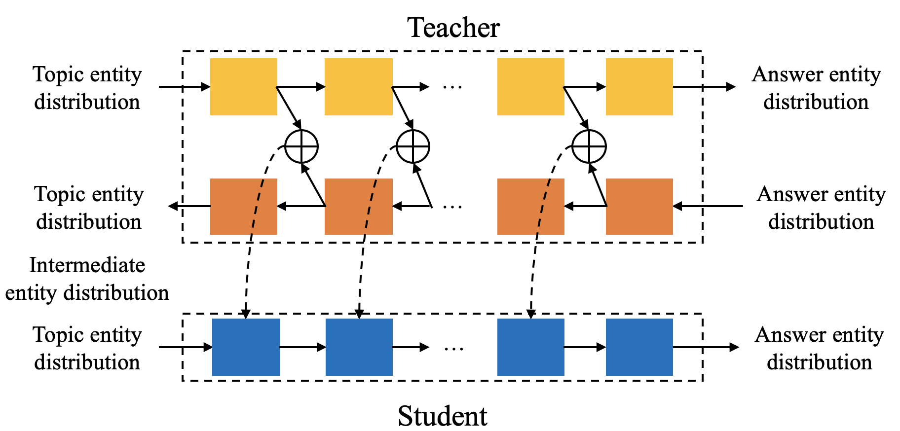
Overview of Teacher Student Framework
Teacher: Learn intermediate supervision signals with bidirectional reasoning
Student: Learn with both answers and Intermediate supervision signals
Notes:
This is an overview of our teacher-student framework. Then I’ll zoom into its details.

Slide 10
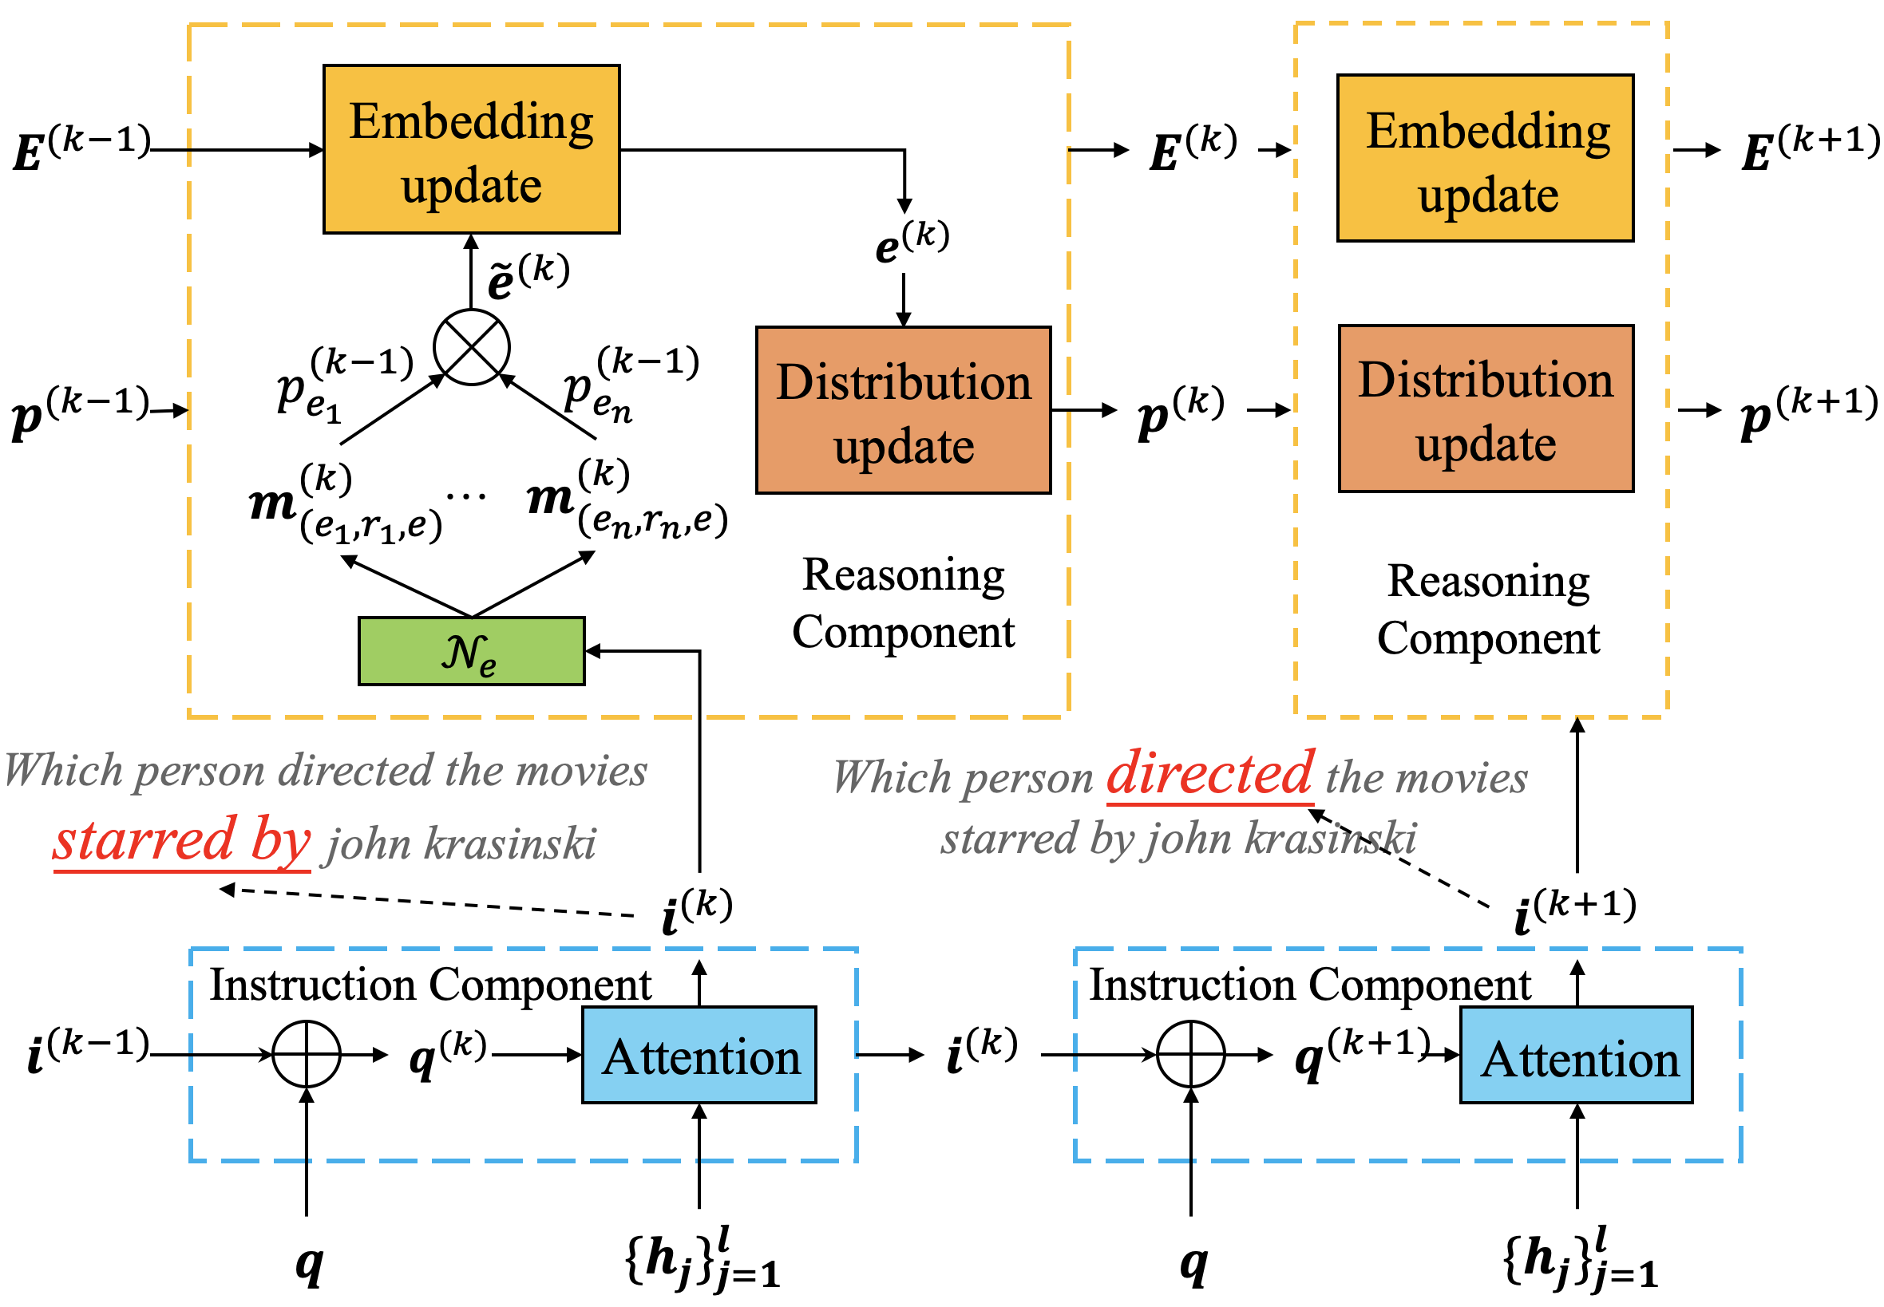
Neural State Machine for Multi-hop KBQA
Notes:
Firstly, I’ll introduce the neural state machine as our basic student network. We present an overall sketch of this model in this figure. It mainly consists of an instruction component and a reasoning component. The instruction component sends instruction vectors to the reasoning component, while the reasoning component infers the entity distribution and learns the entity representations.

Slide 11
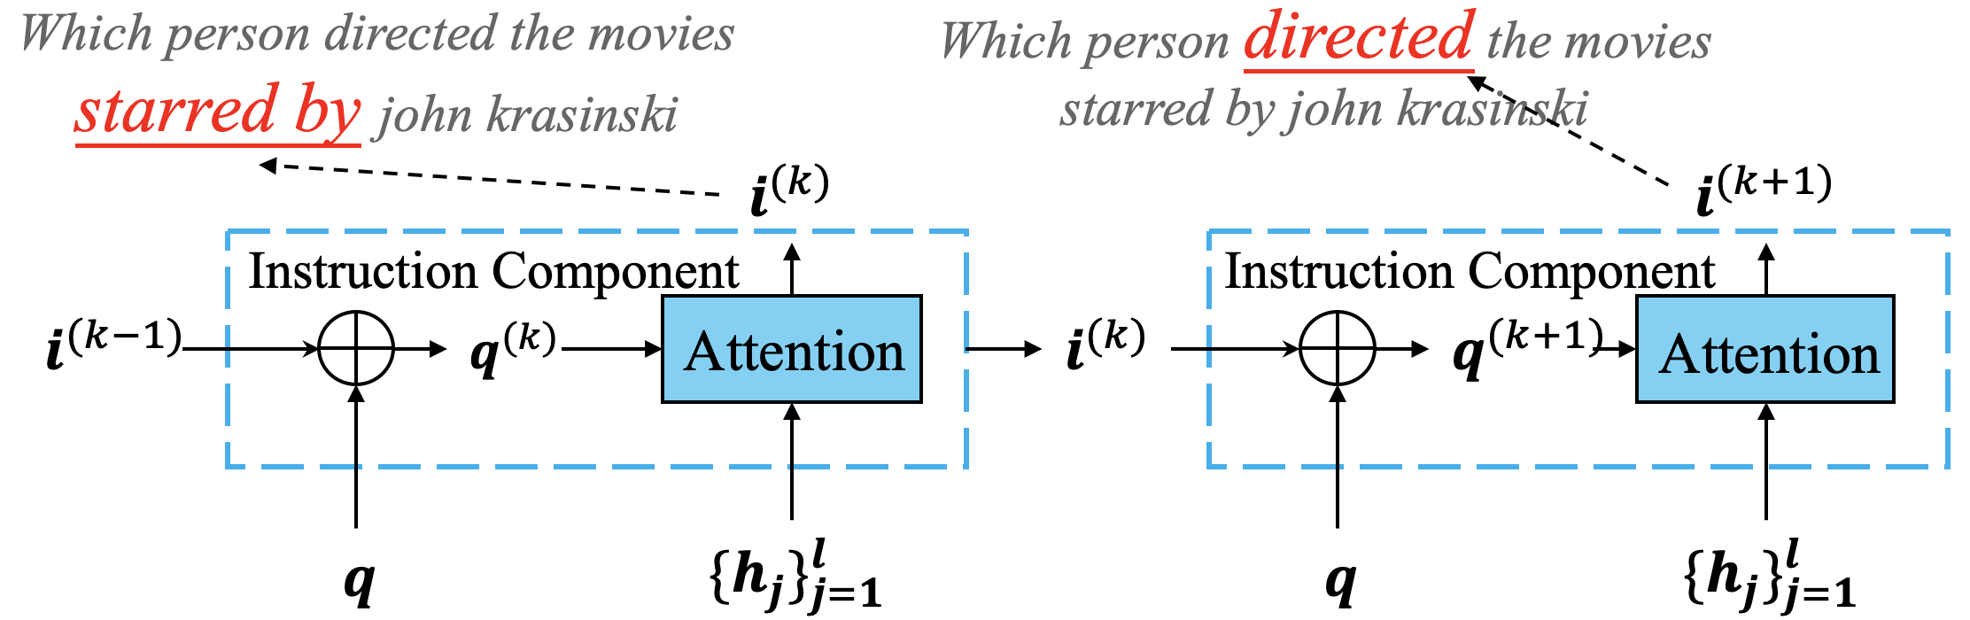

Instruction Component
Input: question hidden states ${\{h}^{j}\}_{j=1}^{l}$, instruction vector $i^{(k−1)}$ from previous step
Output: instruction vectors
Notes:
We first describe how to transform a given natural language question into a series of instruction vectors that control the reasoning process. The core idea is to attend to specific parts of a query when learning the instruction vectors at different reasoning steps. By repeating the process above, we can obtain a list of instruction vectors after n reasoning steps. For details about formulation about the instruction component, you may refer to our paper.

Slide 12
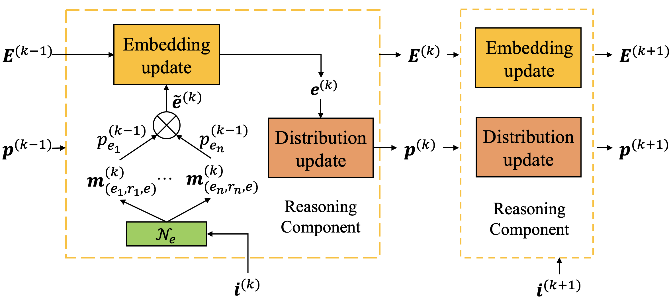
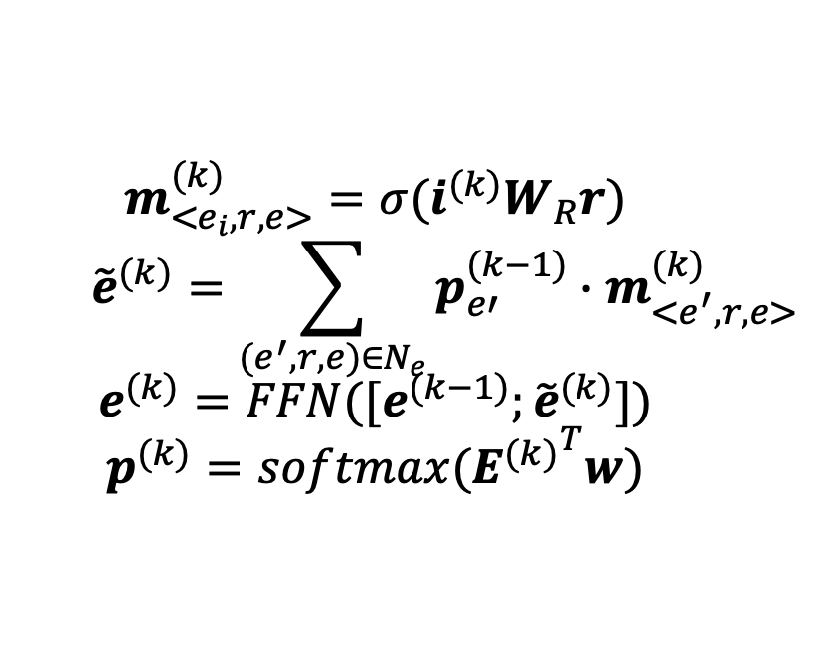

Reasoning Component
Input: instruction vector $i^{(k)}$, entity representation $E^{(k−1)}$, entity distribution $p^{(k−1)}$
Output: entity representation $E^{(k)}$, entity distribution $p^{(k)}$
$$m_{<e_{i},r,e>}^{(k)}=σ(i^{(k)}W_{R}r)$$
$${\tilde{e}}^{(k)}=\sum_{(e^{′}, r,e)∈N_{e}}{p_{e′}^{(k−1)}∙m_{<e^{′},r,e>}^{(k)}}$$
$$e^{(k)}=FFN([e^{(k−1)};{\tilde{e}}^{(k)}])$$
$$p^{(k)}=softmax({E^{(k)}}^{T}w)$$
Notes:
Once we obtain the instruction vector, we can use it as a guiding signal for the reasoning component. The input of the reasoning component consists of the instruction vector of the current step, the entity distribution and entity embeddings obtained from the previous reasoning step.
单击
Given a triple ⟨e_i ,r, e⟩, a match vector is learned by matching the current instruction with relation vector.
单击
Furthermore, we aggregate the matching messages from neighboring triples and assign weights to them according to how much attention they receive at the last reasoning step.
单击
Then, we update entity embeddings with a feed-forward layer taking as input of both previous embedding e (k minus 1) and relation-aggregated embedding e tilde (k).
单击
After that, we can obtain the probability distribution over intermediate entities for step k with a softmax over scoring of every entity representation.
Through such a process, both the relation path (from topic entities to answer entities) and its matching degree with the question can be encoded into node embeddings.

Slide 13
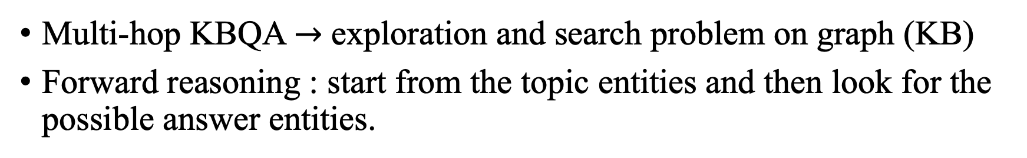
Forward and Backward Reasoning
Multi-hop KBQA $→$ exploration and search problem on graph (KB)
Forward reasoning : start from the topic entities and then look for the possible answer entities.
Backward Reasoning: the opposite search from answer entities to topic entities, which we refer to as backward reasoning.
Notes:
Then, I’ll introduce forward and backward reasoning.
Given a knowledge base, the reasoning process for multi-hop KBQA can be considered to be an exploration and search problem on the graph.
Most existing methods start from the topic entities and then look for the possible answer entities, which we call it forward reasoning. On the other hand, the opposite search from answer entities to topic entities (which we refer to as backward reasoning) has been neglected by previous studies.

Slide 14
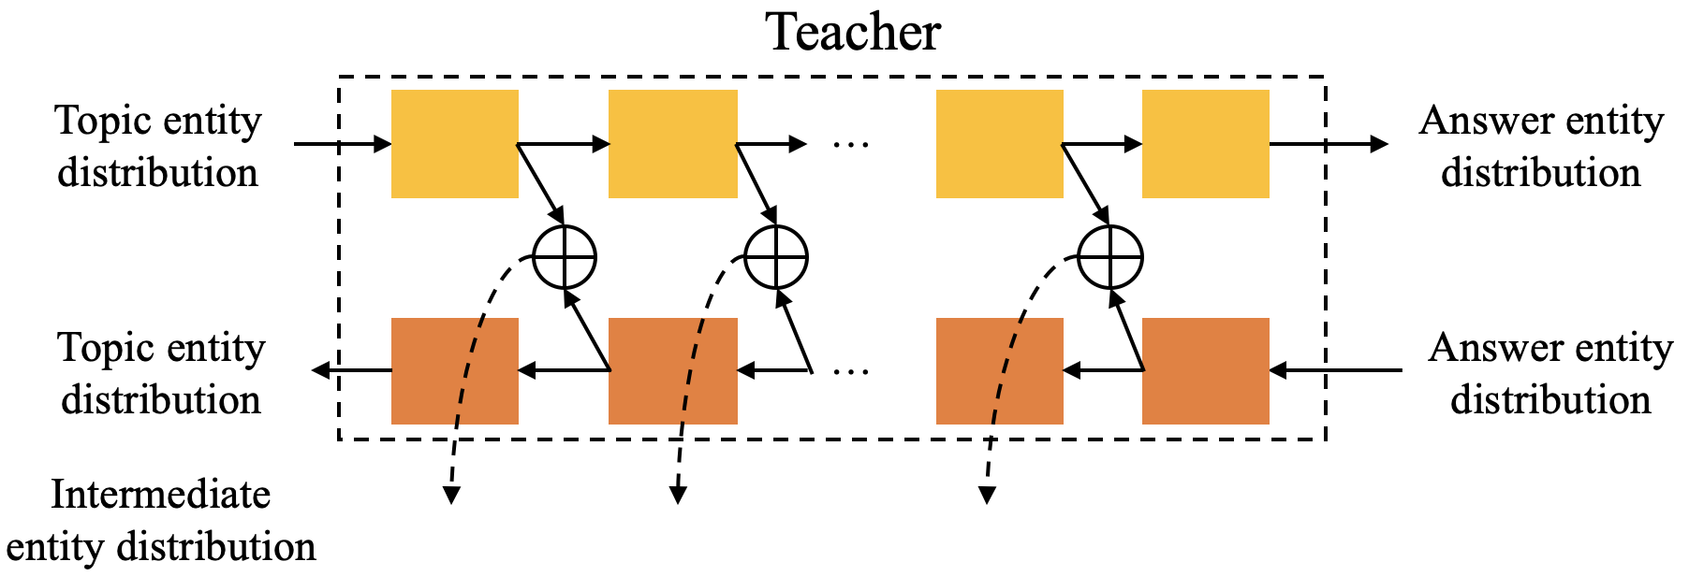
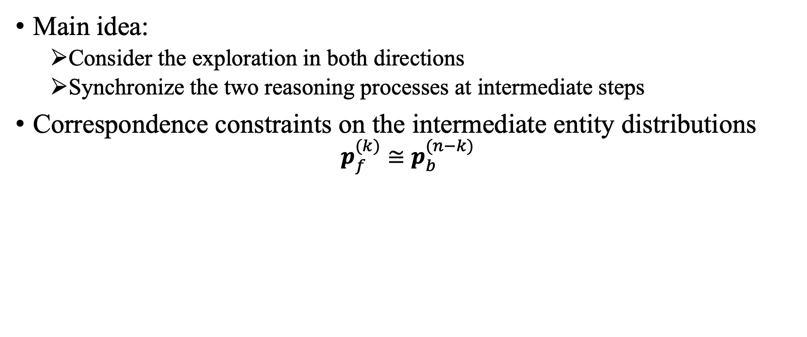
Our idea: Bidirectional Reasoning
Main idea:
Consider the exploration in both directions
Synchronize the two reasoning processes at intermediate steps
Correspondence constraints on the intermediate entity distributions
$$p_{f}^{(k)}≅p_{b}^{(n−k)}$$
Notes:
Our core idea is to consider the exploration in both directions and let the two reasoning processes synchronize with each other at intermediate steps. In this way, the derived intermediate entity distributions can be more reliable than those learned from a single direction.
To make it clear, we try to pose correspondence constraints on the intermediate entity distributions of two reasoning processes. Let the entity distribution at step k of forward reasoning correspond to n minus k step in backward reasoning.
Based on the idea above, we design two kinds of neural architectures for the teacher network, namely parallel reasoning and hybrid reasoning.

Slide 15
Parallel Reasoning
Two separate NSMs learn forward and backward reasoning respectively
No Parameter sharing
Only correspondence constraints on intermediate entity distributions
Notes:
The first way, parallel reasoning, is to set up two separate neural state machines for both forward and backward reasoning, respectively. These two NSM networks are relatively isolated, and do not share any parameters. We only consider incorporating correspondence constraints on the intermediate entity distributions between them.

Slide 16
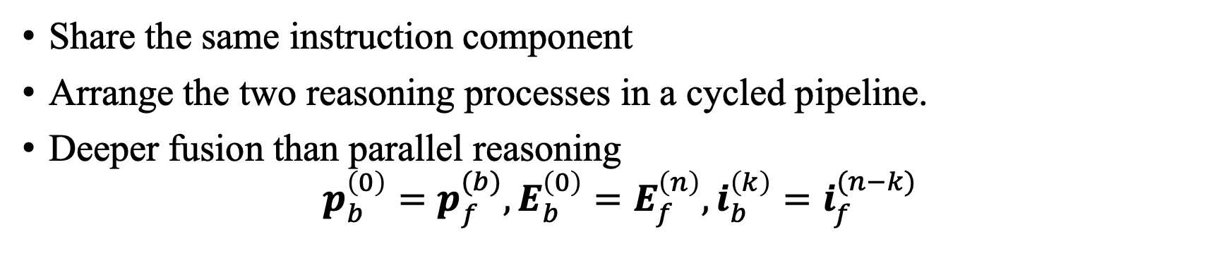
Hybrid Reasoning
Share the same instruction component
Arrange the two reasoning processes in a cycled pipeline.
Deeper fusion than parallel reasoning
$$p_{b}^{\left(0\right)}=p_{f}^{(b)}, E_{b}^{\left(0\right)}=E_{f}^{\left(n\right)},i_{b}^{\left(k\right)}=i_{f}^{(n−k)}$$
Notes:
In the second way, we share the same instruction component and arrange the two reasoning processes in a cycled pipeline. Besides the correspondence constraints, the two processes receive the same instruction vectors. And backward reasoning process is initialized with distribution and entity representation from forward reasoning.
Comparing the two reasoning architectures, it can be seen that parallel reasoning has a more loose integration, while hybrid reasoning requires a deeper fusion between the information from both reasoning processes.

Slide 17
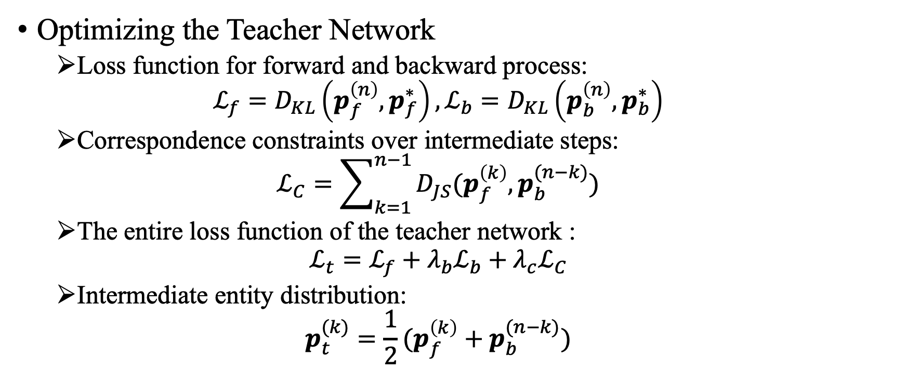
Learning with Teacher-Student Framework
Optimizing the Teacher Network
Loss function for forward and backward process:
$$ℒ_{f}=D_{KL}\left(p_{f}^{\left(n\right)},p_{f}^{∗}\right),ℒ_{b}=D_{KL}\left(p_{b}^{\left(n\right)},p_{b}^{∗}\right)$$
Correspondence constraints over intermediate steps:
$$ℒ_{C}=\sum_{k=1}^{n−1}{D_{JS}(p_{f}^{\left(k\right)},p_{b}^{(n−k)})}$$
The entire loss function of the teacher network :
$$ℒ_{t}=ℒ_{f}+λ_{b}ℒ_{b}+λ_{c}ℒ_{C}$$
Intermediate entity distribution:
$$p_{t}^{(k)}=\frac{1}{2}(p_{f}^{\left(k\right)}+p_{b}^{(n−k)})$$
Notes:
Then, I will show you how to learn with our teacher-student framework.
To optimize the teacher network, we should consider both forward and backward reasoning target and incorporate correspondence constraints on intermediate steps.
The reasoning loss reflects the capacity of predicting the accurate entities, which can be decomposed into two directions. And p_f_n denotes the final entity distribution for forward (backward) reasoning process, p_f_star denotes the ground-truth entity distribution, and we measure the loss with KL divergence.
The correspondence loss reflects the consistency degree between intermediate entity distributions from the two reasoning processes. It can be computed by summing the loss at each intermediate step. And we adopt the Jensen-Shannon divergence to measure it. And the entire loss combines the three term with λb and λc as hyper-parameters to control the weights of the factor.
Finally, we take the average of the two distributions as the intermediate supervision signals.

Slide 18
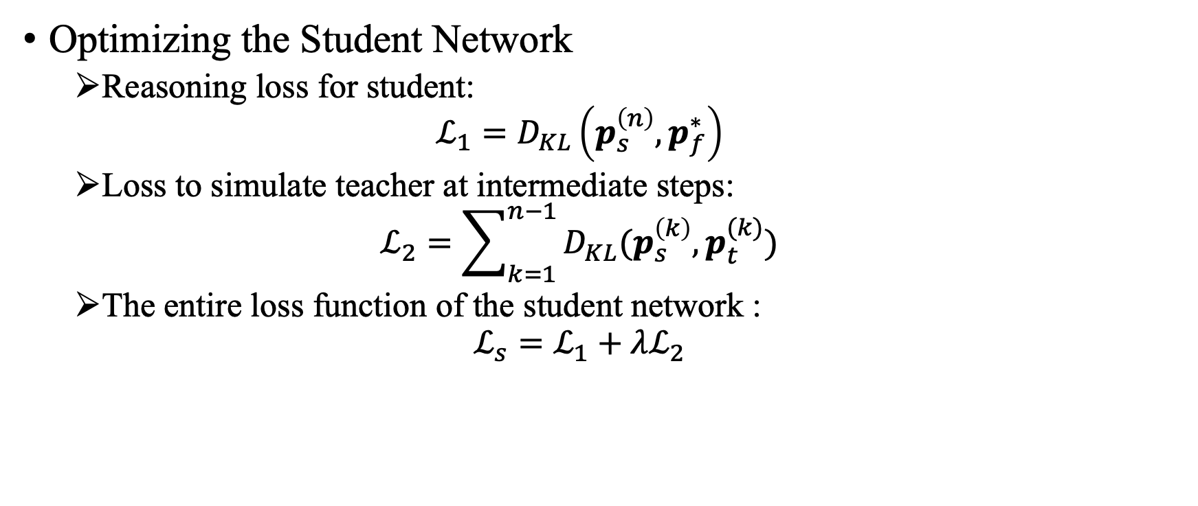
Learning with Teacher-Student Framework
Optimizing the Student Network
Reasoning loss for student:
$$ℒ_{1}=D_{KL}\left(p_{s}^{\left(n\right)},p_{f}^{∗}\right)$$
Loss to simulate teacher at intermediate steps:
$$ℒ_{2}=\sum_{k=1}^{n−1}{D_{KL}(p_{s}^{\left(k\right)},p_{t}^{(k)})}$$
The entire loss function of the student network :
$$ℒ_{s}=ℒ_{1}+λℒ_{2}$$
Notes:
As for the student network.
Besides the reasoning loss, we also incorporate the loss between the predictions of the student network and the supervision signal of the teacher network. And p_t_k and p_s_k denote the intermediate entity distributions at the k-th step from the teacher network and student network, respectively, and λ is a hyperparameter to tune.

Slide 19
Outline
Introduction
Proposed Method
Experiment
Datasets
Setup
Results & Analysis
Case Study
Conclusion
Notes:
Then, let’s move to experiment part

Slide 20
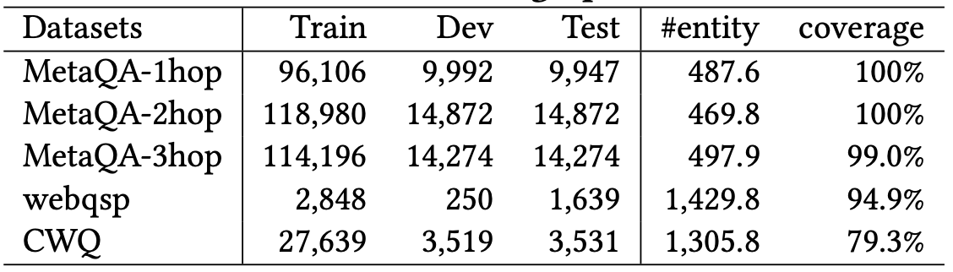
Datasets
Statistics of all datasets.
Following Prior work, we build question-specific subgraph for every question in dataset
“#entity” denotes average number of entities in subgraph, and “coverage” denotes the ratio of at least one answer in subgraph
GraftNet: Open Domain Question Answering Using Early Fusion of Knowledge Bases and Text. Haitian Sun, Bhuwan Dhingra, Manzil Zaheer, Kathryn Mazaitis, Ruslan Salakhutdinov, and William W. Cohen. In EMNLP 2018.
PullNet: Open Domain Question Answering with Iterative Retrieval on Knowledge Bases and Text. Haitian Sun, Tania Bedrax-Weiss, and William W. Cohen. In EMNLP 2019.
Notes:
Following prior work, we use the topic entities labeled in original datasets and adopt PageRank-Nibble algorithm (PRN) to find KB entities close to them.
The data cover three large datasets : MetaQA, WebQuestionsSP and Complex WebQuestions.
For more details about the datasets, please refer to our paper.

Slide 21
Experiment Setup
Evaluation Protocol:
For each test question in a dataset, a list of answers is returned by a model according to their predictive probabilities
Metric:
Top-1 hit ratio (Hits@1) , and F1
Notes:
Following prior work, we cast the multi-hop KBQA task as a ranking task for evaluation.
For each test question in a dataset, a list of answers are returned by a model according to their predictive probabilities. We adopt two evaluation metrics widely used in previous works, namely Hits@1 and F1. Specifically, Hits@1 refers to whether the top prediction is correct.

Slide 22
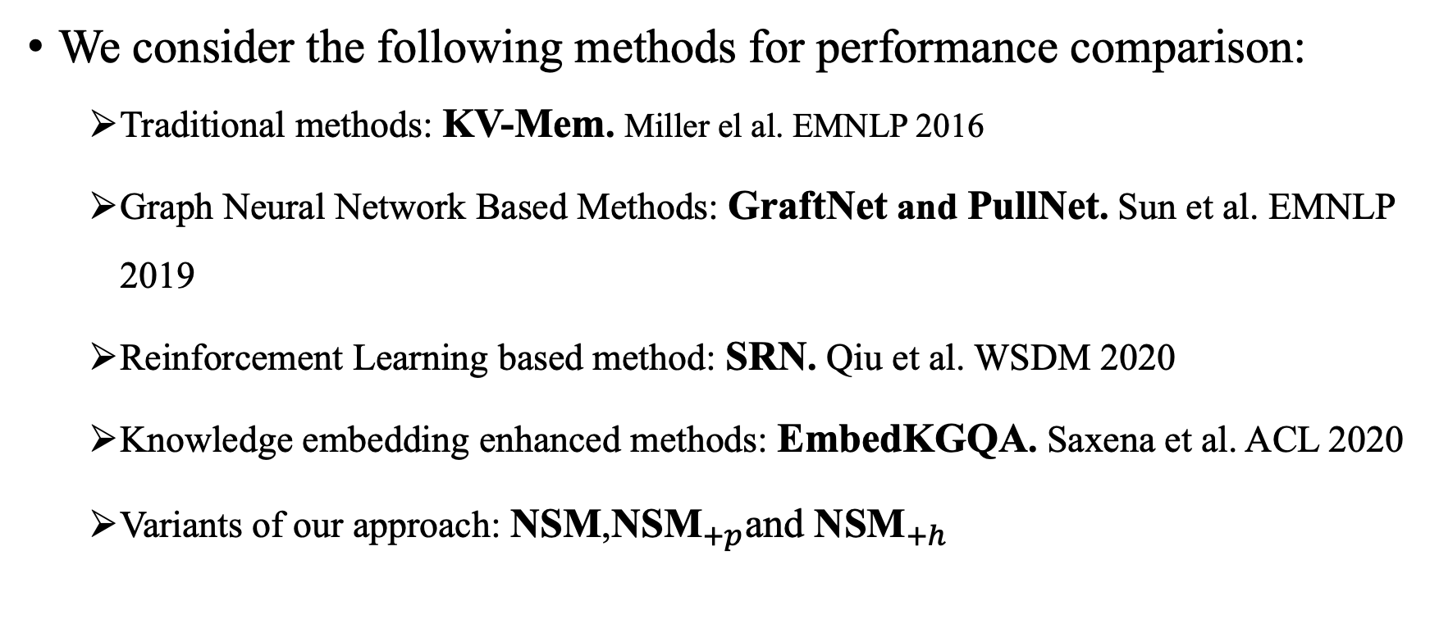
Baselines
We consider the following methods for performance comparison:
Traditional methods: KV-Mem. Miller el al. EMNLP 2016
Graph Neural Network Based Methods: GraftNet and PullNet. Sun et al. EMNLP 2019
Reinforcement Learning based method: SRN. Qiu et al. WSDM 2020
Knowledge embedding enhanced methods: EmbedKGQA. Saxena et al. ACL 2020
Variants of our approach: $\text{NSM}$,${\text{NSM}}_{+p}$and ${\text{NSM}}_{+h}$
Notes:
Our baselines have a comprehensive coverage of the related models.
To summarize, we categorize the baselines into several groups, as shown in this slide, according to the technical approaches.
We also include three variants of our model, which (1) do not use the teacher network, (2) use the teacher network with parallel reasoning, and (3) use the teacher network with hybrid reasoning, respectively.
For more details, you can refer to our paper.

Slide 23
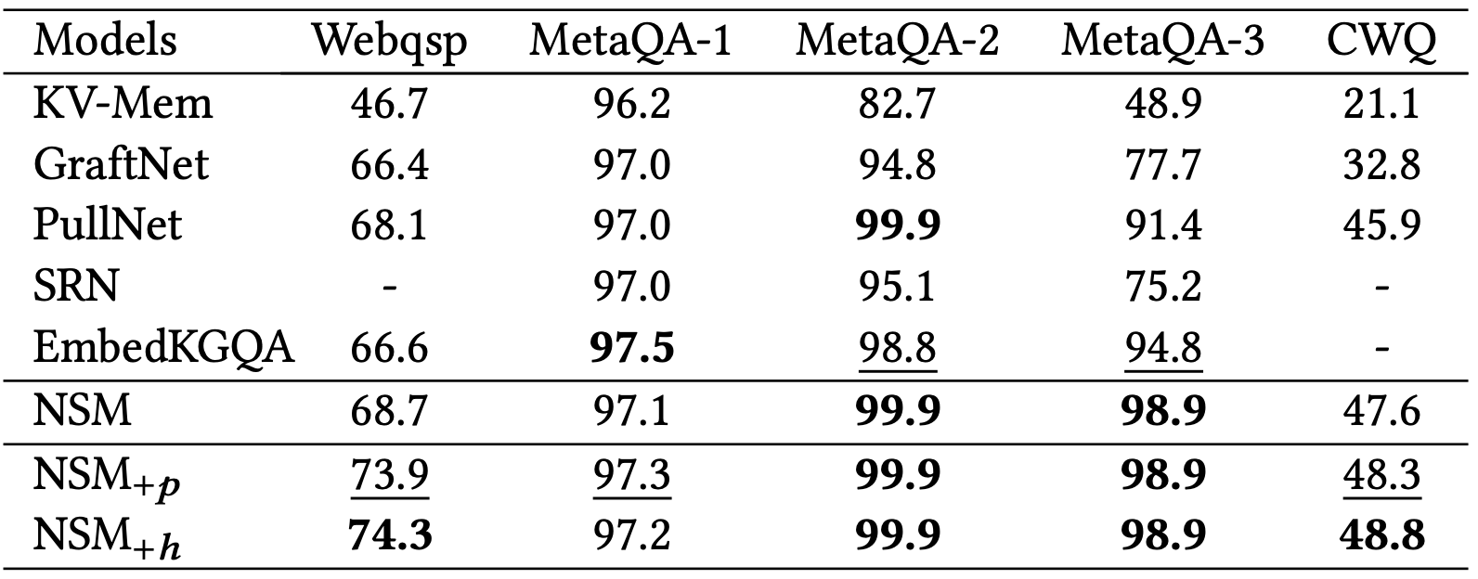
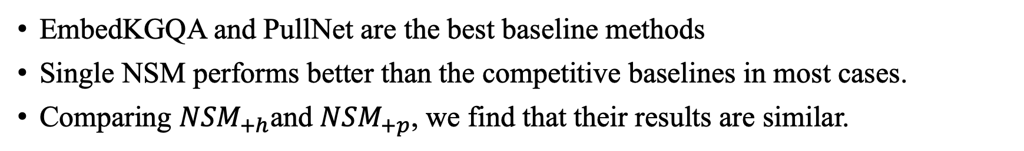
Experimental Results
Performance comparison of different methods for KBQA (Hits@1 in percent)
EmbedKGQA and PullNet are the best baseline methods
Single NSM performs better than the competitive baselines in most cases.
Comparing ${NSM}_{+h}$and ${NSM}_{+p}$, we find that their results are similar.
Notes:
The main results on datasets are shown in the table
Overall, EmbedKGQA and PullNet are better than the other baselines.
Our base model (the single student network) neural state machine performs better than the competitive baselines in most cases.
Comparing hybrid reasoning with parallel reasoning, we find their results are similar.

Slide 24
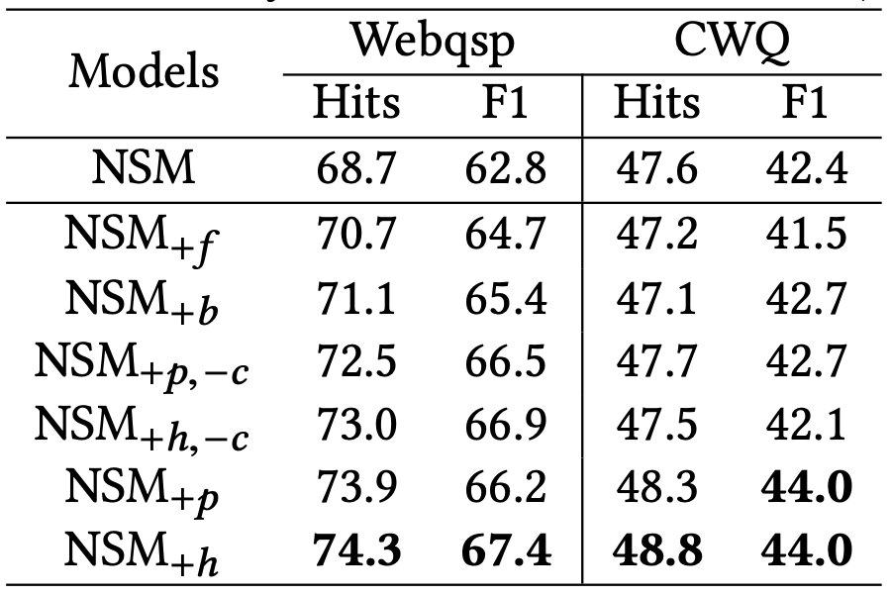
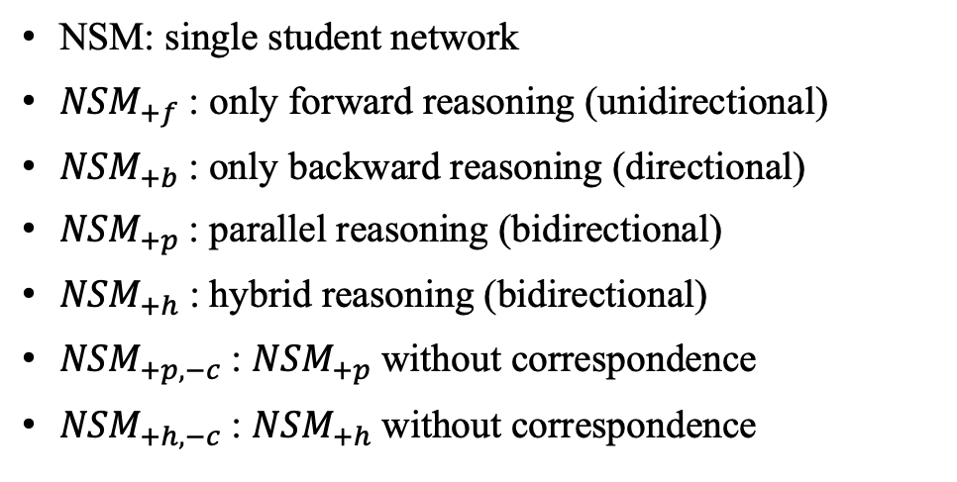
Ablation Analysis
Ablation study of the teacher network (in percent)
NSM: single student network
${NSM}_{+f}$: only forward reasoning (unidirectional)
${NSM}_{+b}$: only backward reasoning (directional)
${NSM}_{+p}$: parallel reasoning (bidirectional)
${NSM}_{+h}$: hybrid reasoning (bidirectional)
${NSM}_{+p,−c}$: ${NSM}_{+p}$without correspondence
${NSM}_{+h,−c}$: ${NSM}_{+h}$without correspondence
Bidirectional variants consistently outperform unidirectional variants
By removing the correspondence loss from the teacher network, the performance substantially drops
Notes:
Previous experiments have indicated that the major improvement is from the contribution of the teacher network. Here, we compare the effect of different implementations of the teacher network. The compared variants are listed here.
As shown in table, the unidirectional reasoning is consistently worse than bidirectional reasoning: look, the variants of NSM plus f and NSM plus b have a lower performance than the other variants.
Such an observation verifies our assumption that bidirectional reasoning can improve the learning of intermediate supervision signals.
Besides, by removing the correspondence loss from the teacher network, the performance substantially drops, which indicates that forward and backward reasoning can mutually enhance each other.

Slide 25
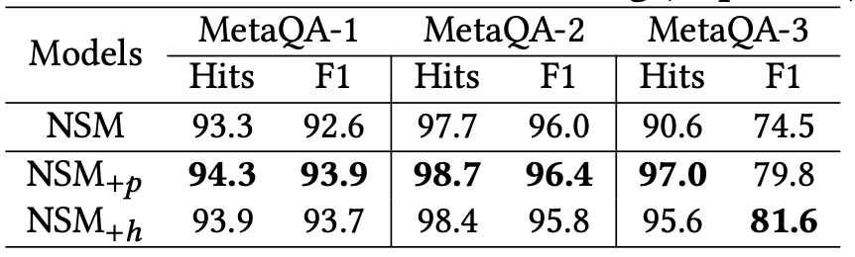
One-shot Evaluation
Results under one-shot setting (in percent)
Training data for MetaQA is more than sufficient, 100K samples for no more than 300 templates
The improvement over the basic NSM becomes more substantial.
Our approach can still work well when the training data is sparse
Notes:
We have found that the improvement of our approach over the basic model is very small on the MetaQA datasets. We suspect that it is because the amount of training data for MetaQA is more than sufficient: they have around one hundred thousand training cases for no more than 300 templates in each dataset. To examine this, we randomly sample a single training case for every question template from the original training set, which forms a one-shot training dataset.
We evaluate the performance of our approach trained with this new training dataset. The results are shown in above table. As we can see, our approach still works very well, and the improvement over the basic NSM becomes more substantial.
This also indicates that our approach can still work well when the training data is sparse.

Slide 26
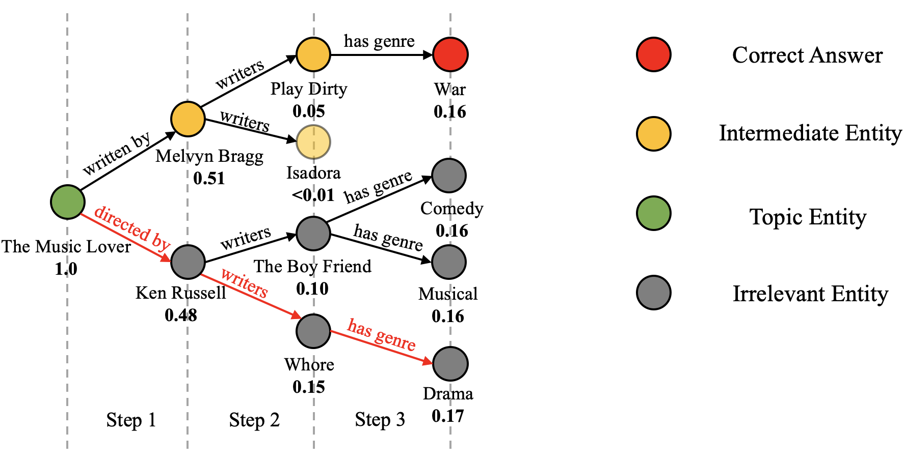
Case Study
Question: “what types are the movies written by the screenwriter of the music lovers””
The color darkness indicates the relevance degree of an entity by a method.
The student network before improvement.
Due to “Ken Russell” was selected in reasoning step 1, finally model choose irrelevant entity “Drama” as answer.
Notes:
The major novelty of our approach lies in the teacher network. Next, we present a case study for illustrating how it helps the student network.
We use green, red, yellow and grey circles to denote the topic entity, correct answer, intermediate entities and irrelevant entities respectively.
As shown in this figure, the original student network has selected a wrong path leading to an irrelevant entity. At the first hop, neural state machine mainly focuses on the two entities “Ken Russell” and “Melvyn Bragg”. Since it mistakenly includes “Ken Russell” (the director of “The Music Lovers”) at the first reasoning step, it finally ranks “Drama”, an irrelevant entity, as the answer.

Slide 27
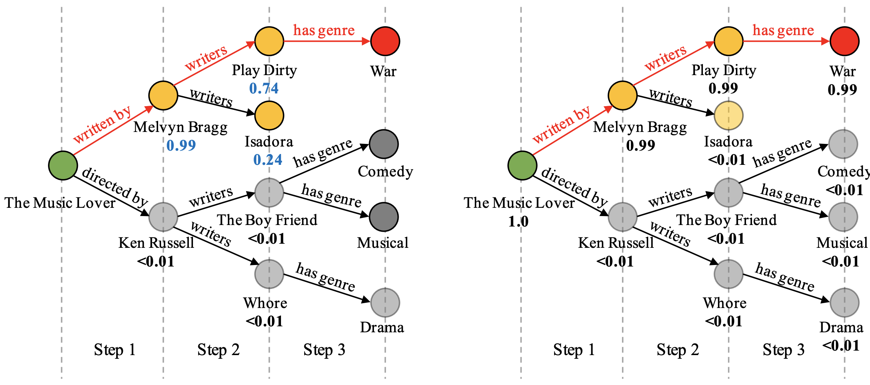
Case Study
Question: “what types are the movies written by the screenwriter of the music lovers””
The teacher network with hybrid reasoning.
The student network after improvement.
Our teacher network indeed provides very useful supervision signals at intermediate steps to improve the student network.
Notes:
In comparison, our teacher network (in the left Figure) is able to combine forward and backward reasoning to enhance the intermediate entity distributions.
单击
As we can see, our teacher assigns a very high probability of 0.99 to the entity “Melvyn Bragg” at the first step.
单击
When the supervision signals of the teacher are incorporated into the student, it correctly finds the answer entity “War” with a high probability (in the right Figure).
This example has shown that our teacher network indeed provides very useful supervision signals at intermediate steps to improve the student network.

Slide 28
Outline
Introduction
Proposed Method
Experiment
Conclusion
Notes:
In conclusion,

Slide 29
Conclusions
This work
An elaborate approach based on teacher-student framework for the multi-hop KBQA task.
A generic neural state machine for multi-hop KBQA task
Leverage bidirectional reasoning in teacher network to learn intermediate supervision signals
Future work
Enhance the entity embeddings using KB embedding methods
Obtain better intermediate supervision signals
Notes:
In this work, we developed an elaborate approach based on teacher-student framework for the multi-hop KBQA task. And we design a generic neural state machine focuses on the multi-hop KBQA task. For the teacher network, we propose to leverage bidirectional reasoning to enhance the learning of intermediate entity distributions.
In the future, we will also consider enhancing the entity embeddings using KB embedding methods, and obtain better intermediate supervision signals.

Slide 30
For Further Research
Our code and data will be available on:
https://github.com/RUCAIBox/WSDM2021_NSM
Notes:
Our code will be open-sourced on github. You can find it with this link

Slide 31
Thanks!
Notes:
Thanks for your time and listening!

Slide 32
Reference
Key-Value Memory Networks for Directly Reading Documents. Alexander H. Miller, Adam Fisch, Jesse Dodge, Amir-Hossein Karimi, Antoine Bordes, and Jason Weston. In EMNLP 2016.
Multi-Hop Knowledge Graph Reasoning with Reward Shaping. In EMNLP 2018. Xi Victoria Lin, Richard Socher, and Caiming Xiong. In EMNLP 2018.
GraftNet: Open Domain Question Answering Using Early Fusion of Knowledge Bases and Text. Haitian Sun, Bhuwan Dhingra, Manzil Zaheer, Kathryn Mazaitis, Ruslan Salakhutdinov, and William W. Cohen. In EMNLP 2018.
PullNet: Open Domain Question Answering with Iterative Retrieval on Knowledge Bases and Text. Haitian Sun, Tania Bedrax-Weiss, and William W. Cohen. In EMNLP 2019.
Stepwise Reasoning for Multi-Relation Question Answering over Knowledge Graph with Weak Supervision. Yunqi Qiu, Yuanzhuo Wang, Xiaolong Jin, and Kun Zhang. In WSDM 2020.
Improving Multihop Question Answering over Knowledge Graphs using Knowledge Base Embeddings. Apoorv Saxena, Aditay Tripathi, and Partha P. Talukdar. In ACL 2020

