Slide 1
The Technology Value Stream
Daniel Fryer
Assignment 1.2
8/14/2026

Slide 2
What is the technology value stream
This is the process required to take a business idea and turn it into something the customer can actually use.
Idea
Development
Test
Deploy
Customer Value

Slide 3
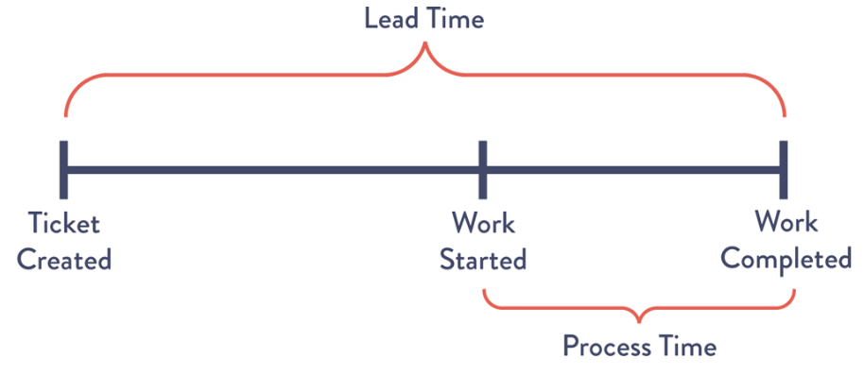
Lead Time Vs Processing Time
LEAD TIME:
This is the total time from when the user submits a ticket to when the work is completed.
PROCESSING TIME:
This is the time from when someone or something is actively working on the request.
Image Reference: The DevOps Handbook : page 51

Slide 4
Deployment Lead Times Requiring Months
Why can deployment lead times take months?
With large companies there maybe many teams that have inputs on the tasks or different code bases not merging and compiling together. This can cause weeks or even months to find and debug the issue.

Slide 5
Deployment Lead Times of Minutes
Using DevOps format:
we can take smaller code changes into the repository then setup automated and exploratory testing, and finally deploy into production

Slide 6
Months Vs Minuets Example
Months: 11 Weeks
Development
5 Days
Wait for Testers
3 Weeks
Testing
3 Days
Wait For Approvers
4 Weeks
Approval Board
1 Day
Wait for a deployment window
3 Weeks
In Production
Minuets: 1 Day
Small Code Change
8 Hours
Commit Change to repository
Automatic
Automated Testing
10 Minuets
Exploratory Testing
10 Minuets
In Production

Slide 7
Using the DevOps Method Benefits
Faster Delivery: changes can be completed in minutes or hours instead of weeks or months
Faster value for the business: New features can be used by the customer in a timelier fashion
Smaller changes: easier to test and troubleshoot.
Faster Feedback: with faster releases you can get feedback from the customer faster and pivot based on the feedback

Slide 8
References:
The DevOps Handbook
SEI Blog: https://www.sei.cmu.edu/blog/taking-devsecops-to-the-next-level-with-value-stream-mapping/

