Slide 1


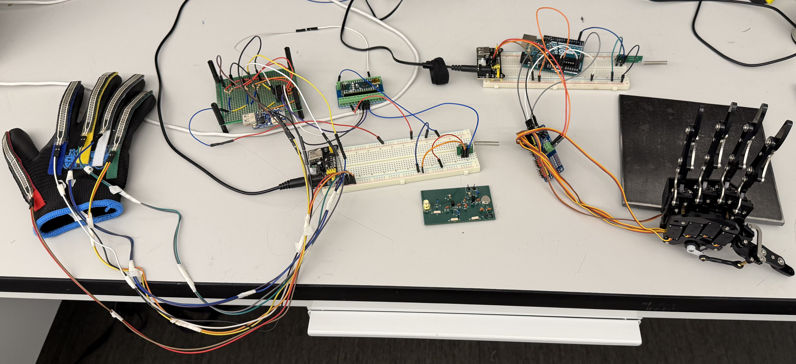
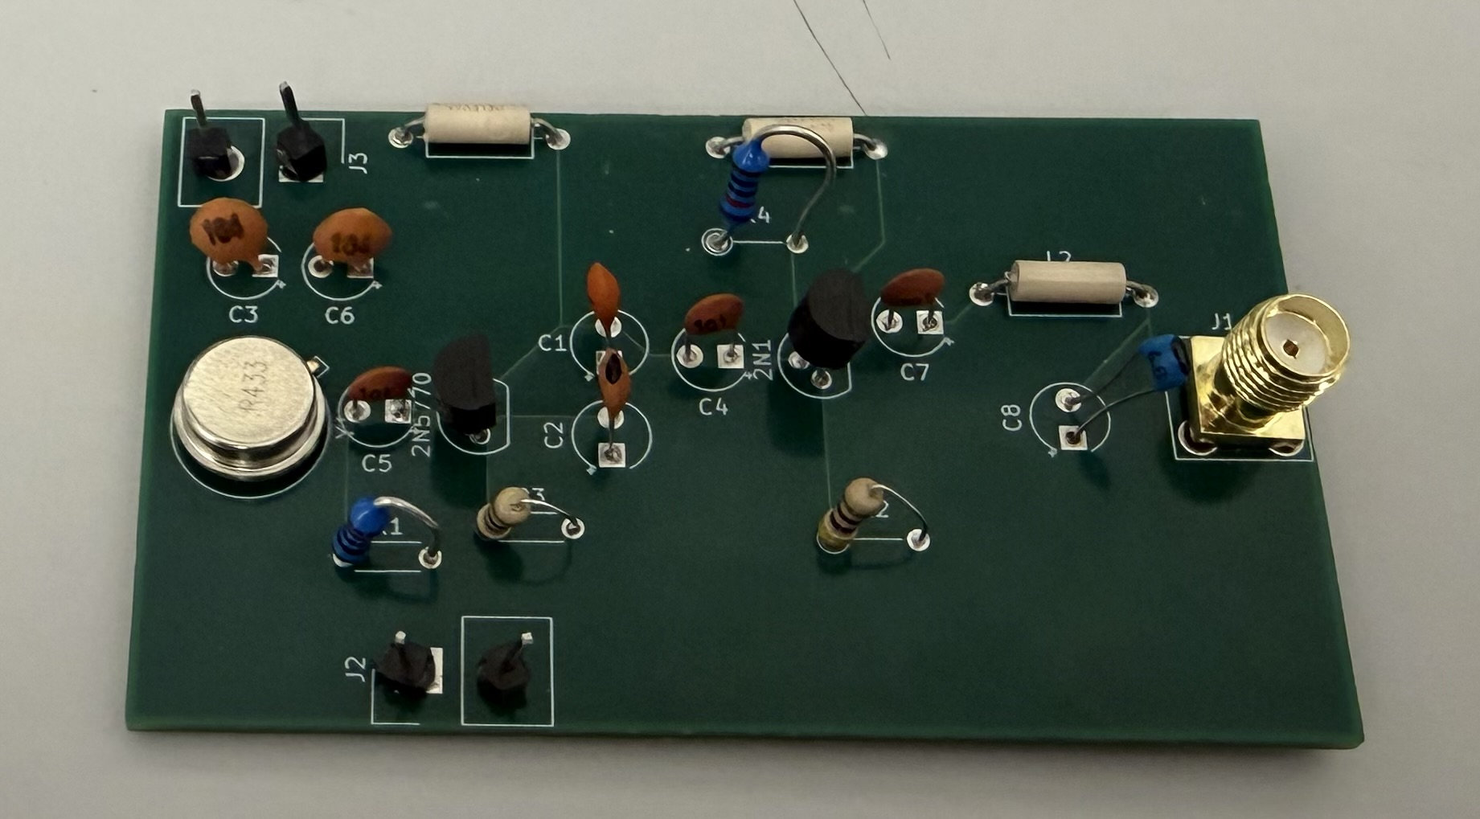
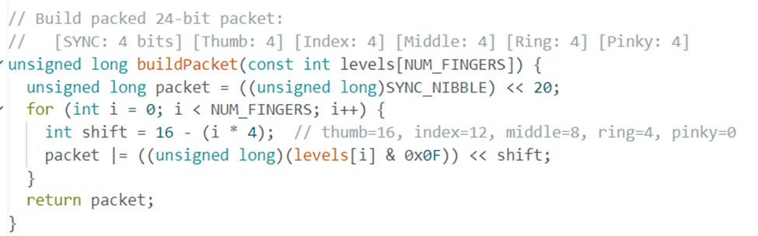
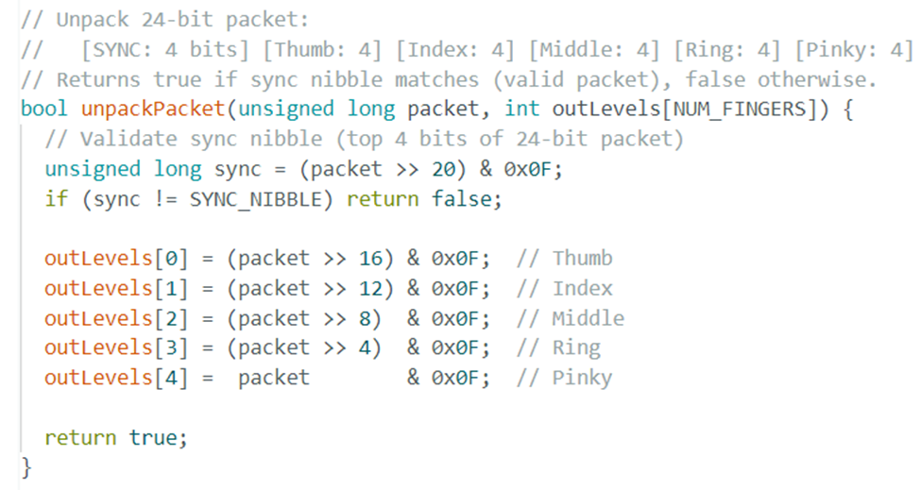
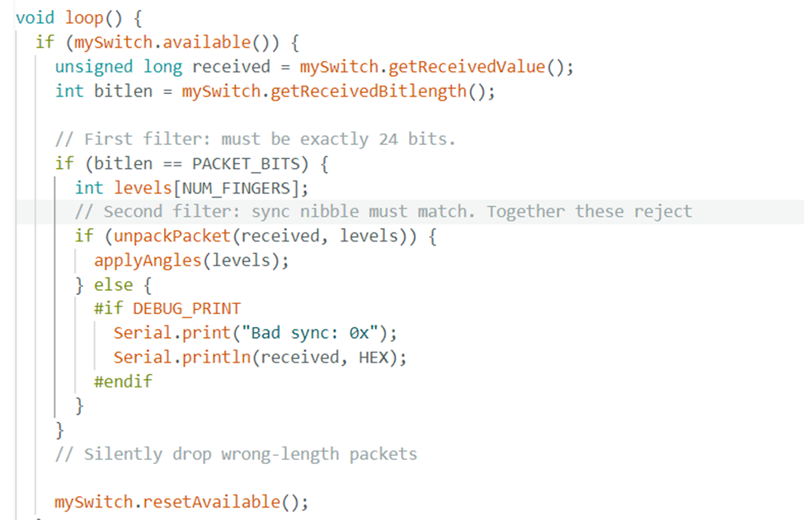
Hand Echo
Student Names: Andres Arcila, John Garcia, Xavier Dammond
Advised by: Ke Bao
Email: arcila.ad23@gmail.com , johngarcia8018@gmail.com , xdammond@gmail.com
Email: kbao@msudenver.edu
Materials and methods
Results
Intro
Arduino Nano: Microcontroller used on the transmitter (glove) side to read multiplexed flex sensor data and drive the RF transmitter.
Arduino Uno: Microcontroller used on the receiver (hand) side to decode the incoming RF signal and generate servo commands.
Flex Sensors (10 kΩ): Five resistive bend sensors, one per finger, used to measure finger articulation via voltage-divider circuits.
74HC4051 8-Channel Multiplexer: Used to sequentially route all five flex sensor outputs into a single ADC input on the Arduino Nano.
SAW Resonator (433.92 MHz): Surface acoustic wave resonator used as the frequency-reference element for the custom Colpitts oscillator transmitter.
Colpitts Oscillator Transmitter Circuit: Custom-built RF transmitter using ASK (Amplitude Shift Keying) modulation at 433.92 MHz.
RF Receiver Module: Paired 433.92 MHz receiver used to demodulate the ASK signal and forward serial data to the Arduino Uno.
PCA9685 16-Channel PWM Driver: I²C-controlled PWM controller used to generate precise servo signals for all five fingers from the Arduino Uno (SDA on pin 6, SCL on pin 7).
5V Power Supply: Powers the glove-side voltage dividers, multiplexer, and Arduino Nano.
3.7 V Li-Po Battery + 5 V Boost Converter: Portable power supply for the wireless glove assembly.
Robotic Hand with 5 Servo Motors: Mechanical end-effector actuated by the PCA9685 to mirror the operator's finger movements.
Hand Echo Systems:
Hand Echo is a wireless tele-operation system designed for real-time replication of human hand movements in environments where direct manual interaction is unsafe or impossible. The system integrates a flex-sensor-equipped glove, a custom 433.92 MHz ASK-modulated RF link, and a servo-driven robotic hand to translate finger articulation into precise mechanical motion, enabling safe operation in hazardous settings and supporting prosthetic research and development
Conclusion
The Hand Echo wireless teleoperation system successfully demonstrated a functional prototype capable of capturing human finger articulation and mirroring it on a remote robotic hand in real time. Through integrated flex-sensor acquisition, a custom-built 433.92 MHz ASK-modulated RF link, and a PCA9685-driven servo actuator architecture, the system translated operator hand movements into responsive mechanical motion and validated the core design principles of the project. While the prototype met all primary objectives, opportunities remain for refinement and expansion, including resolving the servo snap-back behavior observed during initial testing, improving RF link range and noise immunity, adding bidirectional haptic feedback, expanding the sensor set to capture wrist and individual joint angles, and packaging the glove and hand assemblies into more ergonomic, field-ready enclosures. Overall, Hand Echo provides a strong foundation for a scalable, next-generation platform suited to hazardous-environment manipulation and prosthetic research applications
Design
Colpitts Oscillator Transmitter Circuit:
Hand Echo is a wireless teleoperation platform engineered to replicate human hand motion on a remote robotic end-effector in real time. Its architecture centers on a two-microcontroller topology — an Arduino Nano on the transmitter side and a Arduino Uno on the receiver side — linked by a 433.92 MHz ASK-modulated RF channel built around a SAW resonator and a custom Colpitts oscillator. Hand Echo integrates five flex sensors arranged in voltage-divider networks and consolidated through a 74HC4051 8-channel multiplexer, producing high-resolution finger-articulation data that is encoded, transmitted over custom-built antennas, and decoded at the receiver. A PCA9685 16-channel PWM driver communicates with the Uno over I²C to drive five servo motors actuating the robotic hand, while onboard firmware maps sensor input to servo position to maintain responsive, low-latency mirroring with minimal operator calibration. Designed for wireless range, modular sensor-to-servo mapping, and reconfigurable control logic, Hand Echo provides a robust foundation for hazardous-environment manipulation and prosthetic research applications.
Code Bit-Packed Protocol
Literature Cited
[1] Pozar, D. M. (2012). Microwave engineering (4th ed.). Wiley.
[2]
Waveform
Acknowledgements
The group would like to give a special thanks to all of the professors, Lab Coordinators, and student lab assistants at Metropolitan State University of Denver. Without their technical and logistical support and advice this project would not have been possible.

