Slide 1

Financial Hub
The Individual Segment — A Behavior-Driven Financial Intelligence Layer for Every Earner
PRE-ALLOCATION
PROTECTED SAVINGS
FINANCIAL DISCIPLINE BY DESIGN

Slide 2

Our Vision
To accelerate inclusive economic growth by building financial infrastructure that transforms financial discipline into the foundation of wealth creation, resilient businesses, quality employment, that empower every individual and business across Africa.

Slide 3
Financial Gaps in Kenya
Kenya has expanded financial access, but gaps remain in savings, cash-flow resilience, productive credit, and long-term financial health.
KES 35T
68%
5.1M
96%
Mobile Money Flow
Run Out Monthly
Loan Dependency
Earn Under KES 100K/mo
Processed yearly; savings stay below 12%
Of salaried Kenyans face shortfalls before payday
Kenyans trapped in digital loan cycles
Of formal workers; only 2.65% of accounts exceed KES 100K

Slide 4


The Individual Challenge
Access to finance is only part of the problem. Income arrives as a single lump-sum balance—rent, food, transport, school fees, and savings all look like one spendable number.
The result is a framing problem, not financial illiteracy: people see the full balance as available, spend reactively, and stay one pay slip away from distress.
This is a structural design failure, not a personal failing.

Slide 5
The Digital vs. Discipline Paradox
1
Digital Speed
2
Financial Outcomes
Digital payments are faster than ever and generate more financial data than ever before.
But outcomes haven't improved: mobile money made money move faster, not easier to manage.
M-Pesa transactions
Instant transfers
Real-time data
Low savings rates
Loan cycles
Month-end shortfalls

Slide 6
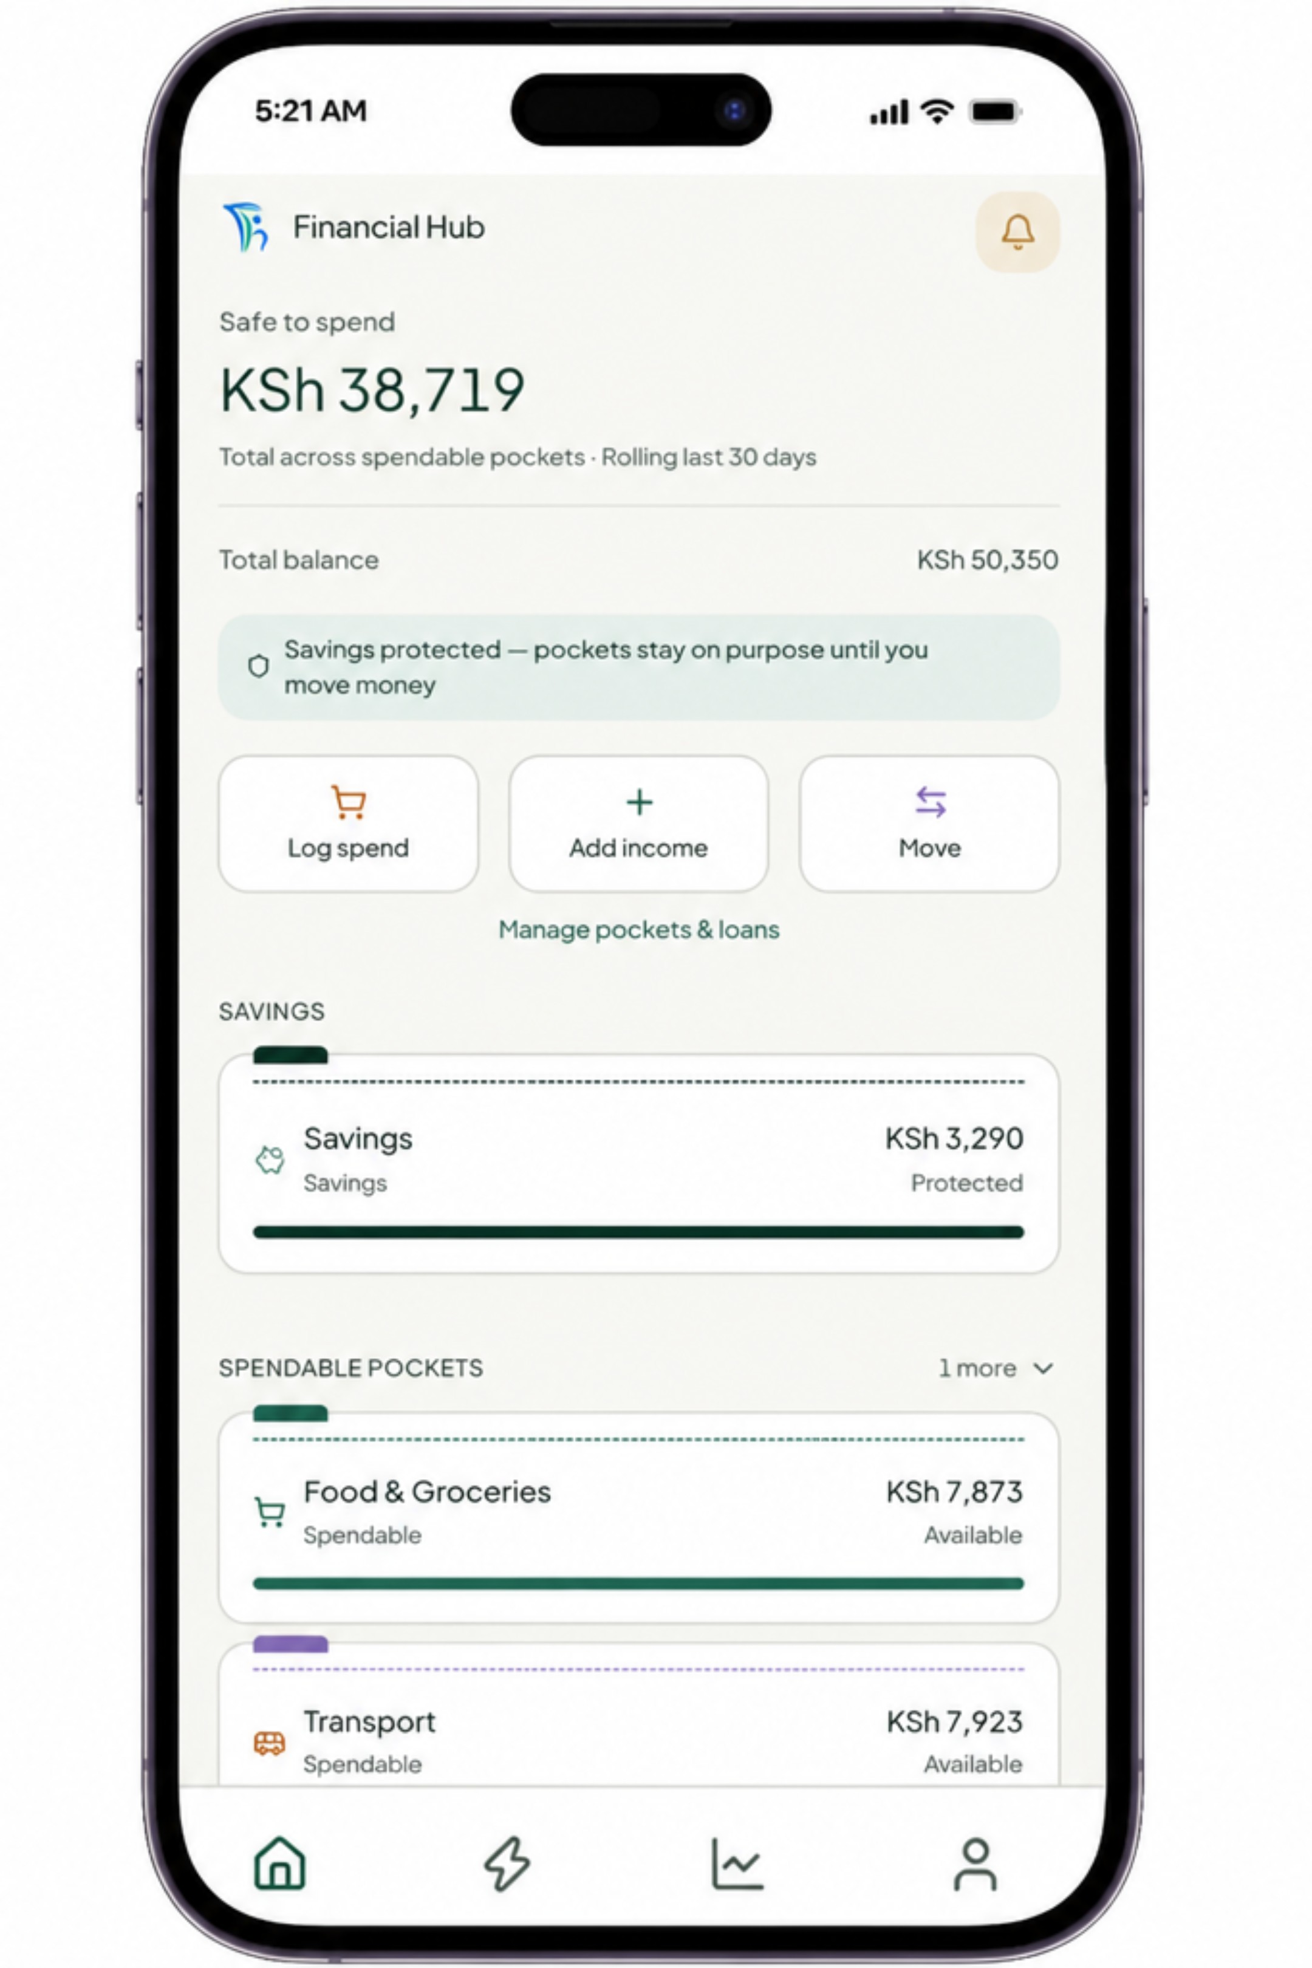
THE SOLUTION
Financial Hub
An intelligent financial operating system — built for every earner in Kenya.

Slide 7

We Don't Track Money. We Make It Behave.
Every feature is an applied behavioral-finance mechanism, live in the product today:
Commitment Devices
Cooling-Off Friction
Discipline Score (0–100)
Streaks & Rollover
Transfers from essentials to leisure pause for 1 hour, based on the user profile.
Unused daily budgets roll into Savings; milestones reward 3/7/14/30/60/90-day streaks.
Savings lock for 30–90 days; early unlock requires biometrics and discipline points.
Clear points reward good habits and penalize risky ones, with monthly caps.
Smart Guardrails
Adaptive Intelligence
Category pockets enforce rules, block gambling, and flag daily-cap overrides.
Monthly planning learns from spending and suggests better allocations.

Slide 8

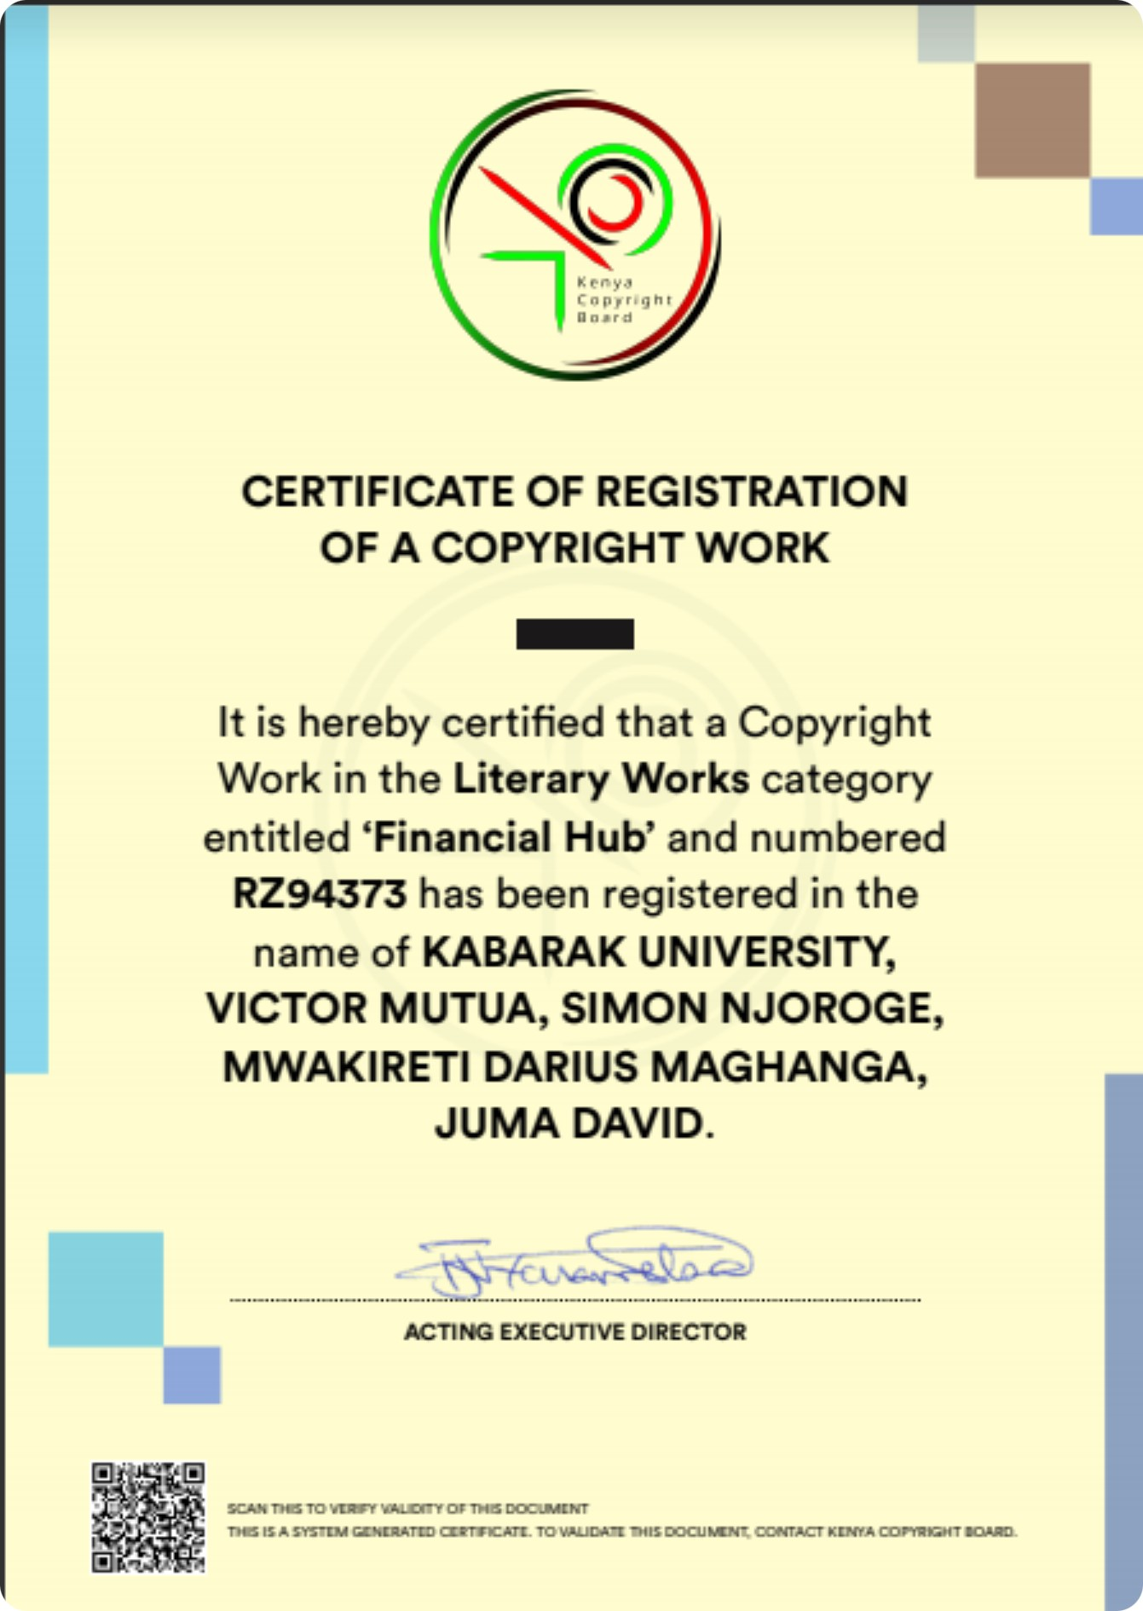
Intellectual Property
Financial Hub has secured copyright protection for its Literary Work, Registration No. RZ94373, issued by the Kenya Copyright Board (KECOBO)
Current IP: Copyright registration — RZ94373 · Issuing Authority: Kenya Copyright Board (KECOBO) · Status: Registered

Slide 9

Every Shilling Arrives with a Job
Financial Hub is an intelligent financial operating system for individuals. Instead of tracking spending after it happens, it splits income into purpose-bound pockets the moment it arrives.
Incoming Income
Financial Hub Allocation
Funds enter the system.
Destination Pockets
Income is sorted automatically.
Money lands in purpose-based accounts.
Income flows into five pockets: Savings (10%, locked), Fixed Costs, Daily Pockets, Loans & Goals, and Emergency Reserve. Unspent daily amounts roll into Savings at midnight.

Slide 10


Three Pillars of Financial Hub
Intelligent Organization
Income is automatically routed into purpose-based pockets.
Behavioral Design
Friction, streaks, and a discipline score support better money habits.
Measurable Outcomes
Savings, discipline, and credit readiness become easier to track.

Slide 11
Business Model
Financial Hub's Individual segment operates a scalable consumer subscription model complemented by embedded financial services.
Free core discipline engine — pockets, auto-allocation, protected savings and daily budgeting drive adoption and daily habit
Premium tier — advanced behavioral insights, multi-goal savings, family/shared pockets, deeper analytics
Embedded financial services — the discipline score becomes a credit-readiness signal for SACCOs, banks and digital lenders; referral partnerships on savings and credit products
Infrastructure licensing — the behavioral intelligence layer offered to financial institutions as an API
Pricing is being validated through the pilot phase; the wedge is the free discipline engine, the monetization is the behavioral data layer and embedded services.

Slide 12
Users Never Build Budgets. Behavior Builds the Plan.
A 6-step behavioral check-in feeds a rules engine that infers the right financial plan.
Salaried — Structured
Salaried — Daily Budget
Monthly pockets with costs, savings, and spending separated.
Daily caps for tighter budgets and spender habits.
Freelancer / Gig — Daily Budget
Student — Simplified
Caps follow real income rhythm, not a fixed month.
One simple daily spend pocket.

Slide 13
CHAPTER 2
The Behavioral Intelligence Layer
Transforming financial discipline into wealth creation.

Slide 14
The Future of Finance is Behavioral
Financial Hub: the individual segment is built. The discipline engine works. Now we scale it.

Slide 15

KES 5 Million
Raising KES 5 million to scale Financial Hub from validated platform to market-ready growth across Kenya.
This Investment Will Fund:
Product hardening and the Behavioral Intelligence Layer for personalization, predictive insights, and a partner API
Regulatory and security compliance for partner integrations
A six-month pilot to validate PMF, savings outcomes, and conversion
Foundation for commercial scale across Kenya before MSME expansion

Slide 16
THE ASK
The Ask
Driving impact through strategic partnership.

Slide 17

MARKET OPPORTUNITY
The Engine of Kenya's Digital Economy

Slide 18
Built for Every Kenyan Earner

Slide 19




One System, Three Lives
The Salaried Professional
"I earn KES 60,000 on the 28th. By the 20th I'm borrowing." → Fixed costs set on payday, 10% savings locked automatically, and one clear number for the rest
The Gig Worker / Freelancer
"Income comes in bursts — good week, dead month." → Daily budgets based on real runway, a monthly reset from actual income, and an emergency unlock once a month at most
The Student / First Earner
"Budgeting apps are overwhelming." → One simple daily pocket, light guardrails, and a streak that rewards consistency

Slide 20
Product Development & Traction
Financial Hub has progressed from concept to a fully built, deployed product — not a mockup.
Product Development: A complete, working Individual-segment platform: production backend live on Railway, full mobile app (iOS/Android) with onboarding, pocket allocation engine, daily budget system, discipline scoring, streaks, loans, emergency unlock, nudges and insights — all implemented and tested
Institutional Collaboration: Developed in collaboration with Kabarak University — academic expertise, innovation support, research, technical validation and entrepreneurial mentorship. Winner, NEIL Campus Spark innovation award in Digital Transformation & AI
Behavioral Validation: Structured user testing with ~30 participants validated the mental-accounting model and refined guardrail tuning; extensive market research confirmed demand for integrated financial management among Kenya's earners
Market Recognition: Showcased at Nakuru ASK 2026 — awarded Best Stand Embracing Technology and Communication Systems, with strong organic demand from farmers, gig workers and salaried earners

Slide 21

Why Now?
53.4M+ Mobile Money Accounts: Digital payments are mature, but financial management is still fragmented.
Growing Digital Loan Fatigue: 5.1M Kenyans in debt cycles are moving toward sustainable planning.
Changing Nature of Income: Gig work, side hustles, and irregular earnings need flexible, rhythm-aware budgeting.
Digital Adoption at Scale: Smartphone penetration and financial literacy are creating ready demand.
Open API Ecosystem: Banks, fintechs, SACCOs, and mobile money platforms can now connect in one system.
2026 is the right time to build the financial intelligence layer for Africa's next generation of digital financial services.

Slide 22
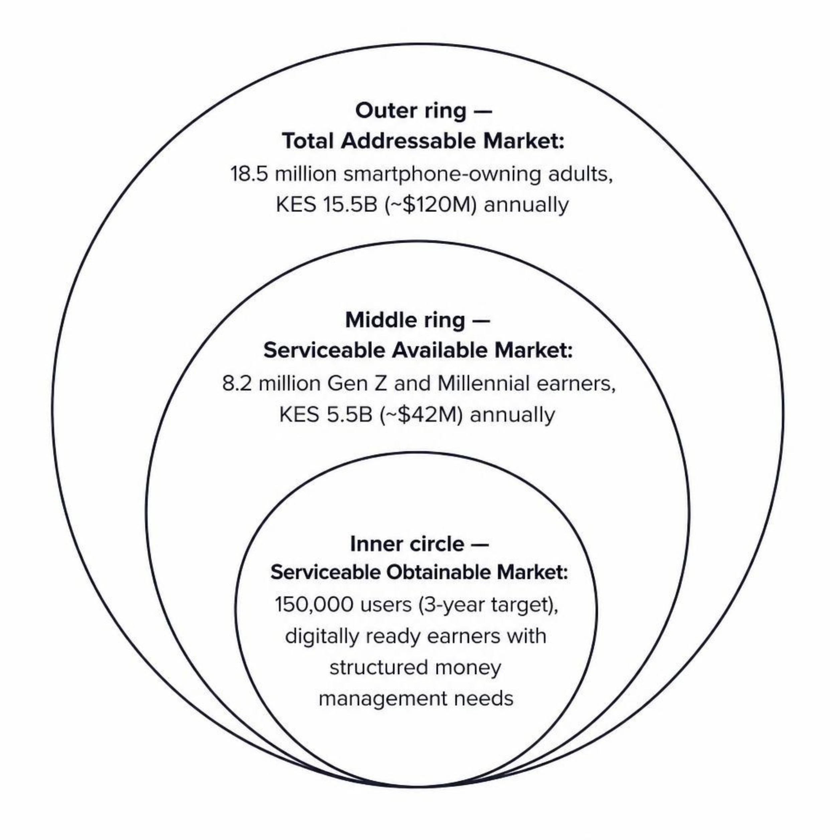
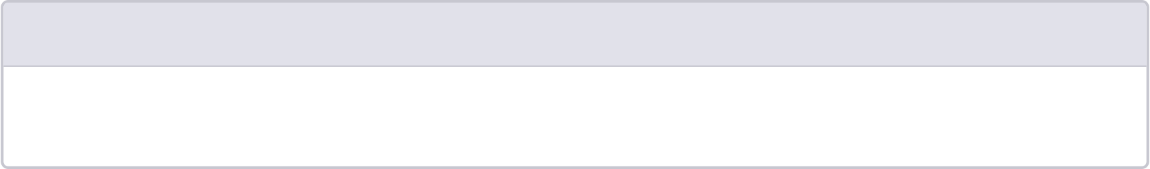
The Engine of Kenya's Digital Economy
1
TAM — 18.5M Adults
Smartphone-owning Kenyans on mobile money; ~KES 15.5B (~$120M) annually.
2
SAM — 8.2M Earners
Gen Z, Millennials, and informal earners needing better budgeting tools; ~KES 5.5B (~$42M) annually.
3
SOM — 150,000 Users
3-year target: digitally ready earners with structured money management needs.
Figures are directional estimates pending pilot validation.

Slide 23





The Team Behind Financial Hub
Victor Mutua — Team Leader, Innovator
Simon Njoroge — IT & Software Lead
Dr. Emmy Kisang — Financial & Business Lead Advisor
Darius Mwakireti — Media, Graphics Design & Technical
Vision & leadership
Technical architecture
Financial expertise
Brand identity, UX, and communications
David Juma Awino — IT & Software Assistant
Software support and coding oversight

Slide 24

Regulatory Compliance & Risk Management
Financial Infrastructure: Integrates through secure APIs with licensed mobile money, banks & SACCOs. The current build records and orchestrates; it does not move money
Custody & Funds Risk: Financial Hub does not hold customer funds; it securely automates authorized allocations across users' existing regulated financial accounts, with a complete double-entry-style transaction ledger as the source of truth
Privacy by Design: Compliant with Kenya's Data Protection Act 2019 & ODPC. Bank-grade security: row-level database isolation, biometric app lock, rate limiting, and audited access

