Slide 1
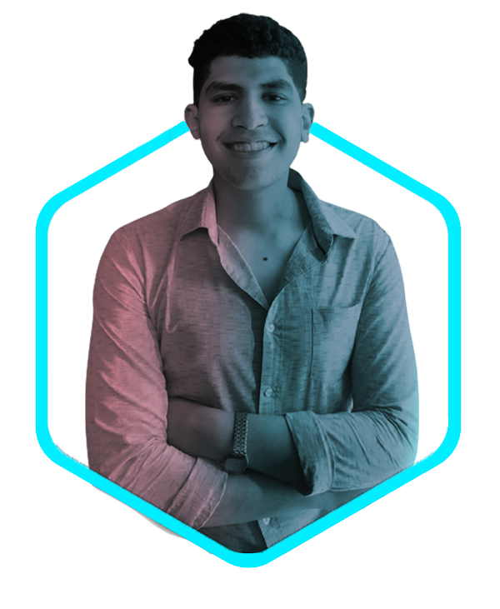
HELLO…
MY NAME IS
Ahmed Refat
PROFILE

Slide 2

“I’M A
<FRONTEND
DEVELOPER”>
ABOUT ME

Slide 3

AND
GRAPHIC
DESINGER
EXPERIENCE

Slide 4
HTML
95%
CSS
63%
JAVASCRIPT
53%
JAVA
85%
PROFESSIONAL SKILLS
CCNA
79%

Slide 5
ADOBE PHOTOSHOP
72%
ADOBE PREMIER
66%
ADOBE ILLUSTRATOR
59%
ADOBE LIGHTROOM
85%
PROFESSIONAL SKILLS

Slide 6
WORD
96%
POWEPOINT
86%
EXCEL
72%
PROFESSIONAL SKILLS

Slide 7


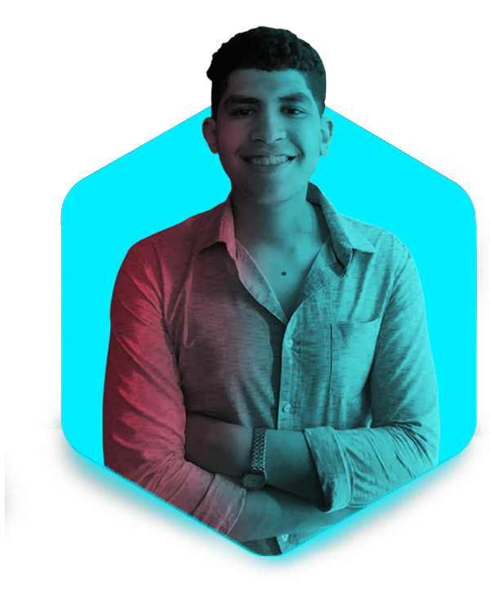



Xē Ãhmèd Rëfât
XE_AHMED
A.XP2121@GMAIL.COM
SOCIAL CONTACT
MY WEBSITE
+20 01141098767

