Slide 1
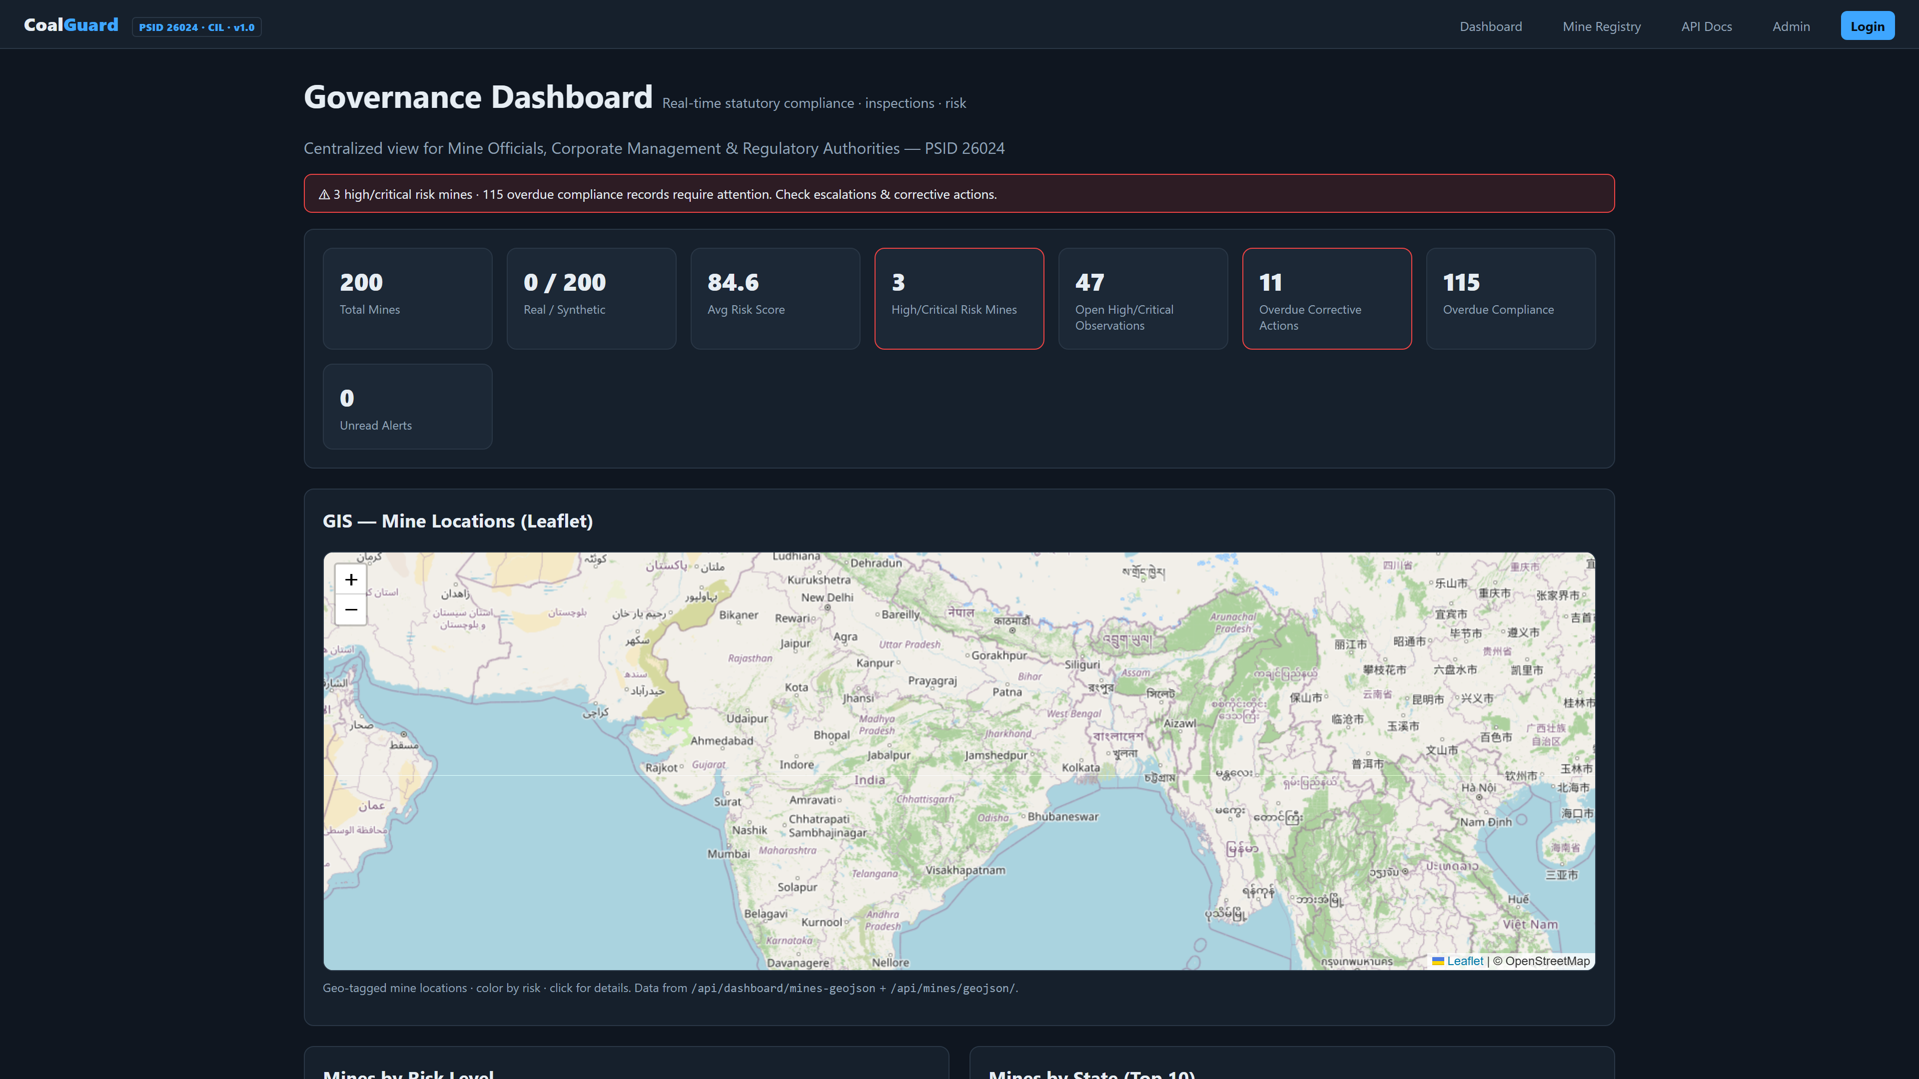
PSID 26024
CG
CoalGuard
LIVE DASHBOARD
Smart Governance for Coal Mines
One Platform.
Every Mine. Every Rule.
Real Time.
459 Mines • 12 States
Ministry of Coal • Coal India Limited • SIH 2026
Live • Real Data
localhost:8001
Built for SIH 2026 • Demo Ready
Notes:
Slide 1 — 2 min: Title. CoalGuard = one platform for every mine/rule/report. Point to live screenshot on right. 30pt forces brevity.

Slide 2
The Problem
Fragmented. Delayed. Opaque.
• Paper & spreadsheets across 37 owners
• Weeks to report. Gaps found only at audit.
• Field work unverifiable.
Scale of Data We Ingested
459 Mines
12 States
52 Districts
Real Kaggle dataset • Geocoded 459 rows
Notes:
Slide 2 — 2 min: Three crisp problems. Scale grounds it in real data. 30pt forces you to talk, not read.

Slide 3
Our Solution
One Ecosystem. Zero Silos.
CoalGuard
Central Platform
Compliance
Inspections
LIVE
LIVE
Corrective Actions
GIS & Dashboards
LIVE
LIVE
Notes:
Slide 3 — 1.5 min: Core platform with 4 pillars. Field → HQ in one place. Keep it visual.

Slide 4
How It Works
1 Field
2 Platform
3 HQ
Geo-tag + Photo
Auto-escalate
Dashboard + Report
→
→
● Verified
● Verified
● Verified
Every report geo-tagged. Hash-audited.
Offline Mobile
Blockchain Audit
client_id sync
SHA256 chain
Notes:
Slide 4 — 1.5 min: 3-step flow. Field → Platform → HQ. Offline + audit are trust anchors.

Slide 5
How We Built It
Django 5.1
Leaflet GIS
Postgres 17 + Redis 7
Chart.js Analytics
Celery Beat
Docker
Hourly Escalations
One-click Run
Local-first. No Cloud Needed.
Notes:
Slide 5 — 1.5 min: Boring-tech for reliability. Local-first, dual-stack, one-click.

Slide 6
PS Coverage
8 / 8 Requirements — Live
✓
✓
✓
✓
Compliance
Inspections
AI Risk
Geo-tagged
✓
✓
✓
✓
Dashboards
Alerts
Paperless
Scalable
All features verified in code & live app.
Notes:
Slide 6 — 1 min: Prove 100% coverage. Every check is code + live, not future plan.

Slide 7
Live Demo — Dashboard
Real Screenshot • localhost:8001/
KPIs • GIS Map • Charts — All Live Data
Notes:
Slide 7 — 3 min: LIVE. Show KPIs, map colors, charts. Switch to browser if possible.

Slide 8
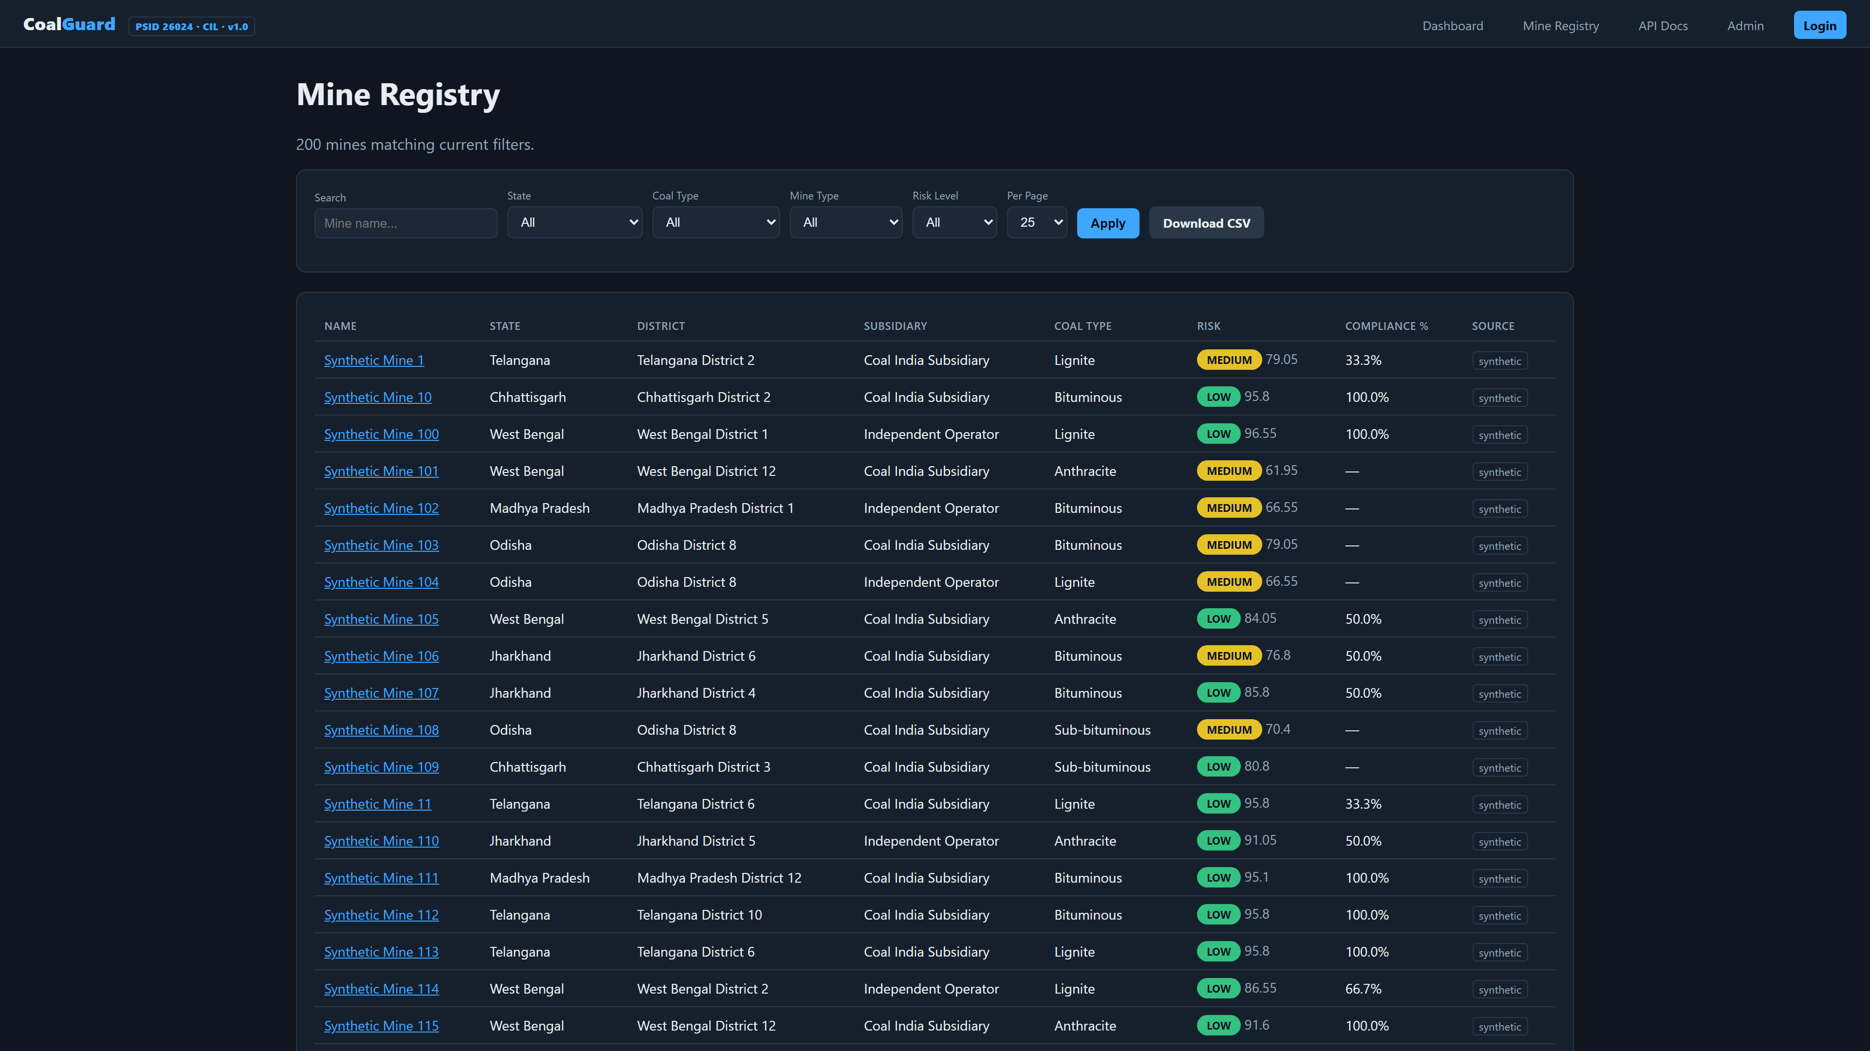
Live Demo — Mine Registry
Real Screenshot • /mines/
Search • Filter • Risk Badge • CSV Export
Notes:
Slide 8 — 1.5 min: Registry drill-down. Filters, risk badge, Real/Synthetic tag. Click to detail.

Slide 9
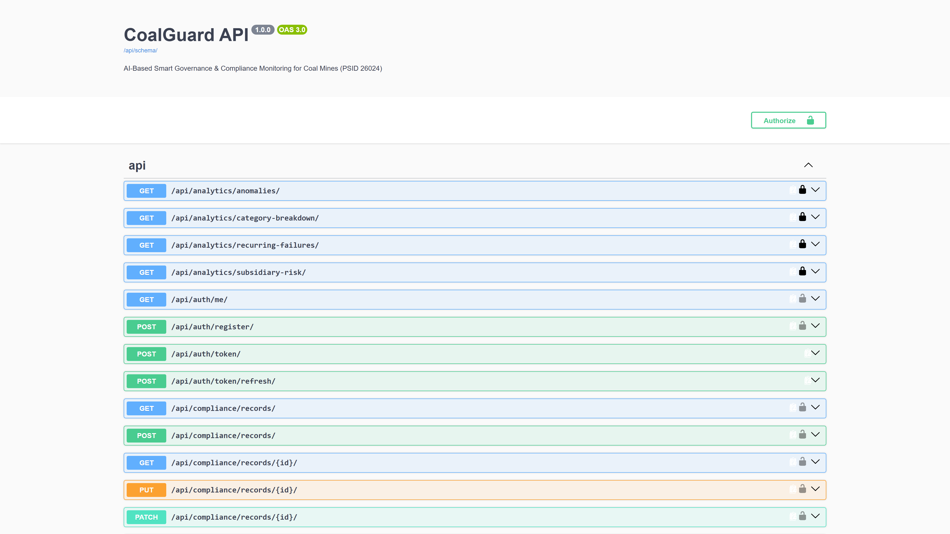
AI Engine + API
Risk Score
Swagger • /api/docs/
safety × 0.35
+ compliance × 0.30
+ contractor × 0.15 + incident × 0.20
LOW • MEDIUM • HIGH • CRITICAL
Explainable. Auditable. Live.
458 scored • Avg 84.4 • 6 High flagged
Notes:
Slide 9 — 2 min: AI is transparent weighted sum, not black box. Show Swagger live on right.

Slide 10
Impact & Next
Real-time
Paperless
Auditable
Not weeks
OCR + PDF
SHA256 chain
Run Now — One Click
start_coalguard.bat
localhost:8001 • Demo logins ready
Ready to Deploy. Thank You.
Notes:
Slide 10 — 2 min: Impact + run + ask. Keep it to 30pt, talk the rest.

