Slide 1
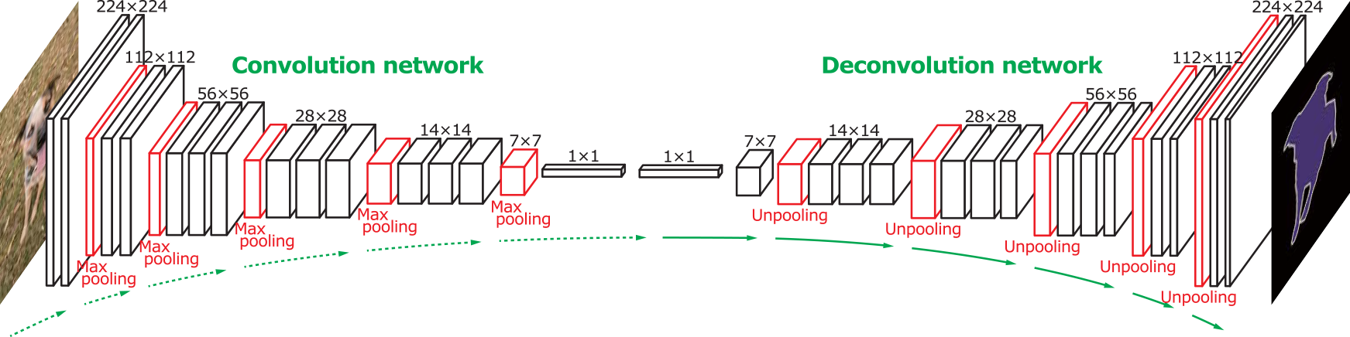
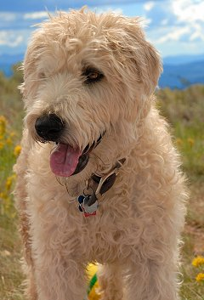
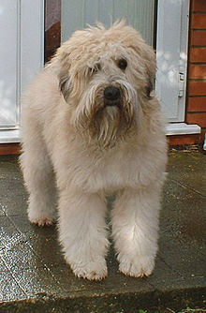
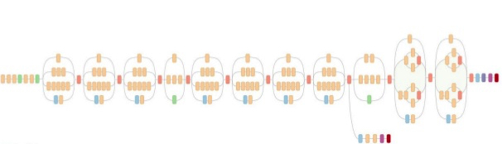
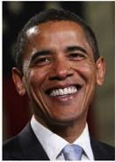
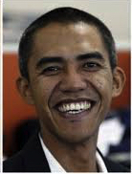


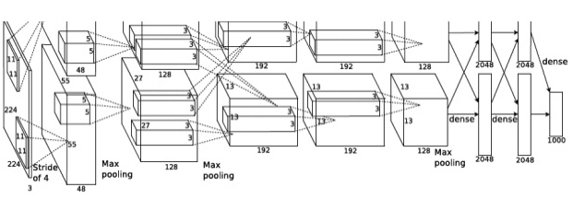
High-Level Diagrammatic Abstract
Pre-Processing
Down-Sizing
object detection
Fusion Layer
Reduction Layer
Similarity Detection
object extraction
object
edge extraction
Fusion of Unsupervised Feature Maps For within-category similarity detection

