Slide 1
Health Manager IES 2022/2023
Project by:
Alexandre Gazur (102751)
Daniel Ferreira (102885)
Ricardo Pinto (102885)

Slide 2
Topics and goals
Manage patients in a hospital/clinic easily
View patient's details in real time
Add, edit, remove patients easily
Quickly view the patients that are the most in need of help
2

Slide 3
Team organization
Team Manager & Product Owner: Alexandre Gazur
Architect: Daniel Ferreira
DevOps Master: Ricardo Pinto
We are all Developers
3

Slide 4
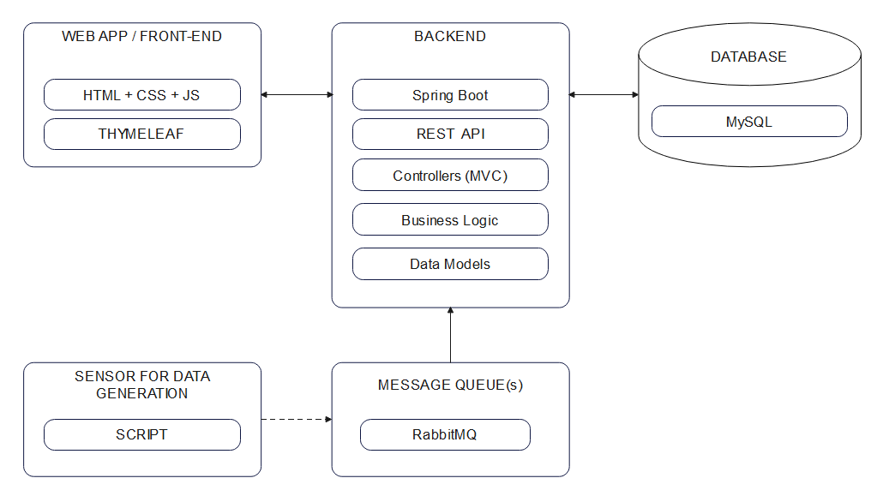
Solution architecture
4

Slide 5
Development
Iteration 1: Core user stories, front-end prototype, a little backend
Iteration 2: Pipeline and data viewing on front-end, some API, 1 graph
Iteration 3: API, endangered patient alert, more graphs, dockerization
Iteration 4: polish everything, finish documentation, deployment in UA's VM
Github flow (branches and pull requests)
5

Slide 6
Dockerization
4 containers:
MySql database
RabbitMQ
Spring Boot app
Sensor (python script)
6

Slide 7
Main results
Decently robust API
Graphs for easy and quick visualization of data
A patient model we're happy with
App calculates patient health status accurately and automatically
Immediate alert when a patient is found to be in critical state
Intuitive patients management (add, edit, remove) and clean patient characteristics display
7

