Slide 1
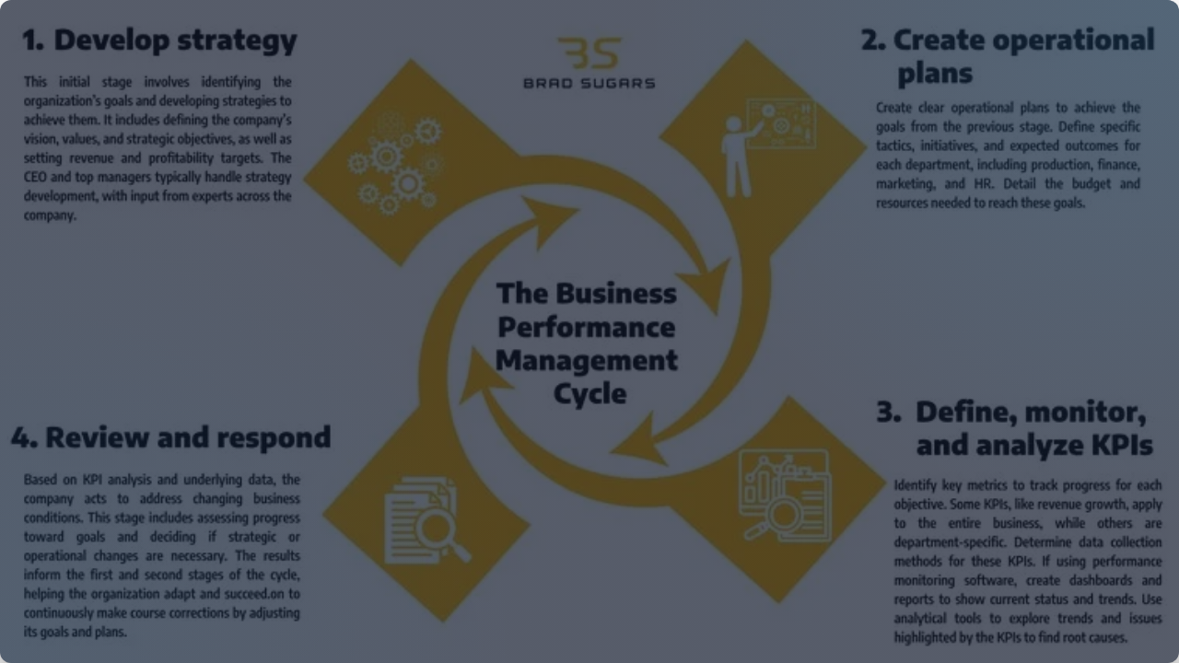

Strategic Software Delivery
Evaluating Agile vs. Waterfall for Future Development SNHU Travel Project Retrospective

Slide 2










The Agile Scrum Team: Core Roles
Product Owner
Scrum Master
Developers & Testers
Acts as the voice of the customer and stakeholders. They are responsible for maximizing business value by strictly prioritizing the Product Backlog and ensuring the team builds what the market actually needs (Atlassian, 2024).
Facilitates the Scrum framework and protects the team. They coach the team on Agile methodologies, host daily events, and actively remove external roadblocks so developers can focus (PMI, 2023).
A self-organizing, cross-functional group that executes the sprint. They collaborate daily to design, code, and test software, delivering functional, high-quality increments at the end of every cycle.

Slide 3


The Agile SDLC: Iterative Phases
Backlog Creation: Requirements are captured as manageable "user stories" rather than a massive technical document.
Sprint Planning: The team pulls high-priority stories from the backlog and commits to a 1-4 week timeframe to build them.
Sprint Execution: Developers and Testers work simultaneously. Daily Scrums keep everyone aligned and identify instant bottlenecks.
Review & Retrospective: Working software is demonstrated to stakeholders for immediate feedback, and the team analyzes their internal processes to improve the next sprint (Microsoft, 2023).

Slide 4

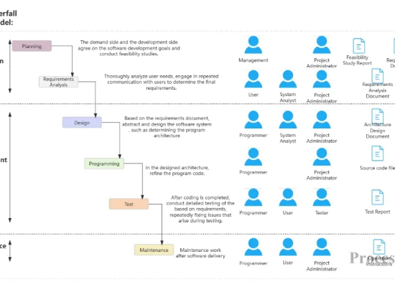
The Waterfall Alternative
Sequential Rigidity: Waterfall flows strictly downward: Requirements → Design → Implementation → Testing → Deployment. You cannot move forward until the previous phase is 100% complete.
Impact on SNHU Travel: If we used Waterfall, the "Top Destinations" feature would have required complete upfront design.
The Cost of Change: When the focus group requested changes mid-project, Waterfall would have required rewriting foundational design documents, causing severe timeline delays and massive sunk engineering costs (IBM, 2024).

Slide 5

Choosing the Right Approach
When to use Agile
When to use Waterfall
Projects with dynamic, evolving requirements.
Projects with extremely predictable, static requirements.
When rapid stakeholder feedback is critical to success.
Strictly regulated industries (e.g., medical devices, aerospace) where exhaustive compliance documentation is required before coding begins.
Our Experience: SNHU Travel thrived on Agile because consumer application trends shift rapidly. Agile allowed us to pivot our features mid-sprint based on focus group feedback without derailing the launch (PMI, 2023).
When the client knows exactly what they want upfront and will not deviate (IBM, 2024).

Slide 6
References
Atlassian. (2024). The ultimate guide to Agile project management. Atlassian. https://www.atlassian.com/agile/project-management
IBM. (2024). What is Agile methodology? IBM. https://www.ibm.com/topics/agile-methodology
Microsoft. (2023). What is Agile? Microsoft Azure. https://azure.microsoft.com/en-us/resources/cloud-computing-dictionary/what-is-agile/
Project Management Institute. (2023). Agile practice guide (2nd ed.). Project Management Institute.

Slide 7



Image Sources
https://img.freepik.com/free-vector/devops-team-abstract-concept-vector-illustration-software-development-team-member-agile-workflow-devops-team-model-it-teamwork-project-management-integrated-practice-abstract-metaphor_335657-2299.jpg?t=st=1777308418~exp=1777312018~hmac=70726216b2bb4cbdb8b2a8b45ba973241293db9d1bfa629c45d7ffb528998819
Source: www.magnific.com
https://cdn.processon.io/admin/knowledge/article_content_img/6791de9abcb4581cedd10afd.png
Source: www.processon.io
https://bradsugars.com/wp-content/uploads/2024/10/The-Business-Performance-Management-Cycle.webp
Source: bradsugars.com

