Slide 1

FNTC_Index
Structure FNTC-TA
GeneralInfo
ResourceList
ResourceName
IndexList
FileList
FileName
Archive
Document
Tail

Slide 2
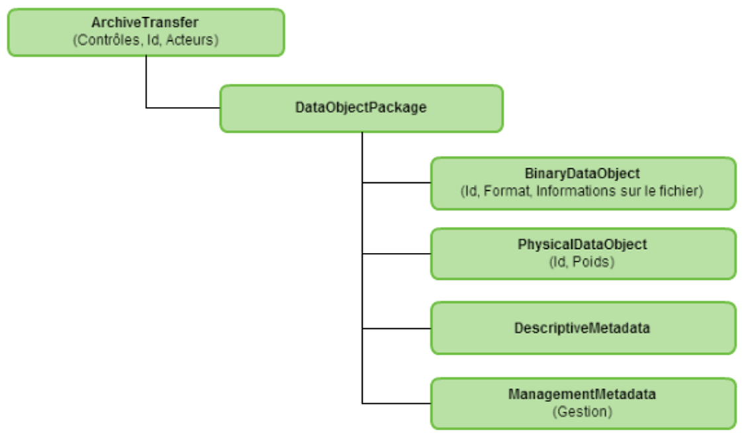
Structure MEDONA

Slide 3
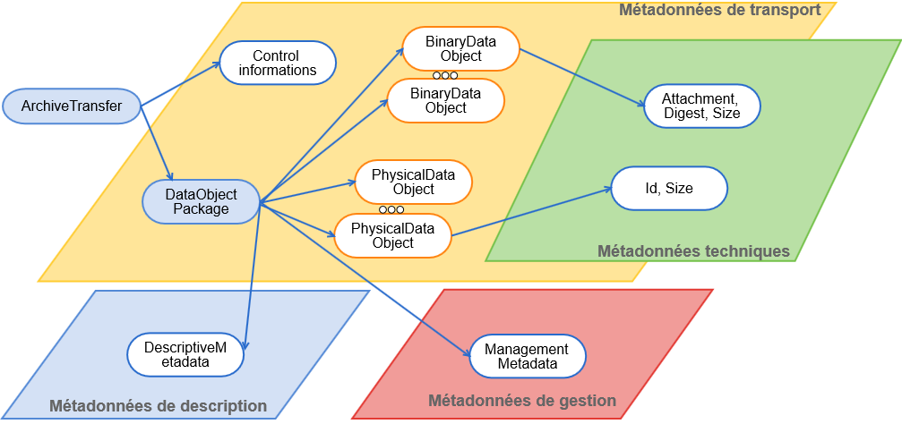
Structure MEDONA

Slide 4
Mapping FNTC-TA / MEDONA
FNTC_Index
GeneralInfo
ArchiveTransfer
ResourceList
DataObjectPackage
ResourceName
BinaryDataObjectPackage
IndexList
PhysicalDataObjectPackage
FileList
DescriptiveMetadata
FileName
ManagementMetadata
Archive
Document
Tail

Slide 5
MEDONA adapté
ArchiveTransfer
DataObjectPackage
BinaryDataObjectPackage
PhysicalDataObjectPackage
DescriptiveMetadata
ArchiveUnit
Management
ManagementMetadata
DataObjectReference
AccessRule
AppraisalRule

