Slide 1

StageMan
Cabrol Alban, Cros Hugues, Majorel Pierre

Slide 2

Index
→ Context
→ Conception
→ Web Application
→ Conclusion

Slide 3

Context
Search an internship
⇒
Hard
complicated
SOLUTION
Stageman

Slide 4
Context
Create a WebSite
Respect functional specifications
Respect technical specifications

Slide 5
Conception
Planning
CDM
Mock-Up

Slide 6
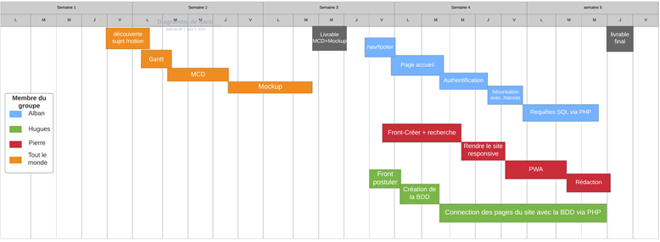
Planning

Slide 7
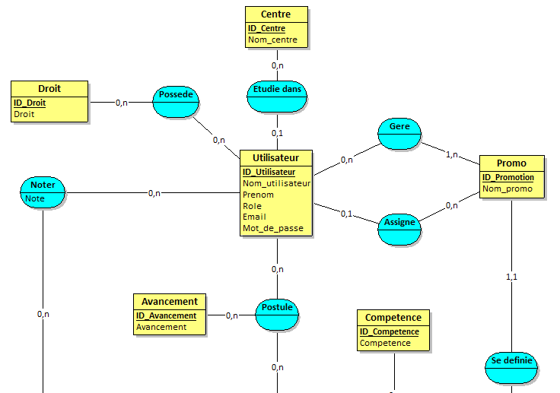
Conceptual Data Model

Slide 8
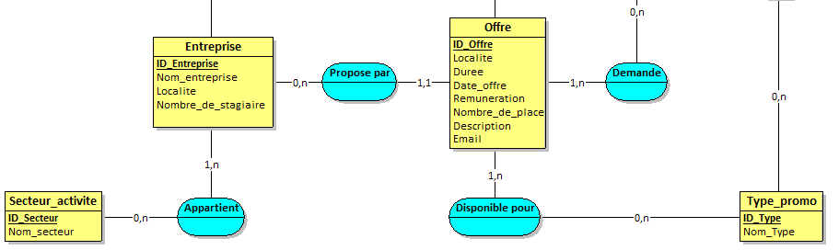
Conceptual Data Model

Slide 9
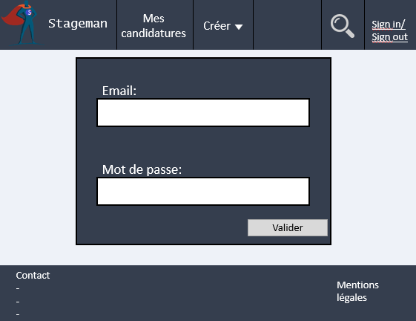
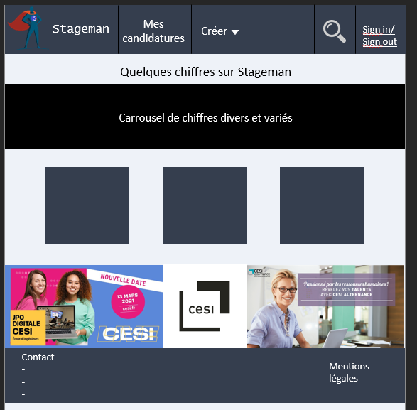
Mock-up

Slide 10
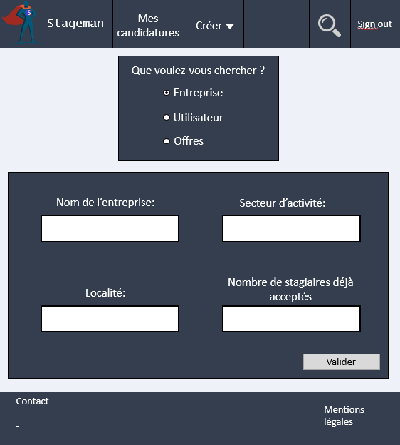
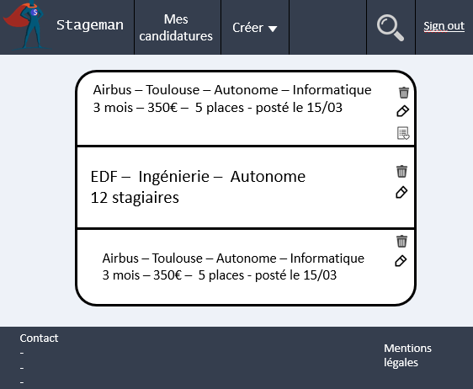
Mock-up

Slide 11
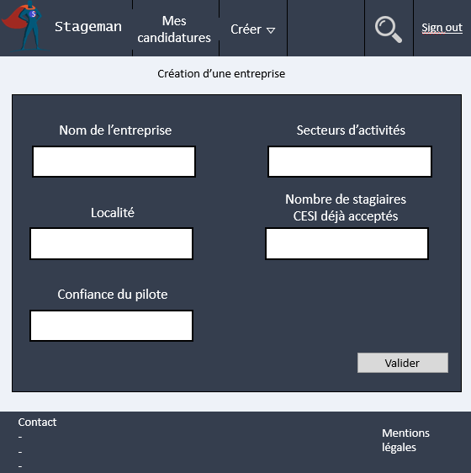
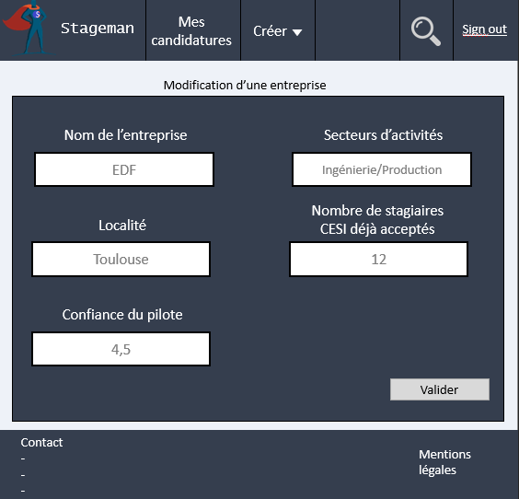
Mock-up

Slide 12
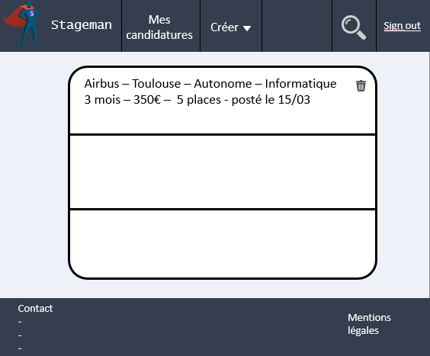
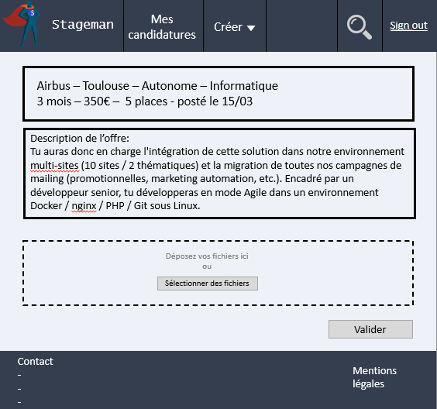
Mock-up

Slide 13
Web Application
Front-end
Back-end
PWA
Security

Slide 14

Front-end
Bootstrap

Slide 15

Back-end
PDO
Smarty

Slide 16
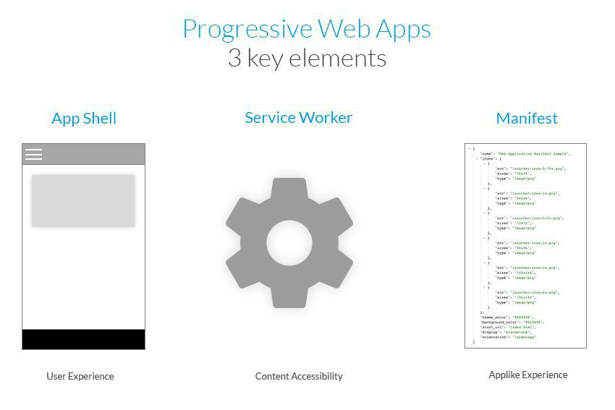
PWA

Slide 17


Security
.htaccess
1 Vhost

Slide 18
Conclusion

Slide 19
Demonstration

