Slide 1

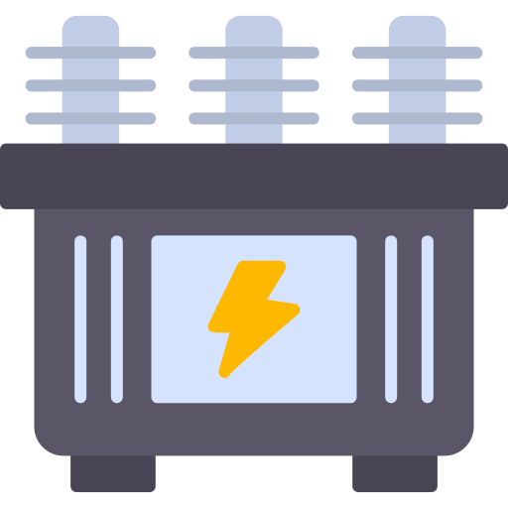

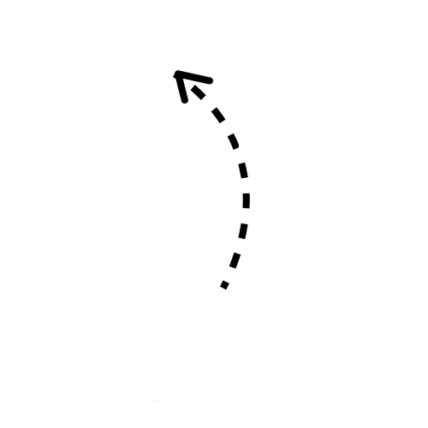

Utility Control Center
CLOUD
Substation 1
Substation 2
FOG
EDGE
Smart Meter 1
Smart Meter 2
Smart Meter 3
Smart Meter 4
PMU 1
PMU 2
PMU 3
PMU 4

