Slide 1

Let the earth breathe weather you like it or not
XTREME_Leander Allan M. Mendoza IT BA-3206

Slide 2
Timeline
DATA VISUALIZATIONS
INTRODUCTION
OBJECTIVES
SDG
PROBLEM STATEMENT
EXPECTED OUTPUT / SOLUTION

Slide 3

Climate Change is making its presence more impactful. Due to the excessive use of non-renewable energy.
INTRODUCTION

Slide 4



Slide 5
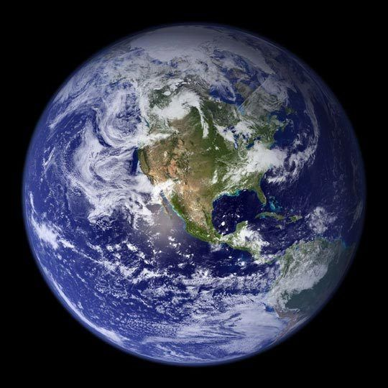
OBJECTIVES
To examine the fossil fuels consumption in the world
To spread awareness on how fossil fuels can affect every aspect of life.

Slide 6
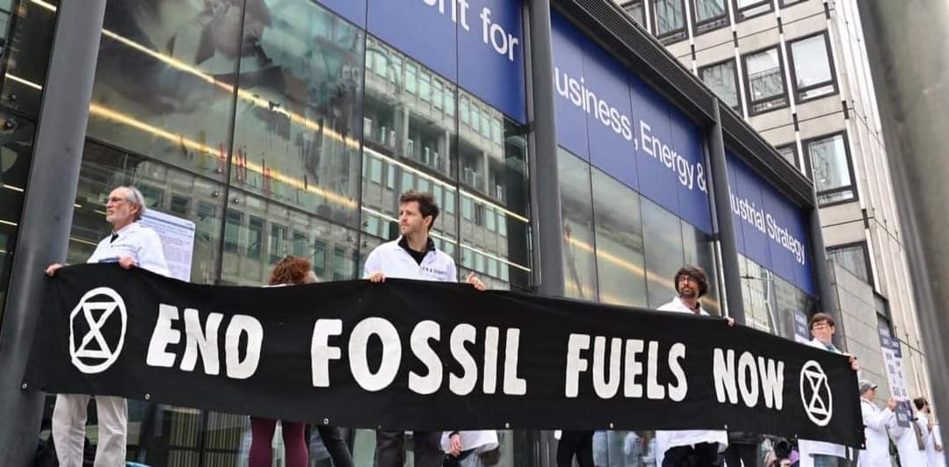
PROBLEM STATEMENT
The earth has 3 to 5 years left before its end due to the continuous use of fossil fuels.

Slide 7
DATA VISUALIZATIONS

Slide 8
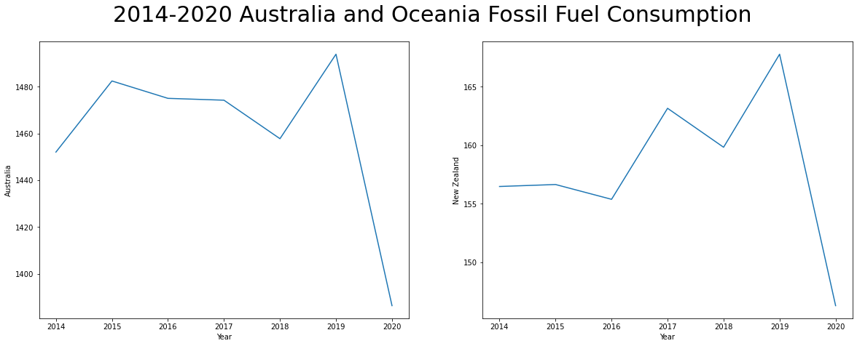

Slide 9
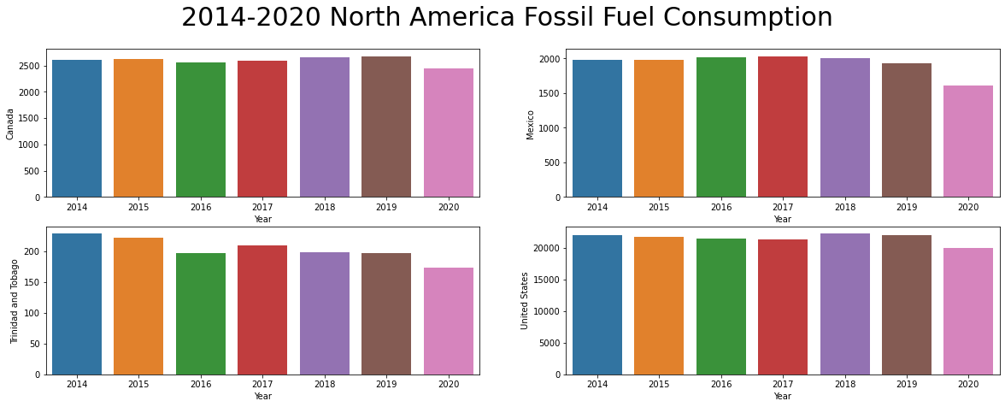

Slide 10
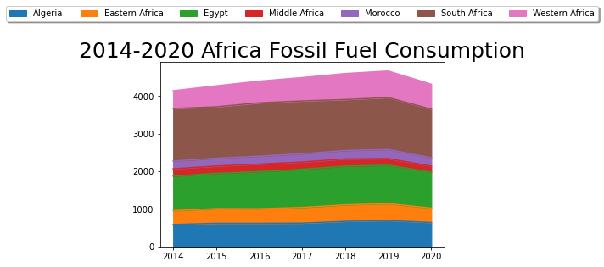

Slide 11
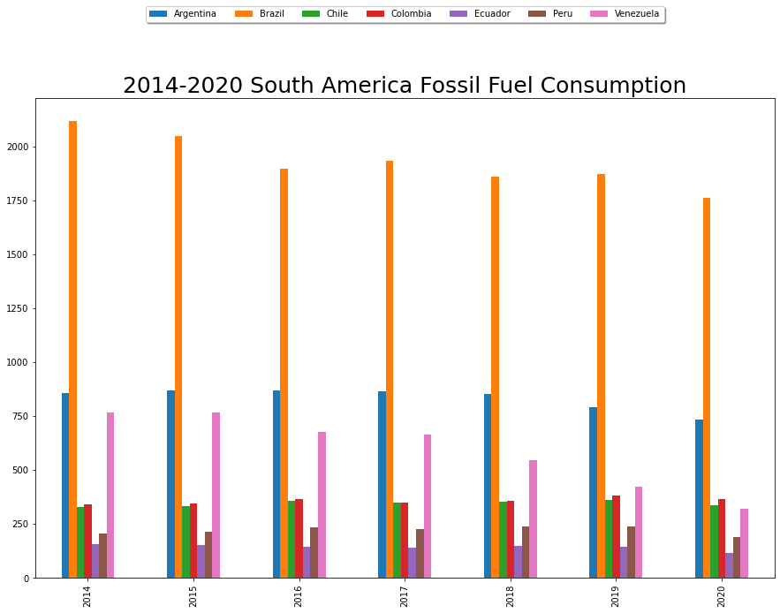

Slide 12
EXPECTED OUTPUT
PARTICIPATE
know
TAKE ACTION

