Slide 1
Hands on with FPGA’s: Module 3
Venkat Rangan

Slide 2
Topics
Pre-class: Open floor for questions
Clocks:
What is a clock?
Why do we need a clock?
Interesting things about clocks
How are clocks used?
Reset
What is a reset
Why do we need a Reset?
Variety of Reset’s
Intro to Verilog/Simulations/Synthesis
Open discussion

Slide 3
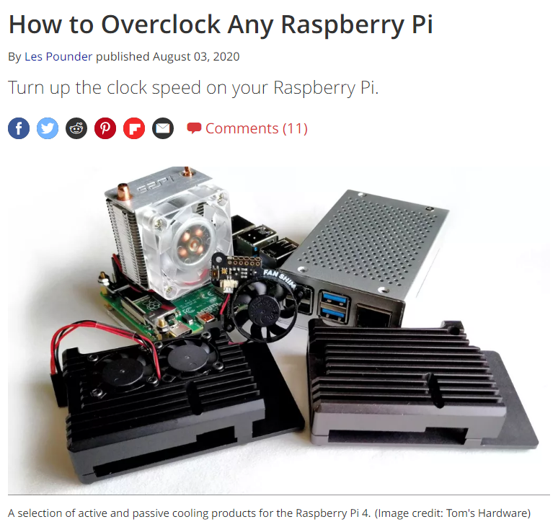
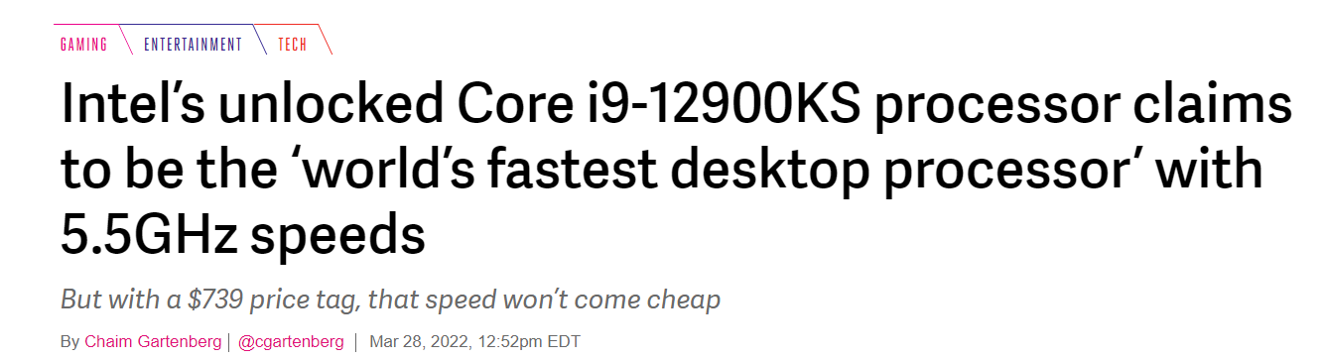
Clocks in Digital Logic circuits
What’s the meaning of it all?
Synchronous vs. Asynchronous design

Slide 4
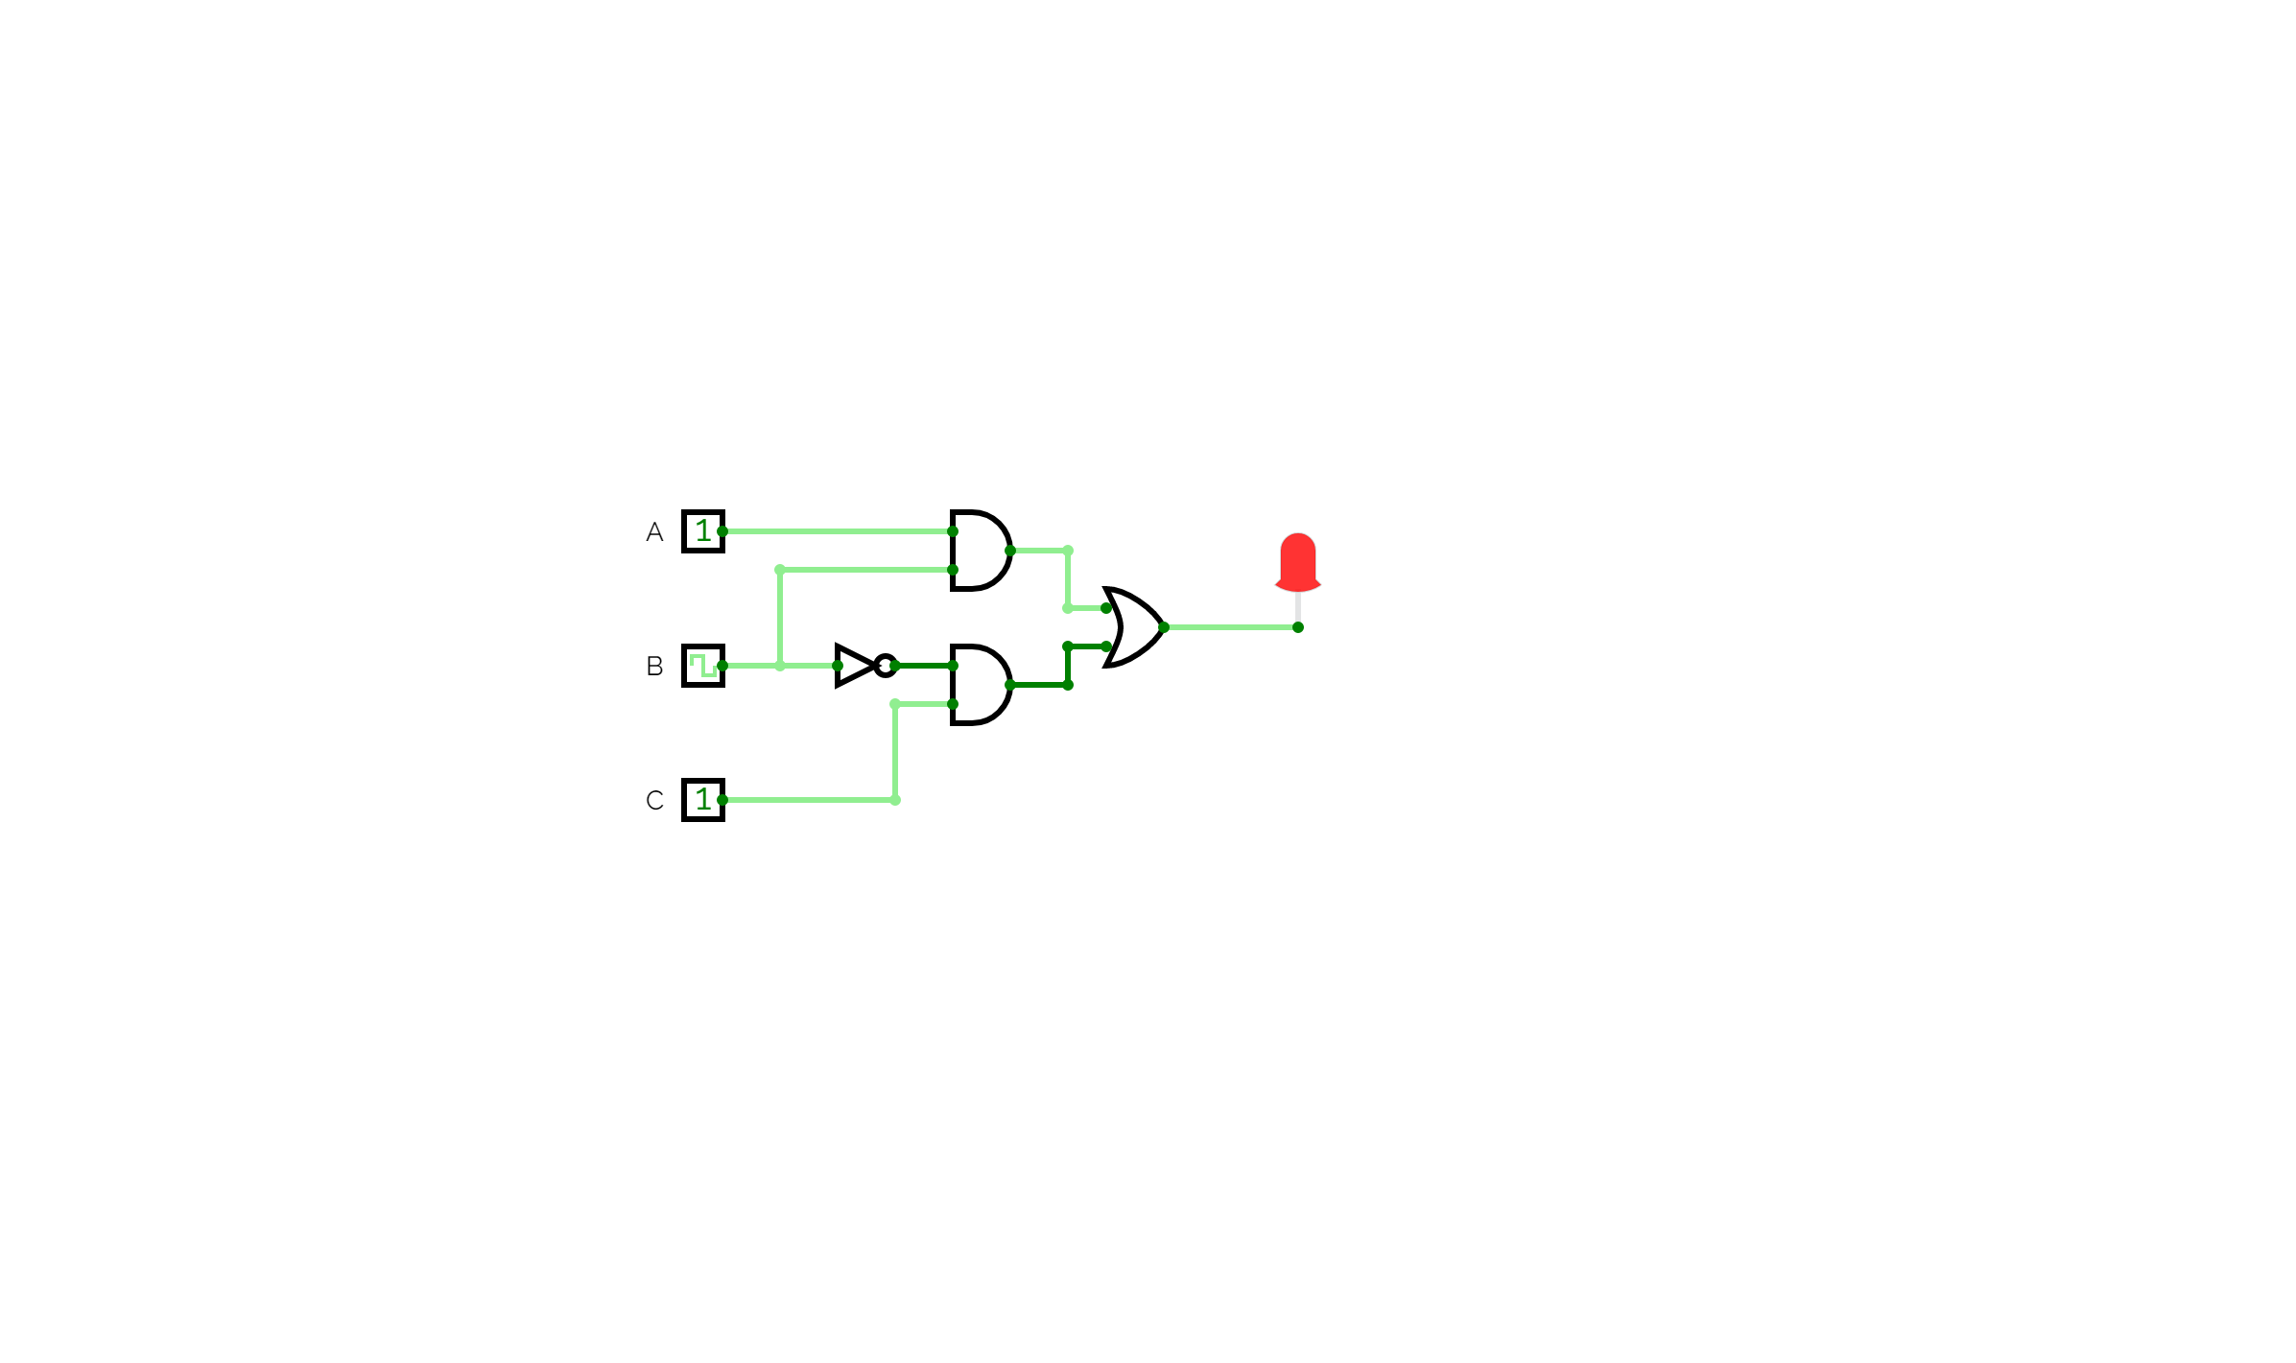
Why clock?
Clocks are one way for circuits to have memory
SR Latch & D Flip Flop (DFF) in Circuitverse
DFF forms the basis of most digital logic
Digital Heartbeat
Synchronization between different parts of a design
Every circuit knows when its time to do something
Glitches

Slide 5
Important properties of a Clock
Frequency
Duty Cycle
Jitter
Setup and Hold
Max frequency of operation
Data
Q
D
Logic
Q
D
Clock
Clock
Data
Setup
Hold

Slide 6
Clocks in Verilog
How does HW actually work?
Everything is running in parallel
All changes happen on the positive edge of a clock
Less commonly also on negative edge or both edges (DDR DRAM)
Between clock edges, signals propagate between registers

Slide 7
Clock Sources
RC Oscillator
Quartz Oscillator
Exotic Sources
Temperature compensated, Oven Controlled
GPS/Atomic Clocks

Slide 8
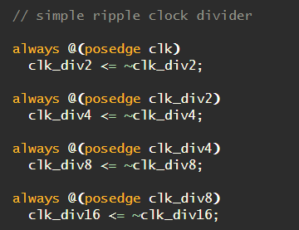
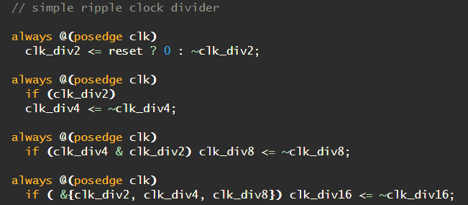
Clocks: Good design practice
Minimize number of clocks in your design
Have a single clock unless absolutely necessary
Poor design vs. Good design practice

Slide 9
Reset
What state does a system start in?
Whats the state of wires at power up?
“x”, “0”, “1” states
Define using an external “Reset”

Slide 10
Verilog Deep Dive
Pages 3-17 of This presentation

Slide 11
Module 3: Clocks and Verilog basics

Slide 12
Open Discussion

