Slide 1
Hands on with FPGA’s: Module 4
Venkat Rangan

Slide 2
Topics
Pre-class: Open floor for questions
Module 3 solutions
Waveforms
State Machines:
What is a State Machine?
Why do we need a State Machine?
Verilog State Machines
Brief overview of upcoming tasks
Open discussion

Slide 3
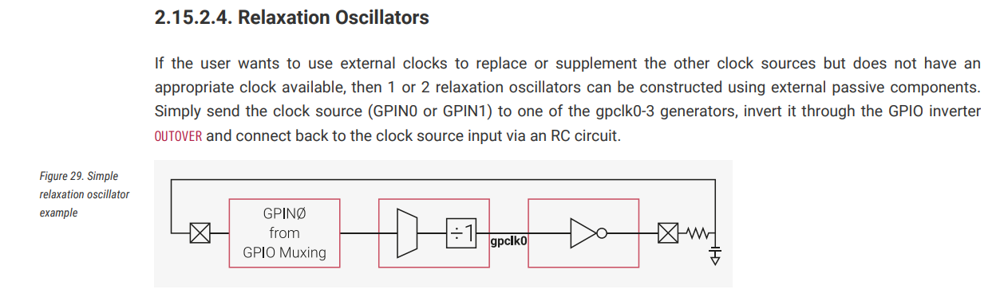
Review of Module 3
Counter problem (Solution)
Oscillator Questions
RP2040 Datasheet Excerpt

Slide 4
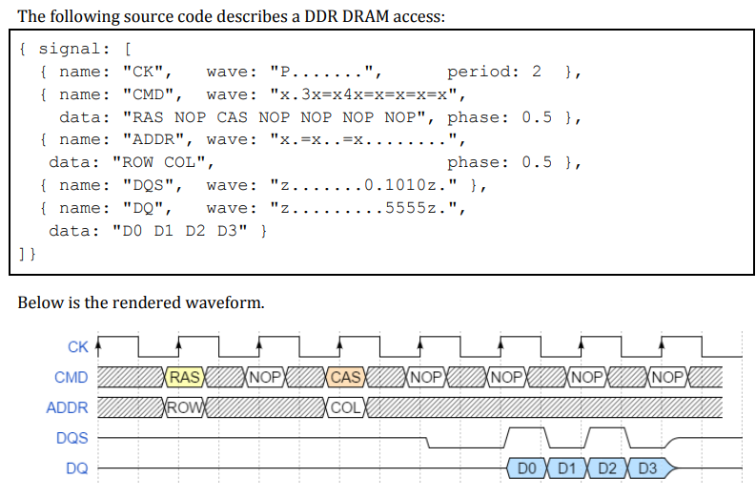
Documentation: Waveforms
Digital circuits are documented using waveforms
Can show interaction of multiple blocks
Good tool to learn: Wavedrom
Text based, open source

Slide 5
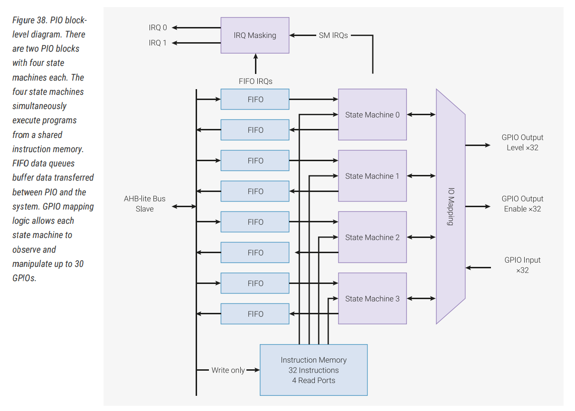
State Machines: Practical uses
RP2040 PIO peripheral

Slide 6
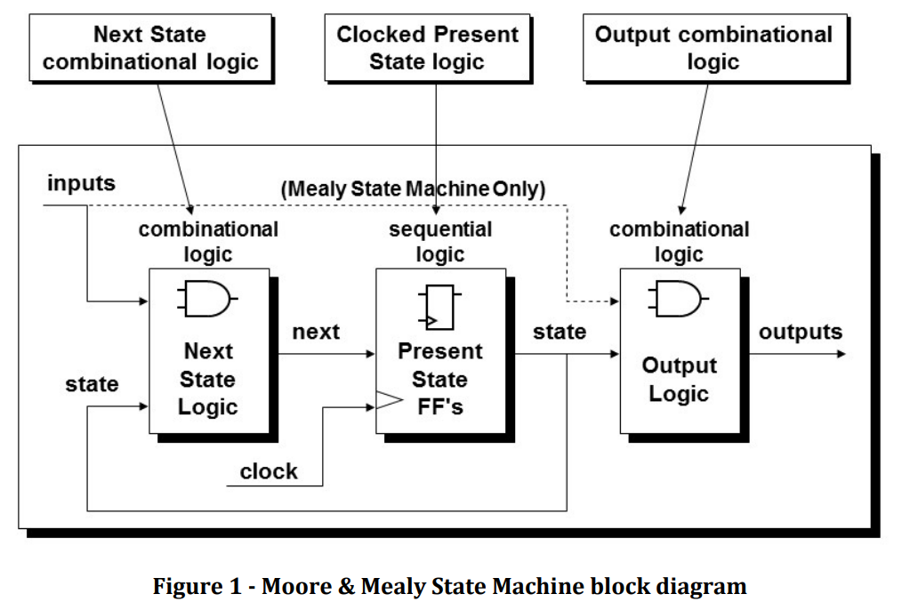
State Machines
SunBurst Design Paper
Moore vs Mealy
Mealy outputs depend on inputs
Moore outputs only depend on current state
Do not use Mealy unless necessary
Usually lowers max clock rate

Slide 7
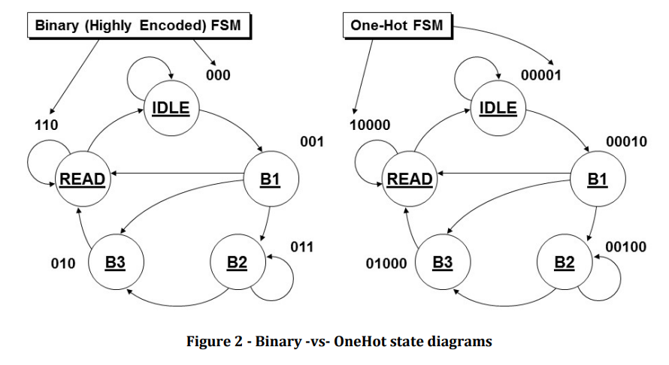
State Encoding
One-hot vs. Binary vs. others
Preference: One-hot for FPGA’s, Binary for ASIC
Other encoding schemes for error resistance/tolerance. E.g. space, military

Slide 8
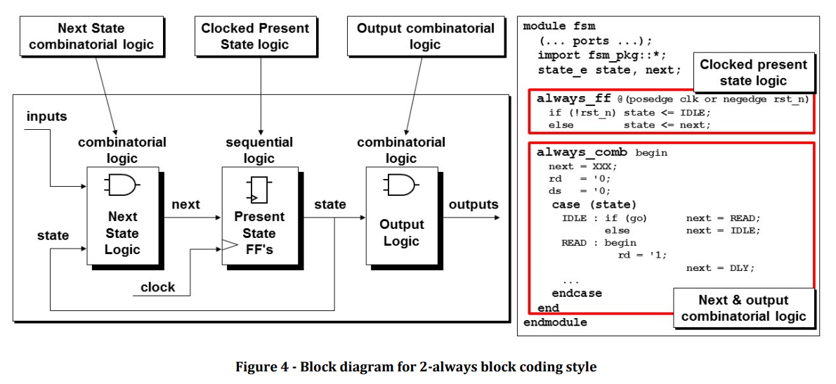
Verilog Coding Style for FSM’s: 2 always blocks

Slide 9
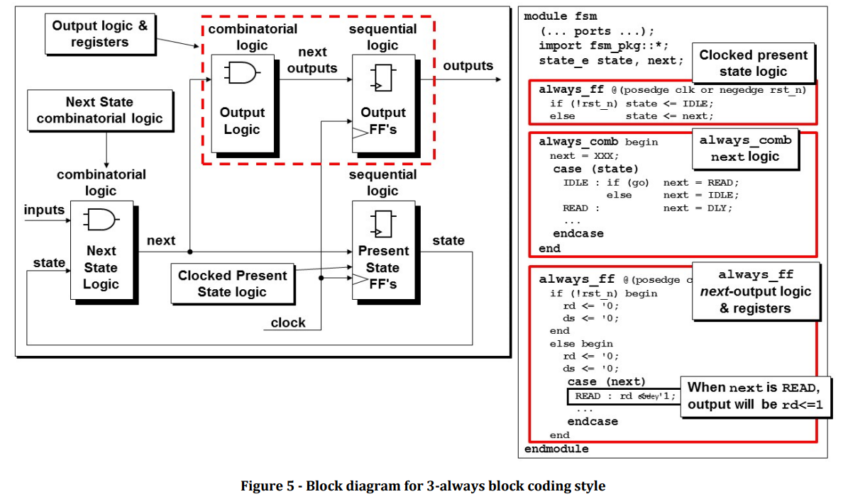
Verilog Coding Style for FSM’s: 3 always blocks

Slide 10
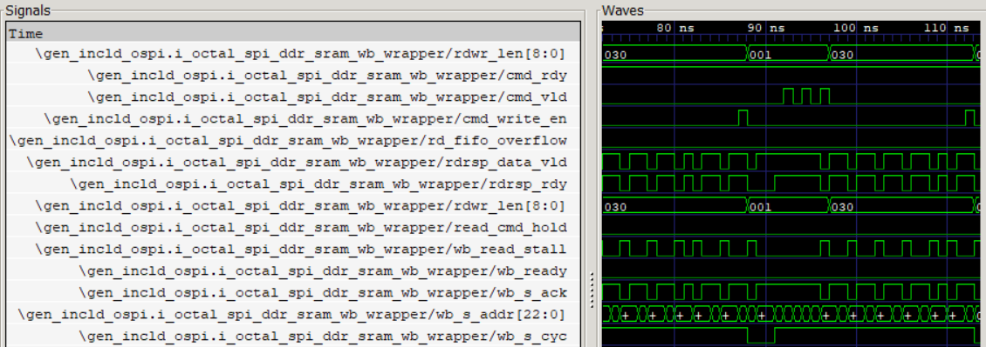
Verilog Deep Dive
EDA Playground
Default FSM Example
No reset!
Poor readability, tough to debug
“Fixed” FSM Example
Added reset
Much more readable
Trap state for unknowns
GTKWave
Open source waveform viewer
Critical tool for HW debug during simulations

Slide 11
Module 4: State Machines
Tasks
Read the Sunburst design paper on state machines
Understand the various coding styles
Try it out!
Challenge
Code up a state machine for a traffic light

Slide 12
Open Discussion

