Slide 1
Hands on with FPGA’s: Module 5
Venkat Rangan

Slide 2
Questions on Module 4
State Machines
Traffic light problem

Slide 3
Topics
Pre-class: Open floor for questions
Module 4
Memories: ROM, RAM
Memory hierarchies
Playing with Memories
Structural vs Behavioral coding styles
Open discussion

Slide 4
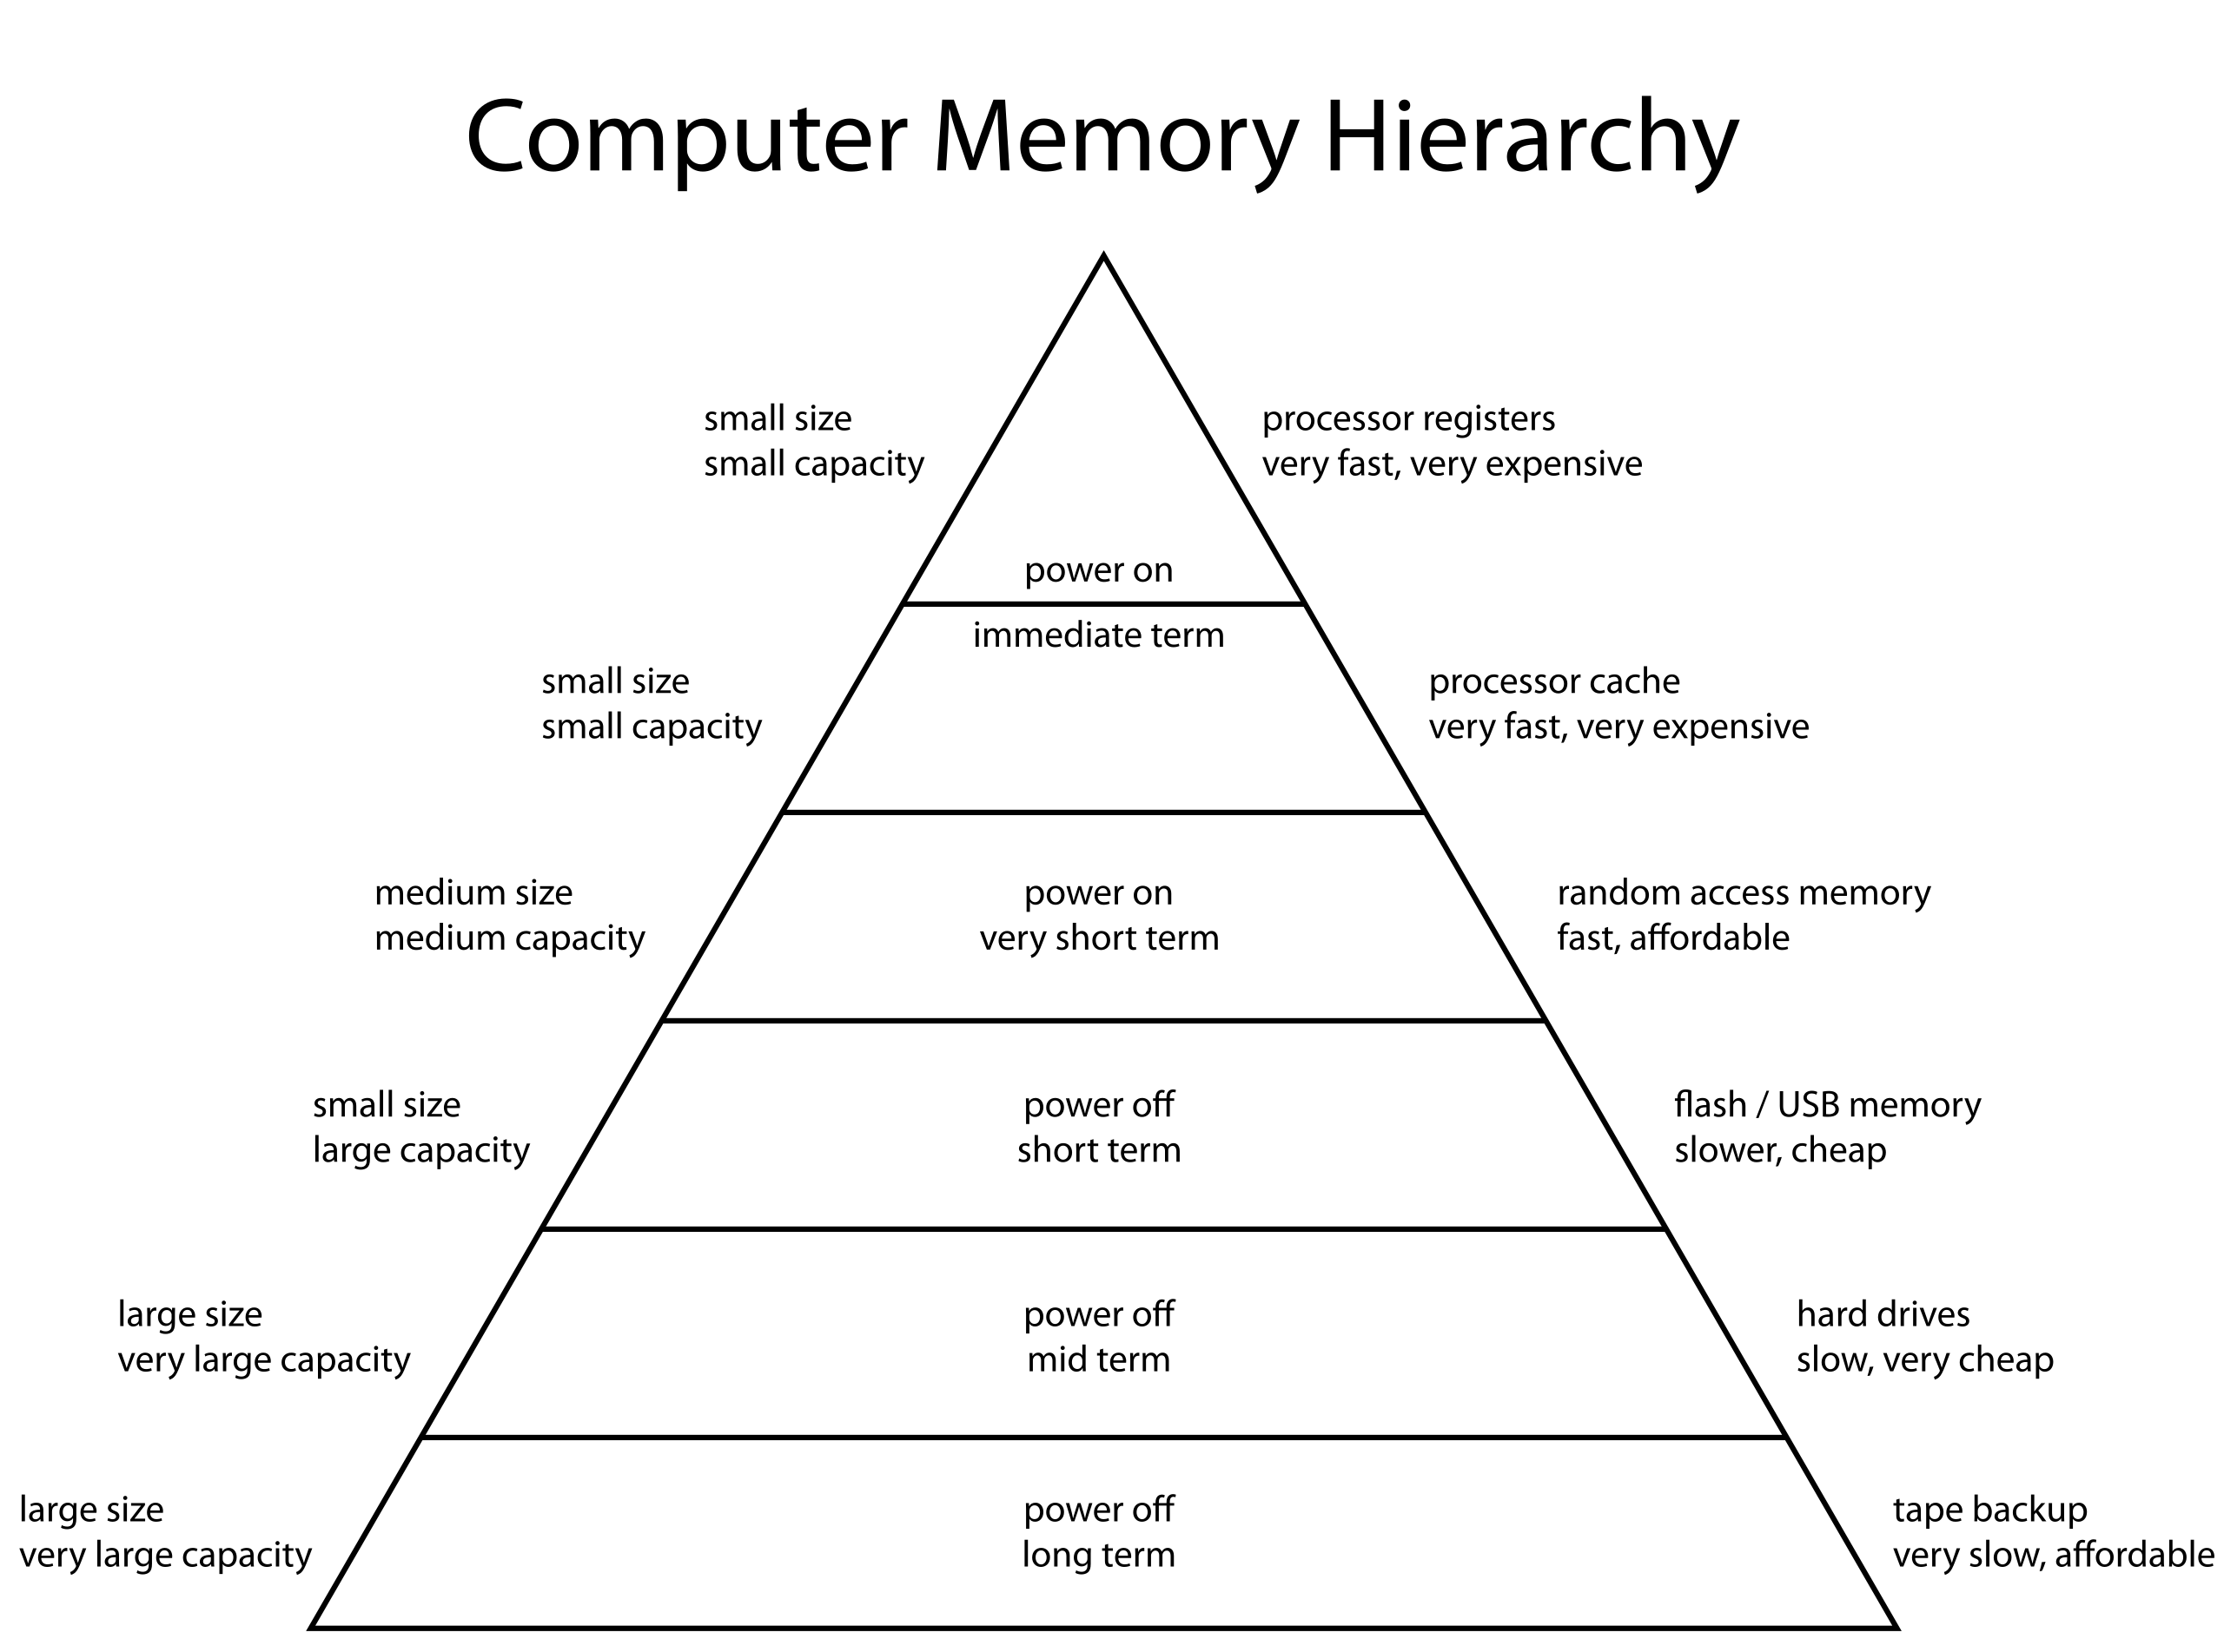
Memory Hierarchy
Non-volatile: ROM
Volatile: RAM
Registers: very fast, small
Compact bank of registers (register arrays)
Found in very few FPGA’s
Look Up Table RAM
Very small, fast RAM
Block RAM
Usually ~10’s of Kb
Large RAM
Usually ~100’s of kB
Off Chip: SRAM/DRAM
Large, slow, high energy (1000x!)
Energy
Size, Cost, Speed
By ComputerMemoryHierarchy.png: User:Danlash at en.wikipedia.org - ComputerMemoryHierarchy.png, Public Domain, https://commons.wikimedia.org/w/index.php?curid=9439275

Slide 5
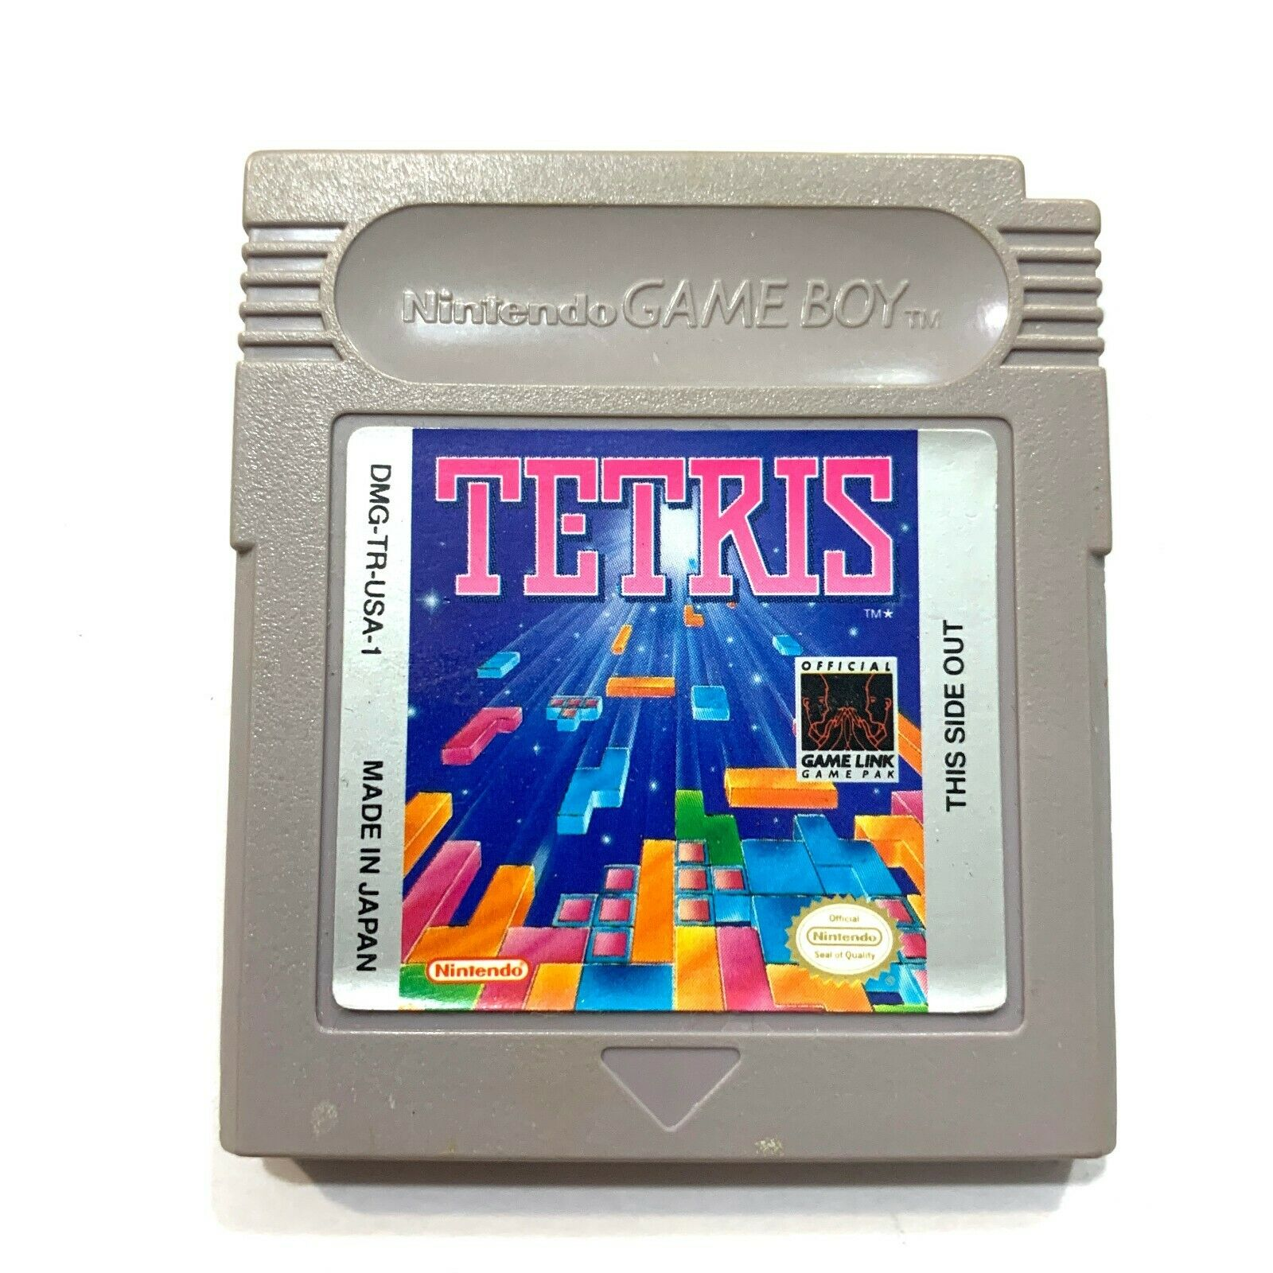
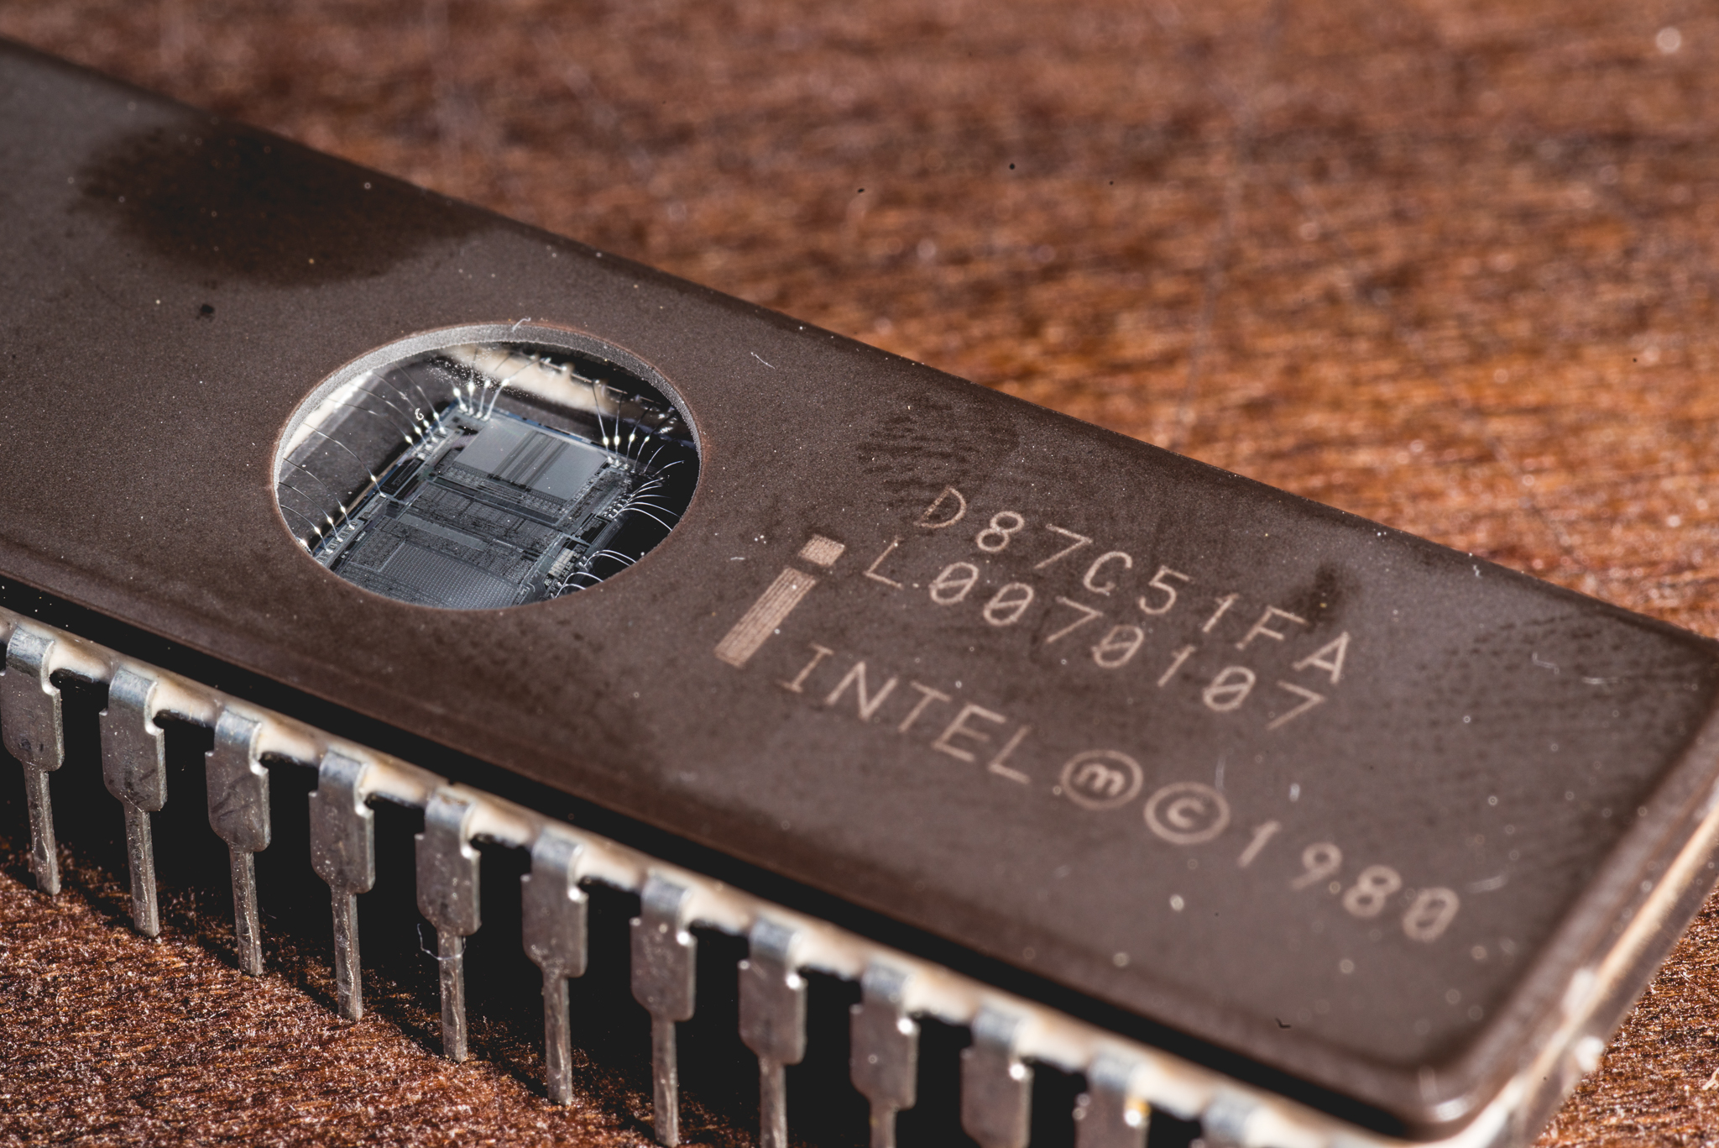
Memories: Read Only Memory
Store programs, data
Can range from a small look up table through a full program
Game cartridges
UV EEPROM

Slide 6
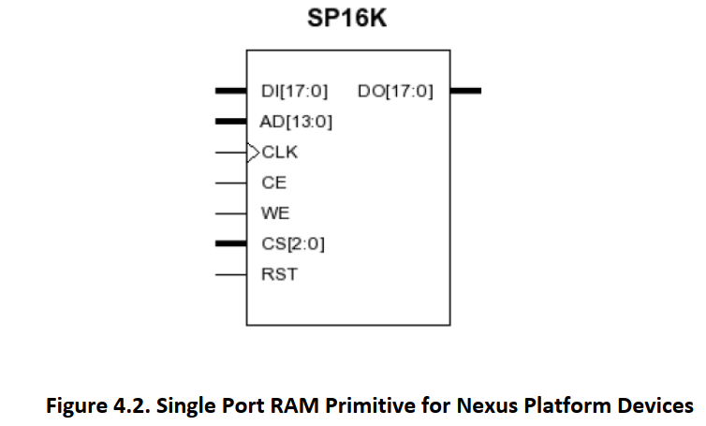
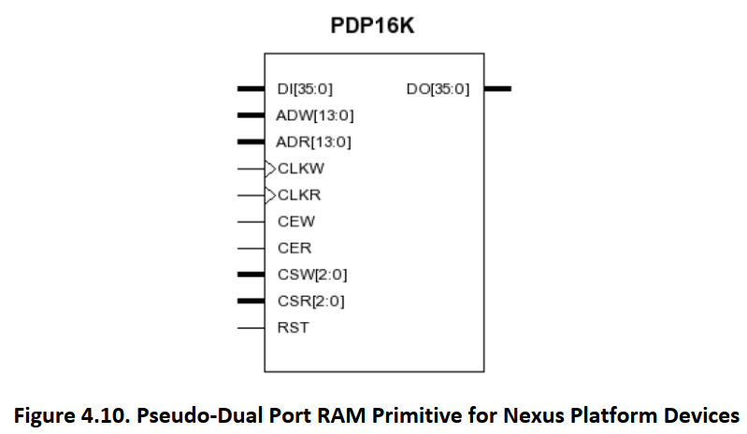
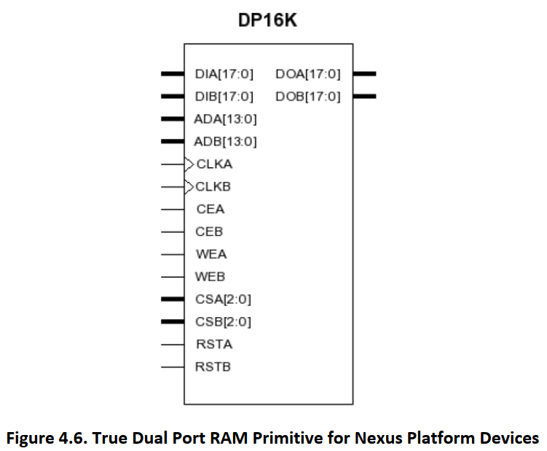
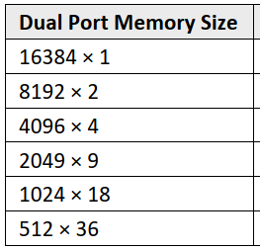
RAM Access
Byte access: more flexibility
Variable access widths
Single Port RAM
Single clock domain
Can do a single write/read per clock cycle
Pseudo Dual Port RAM
Independent read/write ports
Can have independent clock domains
True Dual Port RAM
Each port and read/write independently

Slide 7
Memories in Digital HW: System Level decisions
What kind of memory to use?
How fast?
How much data?
How wide should it be?
How much data to process?

Slide 8
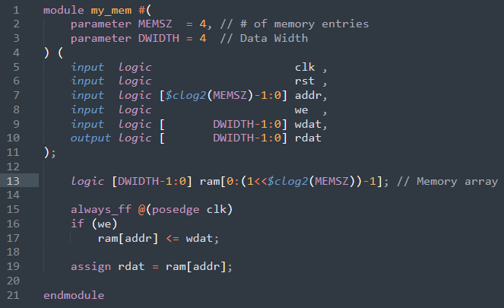
Playing with memories
Lattice Radiant/Synplicity for Synthesis
What happens as we increase memory size?
Experiment # | MEMSZ | DWIDTH | Number and Type of Memory
1 | 4 | 4
2 | 4 | 8
3 | 1024 | 8
4 | 1024 | 32

Slide 9
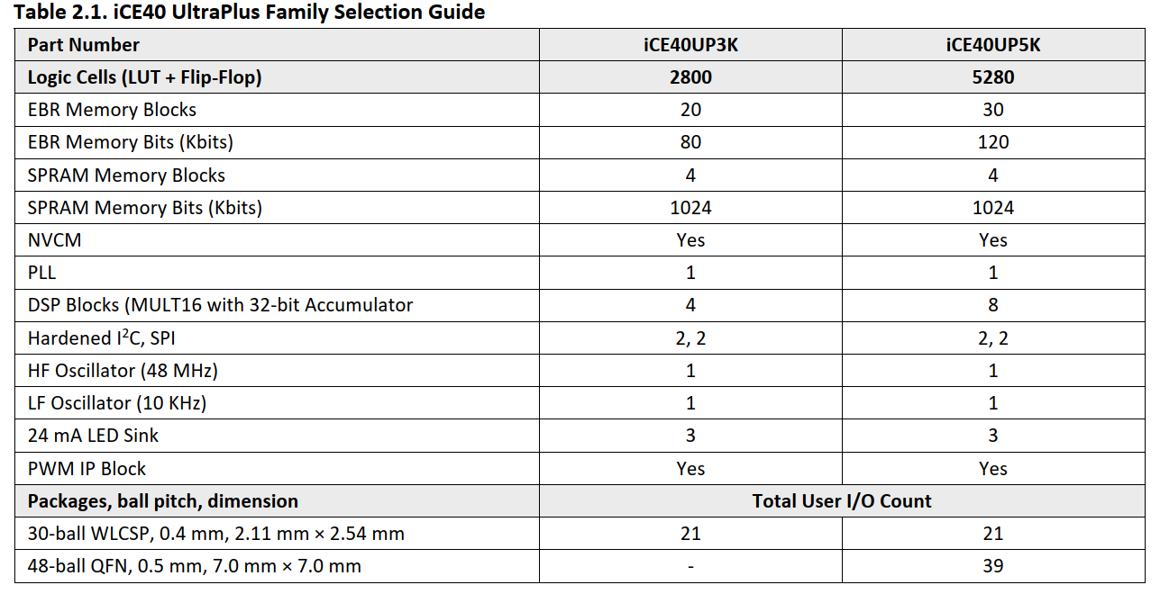
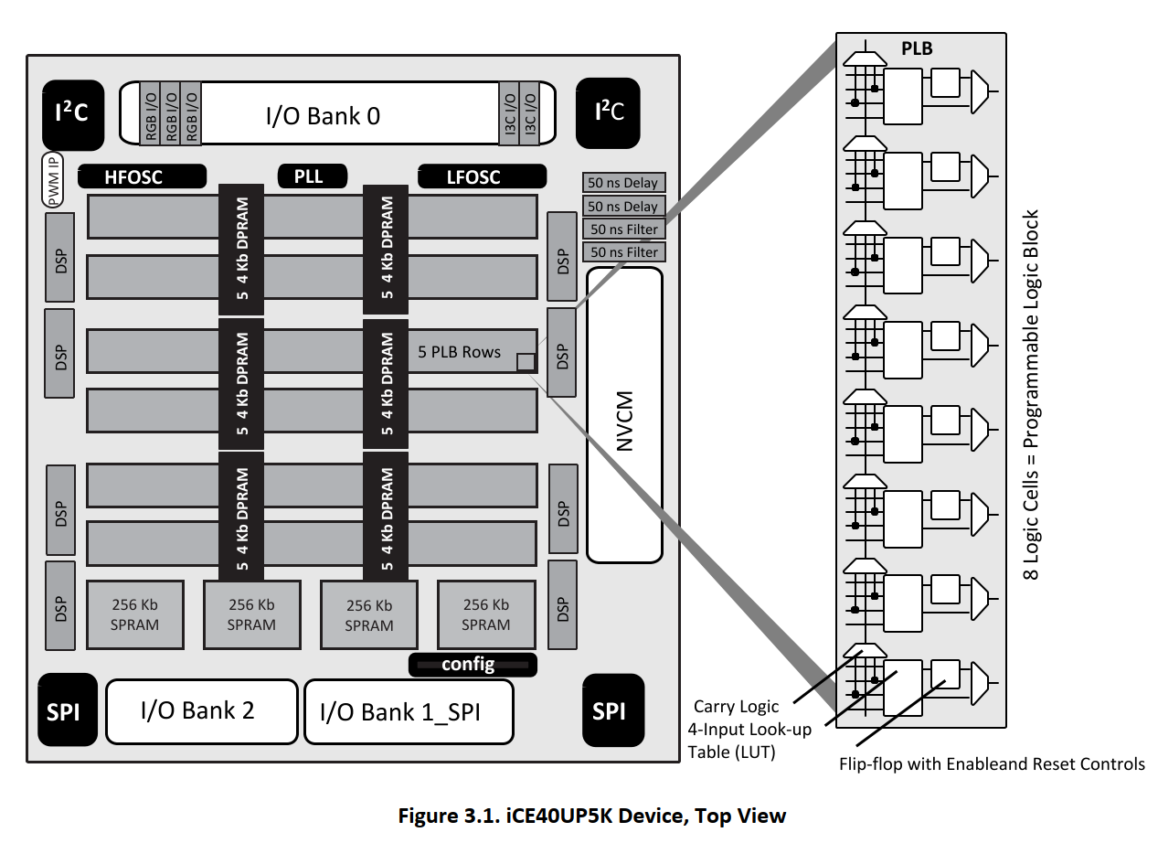
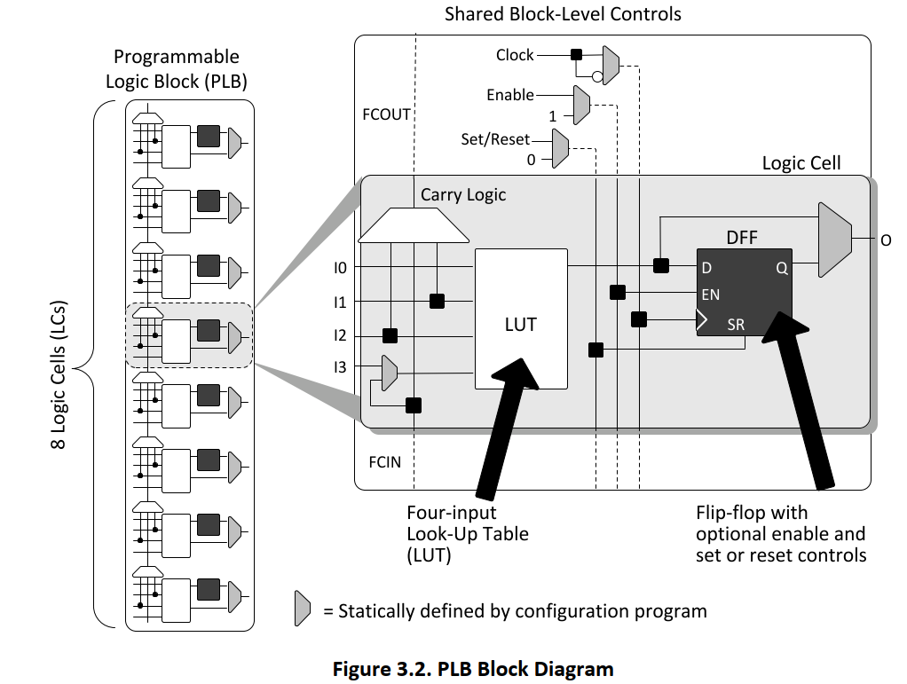
Understanding an FPGA: Lattice iCE40UP)

Slide 10
Coding Style
Structural coding
Specific FPGA features
Found in low level netlists
Excellent for timing
Brittle code
Behavioral code
Easy to understand
Requires logic synthesis
Sometimes have to use for IO cells, specialized blocks
module structural (
input logic a,
input logic b,
output logic y
);
and a1 (y,a,b); // AND gate instantiation
endmodule
module behavioral (
input logic a,
input logic b,
output logic y
);
assign y = a & b; // Behavioral description
endmodule

Slide 11
Module 5: Memories
Challenge
Code up a digital clock

Slide 12
Open Discussion

