Slide 1
Hands on with FPGA’s: Module 6
Venkat Rangan

Slide 2
Questions on Module 5
Alarm clock

Slide 3
Topics
Pre-class: Open floor for questions
Module 5
Putting blocks together
Busses
NoC
Protocols
FPGA Specifics
Open discussion

Slide 4
Typical HW Design
Code up small blocks, target reuse
Interconnect blocks
Data path vs Control path
Other Params
Num_cols
Num_rows
Go
Stats
Done
Busy
Image Processor
Pixels
Pixels

Slide 5
Busses
Common interface specification
Fast design with fewer errors
Unidirectional data flow
Clearly defined accesses
Single transactions
Burst transactions
More efficient than single xactions
Well matched to external memories
E.g. Wishbone Specification, AXI, Avalon…

Slide 6
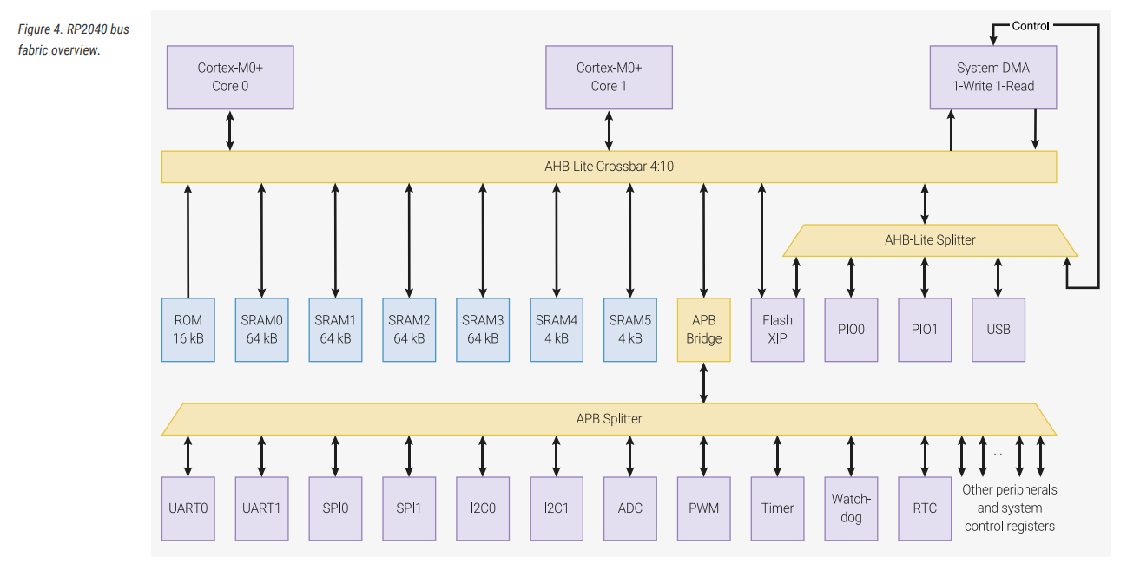
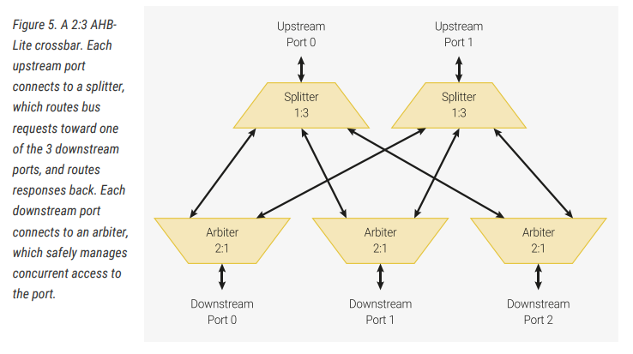
The A in AXI, AHB, APB…
AMBA: ARM specification for on-chip interconnect

Slide 7
Lets build a bus!
CSR
0x60_0000 to
0x70_0000
Use wb_intercon script
Actual blocks not implemented
CSR: Config, Status Registers
32 bits wide, good enough for most configuration type access
Empty
RAM
0x00_0000 to
0x1F_FFFF
Camera
Processor
Encoder
Wishbone 32
RAM
CSR

Slide 8
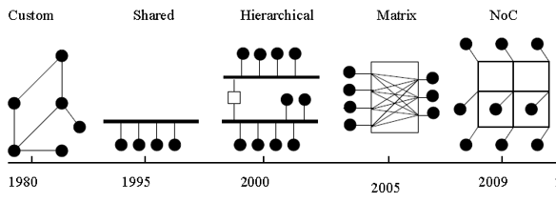
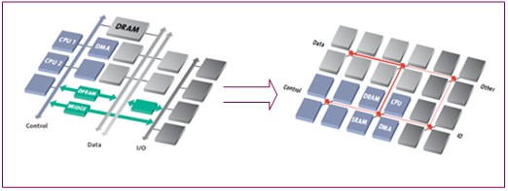
NoC vs. Busses
Busses breakdown when there are many blocks
Hierarchy added to alleviate but adds delay
Network-on-Chip used for higher bandwidths
Highly scalable and easily reconfigurable
FLIT, PHIT
https://www.design-reuse.com/articles/10496/a-comparison-of-network-on-chip-and-busses.html
Open Source NoC using AXI
https://ignitarium.com/network-on-chip-an-overview/
https://ignitarium.com/network-on-chip-an-overview/

Slide 9
Data Path Interconnects
Data only
Assumes data is valid at every clock cycle
Data + Valid
Data bus is used only when valid is active
Data + valid + ready
Can flow control back to source
Most flexible and easily extensible
Can also use NoC
Higher overhead but good for large chips

Slide 10
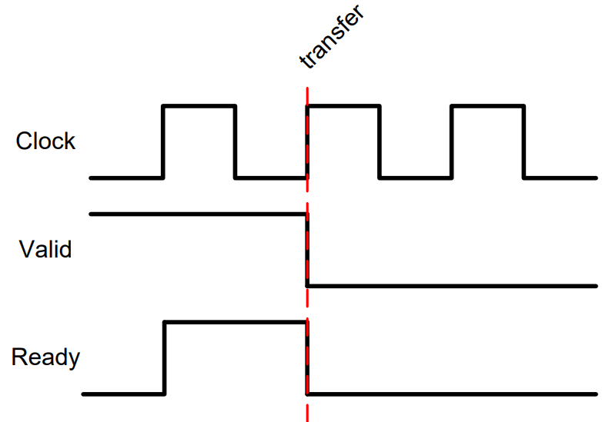
Valid-Ready Protocol Adapted from https://inst.eecs.berkeley.edu/~cs150/Documents/Interfaces.pdf
HW Block A
Data
HW Block B
Valid
Ready
Rule1: Data transfer happens when both Valid and Ready are active
Rule 2: No valid teasing: Once valid, cannot take away valid till ready is high
Rule 3: Ready can tease

Slide 11
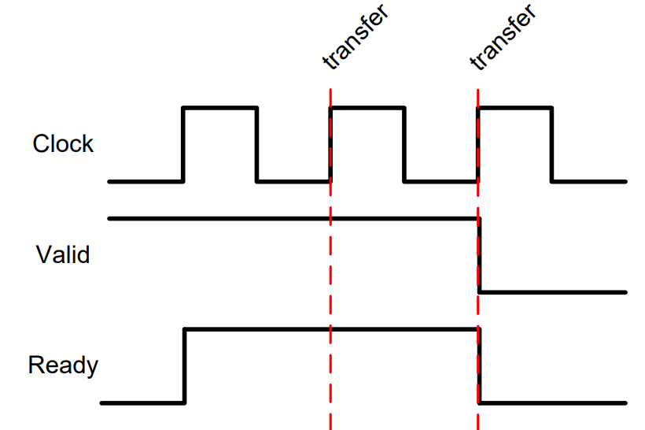
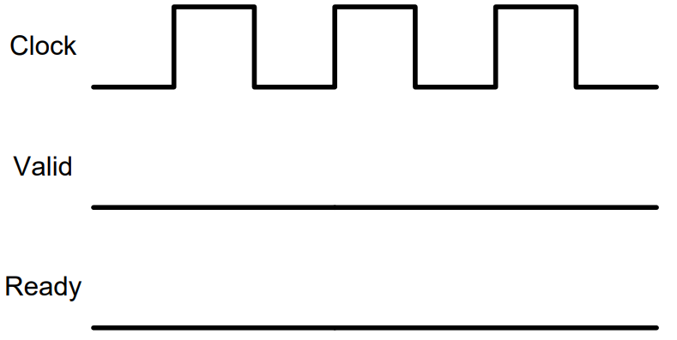
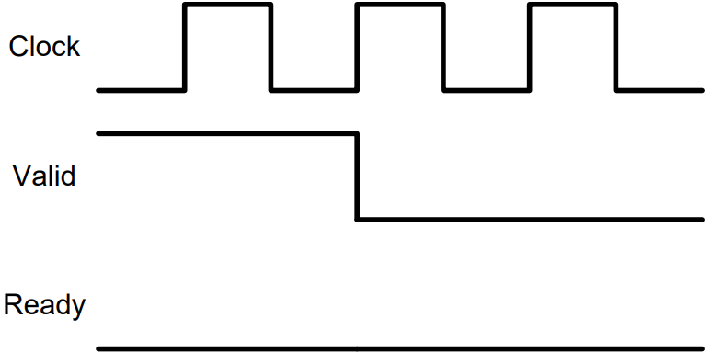
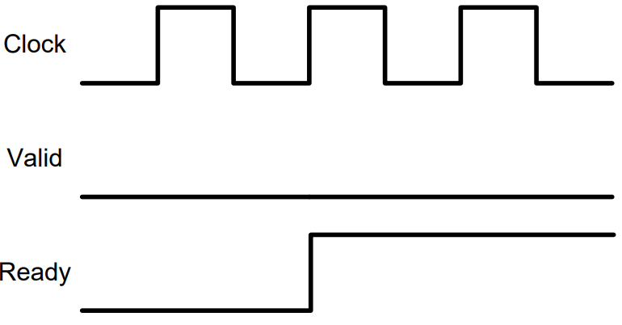
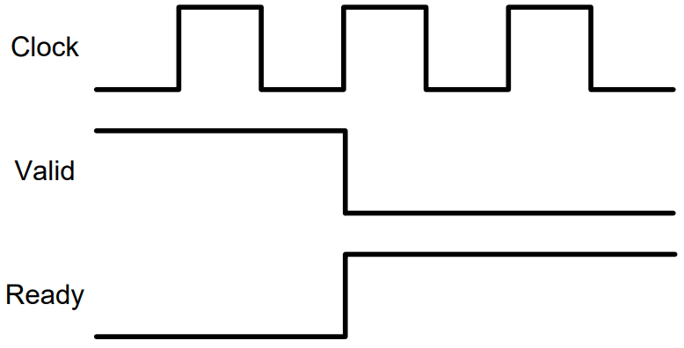
Single Data Transfer
Multiple data transfer (100% throughput)
No Data Transfer

Slide 12
FPGA Backend Process: With great control comes a great amount of work
Select FPGA Part: Make sure of the right part number!
Allocate pins
Specify clock(s)
Specify detailed Input/Output constraints
Place:
Synthesized netlist is placed using complex algorithms
Route:
Wiring added between placed cells
Bitgen
Final binary generated that can be programmed into the FPGA

Slide 13
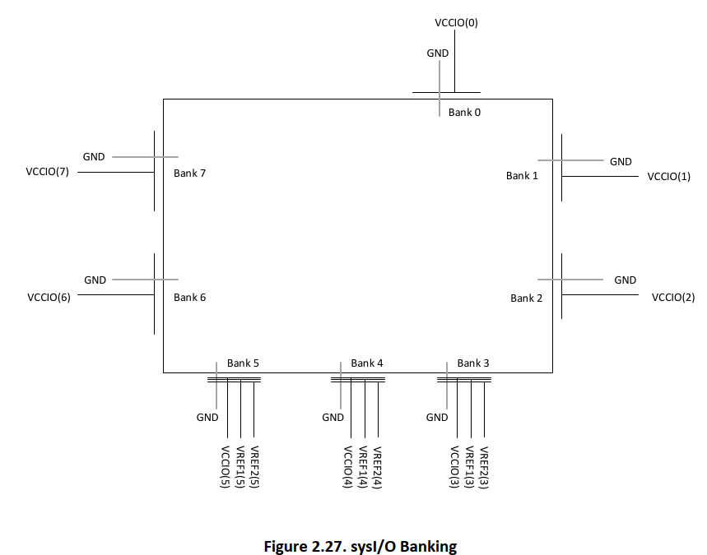
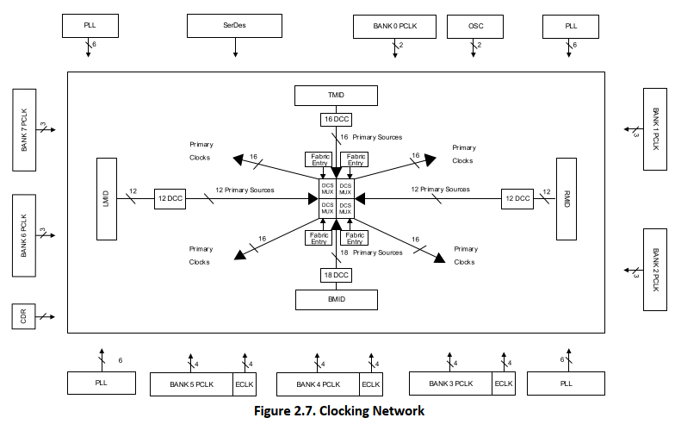
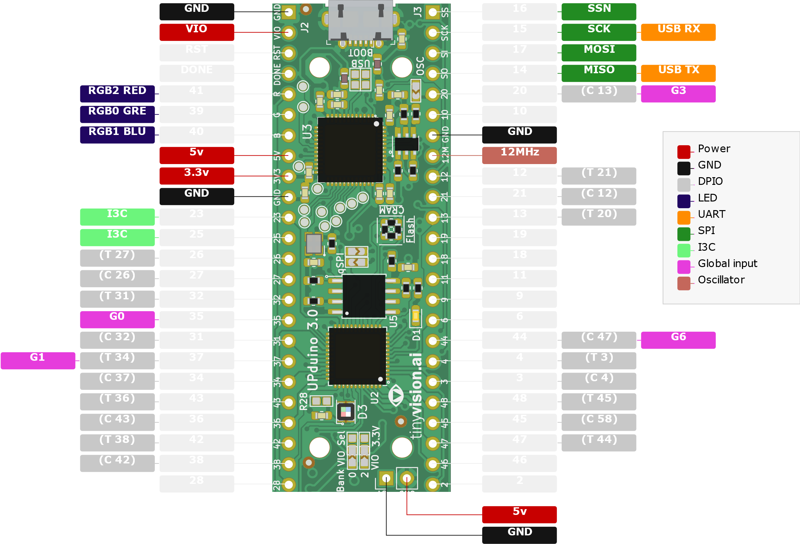
Pin Allocation: Not trivial!
Choose IO Bank:
All pins in a bank share the same IO voltage
Some banks have faster IO than others
Special purpose pins
Clock input (Low capacitance)
Special routing inside the FPGA (e.g. to PLL)
DDR requires a DQS signal, usually a special purpose pin
Differential pair signals
IO Specification
IO Standard: LVCMOS18, LVCMOS33…
Pull up/Down
Slew rate
Open Drain
Go through FPGA datasheet in detail!
https://github.com/nobodywasishere/upduino-pinout

Slide 14
Clock and related Specifications
Whats the expected clock rate?
How should IO be clocked?
How much delay does the board have?
Special constraints on logic
Can get very complex…

Slide 15
Module 6:
Challenge: Go through a non-trivial FPGA design backend

Slide 16
Open Discussion

