Slide 1
Hands on with FPGA’s: Module 7
Venkat Rangan

Slide 2
Questions on Module 6

Slide 3
Topics
Pre-class: Open floor for questions
Module 6
Clock Domain Crossing
Why?
How to deal with it?
IP Reuse
FuseSoC
LiteX
IDE’s: tips/tricks
Open discussion

Slide 4
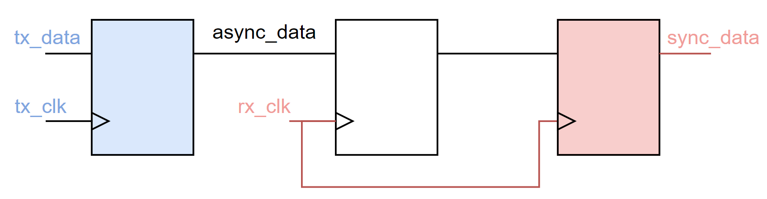
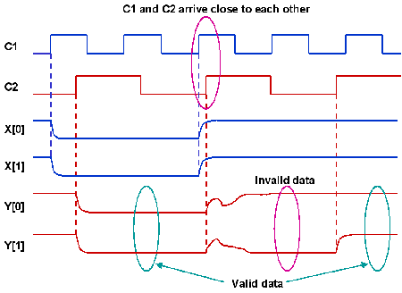
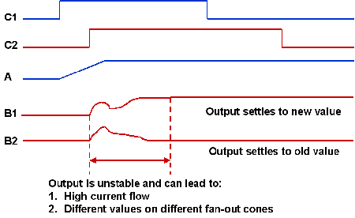
Clock Domain Crossing
Metastability
https://www.eetimes.com/understanding-clock-domain-crossing-issues/

Slide 5
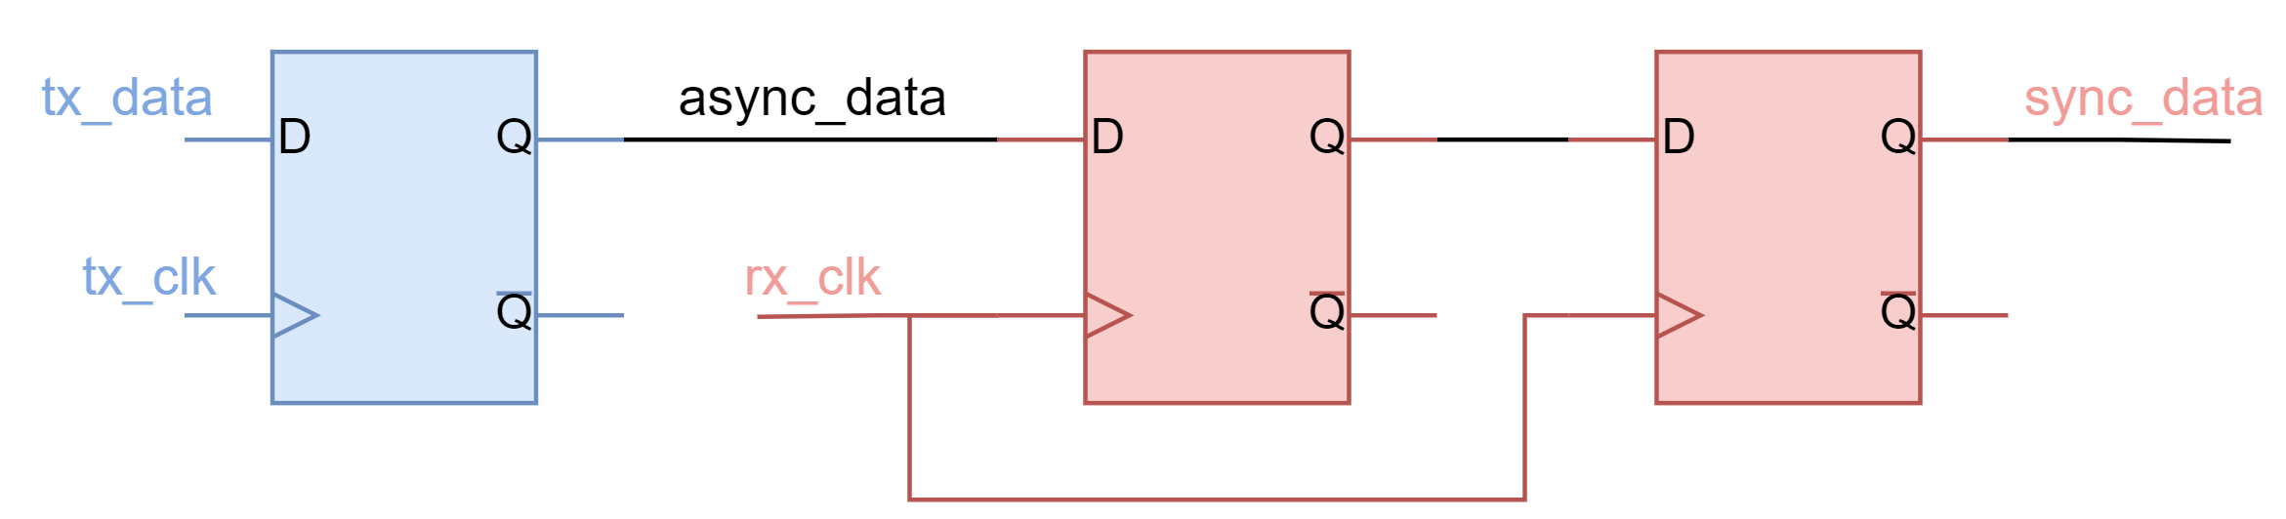
Techniques
Double flop receiving signal
Register sending signal
What if tx_clk is much faster than rx_clk?
Assume a 1 clock wide pulse on tx_data

Slide 6
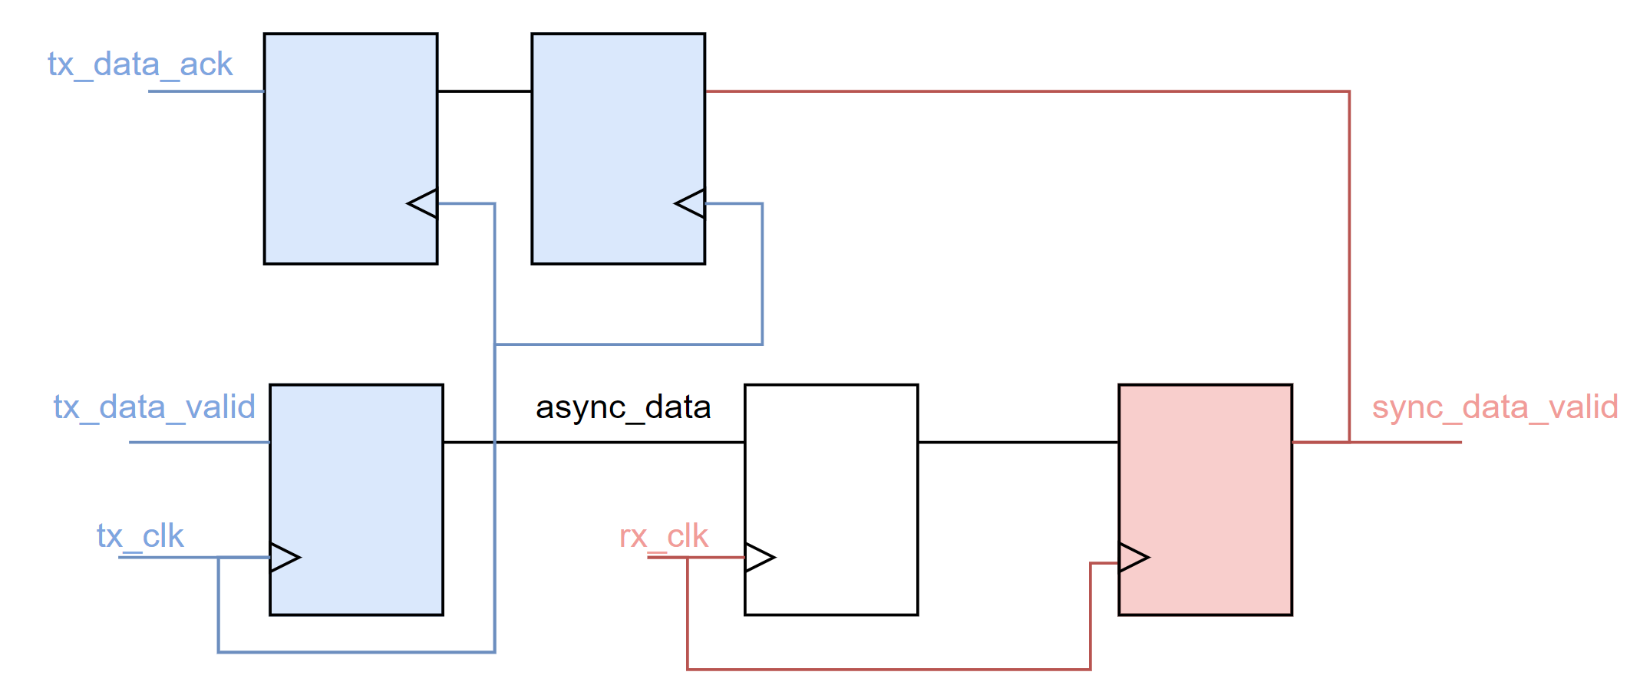
Safe Solution for CDC
Use Acknowledge
Pros:
Reliable transfer across clock domain
Cons:
Significantly larger synchronization delay

Slide 7
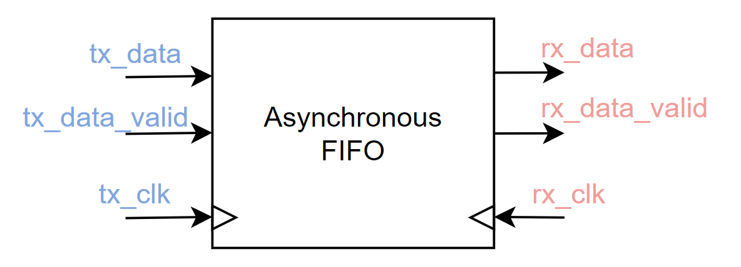
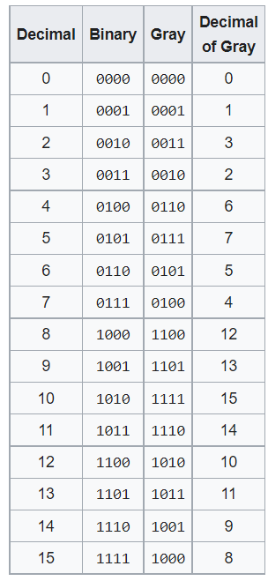
Other CDC techniques…
Asynchronous FIFO’s for multiple bits
Can be just 2 deep FIFO
Gray encoding
Only 1 transition between successive counts
https://en.wikipedia.org/wiki/Gray_code

Slide 8
Lets build an SoC!
Use LiteX
Follow instructions below to install
For windows, use WSL!
Will not work well in the Powershell/Command prompt
If you haven't set up usbip with WSL2 yet: https://docs.microsoft.com/en-us/windows/wsl/connect-usb
After you have the upduino board connected to WSL (ie shows up properly via sudo dmesg and/or lsusb , udev rules are present etc)
wget https://raw.githubusercontent.com/enjoy-digital/litex/master/litex_setup.py && chmod +x litex_setup.py
./litex_setup.py --init --install --user --config=full
./litex_setup.py --gcc riscv
rm -rf litex-boards
git clone https://github.com/tinyvision-ai-inc/litex-boards
Install and add oss-cad-suite to path (if you haven't already) then exit wsl and open powershell/cmd wsl --shutdown to "reboot" the linux vm. Re-open your wsl terminal and ensure your upduino_v3 is still accessible
python3 ./litex-boards/litex_boards/targets/upduino_v3.py --cpu-variant minimal --build --flash

Slide 9
IDE’s: Tips/tricks
Emacs: Verilog mode:
Demo of auto completion
Visual Studio: TerosHDL

Slide 10
Module 7:
Challenge:
Create your own version of a processor using LiteX or FuseSoC
Locate the I2C and SPI cores in it
Can you program your I2C controller to produce some outputs?
Hook up any I2C device to the FPGA and try to read/write registers

Slide 11
Open Discussion

