Slide 1
ICS370: Software Design Models AutoCap (Auto Generator of Catch-A-Phrase puzzles)
Siva Jasthi
Summer 2021

Slide 2
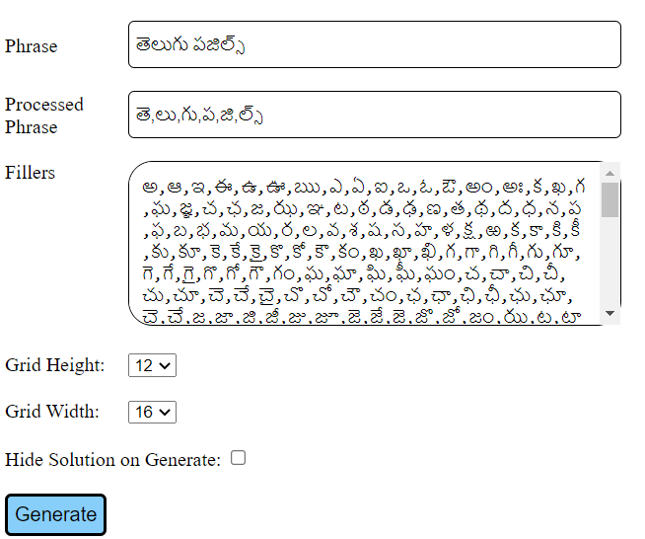
Catch-A-Phrase (Puzzle inputs)
http://cap.telugupuzzles.com/

Slide 3
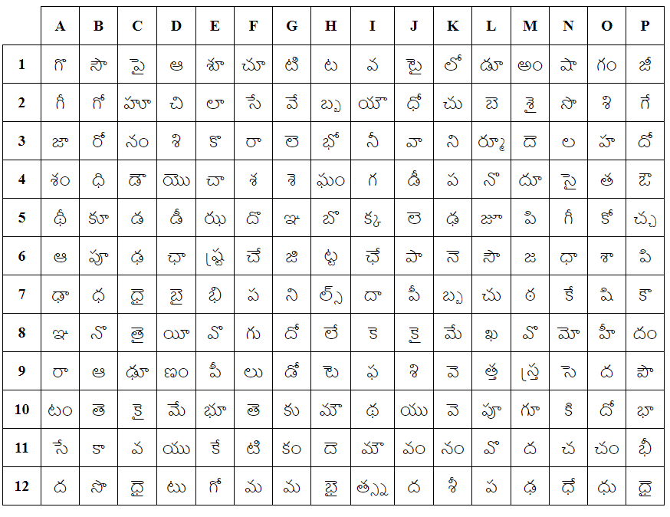
Catch A Phrase (generated puzzle)

Slide 4
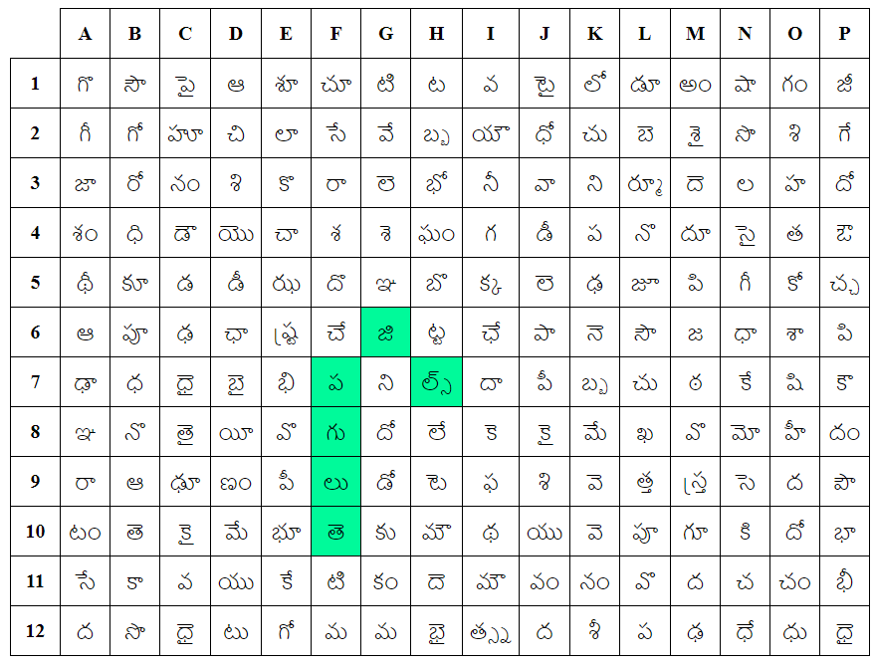
Catch-A-Phrase (Puzzle Solution)

Slide 5
Scope of AutoCap
The current application has several limitations
[1] The application doesn’t have a database support.
[2] Each puzzle needs to be generated individually.
There is no batch processing.
[3] Each puzzle needs to manually copied into PPT slides.
Our “AutoCap” addresses the above limitations.
[1] It connects to a database of phrases. (See the schema file)
[2] It asks the user for the ID range (starting ID and ending ID).
[3] It relies on some default (configurable) filler characters and grid sizes.
[4] It generates all the puzzles in one go in HTML format.
[5] It generates all the puzzles in one go in PPT format.
Assume that there exists an API / Web Service that breaks a string into a set of logical characters. Until that is available, “AutoCap” works only for English.

Slide 6
Links
GitHub: www.github.com/sjasthi/autocap

