Slide 1

Population Genetics Microsatellite Data
Course: Practical Bioinformatics for Biologists
Xenia Lopes
Vania Rivera

Slide 2
#! Introduction
Population genetic studies are very useful for conservation and for understanding ecological and behavioural traits of species.
Process done many times

Slide 3
#! Aim
Pipeline: Automatize part of the process of analysing microsatellite data for identifying population structure.
Pipeline used for any dataset

Slide 4



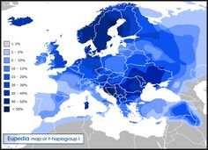
Deviations
Format file
adegenet
H-W
if statement
No deviations
Polymorphism
marmap
Workflow

Slide 5
#! Methods
Wrapper (bash)
R v.3.2.3
Package adegenet
Package Maps
+others
Python → Format data
Parse HW p-values
Obtain a % of loci not in HW
Parse latitude and longitude
If more than 70% of loci not in HW
Run Structure

Slide 6

#! 1st Challenge
Installing software
coding rage | Tumblr
http://www.clipartbest.com

Slide 7
#! 2nd Challenge
Incorporating user input to be used with any dataset
Input file*
# of individuals*
# of Loci*
K
# of runs or iterations
Name for output file
.str

Slide 8
#! Solution
User input in Scripts
Wrapper
#run python
Coordinates.py $1 LatLon_$6
R
args <- commandArgs(TRUE)
data <- read.table(args[1], header=TRUE)
Python
import sys
FileName = str(sys.argv[1])

Slide 9
#! If statement
There are several reasons why the loci might present disequilibrium of HW but in this case we are just testing for population structure (Wahlund effect).
Threshold 70%

Slide 10
#! Structure
Getting familiar with the software and its arguments in the command line
2 nested for loops had to be added
Number of iterations
Number of K
Creates a file per iteration per K
Default values if user do not say anything

Slide 11
#! Workflow
Deviations
Structure
adegenet
H-W
if statement
.str
No deviations
map
Polymorphism
Format file
Debugging!

Slide 12
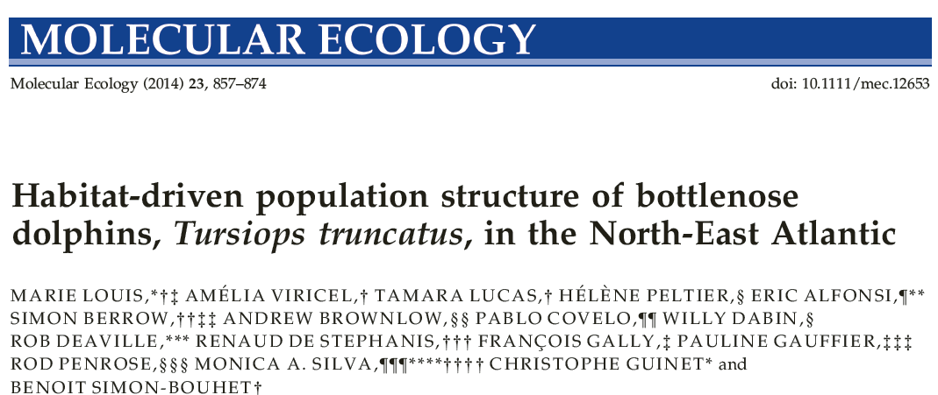
#! Example data set

Slide 13
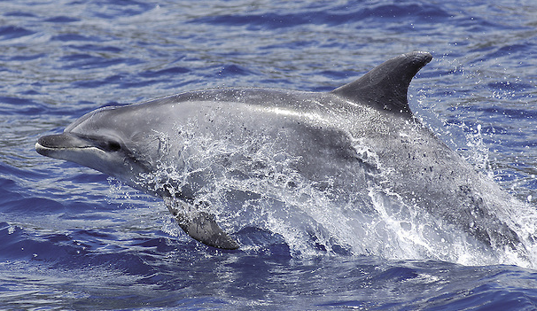
#! Research question
Is there population structure in the NEA bottlenose dolphins?
Costal and pelagic
More anthropogenic pressure in coastal environments
http://kikecalvo.photoshelter.com

Slide 14
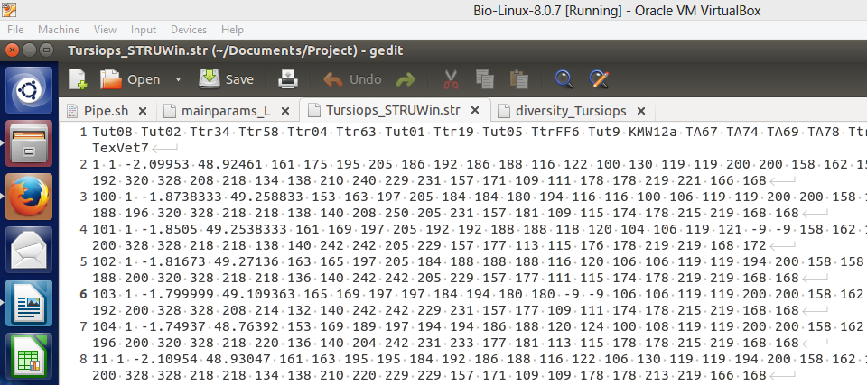
#! Data
Structure format
25 loci
Population Id
Latitude
Longitude
354 individuals

Slide 15
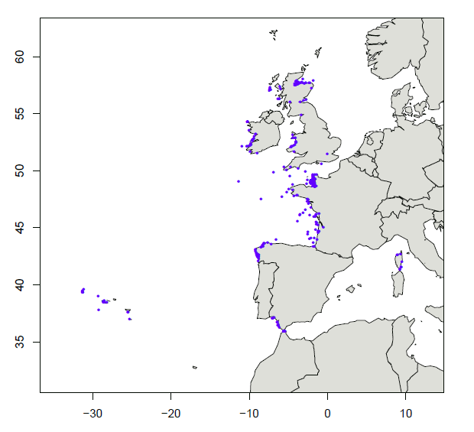
#! Sampling locations
R package (map)

Slide 16
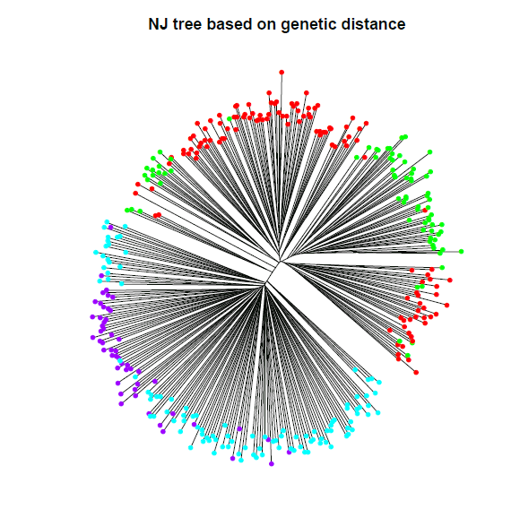
#! Neighbor Joining Distance Tree
R package (adegenet)

Slide 17
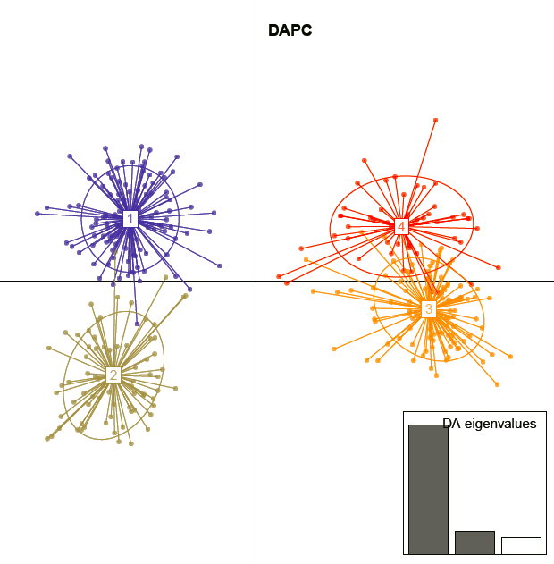
#! DAPC
R package (adegenet)

Slide 18
#! STRUCTURE
Test for the whole data set
Structure
5 independent runs
K 1-5
Burn-in 10,000
100,000 MCMC
STRUCTURE HARVESTER v 0.6.94
STRUCTURE Graphical interface for plot

Slide 19
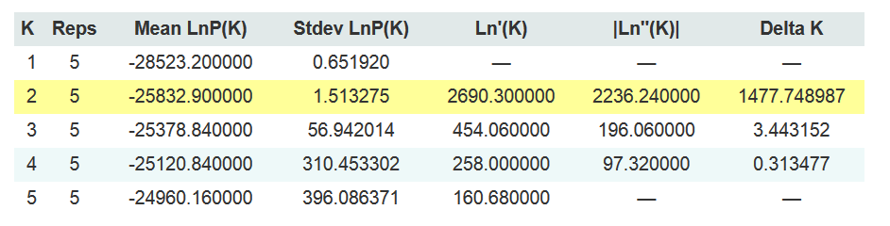
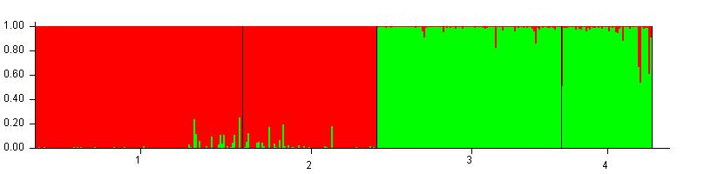
#! Most likely # of populations

Slide 20
#! Improvements
Harvest
STRUCTURE Plot
Run in Peregrine
Layout of figures
Do something if pop is in HW
E.g. Estimate Ne
Error message

Slide 21

Questions

