Slide 1
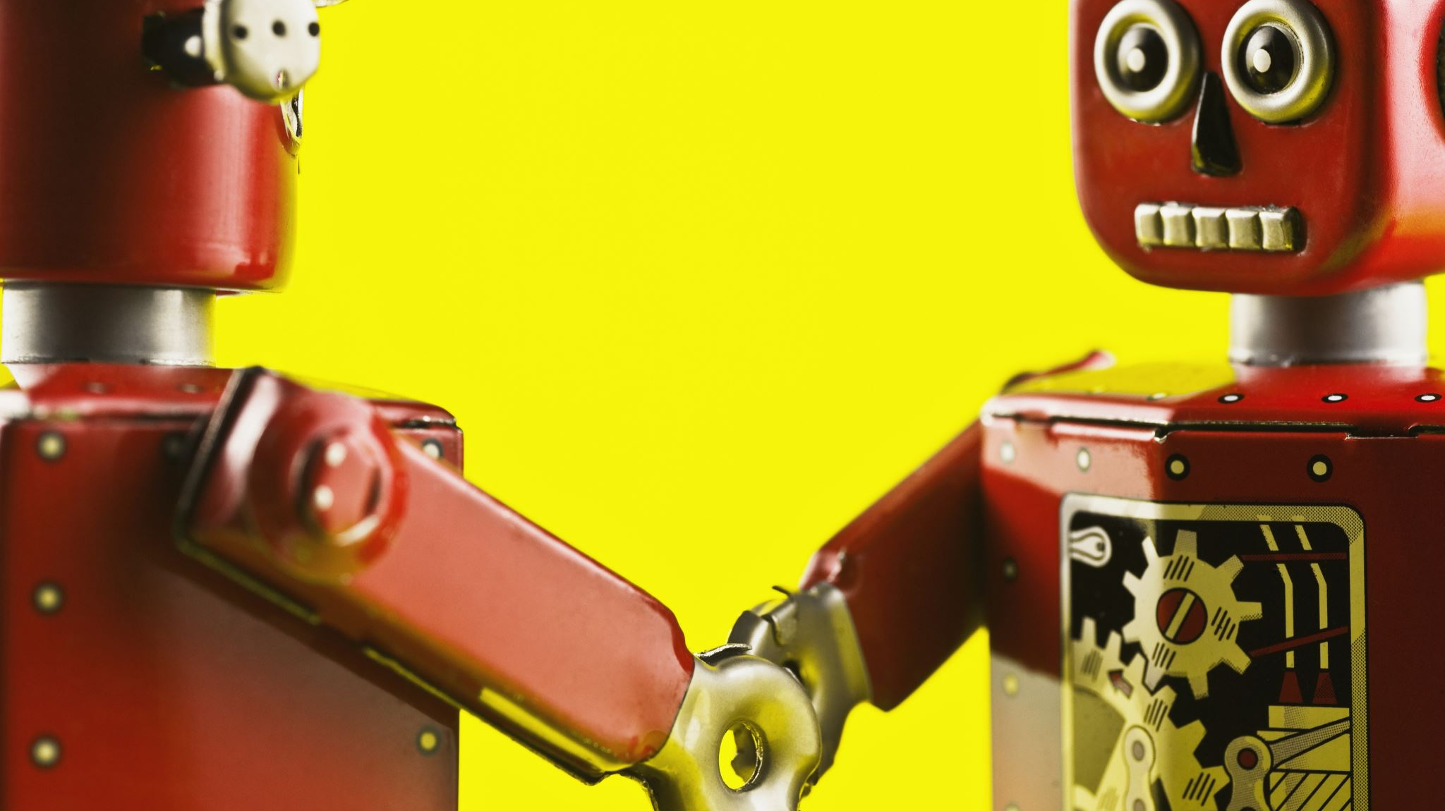
UR-5 Robot Manipulator
Alessio Canzolino
Luigi Cuffaro
Alessandro De Blasi
Simone Romeo

Slide 2
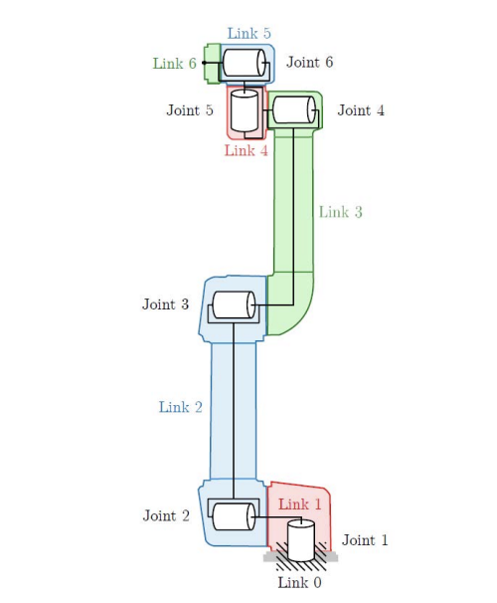
Project Description
Modeling and simulation of UR-5 robotic manipulator
Simulation developed in 20-sim
Kinematics derived according to Denavit-Hartenberg convention
Actuation performed using Harmonic Drives

Slide 3
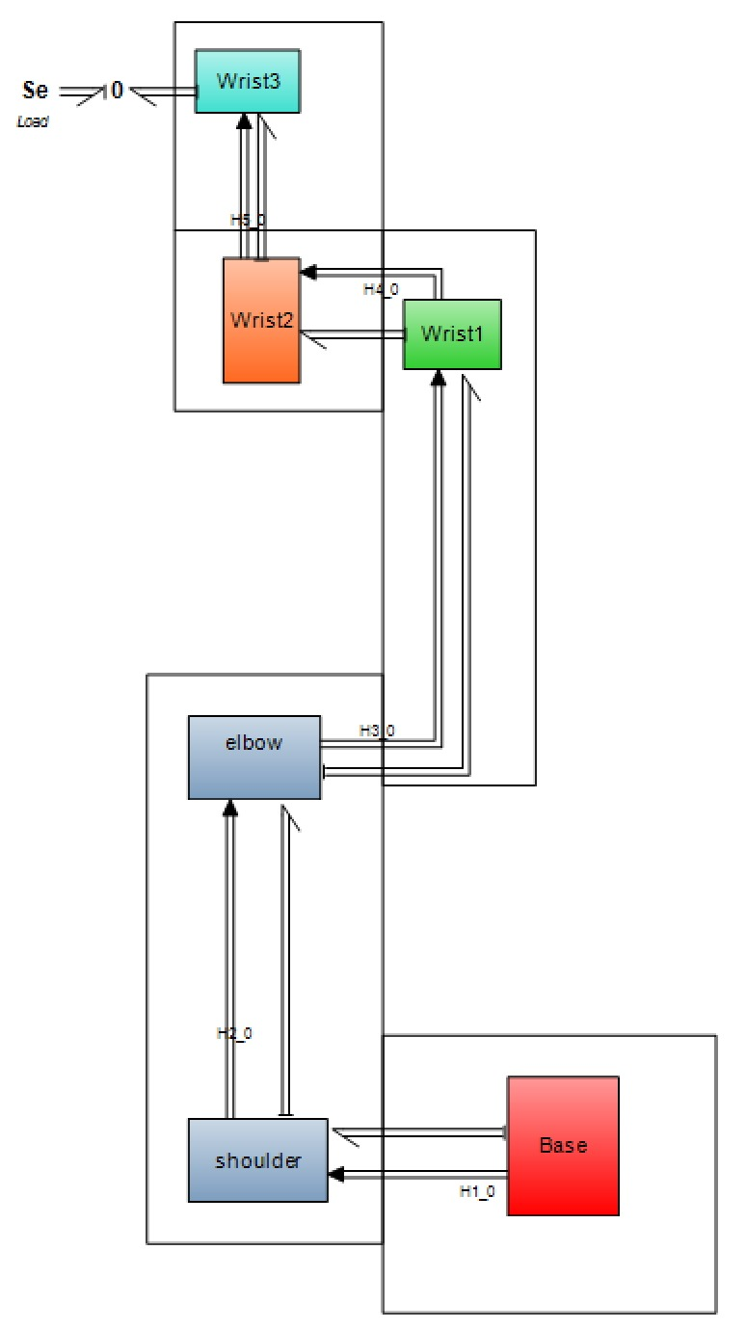
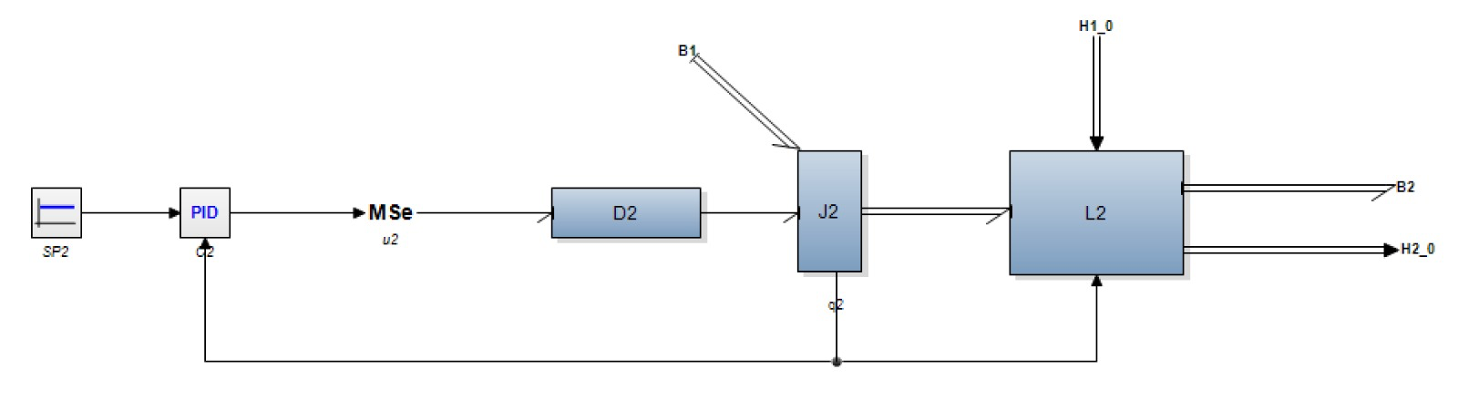
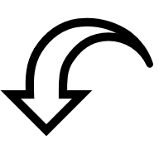
MODEL
Link
Pid controller
Harmonic drive
Joint
Homogeneous traformation

Slide 4
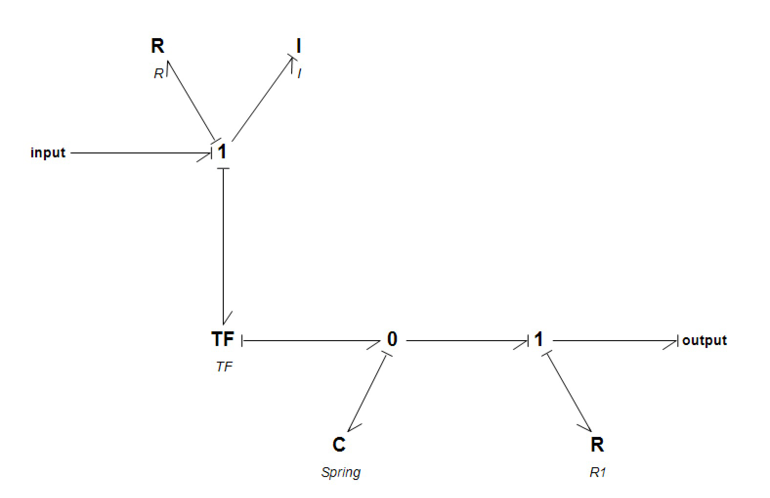
Harmonic drive: description
a flexspline, a flexible gear with internal teeth
a wave generator, an elliptical plug that deforms the flexspline as it rotates
a circular spline, a rigid gear with external teeth
reduction of angular velocity at the output
increase of transmitted torque
a non-linear spring (elasticity of the flexspline)
two bearings (supporting the wave generator)
and the inertia of moving parts.
The mechanical behavior can be modeled with:
The controlled deformation of the flexspline allows:
A gear system consisting of:

Slide 5
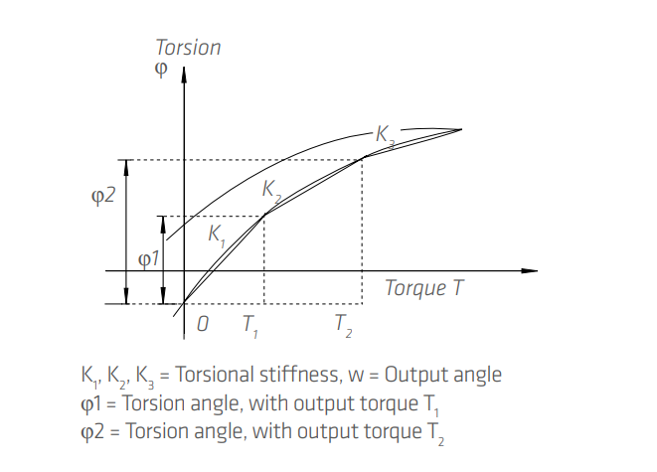


Harmonic drive: elements
The bearing friction is modeled as a combination of viscous and Coulomb friction.
The rotating mass is represented by its inertia, which plays a key role in the system dynamics.
Transformer with a reduction ratio consistent with the standard harmonic drive.
Non-linearity is modeled using three distinct linear sections.

Slide 6
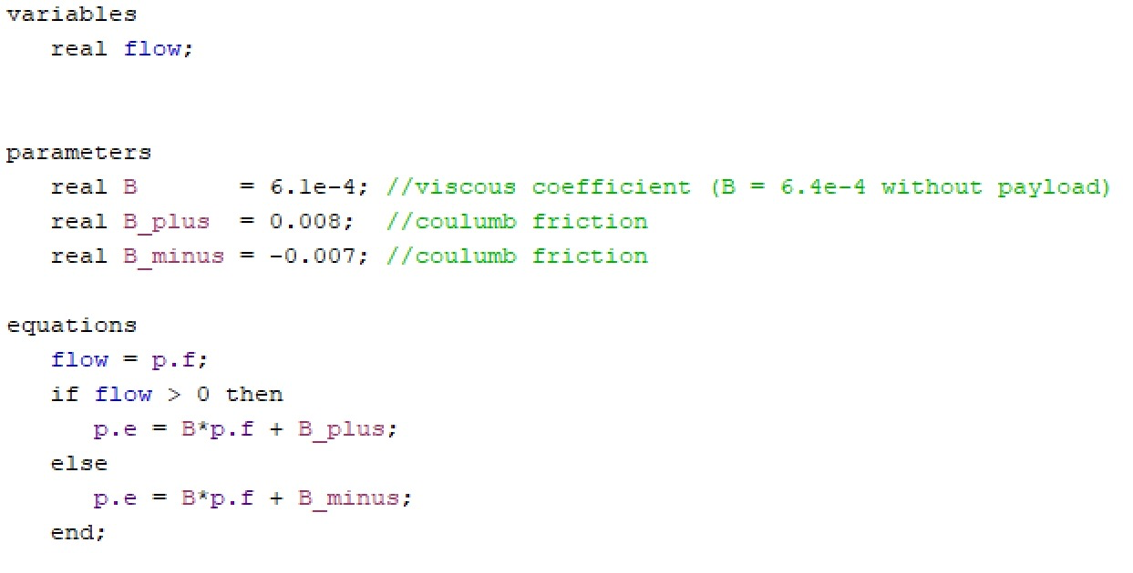
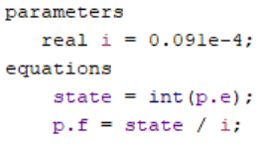
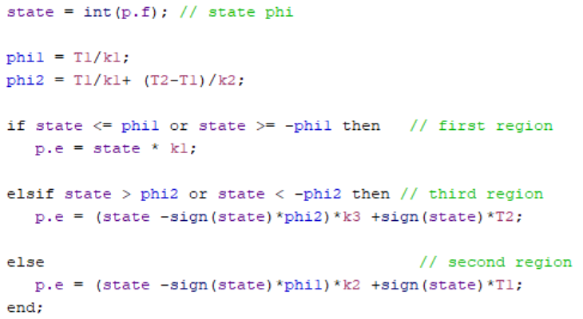
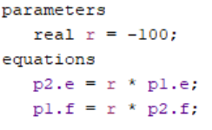
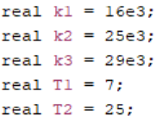
Harmonic drive: code section

Slide 7
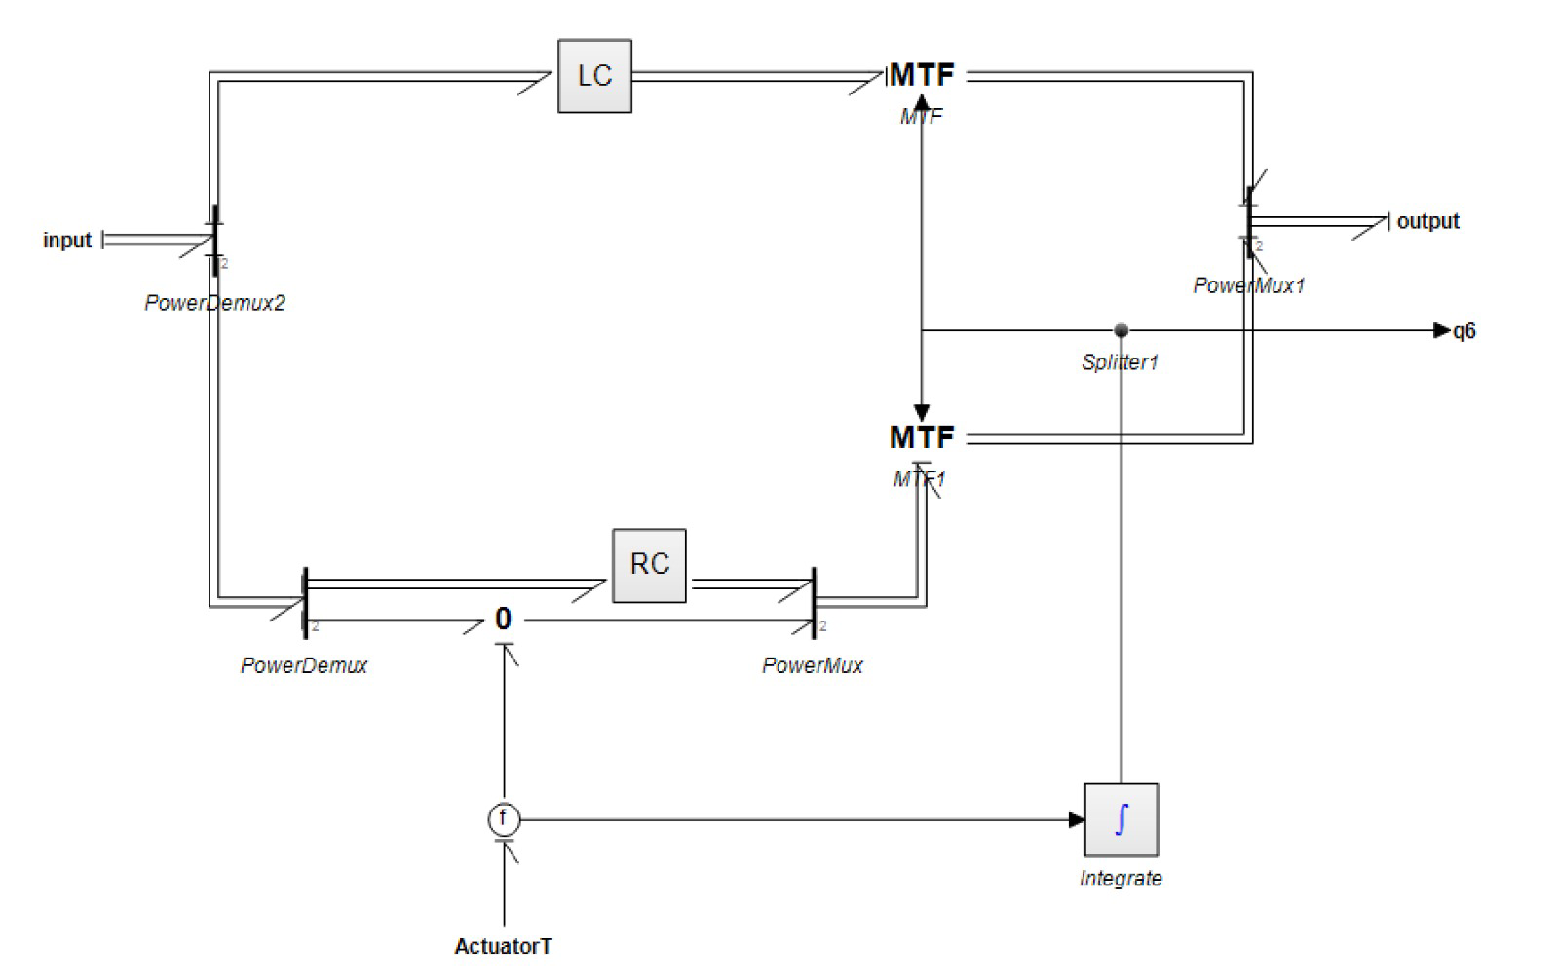
Joint: description
Rotational joint aligned with the z-axis, designed to perform controlled rotational motion.
Actuation provided by the velocity input from the Harmonic Drive, ensuring high torque and precision.
A modulated transformer processes the input to regulate and fine-tune the rotation.
Notes:
Aggiungere piccolo senso a lc e rc

Slide 8
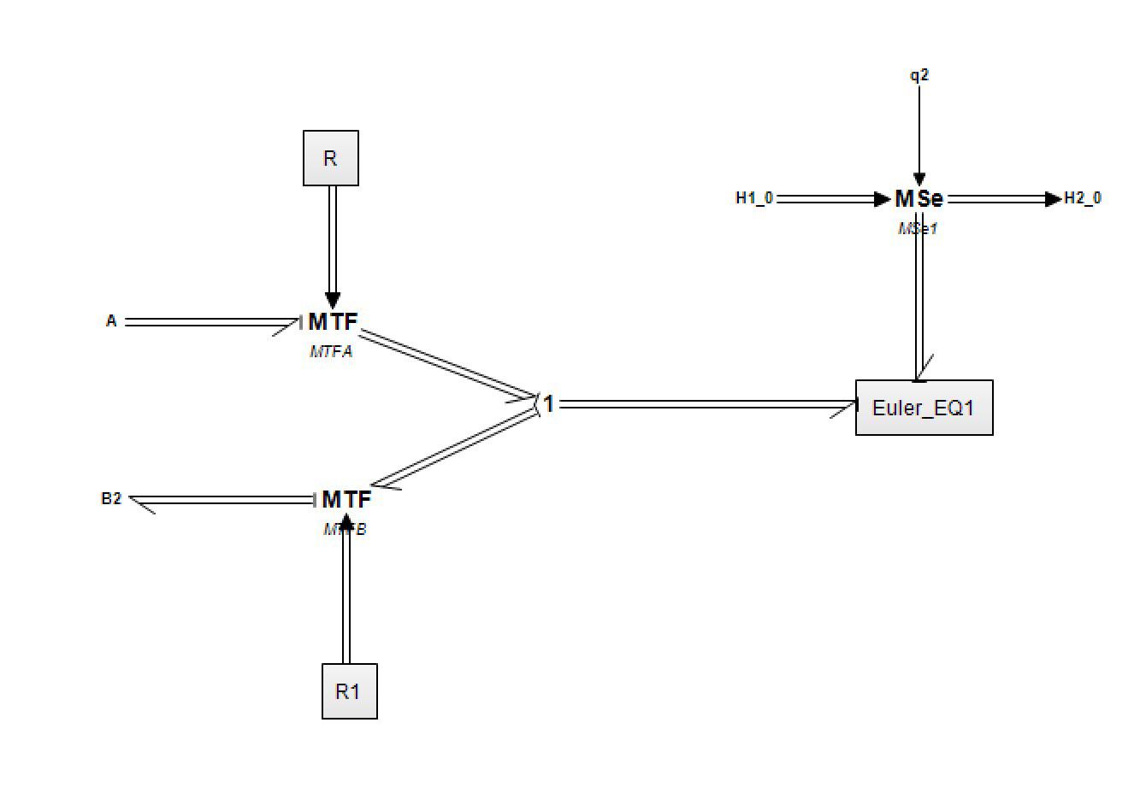
Link: description
The link performs a change of coordinates from reference frame A to reference frame B, ensuring consistent transformation of motion and forces.
It also computes the Euler equations of motion evaluated at the center of gravity of the link, capturing its rotational dynamics.
The coordinate transformations are carried out using the Adjoint Matrix, which maps velocities and forces between frames accurately.

Slide 9
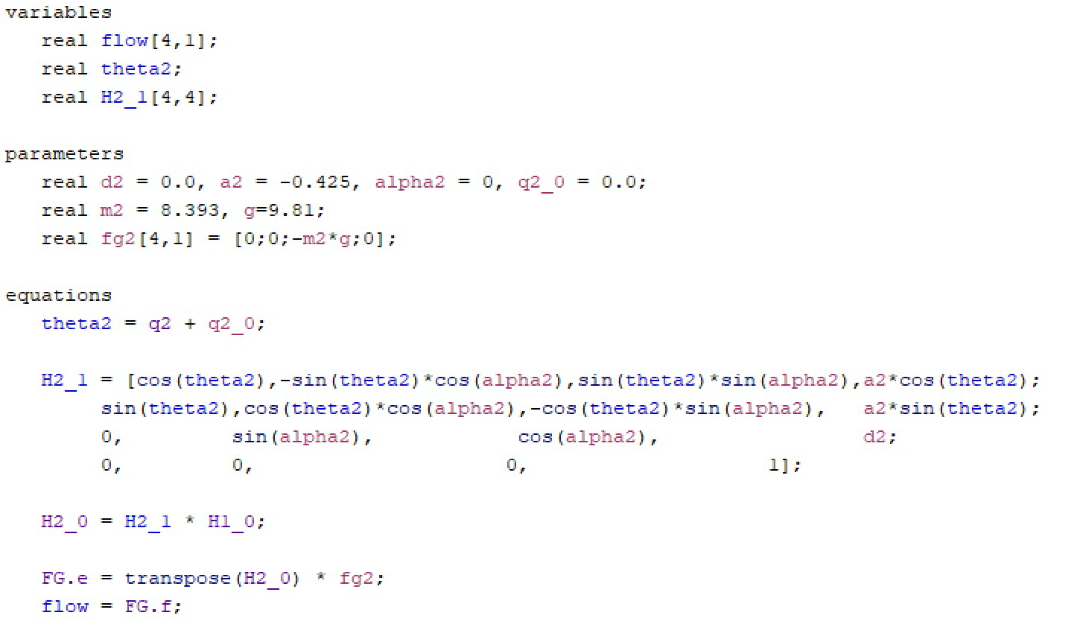
Link: gravity force effects
A homogeneous transformation is applied to express the gravity vector in the body frame, aligning it with the local coordinate system of the link.
The transformed gravity information is then passed to the subsequent links, ensuring consistency in the dynamic computations along the kinematic chain.
Notes:
Clicca su omino per codice

Slide 10
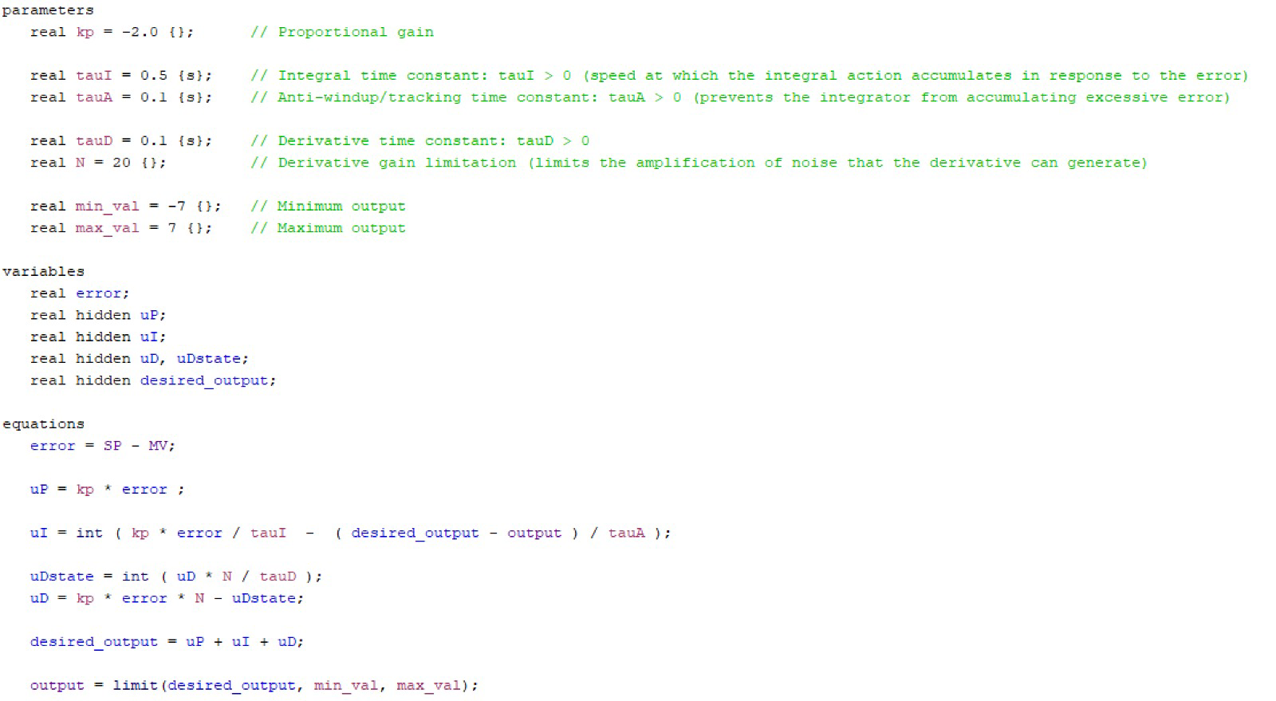
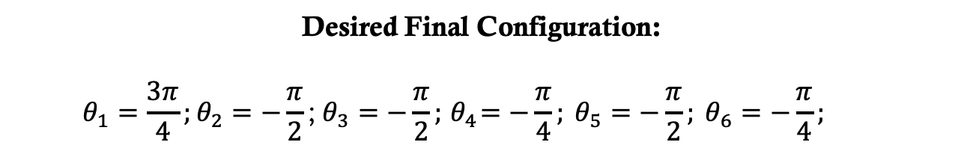
Pid-controller
Desired Final Configuration:
$$θ_{1}=\frac{3π}{4};θ_{2}=−\frac{π}{2}\text{;} θ_{3}=−\frac{π}{2};{ θ}_{4}=−\frac{π}{4}; θ_{5}=−\frac{π}{2}; θ_{6}=−\frac{π}{4};$$

Slide 11
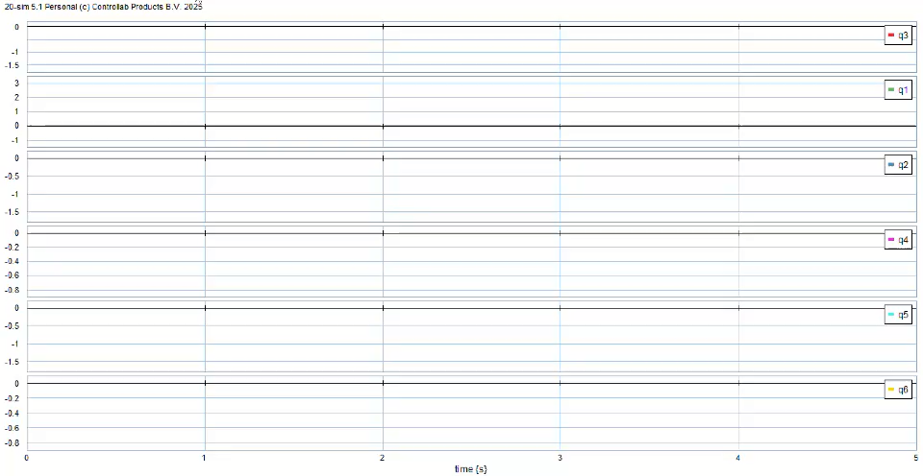
2D-simulation

Slide 12
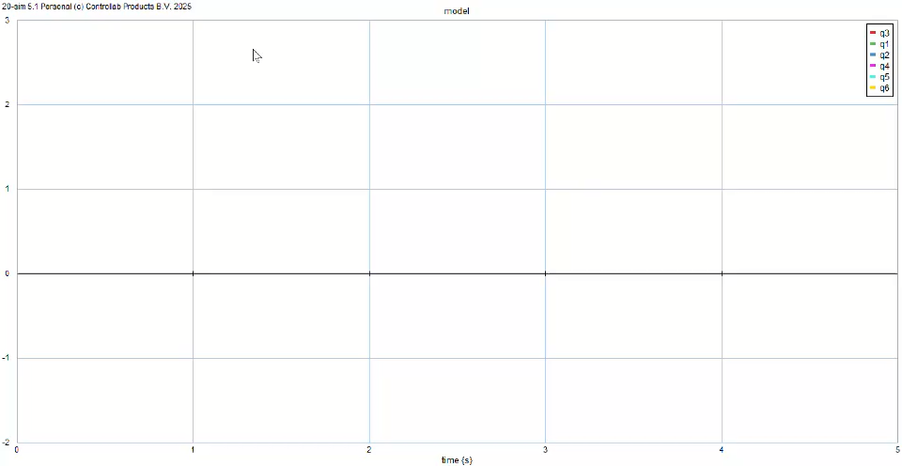
2D-simulation

