Slide 1
Rocca S A Symmetric Key Block Cipher
~Rohan Sudhir Basugade

Slide 2
Introduction
Rocca S is a cryptographic algorithm focused on efficiency with many opportunities for parallelization.
It uses a state-based approach and ciphers in 256-bit blocks of data.
Focus on secure, high-speed data encryption.

Slide 3
Algorithm Structure
ROCCA_STATE is composed of 7 elements of 128-bits each.
The state gets initialized based on the input key and some predefined variables.
Z0 and Z1 are 128bit values used in the initialization of State.
SubBytes Array is the same array that’s used in substitution phase of AES.

Slide 4
Algorithm Structure
Key is 256bit for maximum security. Its divided into K0(left) and K1(right) each 128bits for use in algorithm.
Nonce is an initializing vector. Varies from 96bits to 128bits.
Associated Data (2^61 bytes max_size) is used also used to update State and is sent without encryption.
Plaintext (2^125 bytes max_size) is the text to be ciphered.

Slide 5
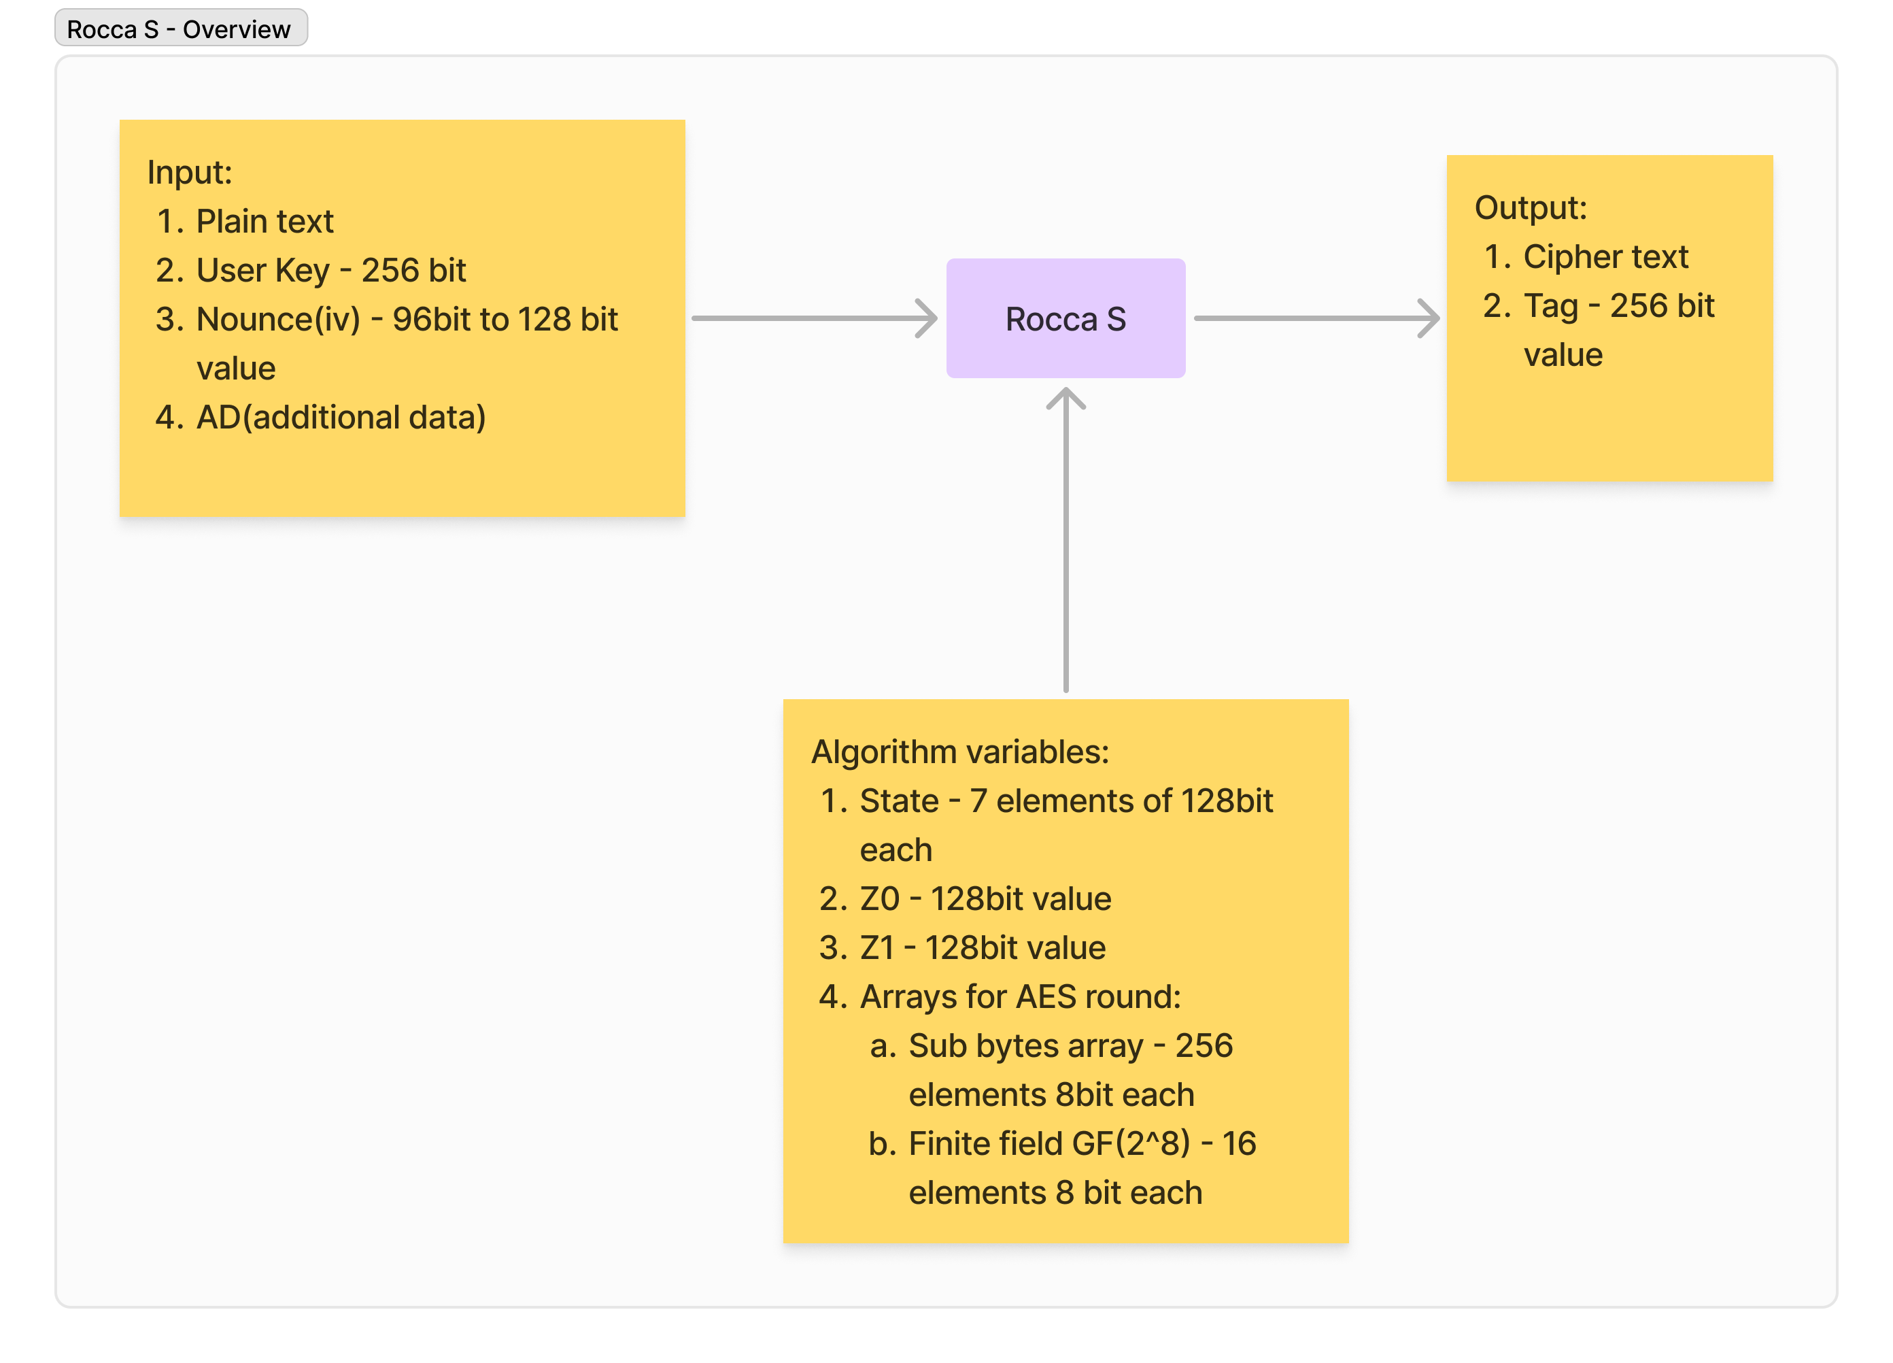
Rocca S - Overview

Slide 6
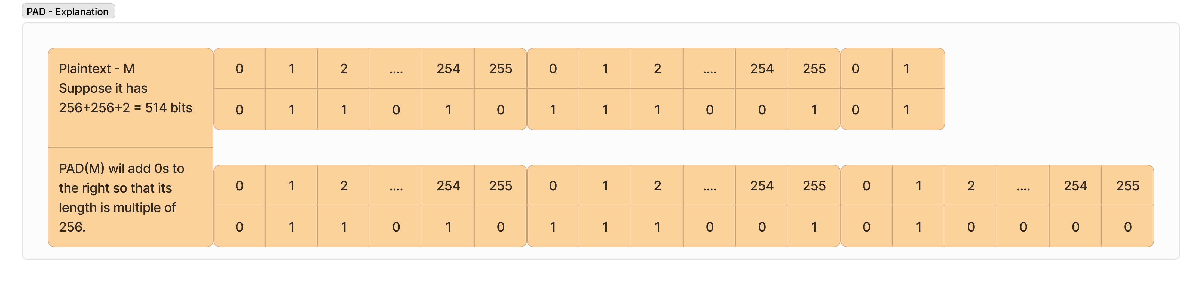
Padding Explanation
PAD(M) pads M to have a length divisible by 256 by adding 0s to the right.
PADN(N) pads N to have length divisible by 128 by adding 0s to the right.

Slide 7
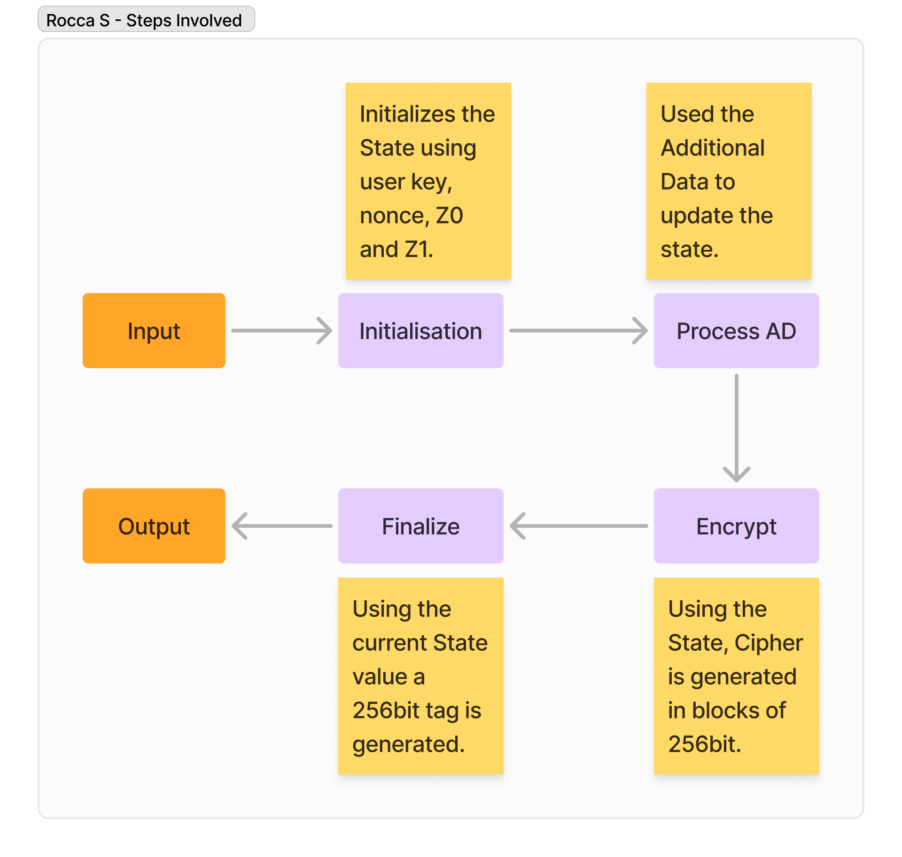
Rocca S – Steps Involved

Slide 8
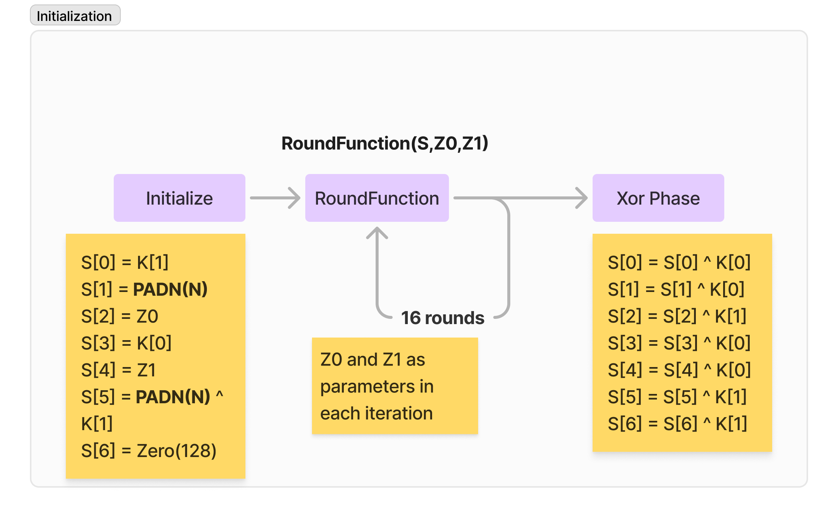
Initialization

Slide 9
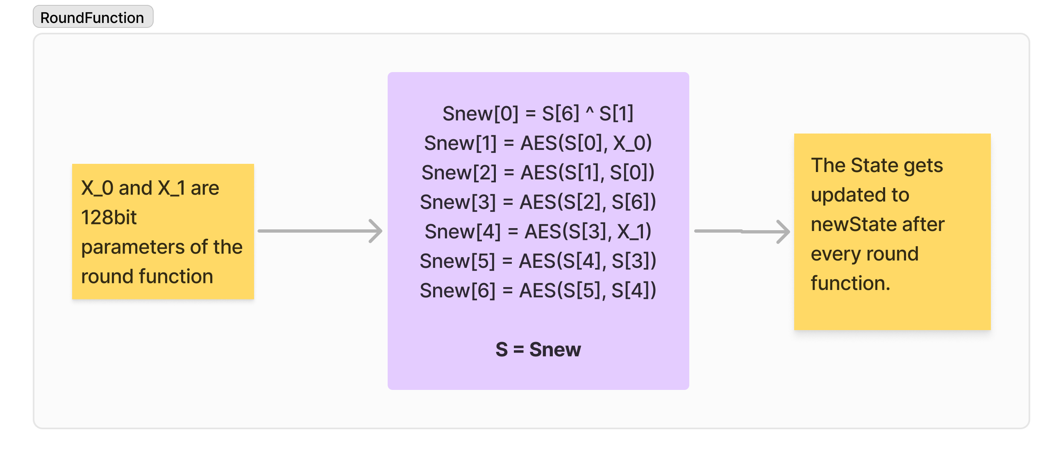
RoundFunction

Slide 10
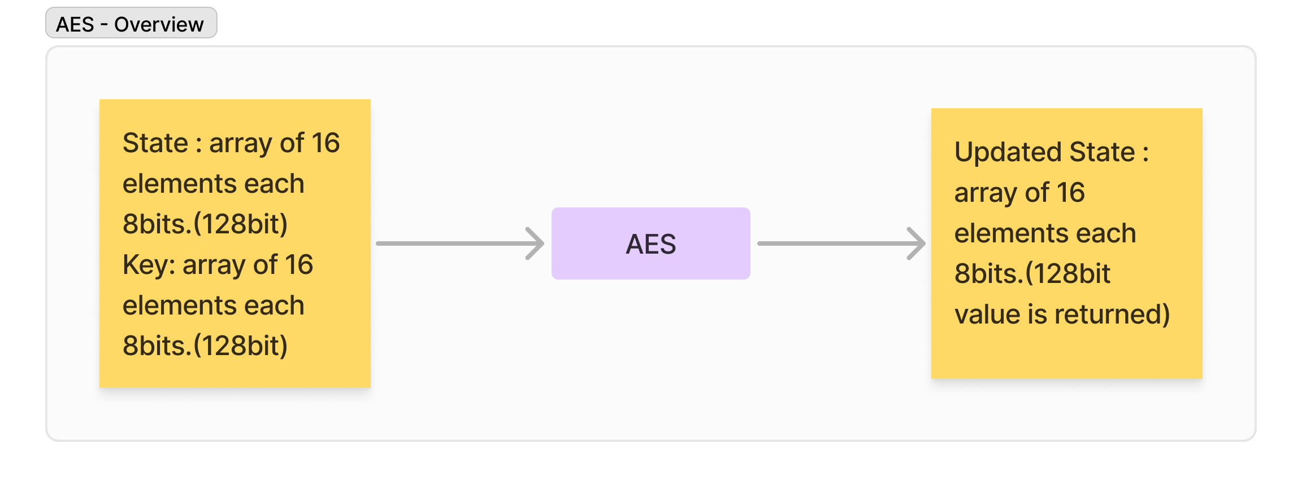
AES - Overview

Slide 11
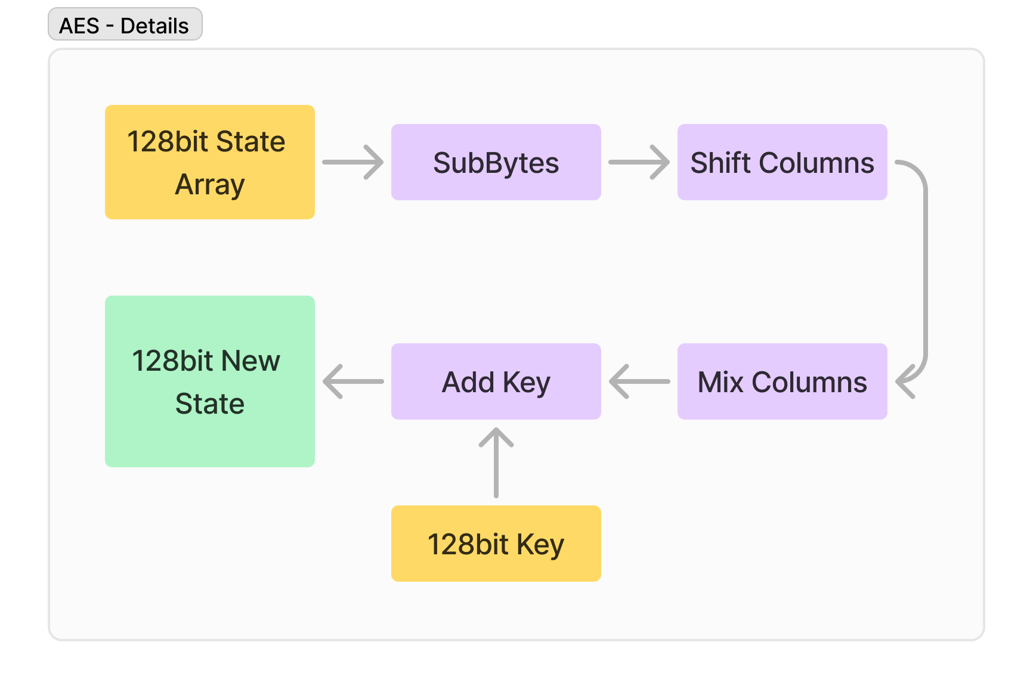
AES - Details

Slide 12
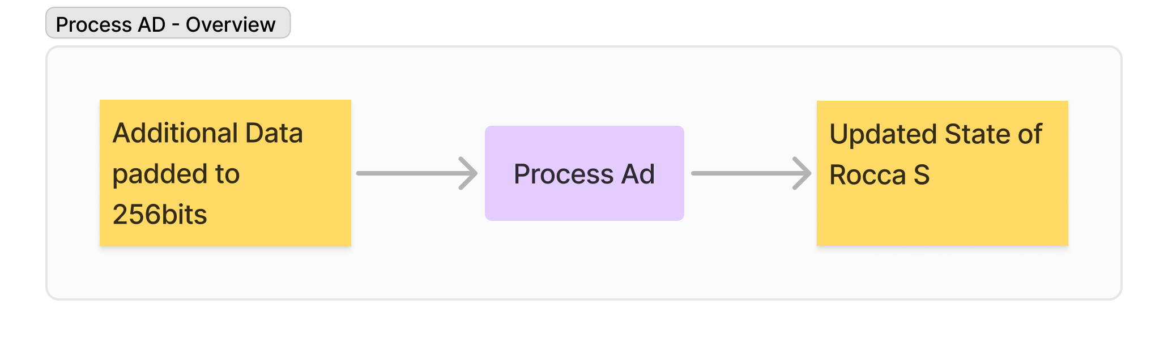
Process AD - Overview

Slide 13
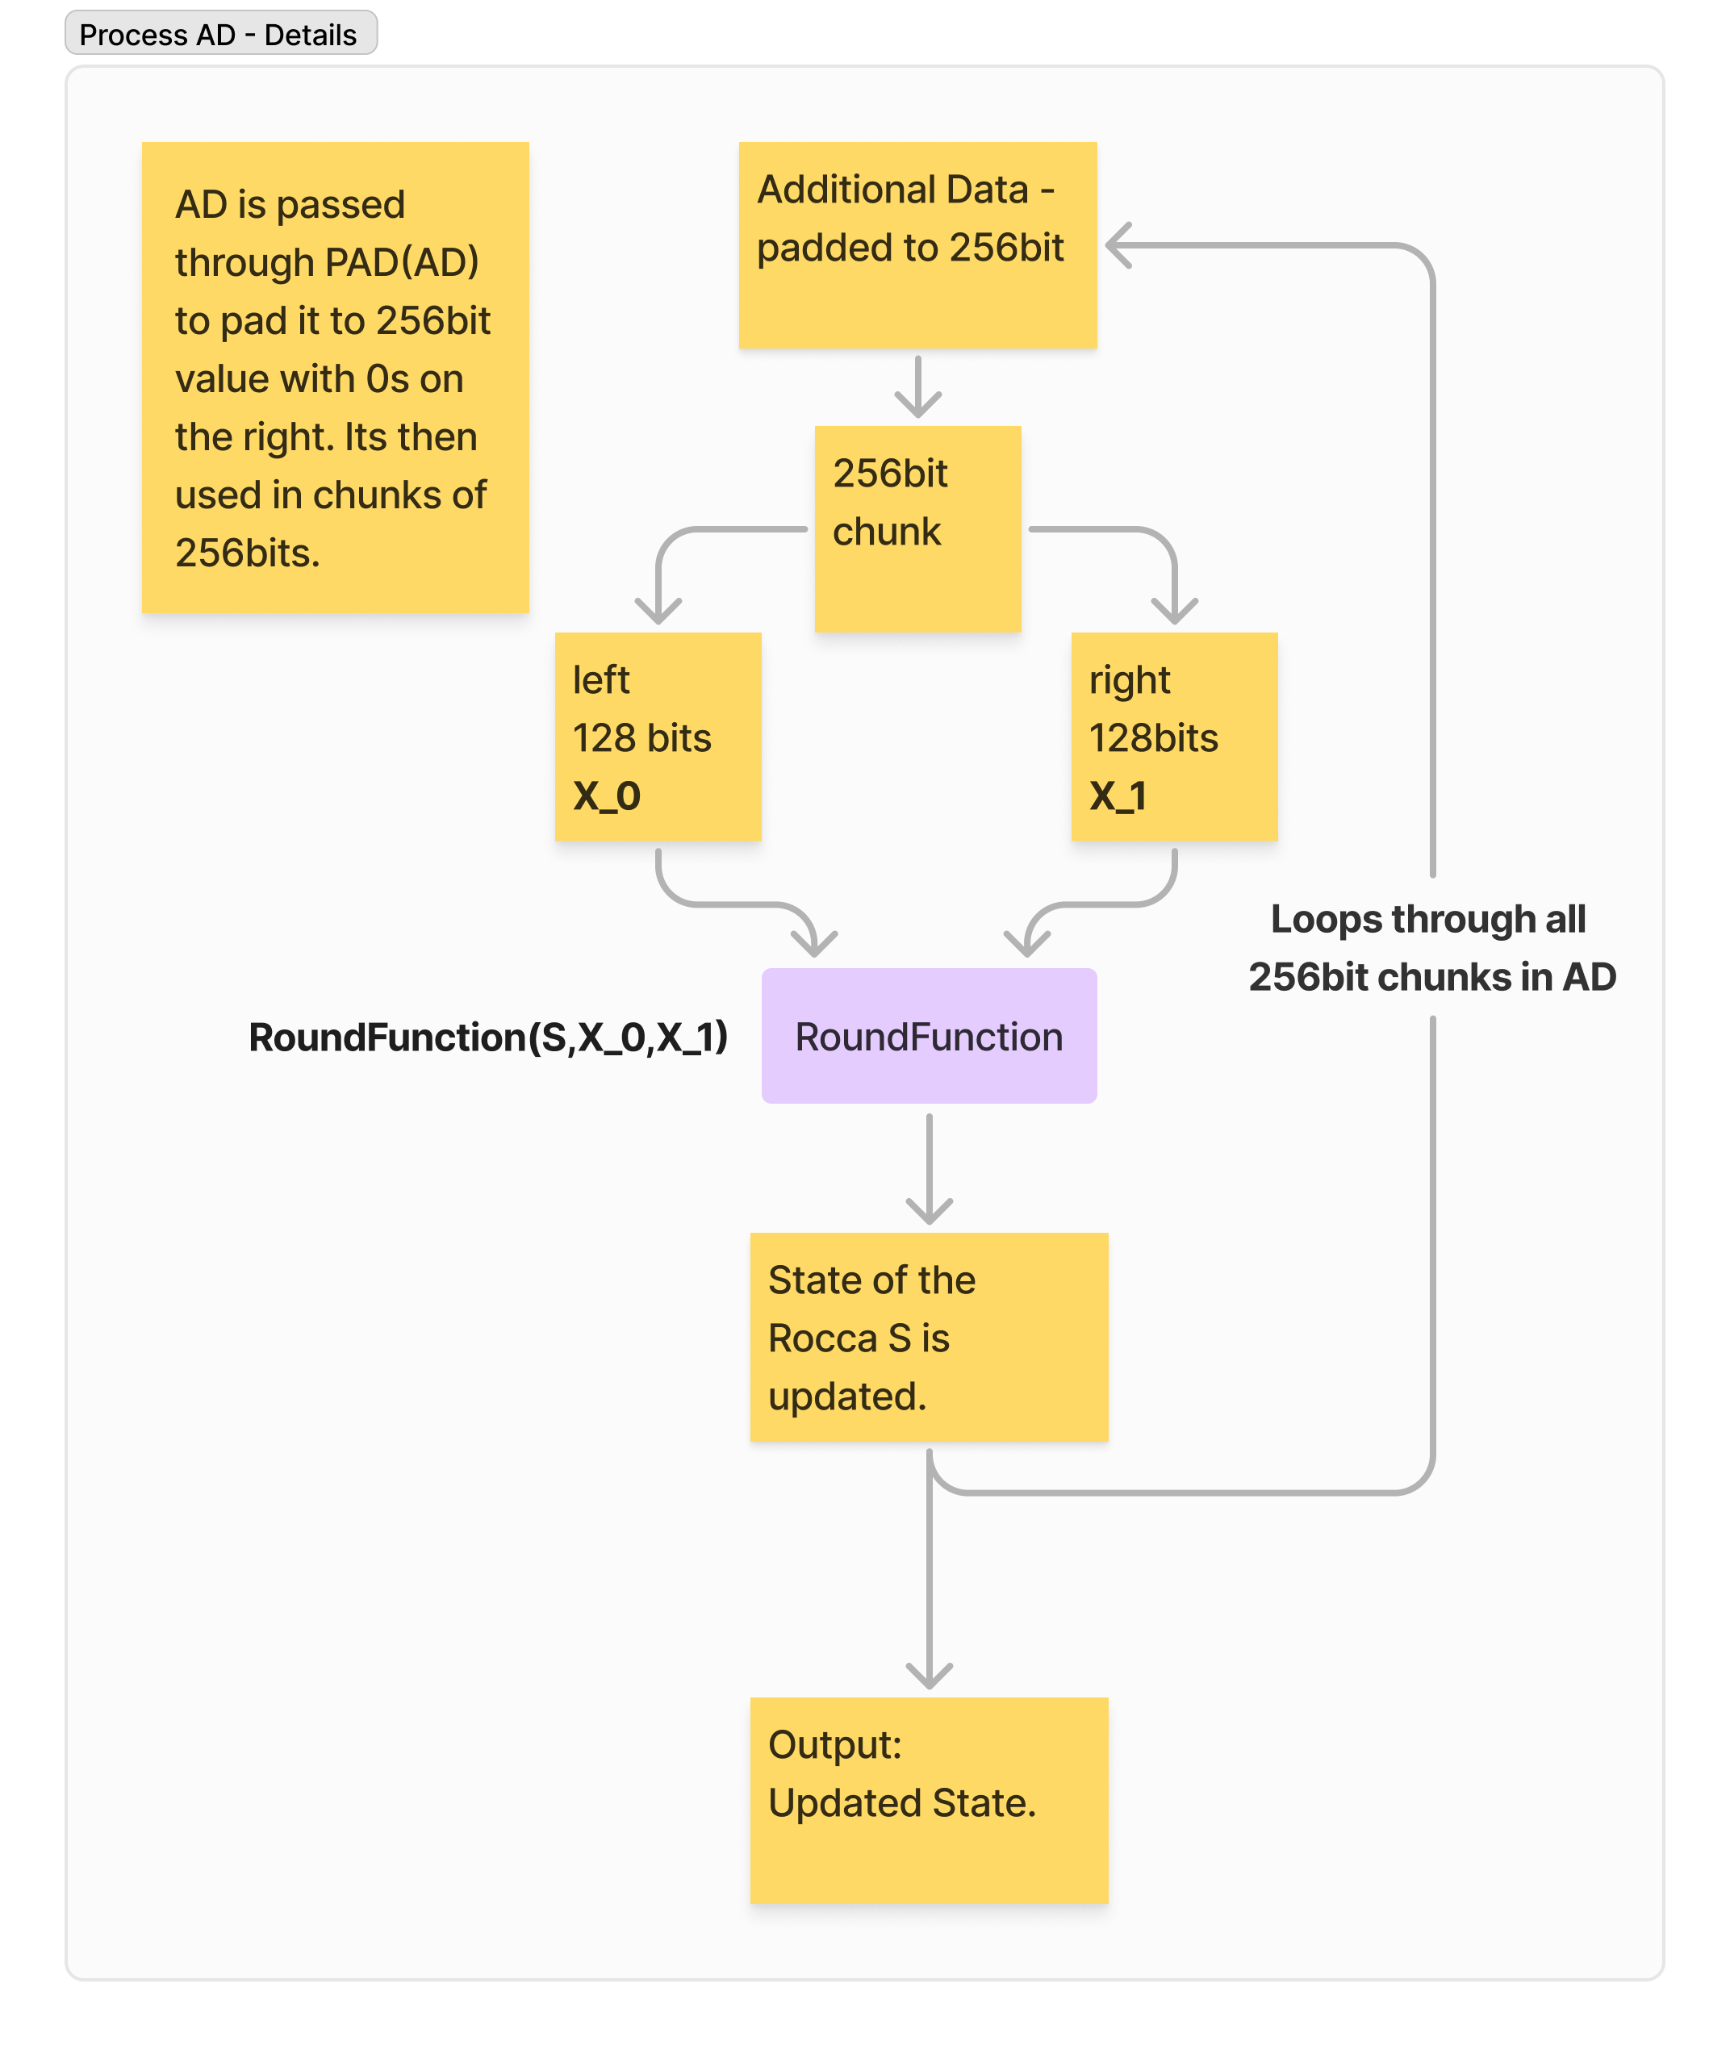
Process AD - Details

Slide 14
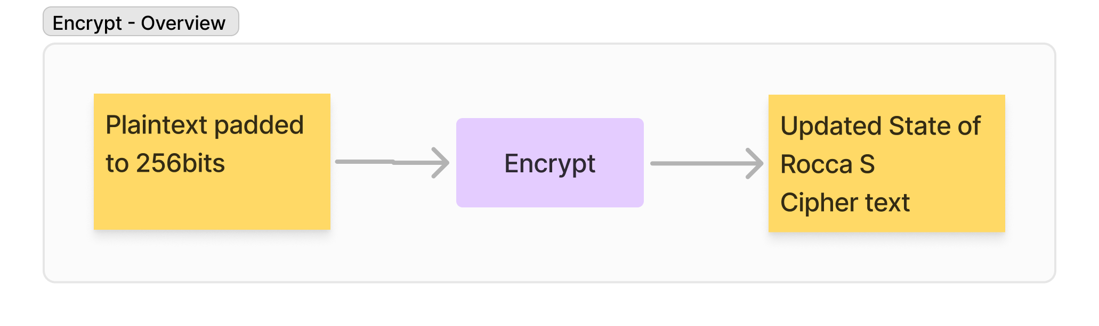
Encrypt - Overview

Slide 15
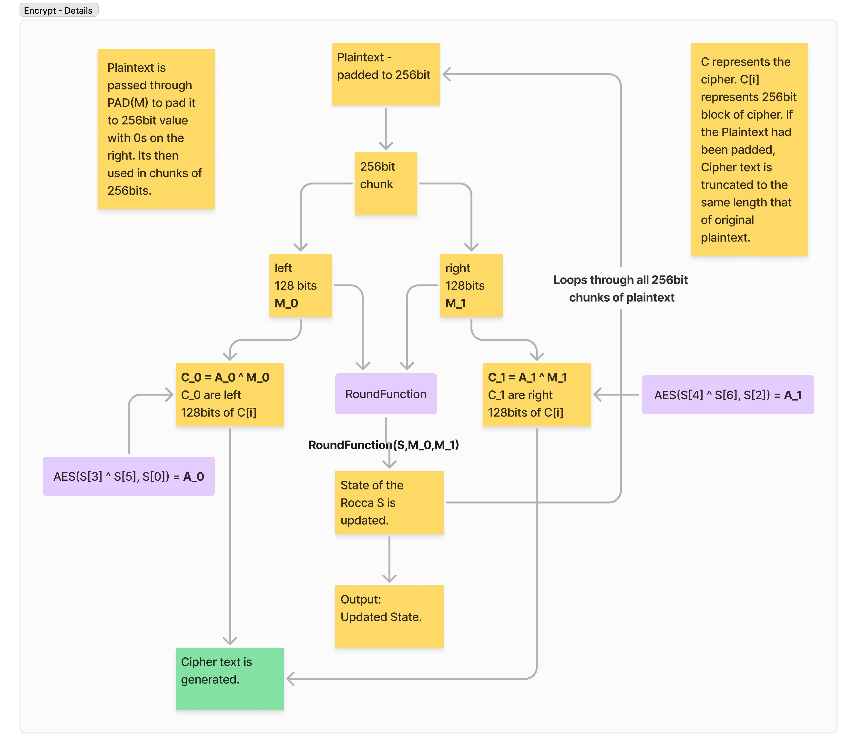
Encrypt - Details

Slide 16
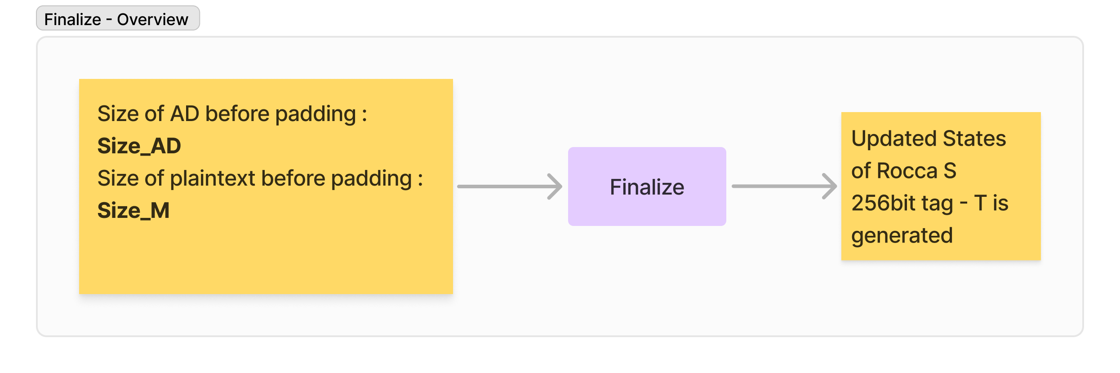
Finalize - Overview

Slide 17
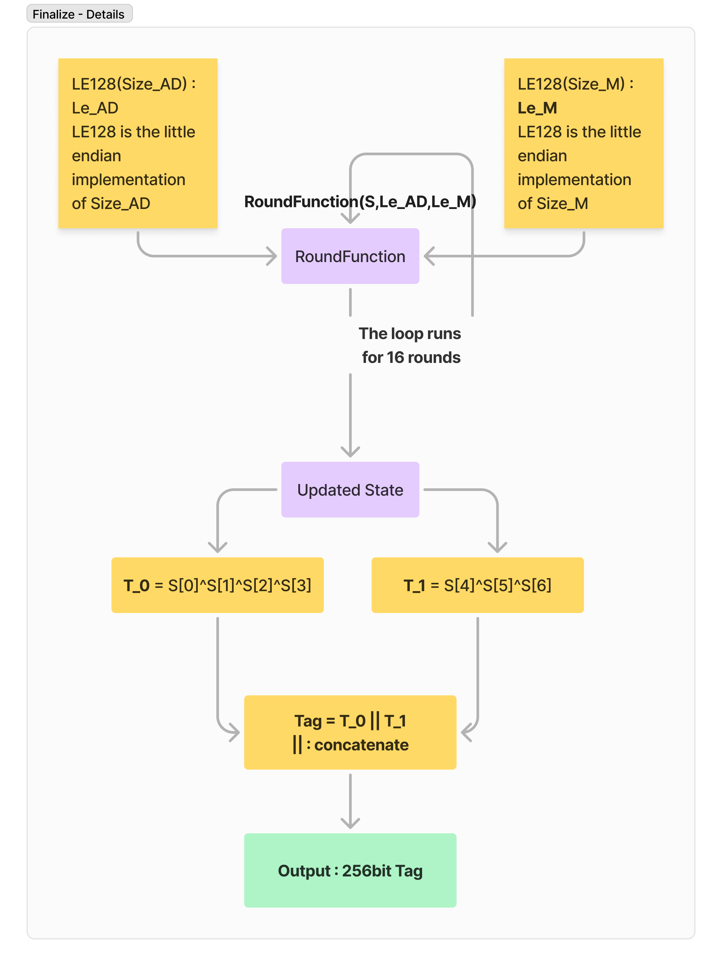
Finalize - Details

Slide 18
Outputs
The Cipher text that’s generated is truncated to the same length as the original message.
The Tag generated is a 256-bit value used for Authentication or Integrity?

