Slide 1
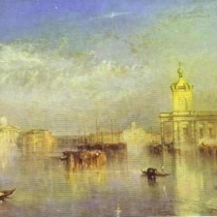
DEEP LEARNING PROJECT
Museum
Guide
Recognise a painting’s genre
Find artworks using words
Alexandre, Vincent, Nahel, Yoni
1 / 10
Notes:
Nahel,
Hello. Today we are presenting Museum Guide, a museum guide that uses deep learning to recognise a painting’s genre and find artworks from a natural language request. We will explain how we built it, from preparing the data to choosing the models, before a live demonstration. Our presentation lasts ten minutes, including the demo.
PROJECT SOURCES
README.md
VISUAL SOURCES
app/collection.csv, William Turner, images/cityscape/s51_r0072.jpg
Latencies are reference measurements on the project’s CPU. Live demo latency may differ.

Slide 2
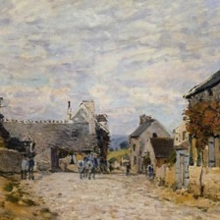
A guide to explore the collection
01
Recognise a genre
A visitor selects a painting.
The model predicts one of five genres.
02
Search by description
“A stormy sea with big waves.”
The guide finds matching artworks.
Alfred Sisley, WikiArt collection
Constraints: CPU inference and no paid API calls per query
2 / 10
Notes:
Nahel,
Our starting point is a fictional museum that wants to help visitors using a kiosk or a phone. We chose two use cases. In the first, a visitor selects a painting and the guide predicts its genre: portrait, landscape, cityscape, still life or religious painting. In the second, visitors describe what they would like to see, such as a stormy sea, and the guide suggests matching paintings from the collection. The museum also sets practical constraints: a standard CPU, a small team and no recurring budget for paid API calls.
PROJECT SOURCES
README.md
demo.py:31
demo.py:183
demo.py:403
VISUAL SOURCES
app/collection.csv, Alfred Sisley, images/cityscape/s51_r0075.jpg
Latencies are reference measurements on the project’s CPU. Live demo latency may differ.

Slide 3
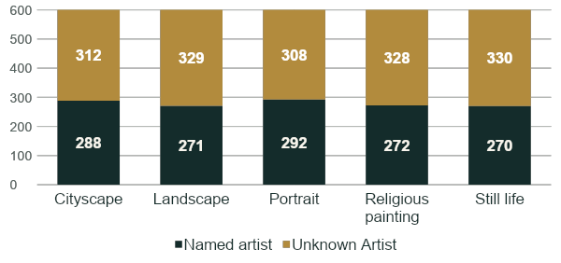
Data exploration shaped our strategy
WikiArt: 81,444 paintings, 27 styles, 11 genres. No captions.
Our subset: 5 genres × 600 = 3,000 images, at 224 × 224 px
54% unknown artist
1,607 unknown images
1,393 named images, 102 artists
Genre shortcut baseline
Artist only 70%
Style only 49%
Random 20%
Why genre over style?
Style pilot: 93% unknown,
about twice the download size
Artist baseline: named-artist images only. Style baseline: all 3,000 images. Both use leave-one-out majority voting.
3 / 10
Notes:
Nahel,
Our exploration shaped the strategy. WikiArt has over 81% thousand paintings but no captions. We selected three thousand images across five balanced genres. 54% have an unknown artist. The rest come from 102 named painters. Why genre rather than style? In our style pilot, 93% had unknown artists, making painter shortcuts difficult to audit, with roughly twice the download size. Those shortcuts are measurable: knowing only the artist predicts the genre in about 70% of eligible named-artist images, compared with 49% from style and twenty percent by chance. We therefore needed a test with unseen painters.
PROJECT SOURCES
src/deep_learning_project_waerniers_lamy_mahieddine/vision/P01_explore_data.ipynb, sections 2–4
adr/0002-classification-target-and-dataset-subset.md
adr/0003-simulated-museum-b-test-set.md
adr/0004-focus-on-genre-classifier.md
DETAILS FOR QUESTIONS
The exact artist-only baseline is 70.2% over 1,391 eligible named-artist images. Two singleton artists cannot receive a leave-one-out prediction. The style-only baseline is 48.6% over all 3,000 images. These baselines use metadata to diagnose shortcut risk. The genre classifier itself receives only pixels, never artist, genre or style metadata.
The style download pilot used five selected styles at 300 images per class: 9 shards, 4.2 GB, compared with 5 shards, 2.3 GB for genres. The chosen genre subset remains 5 shards at 600 images per class. The 93% figure describes that pilot, not every style image in WikiArt.
Named / unknown counts: cityscape 288 / 312 (52% unknown), landscape 271 / 329 (55%), portrait 292 / 308 (51%), religious painting 272 / 328 (55%), still life 270 / 330 (55%). Total: 1,393 named images, 1,607 unknown images, 102 named artists. Percentages round to whole numbers.
Reference CPU latencies may differ from live demo latency.

Slide 4
Split strategy: two simulated museums
WikiArt: 81,444 paintings
Subset: 3,000 images, 5 balanced genres
MUSEUM A: 2,400
MUSEUM B: 600
58 named artists + all 1,607 unknown images
44 named artists, none shared with A
Random 80/20 split
Train: 1,920
Validation: 480
Test only: 120 per genre
384 per genre
96 per genre
Every set: 20% per genre
Unknown Artist stays in A because we cannot verify individual painters’ identities.
All tuning uses validation A. Museum B scores each completed model once.
4 / 10
Notes:
Alexandre,
We created two simulated museums. Museum A contains fifty-eight named artists and every unknown-artist image. An eighty-twenty random image split gives one thousand nine hundred and twenty training images and four hundred and eighty validation images. Museum B contains six hundred paintings from forty-four different named artists. No identified artist appears in both museums. Unknown artists stay in A because we cannot check their identities. All sets are balanced. Every decision uses validation A, and each completed model is scored once on B. The final model reaches eighty-three point three percent on validation and eighty-six percent on B. This supports generalisation to unseen painters, with limits Vincent will explain.
PROJECT SOURCES
adr/0003-simulated-museum-b-test-set.md
src/deep_learning_project_waerniers_lamy_mahieddine/vision/P01_explore_data.ipynb
adr/0012-final-model.md
DETAILS FOR QUESTIONS
Museum A has 2,400 images: 793 named-artist images from 58 artists plus all 1,607 Unknown Artist images. Train has 1,920 images (384 per genre), validation 480 (96 per genre). The random image split within A preserves class proportions. Train and validation may share painters. Museum B contains 600 images (120 per genre), all from 44 named artists absent from A.
The split prevents overlap of identified artist identities between A and B. It does not prove the network uses genre alone. Style correlations and other visual shortcuts can remain. The observed 83.3% validation / 86.0% test result supports transfer to held-out artists, but Museum B may be easier and has no unknown-artist paintings. It uses clean cropped scans, without phone glare or perspective. It simulates the use case rather than reproducing it perfectly. Real museum performance remains unmeasured.
Early stopping, hyperparameters, diagnosis and model selection use validation A. Each completed model is evaluated once on B. This does not mean a single test evaluation for the entire project.
Reference CPU latencies may differ from live demo latency.

Slide 5
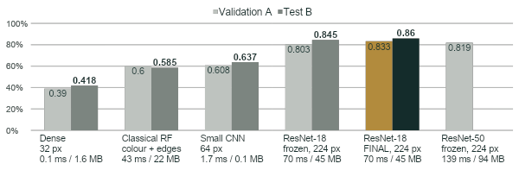
Vision: accuracy and CPU cost
Validation: Museum A (480 images). Test: Museum B (600 images).
Chance: 20%
ResNet-50: not tested on B
Rejected on validation, cost ×2
Final model: ≈ ±3 pts
95% interval on 600 test images
5 / 10
Notes:
Alexandre,
Here we compare validation and test accuracy, together with CPU cost. The classical random forest uses colour and edge features. It reaches fifty-eight point five percent on B, almost seventeen points above the dense network. Simply being a neural network is therefore not enough. Fine-tuned ResNet-18 reaches eighty-six percent, twenty-seven point five points above the classical baseline. Pretraining and image resolution drive the gain. ResNet-50 has only a validation bar. It gained one point six over frozen ResNet-18, below our predefined two-point threshold, while roughly doubling latency and model size. We rejected it before test evaluation, so its Museum B score is missing, not zero. The dotted line marks the twenty-percent chance level. We avoid strong claims about small differences, especially the one-point-five test gap between the two ResNet-18 models.
PROJECT SOURCES
adr/0012-final-model.md
adr/0014-classical-baseline.md
results/experiments.csv
results/classical_baseline.csv
VALUES AND SOURCE DISCREPANCY
Dense: validation 39.0%, test 41.8%, 0.1 ms, 1.6 MB. Classical random forest: 60.0%, 58.5%, 43 ms, 22 MB. Small CNN: 60.8%, 63.7%, 1.7 ms, 0.1 MB. Frozen ResNet-18: 80.3%, 84.5%, 70 ms, 45 MB. Final fine-tuned ResNet-18: 83.3%, 86.0%, 70 ms, 45 MB. Frozen ResNet-50: validation 81.9%, test NOT EVALUATED, 139 ms, 94 MB.
ADR 0012 and the supplied table list 58.8% validation with the CNN’s 63.7% test. The measured cnn_longer row in experiments.csv pairs best_val_acc=0.6083 with test_acc=0.6367. This chart uses 60.8% so the validation and test values describe the same run. Dense and frozen ResNet validation values are the reported multi-seed summaries.
TEST DISCIPLINE
The test series contains only five measured points. Its sixth point, for ResNet-50, is absent. It has no test bar, no zero placeholder and no inferred or newly computed score. Its +1.6 point validation gain is relative to frozen ResNet-18, not the final fine-tuned model. The baseline at 20% corresponds to five balanced genres. No training or test evaluation was run to update this presentation.
UNCERTAINTY AND INTERPRETATION
The final model’s 86% score on 600 test images has an approximate 95% binomial margin of ±3 percentage points. Lower-accuracy baselines have margins closer to ±4 points. Marginal intervals do not establish significance for paired model differences. Do not present the CNN–forest gap or the 1.5-point test gap between the ResNet-18 models as a demonstrated statistical improvement. Fine-tuning was selected on validation (+3.0 points), not that test gap.
CPU latencies and model sizes are reference measurements from the project on one CPU thread. They may differ in the live app.

Slide 6
Interpreting the confusion matrix
Final ResNet-18. Validation A: 480 images, 96 per genre.
Rows: true genre. Columns: predicted genre.
True / predicted | Cityscape | Landscape | Portrait | Religious painting | Still life
Cityscape | 73 | 18 | 0 | 3 | 2
Landscape | 6 | 84 | 0 | 2 | 4
Portrait | 0 | 0 | 76 | 7 | 13
Religious painting | 3 | 3 | 13 | 76 | 1
Still life | 0 | 1 | 3 | 1 | 91
18 / 96
Cityscapes predicted
as landscapes (18.8%).
13 / 96
Religious paintings predicted
as portraits (13.5%).
Portraits also become still life:
13 of 96 images.
Diagonal: 400 correct. Off-diagonal: 80 errors.
Similar subjects may blur genre boundaries. This remains a hypothesis, not a label audit.
Notes:
Alexandre,(Bonus
Here, each row is the true genre and each column is the prediction. The diagonal contains correct answers. Across four hundred and eighty validation images, there are eighty mistakes. Eighteen cityscapes become landscapes, and thirteen religious paintings become portraits. Thirteen portraits also become still lifes. These errors cluster between visually related categories. A city view can contain a lot of landscape, and a religious painting can resemble a portrait. Those are plausible explanations, which would require a label audit to confirm. This matrix describes validation A, where accuracy is eighty-three point three percent.
READING THE MATRIX
Rows are true labels and columns are predicted labels. Cells contain image counts, not percentages. Each row totals 96; the diagonal totals 400 of 480 (83.3%), with 80 errors. Gold highlights frequent off-diagonal errors, including portrait predicted as still life, which also has 13 cases.
PROJECT SOURCES
src/deep_learning_project_waerniers_lamy_mahieddine/vision/P10_error_analysis.ipynb, section 2, saved output for RUN=resnet18_layer4
adr/0003-simulated-museum-b-test-set.md
INTERPRETATION
This is the saved validation confusion matrix for resnet18_layer4_2026-10-22_17-21-37, not the Museum B test matrix. The test set has 600 images and 86.0% accuracy. The corresponding cityscape/landscape and religious/portrait counts on test differ, so do not quote test counts while showing this matrix. No model has been retrained or evaluated to add this slide. Similar subject matter is a plausible explanation rather than proof that the labels are wrong or that stronger models cannot help.
PRESENTATION USE
This hidden bonus sits immediately after the performance chart. The ten main slides retain their displayed numbering and timings. Showing this bonus adds roughly 45 seconds unless other material is shortened.

Slide 7
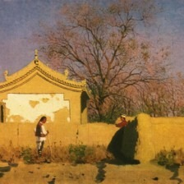
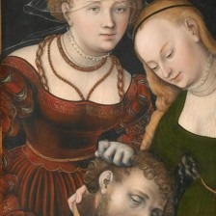
The selected model and its limits
ResNet-18: fine-tuned final block and output layer
86%
Accuracy on the Museum B test set
≈ 70 ms
Cityscape
called “landscape”
Religious painting
called “portrait”
per image on our CPU
+27.5 pts vs the classical baseline on B
The test uses painting reproductions. We still need to evaluate photos taken inside a museum.
Vincent · 3:50–5:00
6 / 10
Notes:
Vincent,
Our final model is ResNet-18 at two hundred and twenty-four pixels, with its last block and output layer fine-tuned. Validation accuracy rises from eighty point three to eighty-three point three percent at the same inference cost. The test score is eighty-six percent, with roughly a three-point uncertainty margin. Four of the five evaluated models improve on B. The classical baseline is the exception, falling from sixty to fifty-eight point five percent. There is no systematic collapse on unseen painters, which supports generalisation, but this is not proof that all shortcuts have disappeared. Museum B may simply be easier. Remaining errors involve overlapping genres, and clean scans do not reproduce phone photos. Yoni will now explain collection search.
PROJECT SOURCES
adr/0012-final-model.md
adr/9999-vision-executive-summary.md
adr/0003-simulated-museum-b-test-set.md
VISUAL SOURCES
app/collection.csv, observed errors s51_r0008 (Vasily Vereshchagin) and s42_r0137 (Lucas Cranach the Elder)
Latencies are reference measurements on the project’s CPU. Live demo latency may differ.
ADDITIONAL CONTEXT
The classical baseline contradicts the blanket claim that every model improves on B. Its validation/test pair is 60.0% / 58.5%. Stable or higher test performance supports transfer to held-out identified artists, while B’s composition, clean scans and remaining style correlations prevent a proof that the model learns genre alone. The split itself guarantees zero shared identified artists, not a particular score pattern. The final network’s +27.5-point gain is 86.0 minus 58.5 on the same Museum B test set.

Slide 8
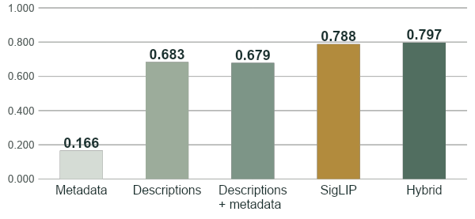
Image features improve search
Ranking quality on Museum B, nDCG@5
0.788
SigLIP alone
Hybrid: +0.010
p = 0.78
No demonstrated gain
from the hybrid.
nDCG@5: quality of the top five results, from 0 to 1. Test set: 40 queries.
7 / 10
Notes:
Yoni,
For search, we followed the same approach: begin with a simple baseline and measure each addition. Metadata, such as artist and genre, poorly describes what visitors are looking for in an image. On Museum B, it reaches about zero point seventeen in nDCG at five. This metric measures the relevance of the top five results on a scale from zero to one. Descriptions generated by a vision-language model raise the score to about zero point sixty-eight. SigLIP compares the query directly with images and reaches about zero point seventy-nine. The hybrid combines both approaches and reaches about zero point eighty. However, this gap is too small to establish an improvement across our forty test queries, so we keep SigLIP alone. An AI judge provides the relevance labels, checked against a human on one hundred and fifty pairs, with a weighted kappa of zero point sixty-five.
PROJECT SOURCES
results/nlp/test_summary.csv
adr/0013-nlp-evaluation-protocol.md
adr/9998-nlp-executive-summary.md
Latencies are reference measurements on the project’s CPU. Live demo latency may differ.

Slide 9
SigLIP connects a query to paintings
01
Index the collection
82 ms
Images become vectors,
computed once in advance.
per query on CPU
02
Encode the query
The query becomes a vector
in the same embedding space.
0 API calls
03
Rank by similarity
for each search
A dot product ranks the paintings
by similarity to the query.
8 / 10
Notes:
Yoni,
Here is how we turned that choice into a usable search system. Before any visit, SigLIP’s image encoder converts each painting into a numerical vector. We compute these vectors once and store them alongside the artwork identifiers. During a visit, the text encoder turns the user’s sentence into a compatible vector. A dot product then compares the request with every painting, and the app displays the best matches. For a collection of six hundred paintings, this stays simple and runs on CPU, without a dedicated vector database or paid API call for each search. Reference latency is eighty-two milliseconds per query once the collection has been indexed. We can now move from the models to their integration into the application. I will hand over to Alexandre.
PROJECT SOURCES
demo.py:65
demo.py:78
adr/9998-nlp-executive-summary.md
scripts/build_app.py:122
Latencies are reference measurements on the project’s CPU. Live demo latency may differ.

Slide 10
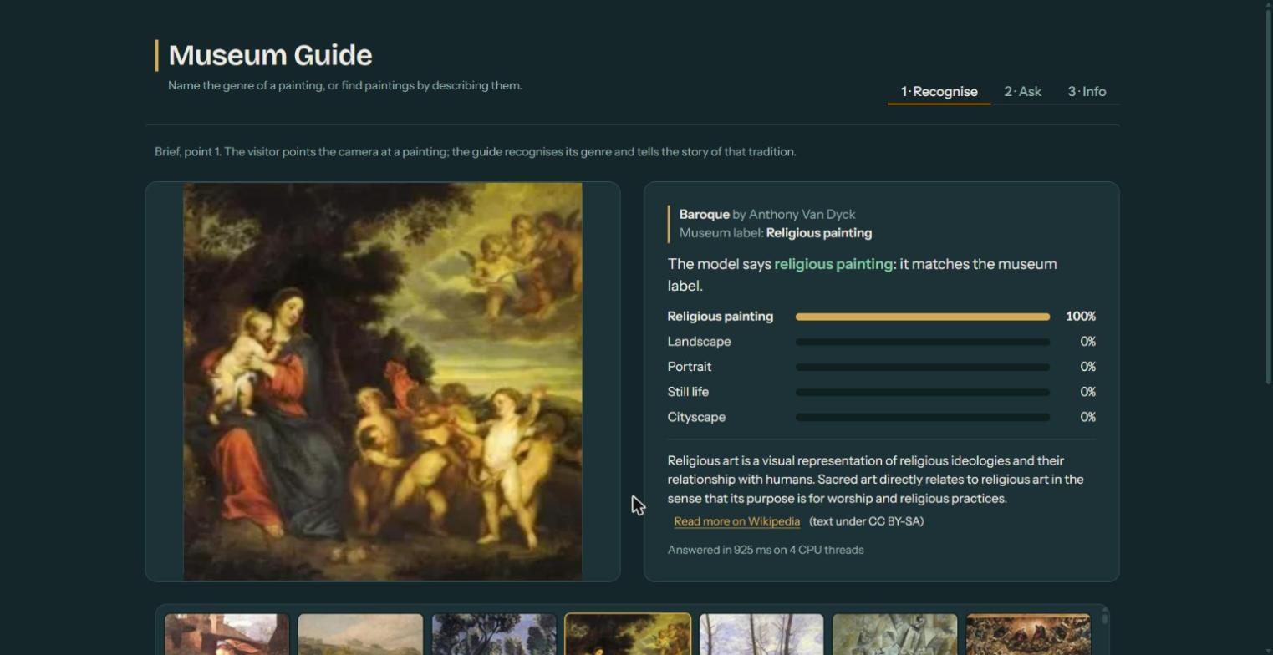
Two models in one application
Gradio
600 paintings
from Museum B
Classification
runs on each click
Search uses
precomputed vectors
The app bundles the models, collection, embeddings and information about each genre.
Alexandre · 7:30–8:00
9 / 10
Notes:
Vincent,
We integrated both models into a Gradio interface. A preparation script packages Museum B’s paintings, thumbnails, model weights and search vectors. It also checks that the shipped model reproduces the eighty-six percent score. Let us switch to the live demo: we will recognise a painting’s genre, then search for artworks using a description.
PROJECT SOURCES
scripts/build_app.py:91
scripts/build_app.py:115
scripts/build_app.py:122
demo.py:370
demo.py:403
demo.py:420
VISUAL SOURCES
docs/img/demo-recognise.jpg, project screenshot
Latencies are reference measurements on the project’s CPU. Live demo latency may differ.

Slide 11
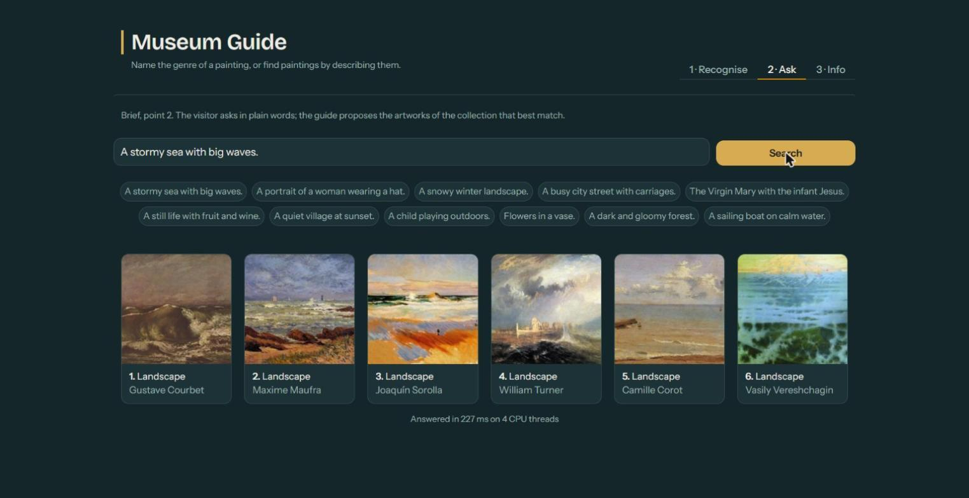
Live demonstration
01 Recognise
Select a painting and read
the predicted genre.
02 Search
Describe a scene, then
compare the results.
03 Interpret
Open the live demo
Read the scores in Info.
museum-guide-643636450457.europe-west1.run.app
10 / 10
Notes:
Alexandre & Vincent,
[8:00–8:40: switch to the already loaded app, open “1 · Recognise”, and click a painting selected during rehearsal.]
Here we choose an artwork from Museum B, whose artist was absent from training. The model shows its predicted genre, the probabilities for the five categories and its response time. We can compare the prediction with the museum label. The probability distribution also shows how the model divides its confidence between related genres.
[8:40–9:30: open “2 · Ask”. Click “A stormy sea with big waves.”, then “A portrait of a woman wearing a hat.”.]
We now describe what we are looking for. Search retrieves paintings that match the subject of the sentence. When we change the request, the results change too. The interface displays six artworks, while our evaluation measures the ranking of the top five. The displayed response time comes from this live search.
[9:30–10:00: open “3 · Info”.]
This page brings together our results and evaluation protocol. We achieved eighty-six percent classification accuracy on six hundred test images, and about zero point seventy-nine in ranking quality for search. Both functions run on CPU without a paid API call for each use. Thank you.
PROJECT SOURCES
demo.py:36
demo.py:386
demo.py:420
demo.py:435
results/nlp/test_summary.csv
adr/0012-final-model.md
VISUAL SOURCES
docs/img/demo-ask.jpg, project screenshot
Latencies are reference measurements on the project’s CPU. Live demo latency may differ.

