Slide 1
NES Static Recompilation
AN UNTRADITIONAL, less feasible approach to emulation
By David Pokora
Notes:
-My name is David Pokora, I did my project on static recompilation of NES ROMs to C source files.
-It’s a less traditional approach to emulation, because it’s significantly more difficult and less possible than dynamic recompilation and interpretation.

Slide 2
Static Recompilation
Recompiling source to target, without interpreting/executing the source.

Slide 3
Why not Static Recompilation?

Slide 4
Lack of Runtime Context
Can predict (no runtime complications):
1) Entry points → start of code
2) Any jump/branch → start of code
3) Certain instructions → end of code
4) Non-code = data
Can’t predict (runtime complications):
Runtime jumps → start of code
Runtime branch conditions always true → end of code
Result: Limited support of ROMs.
Example:
addr = *(0x702)
Jump(addr)
*(0x702) = ???
Notes:
-Although there are things we can predict/discover about our executable, as listed,
-There is also much we can’t (or have a hard time to) predict. As you can see on the picture on the right.
-As a result, I limited the scope of this project to handle certain conventions.

Slide 5
Why Static Recompilation of NES?

Slide 6
Why Static Recompilation of NES?
Educational: A compiler that explores:
Operating Systems
Emulation
Disassembly
Higher level analysis
Otherwise: It’s different and fun.

Slide 7
The Approach

Slide 8
The Approach
Runtime Calculated Jumps: Support jumping anywhere disassembled.
Hope for no jumps elsewhere.
Room for future predictions
(Always True) Branch Conditions: Assume non-existent
(dev should’ve used jump instead of branch)
Every instruction:
CPU Cycle Accuracy: Maintain computational integrity
Interrupts: Ready to interrupt program flow

Slide 9
The Approach
Control Flow (Consolidated Code)
Bad: Function call for every jump. Pollutes C’s stack while NES’ stack should be unused.
Solution: Retain layout. All code in one function (game_execute), use “goto” statements to jump around.
Jump/Branch → “goto” statements (doesn’t use stack)
Call Subroutine/Interrupt → Call game_execute(address) (rely on C stack instead of virtual NES stack to return)
Indirect jump (jump by address) → Use a switch table for every (address → goto label)

Slide 10
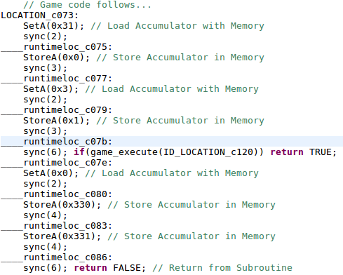
.NES ROM → C Source/Header
Script:
python3.5 NESgen.py -i <ROM.NES> -c <game.c> -h <game.h>
Code Output:
Known Jump Location
Instruction
Update w/ 3 CPU cycles, handle interrupts, other h/w.
Not known, but possible runtime calculated jump location

Slide 11
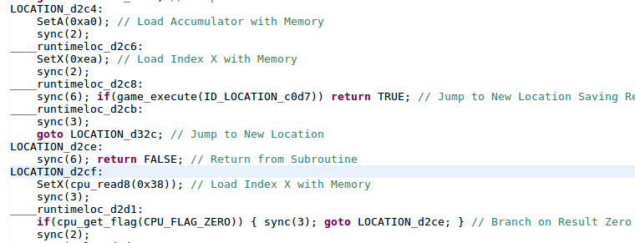
.NES ROM → C Source/Header
Subroutine
Unconditional Jump
Return from Subroutine
Conditional Branch

Slide 12
Why so assembly-like?
Highly legible C-like code requires lots of precise high level analysis/optimization.
Example: You merge instructions which a calculated jump occurs in the middle of.
Problem: To fully know this won’t happen, you’ll need to fully understand the program. Not always possible.
Example: Assume some memory can be split into a separate variable.
Problem: The space is used for various purposes. Or it could be part of a larger variable/construct you cannot truly understand.
This would further ambiguate the code from anyone trying to truly make sense of it.
Example: You don’t account for timing of hardware.
Problem: Lots of developers rely on knowing exactly what clock cycle hardware is at for a given point in their program.

Slide 13
Compiling and Running
Aside from the python written recompiler, I provide a C project to compile results in:
.NES ROM → NESgen (Recompiler) → .c / .h Files
.c / .h Files → NESsys (C Project) → Executable
Notes:
-Okay, so what do you do with the generated .c / .h files?
-Well, I provide a C project to compile the output C files in.
-This way we can go from a ROM all the way to a native executable.

Slide 14
Goal: Get small set of test ROMs working.
Notes:
-So the goal was initially to just get a bunch of test ROMs running from this one source I had.

Slide 15
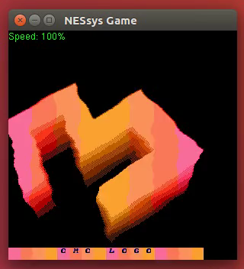
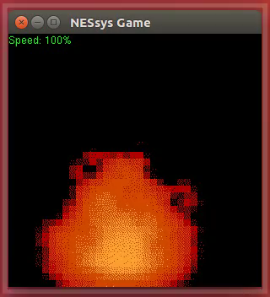
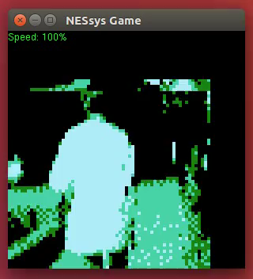
Test ROMs
Notes:
-I was able to support all the test ROMs I had initially set out to support.
-This just included simple ROMs, ROMs that individually tested sprites, backgrounds, interrupts + timing, PPU rendering, etc.
-So here you have some of the first ROMs I supported that played simple animations/videos

Slide 16
Production ROMs?

Slide 17
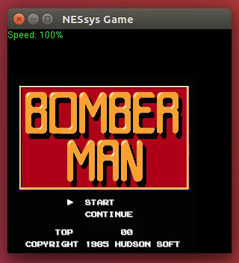
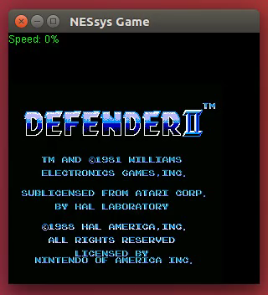
Production ROMs…?
Notes:
-Well unfortunately almost all production ROMs use runtime calculated jumps, and use virtual method tables, or they manipulate the stack in untraditional ways, such as return oriented programming.
-So most ROMs that will run will still have functional issues.
-But there’s always room for improvement, more analysis could be done to better support ROMs.

Slide 18
Moral of the Story
Avoid static recompilation in similar cases if you can
Needing runtime context you don’t have is problematic.
Dynamic recompilation offers context (and is fast)
Interpretation offers context (although slower)
Notes:
-So what can you learn from any of this?
-Avoid static recompilation if you can, for cases like this.
-Needing context you don’t have makes things difficult.
-Dynamic recompilation and interpretation in cases such as this are preferable, and are standard in emulators.

