Slide 1
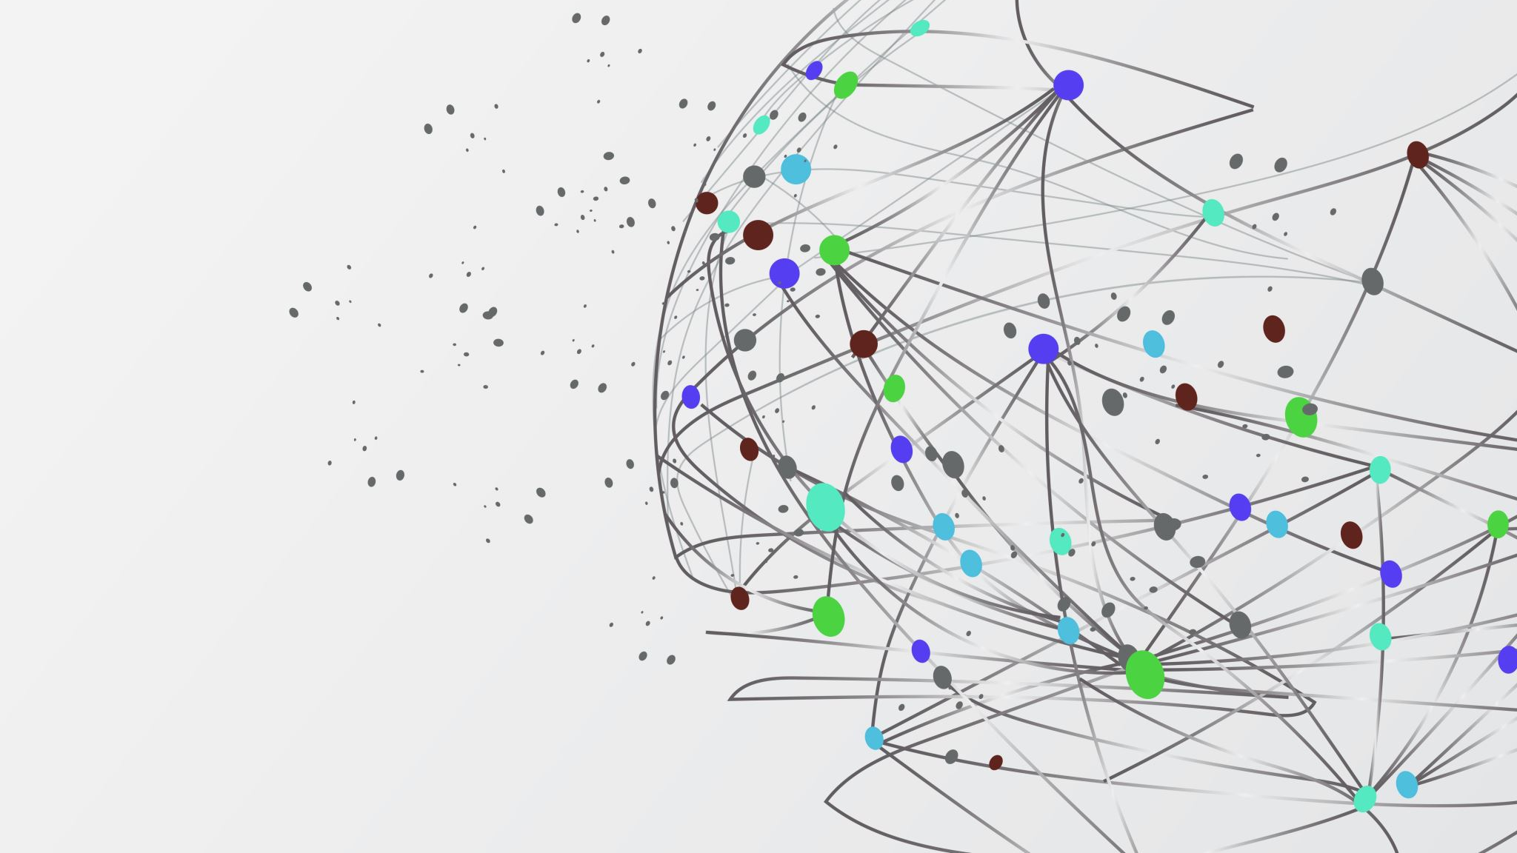
Classification
Muhammad Arslan Shahzad @ICodeGuru

Slide 2
Classification
Classification is the process of recognition, understanding and grouping of objects in to ideas & preset categories/ sub-population.
In ML a classification algorithm is used to utilize the input training data for the purpose of predicting the probability that the given data will fall in predetermined categories.
Examples : Spam Classifier
Classification is the pattern recognition

Slide 3
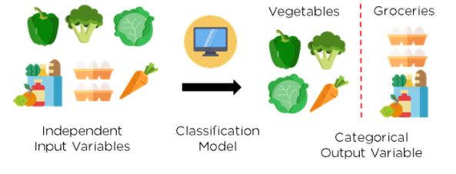
Classification

Slide 4
Types of Classification
Binary Classifier
If the classification problem has only two possible outcomes,
Yes/ No , Cat/ Dog
Multi-Class Classifier
If classification problem has more than two outcomes.
Classification of crops, music

Slide 5
Learner in Classification
Lazy Learners
Lazy Learner firstly stores the training dataset and wait until it receives the test dataset. In Lazy learner case, classification is done on the basis of the most related data stored in the training dataset. It takes less time in training but more time for predictions.
KNN
Eager Learners
Eager Learners develop a classification model based on a training dataset before receiving a test dataset. Opposite to Lazy learners, Eager Learner takes more time in learning, and less time in prediction
Decision Tree, Naïve Byes, ANN

Slide 6
Classification Algorithms
Linear Models
Logistic Regression
SVM
Non- Linear Models
KNN
Kernel SVM
Naïve Byes
Decision Tree
Random Forest

Slide 7
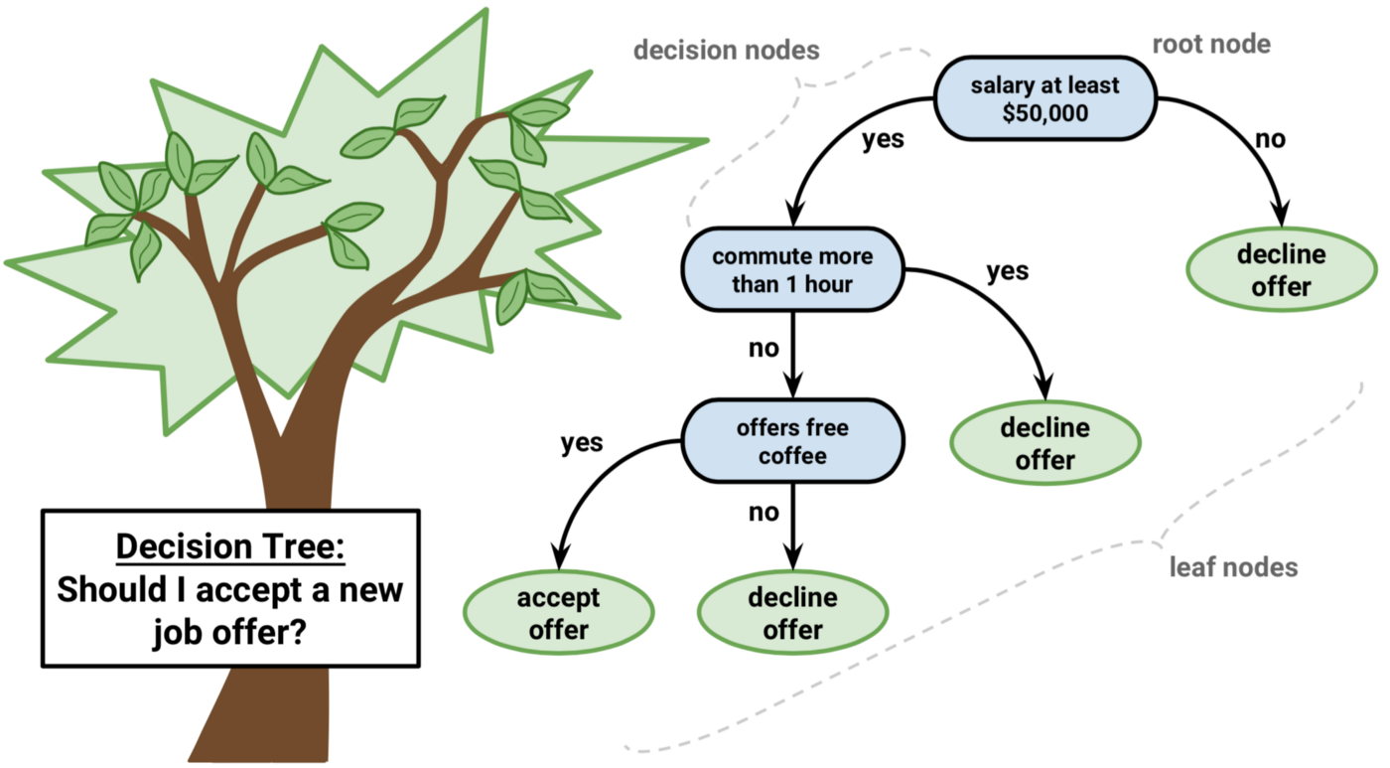
Working of Decision Tree

Slide 8
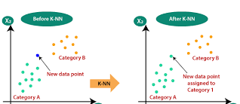
KNN

Slide 9
Evaluating a Classification Model
After training our model we have to assess its performance
Methods to Evaluate a Classification Model
Confusion Matrix
Log Loss or cross entropy- Loss
AUC-ROC Curve

Slide 10
Confusion Matrix
 | Actual Positive | Actual Negative
Predicted Positive | True Positive | False Positive
Predicted Negatives | False Negative | True Negative
Describe the model performance and return a matrix or table as output
Also known as error matrix
Matrix is made up of the results of the forecasts in a summarized way, together with the total number of right and wrong guesses
Accuracy = (TP+TN)/Total Population

Slide 11
Cross-Entropy Loss
It is used to assess the performance between 1 and 0
A good binary classification model should have values close of 0
If the predicted values differs from the actual value the log loss rises
Lower the log loss higher the accuracy of model
(ylog(p)+(1?y)log(1?p))
P is predicted values
Y is actual values

Slide 12
AUC-ROC Curve
Used to show the performance of multi class classification models.
Used TPR (True Positive Rate) and FPR (False Positive Rate) to plot the curve
Takes TPR on y –axis while FPR on the x-axis

Slide 13
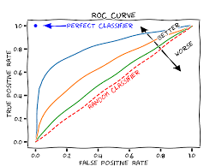
AUC Curve

