Slide 1
Regression
By Muhammad Arslan Shahzad @IcodeGuru

Slide 2
Agenda
Regression
Use of Regression
Types
Linear Regression
Best fit with least Square
Accuracy with R²
Coding Algorithm

Slide 3
Regression
Regression is a statistical technique that relates a dependent variable to one or more independent variables.
Regression Analysis is a form of predictive modelling technique which investigates the relationship between dependent and independent variables.

Slide 4
Mathematical Equation
Y= a + bX + e
Y – Dependent variable
X – independent variable
B – Slope
A – intercept
E – error (residual)

Slide 5
Uses of Regression
Forecasting an effect
Trend Forecasting
Time Series
Determine strength of predictors

Slide 6
Types of Regression
Linear Regression
Simple Linear Regression
Multi -Linear Regression
Logistic Regression
Non-Linear Regression

Slide 7
Linear Regression Selection of Algorithm
Classification and Regression Capabilities
Data Quality
Computational Complexity
Comprehensible and Transparent

Slide 8

Where to use Linear Regression

Slide 9
Linear Regression Uses
Evaluation of Trend and Sales Estimates
Analyzing the impact of prices
Assessment of risk in financial services
Weather Analysis and prediction

Slide 10
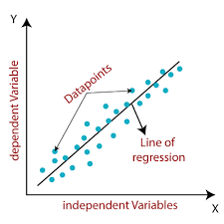
Linear Regression Algorithm
Y=mx+c

