Slide 1
DSE + IELTS English Coach
Helping students in Hong Kong & Shenzhen prepare for DSE and IELTS
幫助香港與深圳學生備戰 DSE 與 IELTS
帮助香港与深圳学生备战 DSE 与 IELTS
Investment Opportunity
投資機會 · 投资机会
For tutorial centres & private schools · 面向補習社與私立學校
[Company Name Ltd] · Confidential

Slide 2
THE ASK
融資要約
200,000 HKD for 30% equity
港幣 20 萬換取 30% 股權
Investment
Your share
Company value
投資金額
股權比例
投後估值
200,000 HKD
30%
~667,000 HKD
We want a partner who can bring students — through centres and schools — not only capital.
我們希望夥伴能帶來學生（透過補習社／學校），而不只是資金。
我们希望伙伴能带来学生（通过补习社／学校），而不只是资金。
DSE + IELTS English Coach · Confidential
2 / 10

Slide 3
FOR STUDENTS
學生痛點
Students practise hard — but still feel lost
學生很努力，卻仍不知道自己差在哪
Unclear feedback
Mixed exams
Hard to stay consistent
不知道錯在哪裡
DSE 與 IELTS 分開準備
難以堅持每天練習
Teachers are busy. Students wait days for comments on writing and speaking.
Many families need both — HK DSE now, IELTS for overseas plans.
Without a clear weekly plan and visible progress, motivation drops.
DSE + IELTS English Coach · Confidential
3 / 10

Slide 4
OUR ANSWER
我們給學生甚麼
A study companion for every skill
讀寫聽說 — 一個地方練齊
• Reading, Writing, Listening, Speaking — for DSE and IELTS
閱讀、寫作、聆聽、說話 — 同時支援 DSE 與 IELTS
• Instant scores after practice, plus clear tips on how to improve
練習後即時得分，並用簡單語言說明如何進步
• Chinese or English interface — parents and students both understand
介面支援英文 / 繁體 / 簡體，家長與學生都看得懂
• Works on phone and computer — practice anytime after class
手機與電腦都可用 — 下課後隨時練習
Centres can assign practice as homework. Students see their weak areas. Parents see progress.
DSE + IELTS English Coach · Confidential
4 / 10

Slide 5
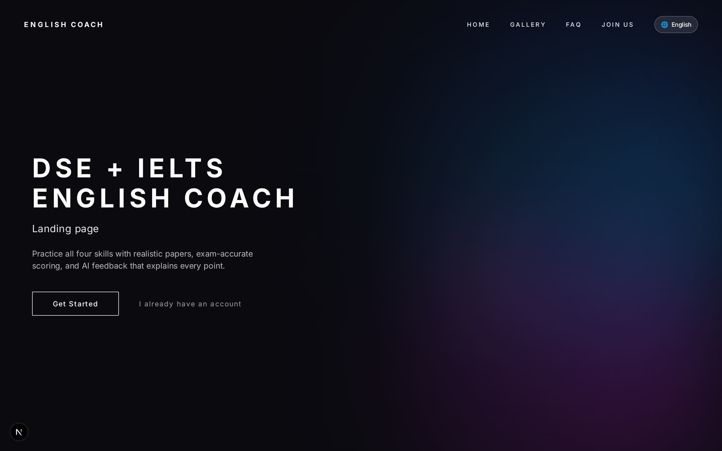
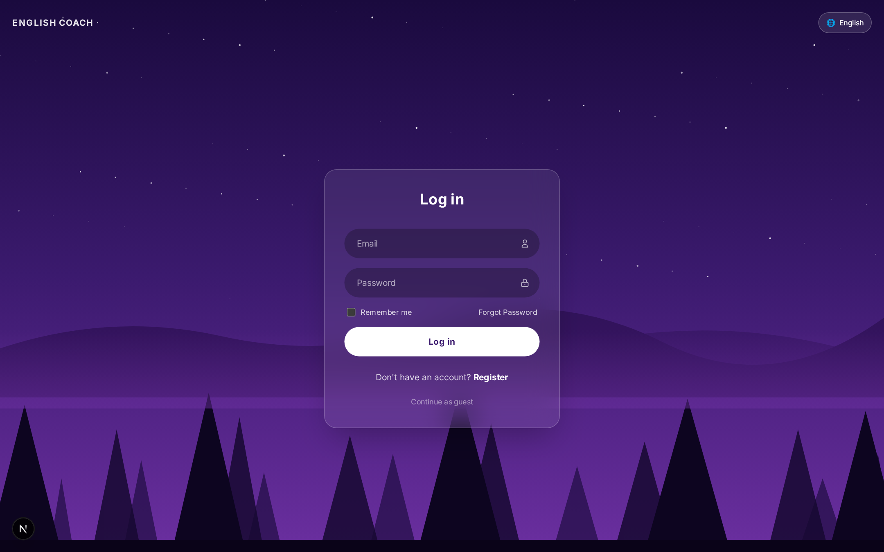
PRODUCT
產品畫面
What students see first
學生第一眼看到的畫面
Homepage · 首頁
Login · 登入
DSE + IELTS English Coach · Confidential
5 / 10

Slide 6
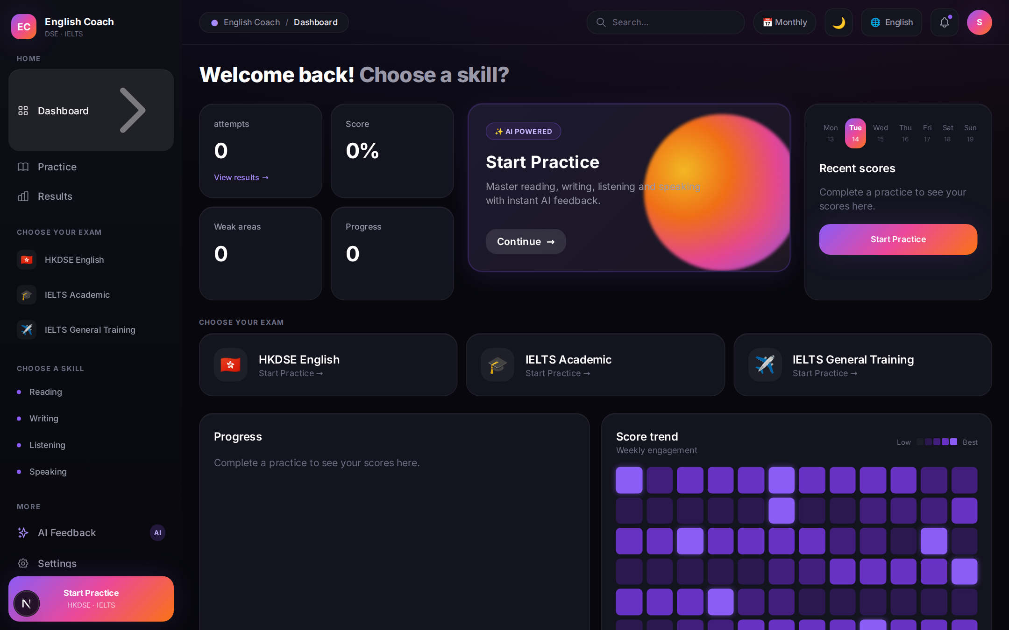
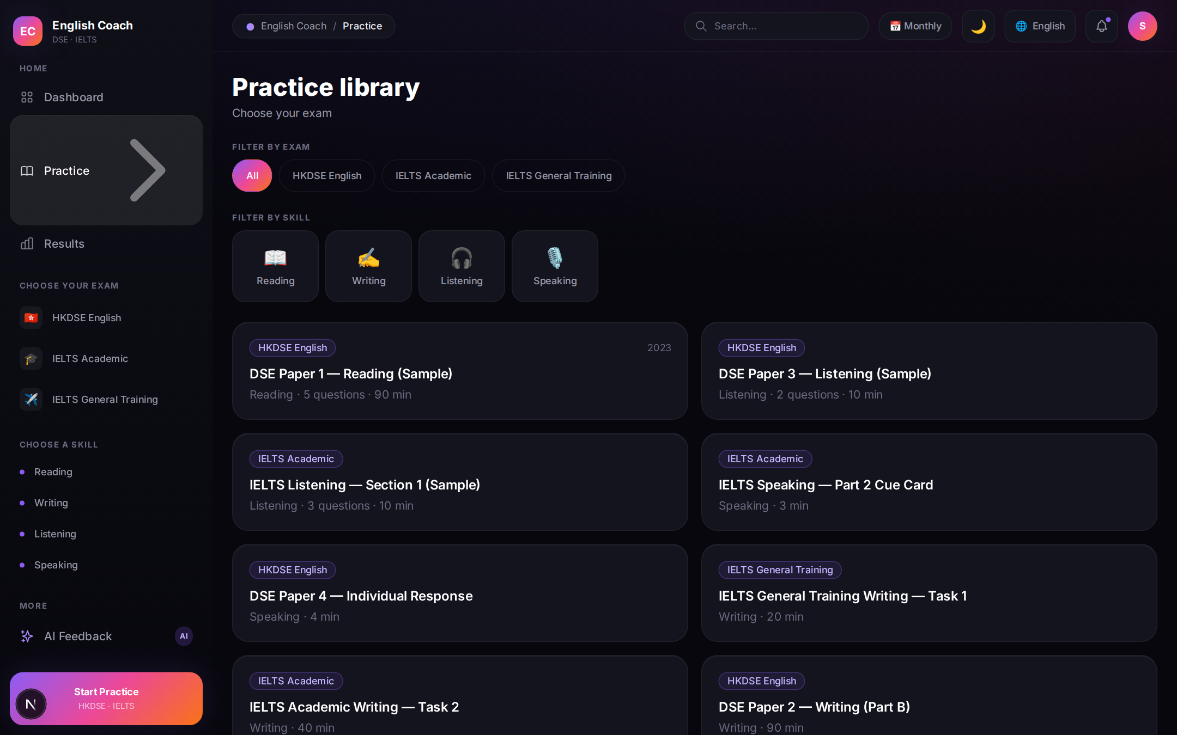
PRODUCT
產品畫面
Where students practise every day
學生每天練習的地方
Dashboard — progress & weak areas · 學習儀表板
Practice library — pick exam & skill · 練習庫
DSE + IELTS English Coach · Confidential
6 / 10

Slide 7
FOR CENTRES
給補習社 / 學校
Help more students without more overtime
幫助更多學生，減少老師加班
Homework that gives feedback overnight
功課 overnight 就能給學生初步反饋
One place for DSE and IELTS classes
DSE 與 IELTS 班共用同一平台
Show parents clear progress, not only attendance
向家長展示學習進度，而不只是出席
Students can start as guest, then create accounts
試堂可用訪客，正式學員再開帳戶
DSE + IELTS English Coach · Confidential
7 / 10

Slide 8
OPPORTUNITY
機會
A corridor of students who need English exams
港深之間，大量學生需要公開試英文
Hong Kong
Shenzhen
香港
深圳
Every year, thousands of Form 5–6 students prepare for DSE English. Families already pay for tutorials — they want tools that show real improvement.
Strong IELTS demand for overseas study. Many students also look toward Hong Kong exams — one platform covers both journeys.
DSE + IELTS English Coach · Confidential
8 / 10

Slide 9
THE DEAL
合作條款
Simple partnership
簡單清晰的合作
How we split
Where the money goes
股權分配
資金用途
Team 70%
35% More practice papers for students
35% Improve the product & launch
You 30%
20% Pilot classes with centres
10% Company setup & operations
200,000 HKD investment
DSE + IELTS English Coach · Confidential
9 / 10

Slide 10
Let’s help more students
reach their exam goals.
一起幫助更多學生達成公開試目標。
Next step
下一步
1) Try the product together 2) Discuss a pilot class 3) Agree 200,000 HKD / 30%
[Founder Name] · [email] · [WhatsApp / WeChat]
DSE + IELTS English Coach · Confidential
10 / 10

