Slide 1
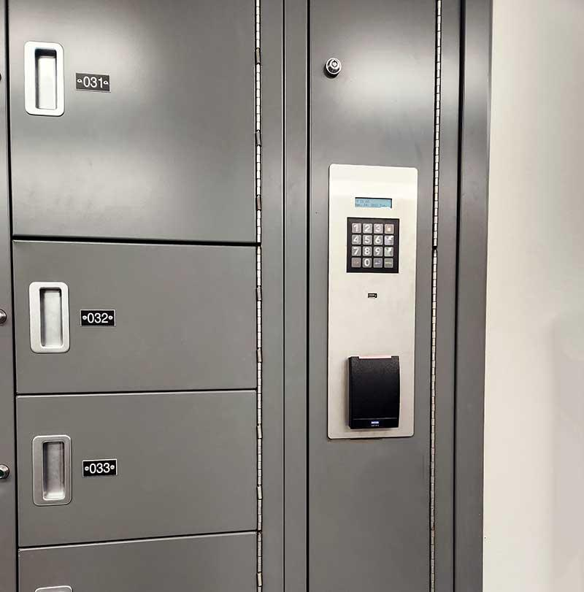

THE SWITCHED SAMPLE / WEBSITE BLUEPRINT
OUR WEBSITE PLAN
CASE FILE • ACCESS RESTRICTED
A forensic mystery built around one switched sample.
01 / WELCOME PAGE
Introduce the mystery: “The Switched Sample.” Let players enter an investigator name and begin.
02 / GAME DESIGN
Use a dark, modern forensic-lab theme with clear instructions, simple navigation, and a consistent visual style.
FORENSIC MYSTERY EXPERIENCE
01 / 05

Slide 2
THE SWITCHED SAMPLE / WEBSITE BLUEPRINT
LEVEL 1 — THE LAB DOOR
Three mini-puzzles stand between the investigator and the lab.
01
02
03
SIGN-LANGUAGE PASSWORD
MORSE CODE
KEYBOARD RIDDLE
Four very small children show hand signs for individual letters. Decode the four letters to find the password.
Decode the Morse-code clue to reveal the next part of the access key.
Solve a short keyboard-based riddle to complete the door verification.
CLUE is the correct password. Do not show the word in the image.
Give a hint if the answer is incorrect.
All three answers unlock the lab door.
FORENSIC MYSTERY EXPERIENCE
02 / 05

Slide 3
THE SWITCHED SAMPLE / WEBSITE BLUEPRINT
INVESTIGATE. THINK. UNLOCK.
Two logic challenges help players test their evidence skills.
LEVEL 2 / THE SAMPLE ROOM
LEVEL 3 / SUDOKU CHALLENGE
Read clues about the sample tubes and use logic to determine which sample is the real one.
Complete a 4 × 4 Sudoku grid. Use the correct solution to unlock the next stage.
GOAL • Choose the correct sample to proceed.
1
3
4
1
2
4
FORENSIC MYSTERY EXPERIENCE
03 / 05

Slide 4
THE SWITCHED SAMPLE / WEBSITE BLUEPRINT
FOLLOW THE EVIDENCE
Connect physical clues with a coded message to narrow the suspect list.
LEVEL 4 / MATCH THE EVIDENCE
LEVEL 5 / THE HIDDEN MESSAGE
01
Fingerprint
DECODE THE SIGNAL
• — • — — • • •
02
Shoeprint
03
Blue fabric sample
Decode the Morse-code message and combine it with earlier clues to narrow down the possible suspect.
Match each item to Riya, Kabir, or Sana.
FORENSIC MYSTERY EXPERIENCE
04 / 05

Slide 5
THE SWITCHED SAMPLE / WEBSITE BLUEPRINT
FINAL LEVEL — IDENTIFY THE CULPRIT
Bring every clue together and solve the case.
THE FINAL DECISION
🏆 FINAL LEADERBOARD
Review the clues and evidence, then select who switched the sample.
RANK
INVESTIGATOR
SCORE
1st
Player name
—
Planned correct suspect: KABIR
2nd
Player name
—
3rd
Player name
—
Display a “CASE SOLVED” screen after a correct answer.
Correct answers • Completion time
Also show:
FORENSIC MYSTERY EXPERIENCE
05 / 05

