Slide 1

Developing HPC Stencil Code using the YASK Framework
This tutorial applies to YASK version 4.05.00 and later*
Chuck Yount Intel Americas, Inc.
April 8, 2024 © 2019-2024 Intel Corporation
*see README.md for any exceptions

Slide 2
notices and disclaimers
Intel technologies’ features and benefits depend on system configuration and may require enabled hardware, software or service activation. Performance varies depending on system configuration.
No computer system can be absolutely secure.
Tests document performance of components on a particular test, in specific systems. Differences in hardware, software, or configuration will affect actual performance. For more complete information about performance and benchmark results, visit http://www.intel.com/benchmarks .
Software and workloads used in performance tests may have been optimized for performance only on Intel microprocessors. Performance tests, such as SYSmark and MobileMark, are measured using specific computer systems, components, software, operations and functions. Any change to any of those factors may cause the results to vary. You should consult other information and performance tests to assist you in fully evaluating your contemplated purchases, including the performance of that product when combined with other products. For more complete information visit http://www.intel.com/benchmarks .
Intel® Advanced Vector Extensions (Intel® AVX)* provides higher throughput to certain processor operations. Due to varying processor power characteristics, utilizing AVX instructions may cause a) some parts to operate at less than the rated frequency and b) some parts with Intel® Turbo Boost Technology 2.0 to not achieve any or maximum turbo frequencies. Performance varies depending on hardware, software, and system configuration and you can learn more at http://www.intel.com/go/turbo.
Intel's compilers may or may not optimize to the same degree for non-Intel microprocessors for optimizations that are not unique to Intel microprocessors. These optimizations include SSE2, SSE3, and SSSE3 instruction sets and other optimizations. Intel does not guarantee the availability, functionality, or effectiveness of any optimization on microprocessors not manufactured by Intel. Microprocessor-dependent optimizations in this product are intended for use with Intel microprocessors. Certain optimizations not specific to Intel microarchitecture are reserved for Intel microprocessors. Please refer to the applicable product User and Reference Guides for more information regarding the specific instruction sets covered by this notice.
Cost reduction scenarios described are intended as examples of how a given Intel-based product, in the specified circumstances and configurations, may affect future costs and provide cost savings. Circumstances will vary. Intel does not guarantee any costs or cost reduction.
Intel does not control or audit third-party benchmark data or the web sites referenced in this document. You should visit the referenced web site and confirm whether referenced data are accurate.
Intel, the Intel logo, and Intel Xeon are trademarks of Intel Corporation in the U.S. and/or other countries.
*Other names and brands may be claimed as property of others.
© 2018 Intel Corporation.

Slide 3
Outline
Introduction
What is YASK?
Motivation and example YASK application
Scope of this presentation
Basic features and usage
Download, build, and test
High-level flow
Writing a simple stencil in the DSL
Building the YASK library
Testing and tuning your stencil
Multi-process usage via MPI
Using the APIs
Access, terms, basic usage, examples
Advanced APIs and exceptions
Advanced stencils and tuning
Multiple stencils
Boundary regions (sub-domains)
Temporal conditions
Scratch variables
Vector folding
Misc. settings (FP precision, etc.)
Parts and stages
Temporal tiling
Nested OpenMP in micro-blocks
More on the auto-tuner
GPU Offloading
Wrap-up
Further reading and call to action

Slide 4
Introduction

Slide 5
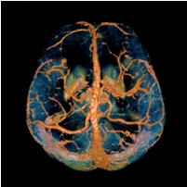
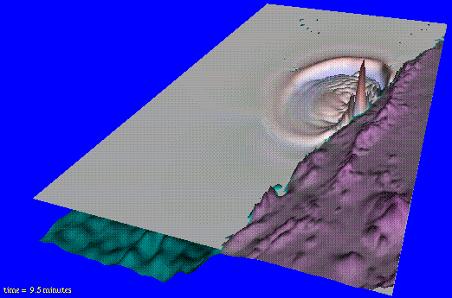

YASK: “Yet Another Stencil Kit”
YASK is a software framework for the rapid development of HPC stencil-based applications
Stencil: an iterative kernel that updates elements in one or more N-dimensional vars using a fixed pattern of computation on neighboring elements
Fundamental algorithm in many scientific simulations, e.g., finite-difference-method (FDM) approximations of differential equations describing various physical phenomena
Image Processing
Seismic Modeling
Weather Simulation
Images from https://commons.wikimedia.org
About the name:
“YASK” is named in the tradition of Linux utilities such as YACC, YAML and YAKL: https://en.wikipedia.org/wiki/Yet_another
Prior to version 3, “YASK” stood for “Yet Another Stencil Kernel”

Slide 6
Technical and business motivation
Rapid Development
Stencils in YASK are coded in a simple DSL (domain-specific language)
YASK programmer only needs to describe what to do, not how to do it
YASK compiler generates high-perf code from the DSL description
Can easily and quickly change the stencil and generate new code
Supports arbitrary dimensions, complex stencils, boundary conditions, and more
Can easily and quickly try different tuning features and parameters without recoding
Many complex optimization techniques are available immediately
Supports cluster scaling, spatial and temporal tiling, vector folding, and more
Generated code compiles into a library with documented C++ and Python* APIs to facilitate integration into real HPC applications
Performance Portability
Can re-target stencils for different Intel® CPU and GPU platforms by generating multiple libraries from single DSL description
Future YASK features and supported platforms can be leveraged immediately without recoding

Slide 7
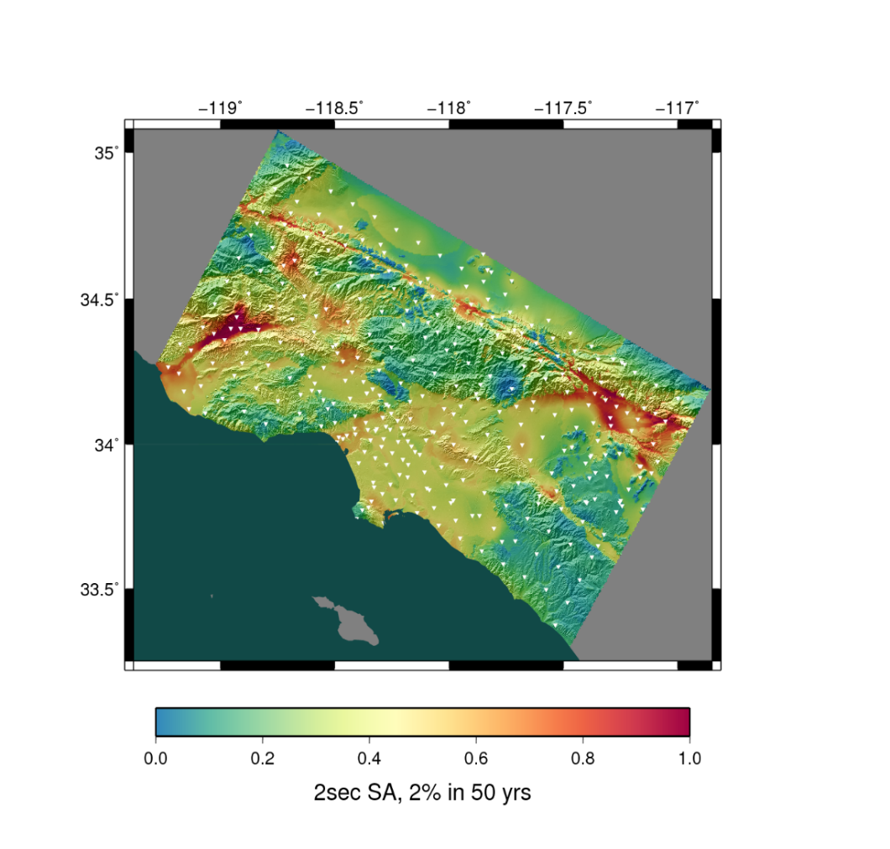
Example application of YASK
AWP-ODC: Anelastic Wave Propagation-Olsen, Day, Cui
Software that simulates seismic wave propagation after a fault rupture
Widely used by the Southern California Earthquake Center (SCEC) community
AWP-ODC-OS
First ever open-source release in 2016 (BSD-2 license), including port to Intel Xeon Phi processor, under development by San Diego Supercomputer Center (SDSC) at Univ. of CA, San Diego (UCSD)
Demonstrated on >9000 nodes of Cori supercomputer
CyberShake Study 15.4 hazard map for 336 sites around Southern California
Warm colors represent areas of high hazard
Content on this slide courtesy of UCSD

Slide 8
Scope of this presentation
Goals
Give a practical introduction to using YASK—a tutorial
Provide an overview of the major YASK performance techniques
Deliver enough information for someone already familiar with the application of stencil codes to start using YASK
Non-goals
Not providing a tutorial on
Finite-difference methods, seismic modeling, brain imaging, etc.
C++, Linux*, OpenMP*, MPI*, github*, etc.
Intel® instruction sets, CPU/GPU architecture, etc.
Not explaining in-depth how the YASK performance techniques work
Not providing performance data on all the various trade-offs
Not describing the internal software architecture
Not a reference manual for the APIs

Slide 9
Basic features and usage

Slide 10
Download, build, and test
Watch for this symbol indicating steps to try
Code access
Download from Intel’s github* project
git clone https://github.com/intel/yask
MIT open-source license
Builds and runs are made from the top-level directory: cd yask
Pre-requisites
See README.md for complete list
Only supported OS is Linux (no specific distribution recommended)
Intel® C++ compiler needed for performance
Install “Intel® oneAPI HPC Toolkit”
https://www.intel.com/content/www/us/en/developer/tools/oneapi/toolkits.html
Common Linux utilities (gmake, perl, awk, python, etc.)


Slide 11
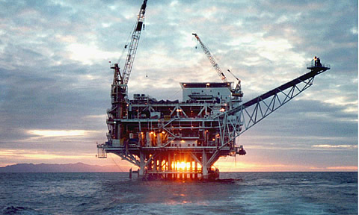
Example 1: Iso3dfd stencil
Description
Isotropic 3D finite-difference code found in seismic-imaging software used by energy-exploration companies to predict the location of oil and gas deposits
Simple stencil with only one updated variable
Recipes for building and running on CPU
Makefile and run script will automatically determine architecture
make clean; make -j stencil=iso3dfd
bin/yask.sh -stencil iso3dfd -g 1024
The –g 1024 option sets the global-domain size to a cube, 1024 elements on a side

Image from https://commons.wikimedia.org/wiki/File:PlatformHolly.jpg. Public domain--U.S. DoE.

Slide 12
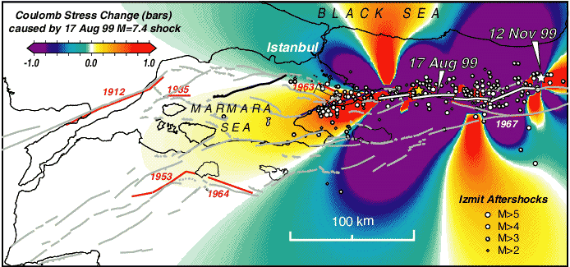
Example 2: AWP stencil
Description
Primary compute kernel for earthquake simulator described in the introduction
More complex problem that consists of 26 vars in a staggered-grid formulation
Recipes for building and running on CPU
Makefile and run script will automatically determine architecture
make clean; make -j stencil=awp
bin/yask.sh -stencil awp –gx 1024 –gy 1024 -gz 128
The –g* options set the global-domain size to specific sizes in each dimension
Compare this to the simpler -g option in the iso3dfd example that set the global-domain size in all three spatial dimensions
This is a common technique used for all spatial-dimension command-line options

Image from https://commons.wikimedia.org/wiki/File:Izmit_11-12-99.gif. Public domain--U.S.G.S.

Slide 13
High-level tool-chain flow
Stencil-specification code
Stencil compiler
Variable declarations and optimized stencil calculation code
Loop compiler
Nested loops with OpenMP pragmas and other optimizations
Performance results
Provided stencil perf-eval utility
Other C++ code
and/or
Optimized stencil-kernel library
Application results
Customer application
Intel C++ compiler

Slide 14
Stencil specification
Stencil-specification code
Stencil compiler
Variable declarations and optimized stencil calculation code
Loop compiler
Nested loops with OpenMP pragmas and other optimizations
Performance results
Provided stencil perf-eval utility
Other C++ code
and/or
Optimized stencil-kernel library
Application results
Customer application
Intel C++ compiler

Slide 15
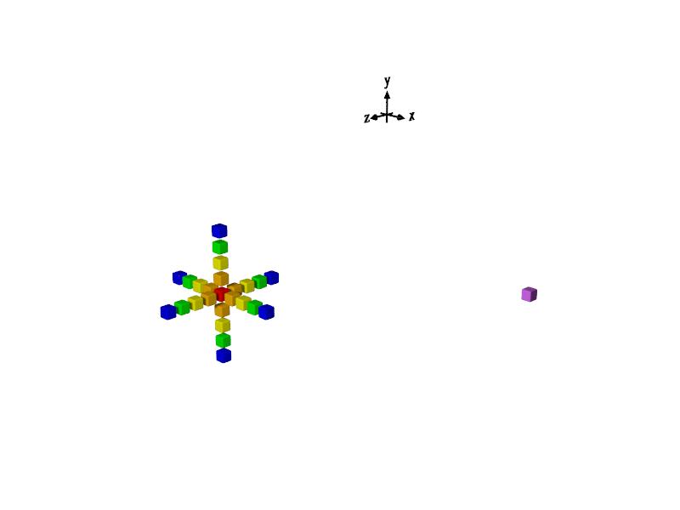
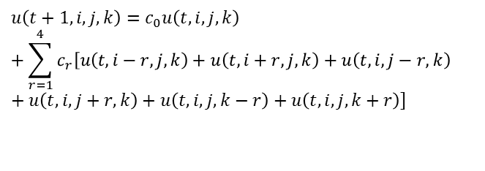

Example simple 25-point 3-D stencil
25 points in 3 spatial dimensions in u(t)
$$u\left(t\right) → u(t+1)$$
…as specified by the RHS of this finite-difference equation
$${u\left(t+1, i, j, k\right)=c}_{0}u\left(t, i, j, k\right)+\sum_{r=1}^{4}{c_{r}\left[u\left(t, i−r, j, k\right)+u\left(t, i+r, j, k\right)+u\left(t, i, j−r, k\right)+u\left(t, i, j+r, k\right)+u\left(t, i, j, k−r\right)+u\left(t, i, j, k+r\right)\right]}$$
…are used to compute 1 point in u(t+1)

Slide 16
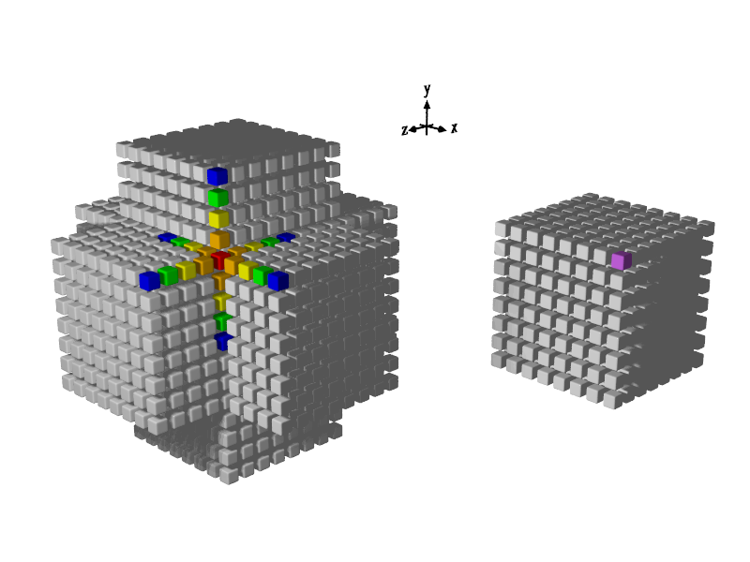

Stencil will be applied over entire problem domain
Entire problem domain—typically millions of points
“Halo” data regions
$$u\left(t\right) → u(t+1)$$
Repeat for u(t+2), u(t+3), …

Slide 17
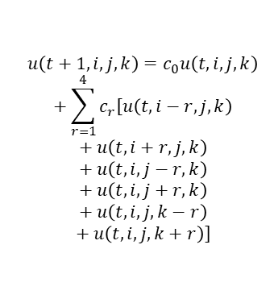
Example stencil DSL code
Derive new class from yc_solution_base (or yc_solution_with_radius_base to get radius parameter)
#include "yask_compiler_api.hpp"
using namespace yask;
namespace {
class MyStencil : public yc_solution_with_radius_base {
public:
MyStencil(int radius=4) :
yc_solution_with_radius_base("my_stencil", radius) { }
MAKE_STEP_INDEX(t);
MAKE_DOMAIN_INDEX(x);
MAKE_DOMAIN_INDEX(y);
MAKE_DOMAIN_INDEX(z);
MAKE_VAR(u, t, x, y, z);
MAKE_MISC_INDEX(i);
MAKE_VAR(c, i);
virtual void define() {
auto nu = c(0) * u(t, x, y, z);
for (int r = 1; r <= get_radius(); r++)
nu += c(r) * (u(t, x-r, y, z) + u(t, x+r, y, z) +
u(t, x, y-r, z) + u(t, x, y+r, z) +
u(t, x, y, z-r) + u(t, x, y, z+r));
u(t+1, x, y, z) EQUALS nu;
}
};
REGISTER_SOLUTION(MyStencil);
}
Mathematical description of finite-difference approximation implemented in DSL code
Declare 1 time and 3 space indices and 4D “u” var
Declare misc index and 1D “c” array for coefficients
Overload define() method
$${u\left(t+1, i, j, k\right)=c}_{0}u\left(t, i, j, k\right)+\sum_{r=1}^{4}{c_{r}\left[u\left(t, i−r, j, k\right)+u\left(t, i+r, j, k\right)+u\left(t, i, j−r, k\right)+u\left(t, i, j+r, k\right)+u\left(t, i, j, k−r\right)+u\left(t, i, j, k+r\right)\right]}$$
Write expression for value at step t+1
Use EQUALS operator to define u(t+1)—this is not an assignment!
Register this stencil with the YASK compiler utility

Slide 18
Building a stencil
Stencil-specification code
Stencil compiler
Variable declarations and optimized stencil calculation code
Loop compiler
Nested loops with OpenMP pragmas and other optimizations
Performance results
Provided stencil perf-eval utility
Other C++ code
and/or
Optimized stencil-kernel library
Application results
Customer application
Intel C++ compiler

Slide 19
Building your example stencil
Build your stencil and the YASK compiler
Put the code from a couple of slides back into a new file src/stencils/MyStencil.cpp
If you really don’t want to copy the example stencil during this tutorial, just substitute iso3dfd for my_stencil in the example commands from here on
If you want to write your own stencil, see the examples in src/stencils and the full DSL documentation for the YASK Compiler as discussed in the “Using the APIs” section later in this tutorial
Optional: rebuild and run the YASK compiler manually
Build the compiler: make -j compiler
Run the compiler: bin/yask_compiler.exe -h
“my_stencil” should be listed as a valid parameter to the -stencil option
Lots of other options shown; most of these are passed automatically from the Makefile
Build the YASK kernel for a CPU target
Build the kernel: make -j stencil=my_stencil radius=4
Targets the instruction-set architecture of your current platform by default
If you want to cross-compile, specify arch=isa-code, e.g., avx2
Targeting a GPU device will be covered later
Uses all the default parameters for static options such as data layout and prefetching
Dynamic options such as problem size are specified at run-time
If you skipped the step of building the compiler above, it will be done here for you automatically




Slide 20
Running a stencil
Stencil-specification code
Stencil compiler
Variable declarations and optimized stencil calculation code
Loop compiler
Nested loops with OpenMP pragmas and other optimizations
Performance results
Provided stencil perf-eval utility
Other C++ code
and/or
Optimized stencil-kernel library
Application results
Customer application
Intel C++ compiler

Slide 21
Running a stencil on a CPU platform
Run the provided benchmark utility
bin/yask.sh -stencil my_stencil -g 512 -no-pre_auto_tune
Problem size is specified as 512 in the 3 spatial dimensions (512³ points) using -g option (“g” for global-domain)
Auto-tuner is disabled ; other parameters are set to their defaults
The script will use MPI to start a separate process on each NUMA node
The global-domain size is automatically decomposed across the processes
By default, uses shared-memory (shm) buffers for inter-process communication
Override communication type with –no-use_shm option, which forces MPI calls between all processes
May also have to use this if your platform limits the amount of shm that can be allocated
The utility prints lots of stats about the stencil, memory usage, performance, etc.
Runs 3 trials for about 10 sec each and reports the best and median time and throughput (rate) stats
The most important performance statistic is usually “mid-throughput (num-points/sec)”, which is printed near the end of the output
A log file is kept in the “logs” directory, which includes some compilation and platform information for posterity



Slide 22
Automatically tuning the size parameters
Use the auto-tuner
bin/yask.sh -stencil my_stencil -g 512
As on previous slide, but with the block-size auto-tuner enabled (by default)
The block size determines the amount of work done by each OpenMP thread at any given time
The utility prints each block size that the auto-tuner tries and its measured performance, e.g.,
auto-tuner: searching block sizes...
auto-tuner: search-dist=16: 3.59 steps/sec (2 steps(s) in 556.7m secs) with size x=96 * y=28 * z=96 -- best so far
auto-tuner: search-dist=16: 3.74 steps/sec (2 steps(s) in 533.7m secs) with size x=32 * y=4 * z=80 -- best so far
…
When the tuner is done, it prints the final sizes, e.g.,
…
auto-tuner: applying size t=0 * x=96 * y=4 * z=80
auto-tuner: done
Waiting for auto-tuner to converge on all ranks...
Auto-tuner done after 73.62 secs
Final settings:
auto-tuner: mega-block-size: t=0 * x=512 * y=512 * z=512
auto-tuner: block-size: t=0 * x=96 * y=4 * z=80
auto-tuner: micro-block-size: t=0 * x=96 * y=4 * z=80
auto-tuner: nano-block-size: x=96 * y=4 * z=80
auto-tuner: pico-block-size: x=96 * y=4 * z=80
Note that the tuned block size printed here is different than at the beginning of the run
Using other auto-tuner options, the other types of blocks (explained later) can be tuned
Compare output and performance of the two runs with and without the auto-tuner


Slide 23
Hand-tuning the size parameters
Block size
From the log file of the last run, find the best block size found by the auto-tuner as highlighted on the previous slide
Specify this manually to bypass the auto-tuner, e.g.,
bin/yask.sh -stencil my_stencil -g 512 -no-pre_auto_tune \ -bx 96 -by 4 -bz 80
You should get similar performance
Play around with block size to see its effect
Contribution opportunity: github ticket #159 to save and reuse the settings automatically
General usage of size-parameter options
Most domain-dimension sizes can be specified in two ways
Spatial dims set separately as we did with block size, e.g., -bx, -by, -bz
Leave off the dimension names to set all domain sizes, e.g., -b
Play around with various problem sizes to see the effect on memory and performance



Slide 24
Getting a list of options
The YASK test utility is composed of a script driver and a binary
Print script options: bin/yask.sh –h
There is only a short list of options here
These are just the ones that control how the binary is launched from the script
Print binary options: bin/yask.sh -stencil my_stencil -help
Need to specify the stencil because there are different binaries for each
If you don’t specify a stencil, the script will show the ones that have been compiled
The long list of options might be overwhelming; we’ll point out the most important ones in this tutorial



Slide 25
Scaling out to multiple nodes in a cluster
Domain decomposition
Many HPC problem sizes won’t fit in the DRAM memory of one platform
Most HPC problems can be divided spatially across multiple nodes in a cluster via domain decomposition
YASK implementation
Data exchanges use two-sided MPI* communication
Important: strong vs. weak HPC scaling
Global-domain size parameters (-g) apply to the overall problem size
This implements a strong-scaling model, where the overall problem size remains constant regardless of the number of MPI ranks
Local-domain size parameters (-l) apply to the size on each MPI rank
This implements a weak-scaling model, where the overall problem size increases with the number of ranks

Slide 26
Conceptual view of 2D, 2×2 rank domains
Due to the read-radius of stencils, halo data must be read to calculate some points in the domain.
Similarly, at rank boundaries, each rank needs to read data from its neighbors.
This data changes every time-step and must be exchanged between ranks every time-step to keep the data consistent.
Rank 0
Rank 1
Read/write “domain” regions
Rank 2
Rank 3
Read-only “halo” regions

Slide 27
Schematic of 2D, 2×2 rank y-edge halo exchanges
Rank 0
Rank 1
Data calculated in rank 1 at time-step n…
Halos are exchanged at beginning of run and after each time-step.
Can get more complex when there are multiple dependent stencils.
Rank 2
Rank 3
…is needed by rank 3 at time-step n+1

Slide 28
Schematic of 2D, 2×2 rank x-edge halo exchanges
Rank 0
Rank 1
Width of halos is based on radius of stencil in each dim.
Rank 2
Rank 3

Slide 29
Schematic of 2D, 2×2 rank corner exchanges
Rank 0
Rank 1
For 3D stencils, exchanges may be needed along faces, edges, and corners of the rectangular solids.
This concept can be extended to any number of dimensions.
Corner exchanges are only needed for halos that have diagonal points.
This is determined automatically by the stencil compiler
Rank 2
Rank 3

Slide 30
Running on multiple nodes in a cluster
Running via Slurm
If a Slurm job is requested with the proper number of nodes and MPI tasks, the bin/yask.sh utility should issue the proper mpirun command
Running the test utility with an explicit MPI command
bin/yask.sh -mpi_cmd 'mpirun <…>' -stencil my_stencil -g 1024
Replace <…> with the specification of host-names, tasks per node, and other needed parameters
Use the technique for your scheduler, e.g., -f or -hosts option, or whatever is used on your cluster
Important: specify how many processes to run on each node, e.g., with -ppn, usually corresponding to the number of NUMA nodes in each cluster node
YASK will automatically partition the global domain and distribute it among the MPI ranks
Use the -nr* YASK options to control the topology of the MPI ranks
Example: -nr 2 specifies 2 ranks in each spatial dimension
Example: -nrx 2 -nry 4 -nrz 8 specifies 2 ranks in the ‘x’ dimension, 4 in the ‘y’, and 8 in the ‘z’, for 64 total ranks
Implementation options
For typical configurations, YASK overlaps communication with some computation using this sequence [simplified]:
Only the data needed by another rank is calculated on each rank for a given time-step and packed for delivery
Asynchronous (non-blocking) MPI receive and send requests are initiated
The remaining data on each rank is calculated while the MPI data is in-flight
The MPI requests are completed and the received data is unpacked before the next time-step is begun
You can disable this feature via -no-overlap_comms to measure the impact
Shared-memory (shm) communication will automatically be applied between ranks that share a virtual address space, but MPI can be forced between all ranks with -no-use_shm as explained earlier



Slide 31
Using the apis

Slide 32
Making a stencil application
Stencil-specification code
Stencil compiler
Variable declarations and optimized stencil calculation code
Loop compiler
Nested loops with OpenMP pragmas and other optimizations
Performance results
Provided stencil perf-eval utility
Other C++ code
and/or
Optimized stencil-kernel library
Application results
Customer application
Intel C++ compiler

Slide 33
API overview
Purpose
Define the DSL (Domain-Specific Language) used by the YASK compiler
Facilitate inclusion of stencil code generated by YASK into real applications
Target languages
C++ natively
Python* interface generated via SWIG*
Design principles
Consistent interface
Stable interface with backward-compatibility maintained except in rare cases
Documented
Hidden implementation via C++ pure-virtual classes in most cases
“Factory” pattern: use small number of factory objects to create more objects

Slide 34
API documentation
From https://github.com/intel/yask, follow the “API documentation” link in the Overview section of README.md
There are four main tabs
Main Page contains an overview of the YASK workflow and API sets
Read this first
Modules lists the API sets
This is the best place to start looking for the API you want
YASK Compiler APIs are used to define stencil solutions, i.e., the “DSL”
Objects in the compiler API start with “yc_”
YASK Kernel APIs are used to create your own application from a YASK library
Objects in the kernel API start with “yk_”
YASK Common Utilities contains some common utility classes like output streams
Objects here start with “yask_”
Classes lists all the C++ classes in alphabetical order
Files lists the C++ header files

Slide 35
API combinations
Start
There are two main steps in using a YASK stencil:
Create a library from the YASK DSL via the “compiler” APIs
Use the library in an application via the “kernel” APIs
For each of these steps, there are three options (making 9 combos):
Use the binary provided in the YASK package
Write your own app in C++
Write your own app in Python
The most common combos:
Compiler: Use the provided YASK compiler binary to create a library for your stencil via the Makefile
Kernel:
Use the provided YASK binary to test and tune your stencil’s performance by running yask.sh
Create your own binary using the C++ kernel APIs to use the stencil library in production
Generate stencil library
or
Write DSL code and use bin/yask_compiler via make
Create your own YASK compiler via APIs in C++ or Python (unusual)
Use stencil library
and/or
Run bin/yask.sh
Create your own app via APIs in C++ or Python
Done

Slide 36
Access to the APIs
C++
The standard method of writing YASK stencils uses the “DSL” part of the C++ compiler API library
Many examples in the src/stencils directory
The provided YASK compiler generates C++ stencil code from the DSL code; this is compiled into a kernel library
You only need to make your own YASK compiler binary in special situations, such as creating a custom stencil generator; otherwise, just build your stencil from the Makefile and use the generated library
The rest of this section in this tutorial covers using the kernel APIs, not the compiler APIs
When you run make as in the previous examples, you have implicitly made a kernel library containing the kernel APIs
A shared object is created in the lib directory, one for each stencil and target architecture
The performance-test binaries we’ve been running via yask.sh are just wrappers around the library
The header files are in the include directory
#include "yask_kernel_api.hpp" in your application
See src/kernel/tests/yask_kernel_api_test.cpp for an example
Python
Build the APIs for Python* only if you want to make a Python app instead of a C++ app
Download src code as before: git clone https://github.com/intel/yask
See README.md for SWIG* version requirement
From yask directory, run make -j api
Python APIs are not documented separately—use the C++ docs with appropriate type mapping
Performance-wise, the stencil calculations will be the same speed as in C++, but data access is slower

Slide 37
Main YASK kernel process steps
Create a YASK “solution” object
Set problem size and other parameters
“Prepare” the solution: allocate memory and sync meta data
Run solution for n time-steps
Initialize data in YASK variables
Inject data representing external stimulus if needed, etc.
No
Done?
Extract results from YASK variables
Yes

Slide 38
Creating a YASK kernel via the APIs
Bootstrap
Declare an object of type yk_factory
Call yk_factory::new_env() to create an “environment” object
This can be used to provide an existing MPI communicator if desired
Call yk_factory::new_solution() to create a YASK “solution” object
The solution object provides methods to configure the problem size, access YASK variables, and run the stencil calculations
FAQ: What’s with all the output?
Calling many APIs results in debug output written to a stream
By default, this stream is standard output
Handy for development, but you probably don’t want this in your final application
Call yk_solution::set_debug_output() to change it to a file or yk_solution:: disable_debug_output() to simply discard it
Use a yask_output_factory to create new output streams
NB: this mechanism was used instead of raw C++ streams to enable Python usage, but you can get access to the C++ stream via yk_env::get_debug_output()->get_ostream()

Slide 39
Key terms related to domain sizes
Overall (global) and rank (local) domain sizes
As with the test utility, each MPI rank can define the local-domain size or the global-domain size in each dimension
The size that is not specified will be calculated automatically
All ranks in a given row must have the same rank-domain height, etc.
Also, each rank can specify the number of ranks in each dimension or let the run-time assign them automatically
YASK-variable dimensions and sizes
When YASK variables are defined, they can have three types of dims
Step dim: often “t” for “time”
Domain dim: often used for spatial dims like “x” and “y”
Generally, can be any domain-size parameter that may be decomposed over ranks
Misc dim: an index that is known and fixed at YASK-compile time like a coefficient index
The size of the domain will be used when allocating each variable
Read the “Detailed Description” section of the yk_var API page for an explanation of each size

Slide 40
Global view of 2D problem size
Rank 0
Rank 1
The “domain” is the region where the stencils are calculated and the YASK vars are updated
Global-domain size in y dim
Rank 2
Rank 3
Important: Halo regions are not considered part of the domain size
Local-domain size in x dim in ranks 1 and 3

Slide 41
Per-rank view of 2D problem sizes
YASK may add extra padding to ensure vector data-alignment, etc. to each variable.
Local-domain size in y dim in ranks 0 and 1
Rank 0
Rank 1
Halo size—can be different for each variable, dimension, and side of domain; determined automatically by stencil compiler
Application programmers usually don’t need to set the size of halos or padding—YASK computes them for you.
Rank 2
Rank 3

Slide 42
Prepare the kernel solution
Set up the problem sizes and ranks
Call yk_solution::set_overall_domain_size() to set the global-domain sizes or yk_solution::set_rank_domain_size() to set the local-domain sizes
Call yk_solution::set_num_ranks() to explicitly set the number of ranks if desired
Call yk_solution::set_rank_index() to explicitly set the position of each rank if desired
Optional: Set other solution parameters
Call yk_solution::set_block_size() to use the best block size you found during the tuning process
Alternatively, or in addition, you can use the block-size auto-tuner
The auto-tuner can be controlled with APIs
There are several ways to use the auto-tuner, discussed in the advanced section
Other solution parameters, including other tile sizes, can be set via yk_solution::apply_command_line_options()

Slide 43
Allocate data and synchronize info across ranks
Call yk_solution::prepare_solution()
Shares MPI positions across ranks or calculates a default position for each rank
Since prepare_solution() uses MPI calls, it is critical to call it from each rank
Ensures domain-size consistency across ranks
Allocates data for each YASK variable based on halo sizes determined by the YASK compiler and the local domain sizes
Determines MPI buffer requirements and sizes and allocates data for them

Slide 44
Initialize data
Access YASK variables
Get a list via yk_solution::get_vars() or find a specific var by name via yk_solution::get_var()
Either one returns pointers to variables of type yk_var
Used to find all meta data about each var
Use get_*_index() APIs to determine valid indices
Use idx_t as a type for indices: size_t and int are not good alternatives.
Data access
YASK uses a non-standard tiled data layout (“vector folding” discussed later)
Thus, it does not support simple overlay with native row-major or column-major arrays of floating-point numbers
NB, github issue #147 requests to support this under certain restrictions for easier integration with legacy applications
There are several APIs for writing one or more FP elements from and to the variables
Start with set_element(), set_elements_in_slice(), and set_all_elements_same() in yk_var
The “slice” versions are threaded for performance and convert to and from row-major layout
But you’ll probably want to avoid copying whole vars this way to avoid wasting memory

Slide 45
YASK-variable indices
get_rank_domain_size(“x”) → 100
get_right_extra_\ padding_size(“x”) → 3
get_left_halo_size(“x”) → 5
Important: var indices are always global!
Note: some may be negative.
Tip: use an API to determine each index instead of adding sizes or doing similar math.
Rank 0
Rank 1
get_first_rank_\ halo_index(“x”) → -5
get_last_rank_\ halo_index(“x”) → 204
get_first_rank_domain_index(“x”) → 0
get_last_rank_domain_index(“x”) → 199
get_last_rank_domain_index(“x”) → 99
get_first_rank_domain_index(“x”) → 100
get_last_rank_halo_index(“x”) → 104
get_first_rank_halo_index(“x”) → 95
get_last_local_index(“x”) → 107
get_first_local_index(“x”) → 92

Slide 46
Notes on initializing data
Of course, load data into the domain areas
Rank 0
Rank 1
Load data into the outer halos or initialize them to a safe value
No need to load data into the halos between ranks because they will be copied from the neighbors during the first halo exchange
No need to load data into the extra padding area because it is never read

Slide 47
Make the stencil calculations and get results
Advance the simulation through a series of time-steps
Call yk_solution::run_solution()
General form takes first and last time indices, e.g.,
run_solution(0, 9) runs the first 10 time-steps
run_solution(10, 19) runs the next 10
If needed, between time-steps, you can access var data, e.g., for source injection
Access results
Use appropriate var methods analogous to the data-writing ones listed earlier
Examples: get_element(), get_elements_in_slice(), reduce_elements_in_slice()
Call yk_solution::get_stats() to collect some performance stats if desired
Call yk_solution::end_solution() when all done to release memory, etc.

Slide 48
Example applications
2D Wave equation
Stencil DSL: src/stencils/Wave2DStencil.cpp
Application code: src/examples/wave_eq_main.cpp
Illustrates
Sub-domains and scratch vars (see next section on advanced stencils)
Using both YASK-library and application-specific options
Determining global and local domain sizes
Initializing YASK var data efficiently by slices
Running the simulation loop, and calculating reductions and reporting simulation stats within the simulation loop
Retrieving final simulation results and reporting performance
2D Shallow-water equation
Stencil DSL: src/stencils/SWE2DStencil.cpp
Application code: src/examples/swe_main.cpp
Builds upon 2D wave-equation example to additionally illustrate
Different sub-domains for various vars
Restricting certain calculations to specific simulation steps controlled by the simulation loop
Run “make examples” to build and “make example-tests” to run validation tests
Use “-bench” and “-g” knobs to run benchmarks of various sizes
Use “mpirun” and “-outer_threads” knobs to tune for number of NUMA nodes and cores per NUMA node

Slide 49
Advanced APIs
Misc interesting APIs (not exhaustive)
Call yk_var::set_numa_preferred() to set the NUMA node for a given variable—useful for explicit placement in MCDRAM or DDR on Xeon Phi CPUs
Call yk_solution::new_var() to make variables beyond those used in the solution; may be useful for checkpoint/restore of vars, etc.
Call yk_solution::apply_command_line_options() to parse a command-line string—useful for quickly applying options from the test utility in another application or for setting options that do not have corresponding APIs
Call yk_var::add_to_element() to atomically update a var element—useful for threaded source injection

Slide 50
Exceptions
YASK APIs that can trigger errors throw exceptions
Allows applications to catch and process errors
Find exception documentation in the YASK Common Utilities module tab
C++
Throws object of type yask_exception
Call yask_exception::get_message() for a human-readable explanation
See src/kernel/tests/yask_kernel_api_exception_test.cpp
Python
Throws RuntimeError as defined by SWIG*
Call format() for a human-readable explanation
See src/kernel/tests/yask_kernel_api_exception_test.py

Slide 51
Advanced stencils and tuning

Slide 52
Solutions with multiple stencils
Purpose
Many simulations require multiple variables to be updated, each with a different stencil
Independent stencils
Definition: for any two stencils, the input of one stencil does not depend on the output of the other within the same time-step, and vice-versa
Example: x-stress(t+1) depends on x-stress(t), and y-stress(t+1) depends on y-stress(t), but x-stress(t+1) does not depend on y-stress(t+1) or vice-versa
See define_str_TL() in src/stencils/SSGElasticStencil.cpp
Thanks to contributor Albert Farres from the Barcelona Supercomputing Center!
For independent stencils, YASK applies the stencils simultaneously in one pass over the domain
Dependent stencils
Definition: for any two stencils, the output of one stencil is required for the input of the other stencil in the same time-step (the opposite cannot also be true)
Example: x-velocity(t+1) depends on x-stress(t), and x-stress(t+1) depends on x-velocity(t+1) –see same DSL file
For dependent stencils, YASK cannot apply the stencils simultaneously and makes multiple passes over the domain, called “stages”
YASK automatically determines the dependencies between equations in the DSL and schedules their stencils

Slide 53
Boundary regions
Used in wave-propagation simulation
Simulation domain covers only a finite block of earth, water, etc.
Simulated waves will erroneously reflect from the arbitrary boundaries
Artificial absorbing boundary conditions (ABC) or boundary layers are used to reduce these reflections
There are many techniques and papers covering this field of study
Two high-level approaches to use in YASK
Modify the stencil(s) to include simple attenuation factors
Example: Cerjan sponge layers
See Iso3dfdSpongeStencil class in src/stencils/Iso3dfdStencil.cpp
Try modifying your test stencil to use sponge layers and check the impact on performance
This stencil illustrates the use of combining 3D and 2D variables to save memory
Tip: this stencil and its parent class also show the recommended practice of creating functions to return expressions, allowing more flexible composition
Use different stencils in the boundary layers by creating sub-domains
Examples: Higdon BCs, perfectly-matched-layers (PML), and the convolutional form (CPML)


Slide 54
Sub-domain (spatial) conditions
A sub-domain is a subset of the domain in which a stencil is applied
Defining special stencils in boundary regions is a common use-case for sub-domains
A sub-domain is defined in the DSL by a Boolean expression on the domain indices
The DSL includes terms for the left-most and right-most indices in the domain
Example: (x < first_domain_index(x) + 5) defines a sub-domain on the left side of the domain, 5 elements wide
(x > last_domain_index(x) – 5) would be the same on the right side
(x >= first_domain_index(x) + 5) && (x <= last_domain_index(x) - 5) would be used for the interior sub-domain between the left and right boundary sub-domains
These conditions are placed after the stencil equation using the IF_DOMAIN operator in the DSL
Example: A(t+1,x) EQUALS A(t,x) + A(t,x+1) IF_DOMAIN x > 10
Search for TestBoundaryStencil in src/stencils/TestStencils.cpp for simple synthetic examples
See src/stencils/FSGElasticStencil.cpp for a more complex real-world example

Slide 55
Sub-domains on multiple ranks
Sub-domain described by
(x < first_index(x) + 5)
Sub-domain described by
(x > last_index(x) - 5)
Rank 0
Rank 1
Rank 2
Rank 3
Sub-domains always apply across the overall problem domain.
(This is one reason that domain indices are always global.)
Halo regions are not considered part of any domain or sub-domain
Sub-domain described by
(x >= first_index(x) + 5) && (x <= last_index(x) - 5)

Slide 56
Step (temporal) conditions
A step-condition expresses which time-steps are valid for a stencil
Some stencil applications require special processing on regular intervals
Wave-field sub-sampling can be implemented with step conditions
Like sub-domain conditions, step conditions restrict stencil application
Sub-domain expressions can use only the domain indices
Step-condition expressions can use the step index (usually time) or values in other YASK variables (but not via domain indices)
Example: (t % 8 == 0) is true every 8th time-step
These conditions are written after the equation using the IF_STEP operator in the DSL
Example: A(t+1,x) EQUALS A(t,x) + A(t,x+1) IF_STEP t > 5;
Look for TestStepCondStencil in src/stencils/SimpleTestStencils.cpp for a simple example
To apply both sub-domain and step conditions, put parentheses around the value definition and the first condition, e.g.,
( A(t+1,x) EQUALS A(t,x) + A(t,x+1) IF_DOMAIN x > 10 ) IF_STEP t > 5;

Slide 57
Scratch variables
Purpose
Provide a mechanism to calculate intermediate values efficiently
Usage
Often, stencils create intermediate values that do not need to be accessed across simulation steps
Rather, these intermediate values are then used in subsequent stencils to calculate the final desired values
These intermediate values can be stored in “scratch” variables instead of regular YASK variables
Scratch variables cannot have the step dimension since they do not exist across steps
Unlike regular variables, the values of all possible points must be defined, including those outside of the YASK domain
When defining scratch values without conditions, this happens normally, but be careful when using conditions on scratch vars
As a development step or debug aid, the option -init_scratch_vars may be used to set all the values to zero in each scratch var before calculations are done, but this usually results in poor performance because most values in each scratch var will be written twice
See src/stencils/Wave2dStencil.cpp for example usage, e.g., u_sub1
Implementation
Unlike regular vars, scratch-var memory is not allocated to cover the whole domain
Memory is automatically allocated by the YASK runtime to cover only a block (more accurately, a micro-block as described later)
The memory is reused as each micro-block is evaluated sequentially by each thread (actually, each outer thread as described later)
There is a separate scratch-var memory allocation for each outer thread
YASK can also reuse the same memory allocation for more than one scratch variable when possible
All these implementation details contribute to increasing cache locality and decreasing memory usage when using scratch variables

Slide 58
Scratch-variable examples
Without sub-domain or step conditions
MAKE_VAR(A, t, x, y); MAKE_SCRATCH_VAR(S1, x, y); … S1(x,y) EQUALS (A(t,x,y) + A(t,x+1,y)) / 2; A(t+1,x,y) EQUALS (S1(x,y) + S1(x,y+1)) / 2;
With sub-domain conditions
MAKE_VAR(A, t, x, y); MAKE_SCRATCH_VAR(S1, x, y); auto d1 = x>=first_domain_index(x) && x<=last_domain_index(x) && y>=first_domain_index(y) && y<=last_domain_index(y); … S1(x,y) EQUALS (A(t,x,y) + A(t,x+1,y)) / 2 IF_DOMAIN d1; S1(x,y) EQUALS 0.0 IF_DOMAIN !d1; // Define all possible points A(t+1,x,y) EQUALS (S1(x,y) + S1(x,y+1)) / 2;

Slide 59
Vector folding (multi-dimensional vectorization)
Concept
Store small 2D or 3D block of data into each SIMD vector
Pros: reduces memory loads and memory streams compared to traditional 1D in-line vectorization
Cons: requires non-traditional tiled data layout and additional shift and/or permute operations preceding SIMD arithmetic operations
Results
Significant speedup shown on many systems, esp. those containing high-bandwidth memory (HBM)
Works well paired with tiling and other performance techniques
Implementation
The YASK compiler automatically generates the proper shift and permute instructions
The YASK kernel code automatically generates code to store the tiled data and look up elements by index when needed
Intel® AVX-512 instruction set is needed for efficient permutes, so only enabled when available
See the paper in the upcoming reading list showing up to 1.5× speedup from vector-folding

Slide 60
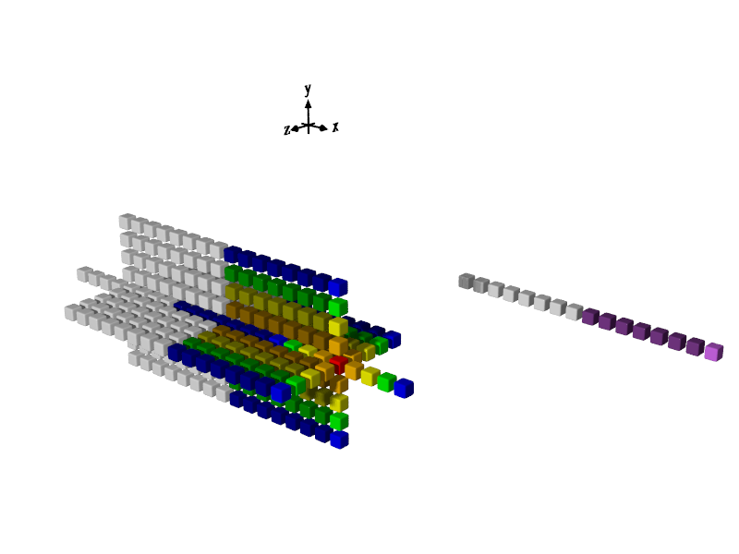
Traditional 1D Vectorization
Inner 3D loop iterates in x direction, i.e., same dimension as vectorization
8 new vectors must be read for k±r points (4 for k+r and 4 for k-r for r=1..4)
Total BW cost for traditional “in-line” vectors = 17 new vector inputs for each vector of output (some loads will come from cache with blocking)
Only 1 new vector must be read for i±r points due to overlap along x axis
8 new vectors must be read for j±r points

Slide 61
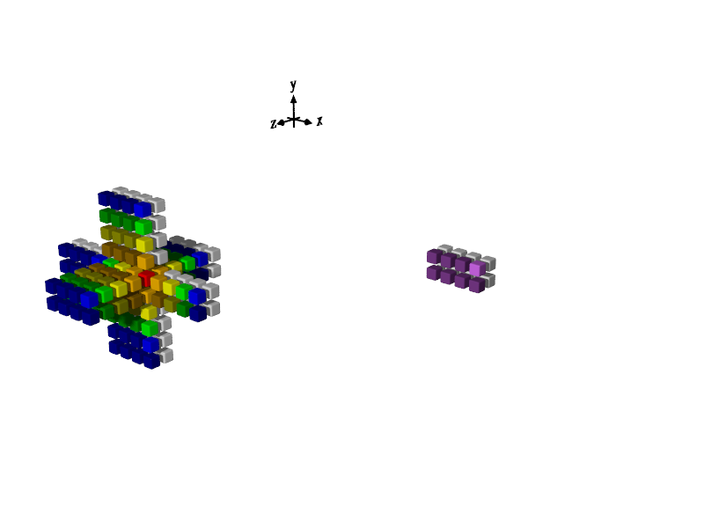
2D Vector-Folding
4 new 4x2x1 vectors must be read for j±r points
Inner 3D loop iterates in z direction, i.e., perpendicular to 2D vector
Only 1 new vector must be read for k±r points
Total BW cost for 4x2x1 vector with z-axis loop= 7 new vector inputs for each vector of output (2.4x lower than in-line)
2 new vectors must be read for i±r points

Slide 62
Vector-Folding Memory Layout and Code Gen
2D “4x2” vector folding
Access to elements in custom memory layout encapsulated behind C++ & Python APIs
Logical indices in 2D with 8-element SIMD in x and y dimensions
5,1 | 5,2 | 5,3 | 5,4 | 5,5 | 5,6 | 5,7 | 5,8 | 5,9 | …
4,1 | 4,2 | 4,3 | 4,4 | 4,5 | 4,6 | 4,7 | 4,8 | 4,9 | …
3,1 | 3,2 | 3,3 | 3,4 | 3,5 | 3,6 | 3,7 | 3,8 | 3,9 | …
2,1 | 2,2 | 2,3 | 2,4 | 2,5 | 2,6 | 2,7 | 2,8 | 2,9 | …
1,1 | 1,2 | 1,3 | 1,4 | 1,5 | 1,6 | 1,7 | 1,8 | 1,9 | …
y
Load and permute instructions generated automatically by YASK stencil compiler
x
Layout in memory (1D)
1,1 | 1,2 | 1,3 | 1,4 | 2,1 | 2,2 | 2,3 | 2,4 | 1,5 | 1,6 | 1,7 | 1,8 | 2,5 | 2,6 | 2,7 | 2,8 | 1,9 | …
2D vector folding layout (8×1)
Two aligned vectors are colored
Unaligned read shown with bold borders done by loading aligned vectors and then shuffling the requisite elements via an AVX-512 permute instruction

Slide 63
Vector-folding customization
Specify the vectorization length in each dimension
Use the fold='x=n,y=n,z=n' argument to the make command-line
The values are passed to the YASK stencil compiler and used to generate code
The fold settings are also included in non-generated code during compilation
Example: make fold='x=1,y=2,z=8' generates code using a 1×2×8 fold
Try different fold settings on the test stencil and check the impact on performance
Important: Be sure to run make clean before re-compiling when changing compile-time options like vectorization
The product of the fold lengths should equal the number of SIMD vector elements in the target architecture and FP precision (single or double)
Example: single-precision FP using 512-bit SIMD contains 16 elements per vector
If the fold is not the right size, the compiler will adjust the requested fold using a heuristic algorithm (i.e., the fold you specify is a hint)
The vector length in any dimension not specified defaults to one (1)
The default fold varies depending on dimensionality, architecture, and FP precision
Is 4×4×1 for a 3D problem using SP FP on Xeon Scalable CPUs, for example


Slide 64
More compile-time settings
Floating-point precision
The default FP size is 4 bytes, which is the norm in seismic modeling
Build with double-precision by adding real_bytes=8 to the make command
Prefetching
Software prefetch instructions can be added by the YASK compiler
Use make … pfd_l1=n to set the L1 prefetch distance to n iterations ahead
Use make … pfd_l2=n to set the L2 prefetch distance to n iterations ahead
Set n to zero (0) to disable generation of any prefetch instructions for a level
The default prefetch depends on the architecture
Time allocation
By default, the YASK compiler tries to determine the minimum number of time-steps that need to be saved in each variable, but you may want to override it
Override this with make … time_alloc=n (to affect all vars at compile-time)
Override at run-time with the yk_var::set_alloc_size() API

Slide 65
More compile-time settings
Order of domain dimensions
The order of domain dimensions determines
The inner-most or “unit-stride” dimension in the memory layout
The nesting order of loops for the stencil-calculation code
Default vector-folding and default rank layout
By default, the order of domain dimensions is determined from the variable declarations
For example, new_var(“A”, {t, x, y, z}) implies domain dimensions are in ‘x, y, z’ order
If vars have different domain-dimension index orders, dimensions are sorted in the order they are seen by the compiler
You can explicitly set the order of domain dimensions
For example, make … domain_dims='z,y,x' creates domain dimensions in ‘z, y, x’ order
This setting overrides the order of the dimensions specified in the variable declarations and affects memory layout, looping order, vector-folding, and rank layout
Try different orders on the test stencil and check the performance impact (remember to make clean)
Misc settings
Any preprocessor macro can be set by make … EXTRA_MACROS='name=value …'
Type make help for examples of settings the C++ optimization level and more


Slide 66
More grouping terms: parts and stages
You may notice the terms “parts” and “stages” in the YASK debug output
Parts
A part is the term used for independent stencil equations that are grouped into one C++ function by the YASK compiler
A part cannot contain equations from different sub-domains
The compiler eliminates common sub-expressions between stencils in a part
Stages
A stage is the term used for a group of parts that are not inter-dependent
This can occur when there are equations in different sub-domains that are not dependent on one another
Multiple stages are scheduled in the correct order based on dependencies (e.g., in a staggered-grid problem)
The amount of work and performance of each stage is listed in the debug output

Slide 67
Temporal wave-front tiling
Goal
Increase temporal locality in caches at a package level
Especially useful for large unified cache (such as HBM used for caching DDR memory)
Technique
In each MPI rank
Evaluate n time-steps within a subset of the local rank domain
We refer to this subset as a Mega-block in YASK
Evaluate each Mega-block sequentially until entire rank domain is evaluated for n time-steps
Some redundant work is done between ranks to allow halo exchange after every n time-steps
YASK handles all the temporal tiling complexity automatically

Slide 68
Temporal wave-front dependencies
Key
○
○
value already known
value not yet known
known value used as input
value being calculated
Highest x-value that may be calculated for t=4 due to the dependencies on t=3 values
t=4
t=3
t=2
t=1
○ | ○ | ○ | ○ | ○ | ○ | ○ | ○ | ○
○ | ○ | ○ | ○ | ○ | ○ | ○ | ○ | ○ | ○ | ○ | ○ | ○ | ○ | ○ | ○ | ○ | ○ | ○ | ○ | ○
○ | ○ | ○ | ○ | ○ | ○ | ○ | ○ | ○ | ○ | ○ | ○ | ○ | ○ | ○ | ○ | ○ | ○ | ○ | ○ | ○ | ○ | ○ | ○ | ○ | ○ | ○ | ○ | ○
○ | ○ | ○ | ○ | ○ | ○ | ○ | ○ | ○ | ○ | ○ | ○ | ○ | ○ | ○ | ○ | ○ | ○ | ○ | ○ | ○ | ○ | ○ | ○ | ○ | ○ | ○ | ○ | ○ | ○ | ○ | ○ | ○ | ○ | ○ | ○ | ○
t
x
Highest x-value that may be calculated for t=2 due to the dependencies on t=1 values
Tile ends here for t=1
In the first temporal wave-front tile shown here, the number of values that can be calculated is reduced for each time-step (and/or each stage within a time-step)
The amount of shift is called the wave-front or temporal angle and is based on the radius of the largest stencil (shift of 8 shown)

Slide 69
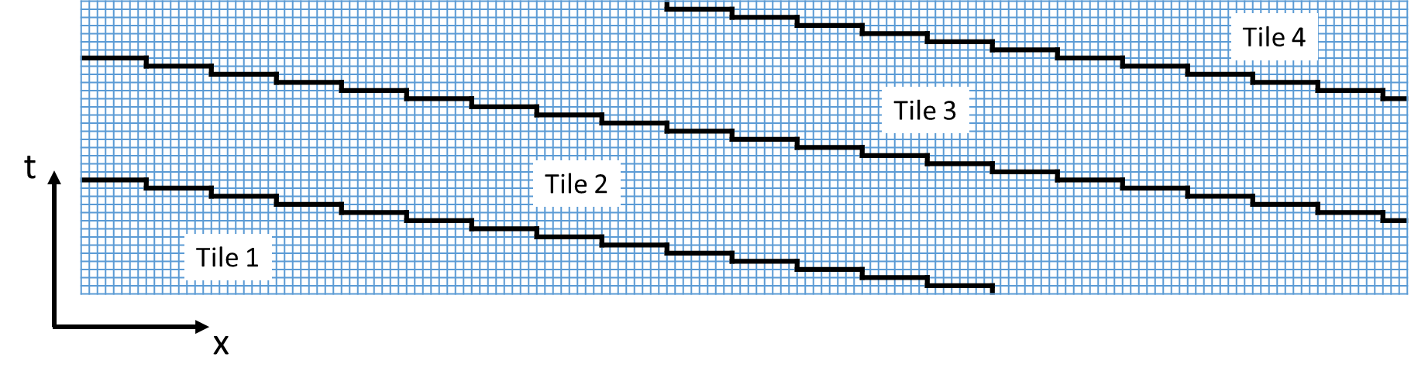
Covering a temporal range via multiple tiles
Wave-front tiles (Mega-blocks) are computed sequentially, but multiple values within one time-step of a given tile may still be evaluated concurrently
After last tile is complete, YASK variables contain the same data as they would have without temporal tiling, so no change is needed when inputting data or reading results
This concept is directly extended to 2D or 3D stencils by shifting in each spatial dimension

Slide 70
Using temporal wave-front tiling in YASK
Another level of tiling hierarchy
Earlier, we explained how each rank domain is divided into blocks, set via –b
Ranks may also be divided into Mega-blocks, where each Mega-block is a wave-front tile
Control the spatial size of a Mega-block with -Mb, -Mbx, -Mby, etc.
Be sure to use a capital “M”; a lower-case “m” is for micro-blocks, explained later
Control the temporal size of a Mega-block with -Mbt (assuming your time dim is “t”)
By default, the spatial size of a Mega-block is the size of the rank
Selecting values
When using a very large unified cache (e.g., HBM used to cache DDR memory), set the spatial size to fit within this cache
See the paper in the upcoming reading list showing ~2× speedup on two stencils
For processors that have much smaller third-level caches (e.g., a Xeon Scalable processor), values are much more critical, and additional performance is more difficult to obtain

Slide 71
Temporal block-level tiling
Goal
Increase temporal locality in caches at a core level, e.g., level-2 caches
Technique
Evaluate n time-steps in each block
Recall that a rank is composed of Mega-blocks, and a Mega-block is composed of blocks
Evaluate blocks concurrently until entire Mega-block is evaluated for n time-steps

Slide 72
Temporal block dependencies
Key
○
○
value already known
value not yet known
known value used as input
value being calculated
t=4
t=3
t=2
t=1
○ | ○ | ○ | ○ | ○ | ○ | ○ | ○ |  |  |  |  |  |  |  |  | ○ | ○ | ○ | ○ | ○ | ○ | ○ | ○ |  |  |  |  |  |  |  |  | ○ | ○ | ○ | ○ | ○ | ○ | ○ | ○
○ | ○ | ○ | ○ | ○ | ○ | ○ | ○ | ○ | ○ |  |  |  |  | ○ | ○ | ○ | ○ | ○ | ○ | ○ | ○ | ○ | ○ | ○ | ○ |  |  |  |  | ○ | ○ | ○ | ○ | ○ | ○ | ○ | ○ | ○ | ○
○ | ○ | ○ | ○ | ○ | ○ | ○ | ○ | ○ | ○ | ○ | ○ | ○ | ○ | ○ | ○ | ○ | ○ | ○ | ○ | ○ | ○ | ○ | ○ | ○ | ○ | ○ | ○ | ○ | ○ | ○ | ○ | ○ | ○ | ○ | ○ | ○ | ○ | ○ | ○
t
x
These three “upward” triangle blocks may be evaluated concurrently.
When they are complete, the “downward” triangle blocks are evaluated.
In one spatial dimension (as shown), this is called triangle or trapezoid tiling (half of diamond tiling)
Extension into multiple spatial dimensions uses a more complex series of multi-dimensional shapes (polytopes) to tessellate the space (not shown)
The amount of shift or temporal angle is based on the radius of the largest stencil (shift of 2 shown)

Slide 73
Using temporal block tiling in YASK
Not another level of tiling hierarchy
As before, control the spatial size of a block with -b, -bx, -by, etc.
Control the temporal size of a block with -bt (assuming your time dim is “t”)
By default, there is no temporal block tiling
Temporal block tiling occurs within wave-front rank tiling, so the temporal size of a Mega-block defaults to the temporal size of a block
But the default spatial size of a Mega-block is still the spatial size of a rank domain
You can use both wave-front rank tiling and temporal block tiling, and the temporal size of the Mega-blocks can be larger than the temporal size of the blocks
Selecting values
When selecting spatial sizes, consider level-2 cache size, number of YASK variables accessed, the FP-element size, and the number of cores

Slide 74
Temporal wave-front micro-block tiling
Goal
Observation: block sizes are used as a unit-of-work for OpenMP* threads as well as level-2 cache targeting
These objectives can conflict when there are many variables in a stencil, which requires small blocks to fit in cache
This can lead to many short OpenMP tasks, which may not be optimal
Also, it may be beneficial in some cases to combine the concepts of trapezoid tiling and wave-front tiling across different dimensions
Goal is to separate the thread and cache block concepts and provide more tiling flexibility
Technique
Evaluate n time-steps in a subset of each block
We refer to this subset as a micro-block in YASK
Evaluate each micro-block sequentially until entire block is evaluated

Slide 75
Temporal micro-block dependencies
Key
○
○
value already known
value not yet known
known value used as input
value being calculated
t=4
t=3
t=2
t=1
○ | ○ |  |  |  |  |  |  |  |  |  |  |  |  |  |  | ○ | ○ |  |  |  |  |  |  |  |  |  |  |  |  |  |  | ○ | ○
○ | ○ | ○ | ○ | ○ | ○ |  |  |  |  |  |  |  |  | ○ | ○ | ○ | ○ | ○ | ○ | ○ | ○ |  |  |  |  |  |  |  |  | ○ | ○ | ○ | ○ | ○ | ○ | ○ | ○
○ | ○ | ○ | ○ | ○ | ○ | ○ | ○ |  |  |  |  | ○ | ○ | ○ | ○ | ○ | ○ | ○ | ○ | ○ | ○ | ○ | ○ |  |  |  |  | ○ | ○ | ○ | ○ | ○ | ○ | ○ | ○ | ○ | ○ | ○ | ○
t
x
Block boundaries as shown previously
Mini-block boundaries
Blocks are evaluated concurrently as before using OpenMP threads
Micro-blocks are evaluated sequentially within each block
Micro-blocks use wave-front tiling, similar to Mega-blocks, but inside blocks instead of ranks

Slide 76
Using micro-block tiling in YASK
Another level of tiling hierarchy
Blocks may be divided into micro-blocks, where each micro-block is a wave-front tile
Control the spatial size of a micro-block with -mb, -mbx, -mby, etc.
The temporal size of a micro-block is always the same as a block, so it is set implicitly via -bt
By default, the spatial size of a micro-block is the size of a block
Selecting values
The size of a micro-block should normally correspond to the size of a level-2 cache, considering the number of variables accessed and the FP-element size
Any scratch-var values are evaluated at the micro-block level, so consider their sizes
The block sizes can now be larger than what would fit in a level-2 cache, considering the number of cores with thread balancing
By sizing micro-blocks as wide as blocks in one or two dimensions and/or sizing blocks as wide as Mega-blocks in some dimensions, interesting special-case scenarios may be created

Slide 77
Nested OpenMP threads
Goal
Observation: using hyper-threads (SMT) across blocks effectively reduces the usable size of the level-2 cache available to each thread
This is particularly impactful on Xeon Phi processors with not only 4 hyper-threads per core but also 2 cores sharing a level-2 cache
Goal: allow multiple threads to use shared caches constructively rather than destructively
Technique
Evaluate subsets of each micro-block by threads that share caches
We refer to this subset as a nano-block in YASK
Evaluate nano-blocks concurrently until a single time-step in a mini-block is evaluated (thus, there is no temporal nano-block tiling)
Since blocking already uses OpenMP threads, nano-blocking is implemented with a nested level of OpenMP threading

Slide 78
Using nano-block tiling in YASK
Another level of tiling hierarchy
Micro-blocks may be divided into nano-blocks
Control the spatial size of a nano-block with -nb, -nbx, -nby, etc.
There is no temporal nano-blocking, so there is not an -nt option
Selecting values
By default, the spatial size of a nano-block depends on the number of threads are used per block
If there is one thread per block (no nested OpenMP), the default size of a nano-block is the size of a micro-block
In this case, it is recommended to use only one thread per level-2 cache
If there are >1 threads per block (nested OpenMP active), the default size of a nano-block is a narrow slab the width of one vector (usually in the first dim) and the size of a micro-block in the other dims
This setting is intended to increase reuse between hyper-threads while keeping threading overhead as low as possible
Control the number of threads
By default, the yask.sh script runs one thread per core by passing -outer_threads to the binary, and the default number of inner threads is one (1).
If you want to use hyper-threads, use the -inner_threads option, e.g., -inner_threads 2 will use both hyper-threads on most Intel® Xeon™ processors, assuming hyper-threading is enabled in the BIOS settings
You can also override the -outer_threads value to, for example, experiment with multiple cores sharing data across their L2 caches
Try adjusting threads-per-block and/or nano-block sizes on the test stencil and check performance


Slide 79
Using pico-block tiling in YASK
Lowest level of tiling hierarchy
Nano-blocks may be divided into pico-blocks
Control the spatial size of a pico-block with -pb, -pbx, -pby, etc.
There is no temporal pico-blocking, so there is not an -pt option
Pico-blocking can be used for level-one (L1) cache-blocking on CPUs, but its use is more critical on GPUs, explained later in this tutorial
Selecting values
By default, there is only one pico-block per nano-block
Pico-blocking allows each nano-block, which is evaluated by an inner OpenMP thread, to have even more locality
In some stencils, pico-blocking may be able to take advantage of L1 cache locality
Try adjusting pico-block sizes on the test stencil and check performance


Slide 80
Review of the CPU tiling hierarchy
Hierarchy level | Spatial size options | Concurrent evaluation? | Temporal tiling? | Temporal size options (assuming time dim is “t”)
Global domain | -g* | N/A (only one) | N/A | -trial_steps
Local domains | -l* | Yes, via MPI | No
Mega-blocks | -Mb* | No | Yes, via sequential wave-front tiling | -Mbt
Blocks | -b* | Yes, via outer OpenMP threads | Yes, via concurrent hyper-trapezoid tiling | -bt
Micro-blocks | -mb* | No | Yes, via sequential wave-front tiling | -bt (implicitly)
Nano-blocks | -nb* | Yes, via inner OpenMP threads | No
Pico-blocks | -pb* | No (unless on GPU) | No
Vectors | fold=… | Yes, via HW ILP (instruction-level parallelism) | No
Elements | real_bytes=… | Yes, via HW SIMD | No

Slide 81
Example tile settings for temporal tiling
The following options were hand-tuned for an Intel® Xeon® Platinum 8352Y CPU
bin/yask.sh -stencil my_stencil -l 1024 \ -mbx 32 -mby 32 -mbz 128 \ -b 256 -bt 12 \ -no-pre_auto_tune
Micro-block settings selected targeting 1MiB
The Intel® 8352Y has a 1280KiB L2 cache per core, and this gives some extra space
32 × 32 × 128 × 4B × 2 = 1MiB (128 ⇒ longer in unit stride; “4B” ⇒ 4 bytes per FP element; “× 2” to keep two time-steps in cache)
Spatial block settings selected for a multiple of number of cores per socket
The Intel® 8352Y has 32 cores per socket
Trying 2 blocks per core: 64 blocks (modify for CPU with different core count)
A small multiple (like 2 or 4) often works better than the exact count because several blocks per core gives more opportunity for dynamic load balancing
Trying 4 blocks across each dimension: 4 × 4 × 4 = 64
1024 ÷ 4 = 256, so using -b 256
Temporal block setting (-bt 12) was chosen experimentally by iterating manually through several values
Mega-block size not set because L3 blocking is not being targeted in this experiment
Nano-block size not set because only one thread per block is used in this experiment
Pico-block size not set because L1 blocking is not being targeted in this experiment
These settings resulted in about a 40% speedup over default non-temporal tiling; your results may vary


Slide 82
Controlling when the automatic tuner runs
Pre-calculation mode
Runs before the desired stencil calculations are done
Does not ensure that calculations are done in the proper order
Thus, important to [re]initialize data after running in this mode for use in deployed applications
Intended for benchmarking to tune block-size before running actual time-steps
Use [-no]-pre_auto_tune option to control in provided test utility (default is on)
Call API run_auto_tuner_now() to activate outside in your application
Intra-calculation mode
Runs during desired stencil calculations
Maintains proper calculations
Intended for deployment, esp. on multiple platforms or when all final platforms are not known a priori
Use [-no]-auto_tune option to control in provided test utility (default is off)
Call reset_auto_tuner() to turn off or on explicitly
Call API is_auto_tuner_enabled() to determine whether it is [still] running

Slide 83
Controlling what the automatic tuner does
Tiling levels
By default, the auto-tuner is applied to the “block” tiles only
More generally, you can supply a list of tiling levels via -auto_tune_targets
The argument is a comma-separated list of level abbreviations: Mb for mega-blocks, b for blocks, mb for micro-blocks, nb for nano-blocks, and pb for pico-blocks
The order specified is the order in which the tile sizes are tuned, and targets can be repeated
Example: -auto_tune_targets b,Mb,b will tune blocks, then mega-blocks, then blocks again
Other controls
-auto_tune_radius controls how far the tuner will start exploring from the initial settings
-auto_tune_trial_secs controls how long a new trial must be run to consider it better than the current best trial; higher values avoid measurement noise but require more time to converge

Slide 84
GPU Offloading

Slide 85
GPU offload overview
Mechanism
GPU offloading is via OpenMP Device Directives (see OpenMP 5.1 spec)
Run make offload=1 to build a kernel with GPU offloading
Add offload_arch=device_name to make command to change the OpenMP target
Default device name is spir64 to target Intel GPUs when using the Intel compiler
When targeting spir64, specific device code is generated at run-time with JIT offload compiler
Run yask.sh -offload to select the GPU offload kernel
The nano- and pico-block loops are offloaded by default
Nano loops executed via omp target…
Thread limit set via -device_thread_limit command-line option
Pico loops are nested within nano loops
These are the default auto-tuner targets for an offload binary (instead of blocks as for CPU binaries)
For a solution with N domain dimensions, N-1 dim loops are concurrent; one (1) is sequential
All higher-level loops are executed on the CPU
The default number of CPU threads for an offload binary is one (1)
Using more than one CPU thread allows launching more than one GPU kernel concurrently
The default sizes of all blocks larger than pico-blocks are the full rank size

Slide 86
Example offload pseudo-code for a 3D stencil when using Intel oneAPI
// The “nano” loop distributes the device teams across the 3D space to the “pico” blocks. #pragma omp target teams distribute thread_limit(thread_limit) for (3D-index in manually-collapsed 3D loop over current nano block, stepping by size of a pico block) {
// The “pico” loops evaluate points in the pico block within each device team. #pragma omp parallel for collapse(2) for (y-index over current pico block) { for (z-index over current pico block) { Set up pointers for inner loop; for (x-index over current pico block) { Evaluate stencil equation at x, y, z indices; } } } }

Slide 87
Example offload using Intel oneAPI
Build for offload device
make -j stencil=iso3dfd offload=1
Note the CPU-target.offload-target arch string that is printed at the end of the build
By default, the Intel compiler is used for a spir64 target
Run via yask.sh
bin/yask.sh -stencil iso3dfd -offload -g 1024 \ -no-pre_auto_tune -pb 32 -pbx 256
bin/yask.sh -stencil iso3dfd -offload -g 1024
Use the -device_thread_limit option to set the number of OpenMP device threads per team
The script will attempt to find the number of Intel GPUs on the current system and use that to determine how many MPI ranks to start; use -ranks to override



Slide 88
Example offload pseudo-code for a 3D stencil when using a non-Intel compiler
// The “nano” loop assigns workers across the 3D space to the “pico” blocks. #pragma omp target teams distribute parallel for collapse(3) \ thread_limit(thread_limit) for (x-index over current nano block) { for (y-index over current nano block) { for (z-index over current nano block) {
// The “pico” loops evaluate points in the pico block in each device thread. for (y-index over current pico block) { for (z-index over current pico block) { Set up pointers for inner loop; for (x-index over current pico block) { Evaluate stencil equation at x, y, z indices; } } } } } }

Slide 89
Example offload using the Nvidia* HPC SDK
Build for offload device
make -j stencil=iso3dfd offload=1 mpi=0 YK_CXX=nvc++
This command disables MPI and sets the C++ compiler
For MPI support (for more than 1 GPU), build with mpi=1 YK_CXX=mpic++
Run via yask.sh
bin/yask.sh -stencil iso3dfd –offload -g 1024 \ -no-pre_auto_tune -pb 1 -pbx 128
bin/yask.sh -stencil iso3dfd –offload -g 1024
The script will attempt to find the number of Nvidia GPUs on the current system and use that to determine how many MPI ranks to start; use -ranks to override
Note: it is not suggested that these build configurations and run options are optimum for any particular stencil or device



Slide 90
Wrap-up

Slide 91
Read more about YASK features and applications
“Vector Folding: improving stencil performance via multi-dimensional SIMD-vector representation.” C Yount. 17th International Conference on High Performance Computing and Communications (HPCC), 2015
“YASK—Yet Another Stencil Kernel: A Framework for HPC Stencil Code-Generation and Tuning.” C Yount, J Tobin, A Breuer, A Duran. Domain-Specific Languages and High-Level Frameworks for High Performance, 2016
“Effective use of large high-bandwidth memory caches in HPC stencil computation via temporal wave-front tiling.” C Yount, A Duran. 7th International Workshop on Performance Modeling, Benchmarking and Simulation of High Performance, 2016
“Accelerating seismic simulations using the Intel Xeon Phi knights landing processor.” J Tobin, A Breuer, A Heinecke, C Yount, Y Cui. International Supercomputing Conference, 2017
“Performance Optimization of Fully Anisotropic Elastic Wave Propagation on 2nd Generation Intel® Xeon Phi (TM) Processors.” A Farres, C Rosas, M Hanzich, A Duran, C Yount. 2018 IEEE International Parallel and Distributed Processing Symposium
“Multi-level spatial and temporal tiling for efficient HPC stencil computation on many-core processors with large shared caches.” C Yount, A Duran, J Tobin. Future Generation Computer Systems, March, 2019
Please use one or more of the above citations in any publication submissions

Slide 92
Call to action
Work through this tutorial
Code your own stencil
Use it in a real application
Please feel free to contact the developers with questions
Contribute your stencil for others to use: create a fork on github* and submit a pull request
Please tell the developers about your experience, maybe even co-publish results
Contribute to the project
See the “issues” database on github* for the to-do list
Talk to the developers about something you’d like to work on
Probably some good academic projects in there!

Slide 93
https://github.com/intel/yask

