Slide 1
Weather Forecast Sprint 1
Álvitézek
Lipők Lambert, Poroszlay Richárd, Sidlóczki Balázs, Tar Zoltán

Slide 2

User Interface

Slide 3

User Interface - Welcome Screen

Slide 4

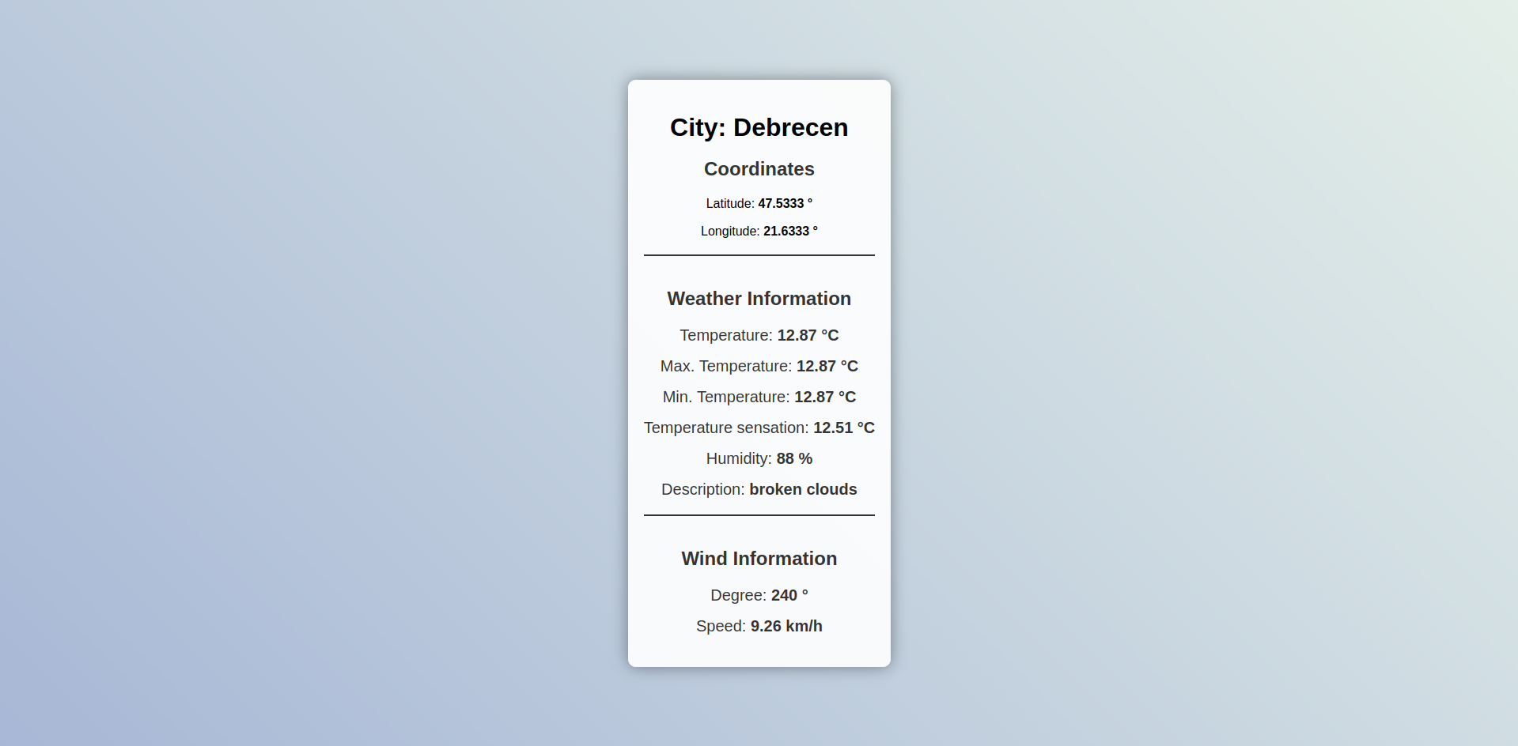
User Interface - Search weather by city
Provides a convenient interface to search the weather by certain cities
Users can search for non-hungarian cities as well

Slide 5
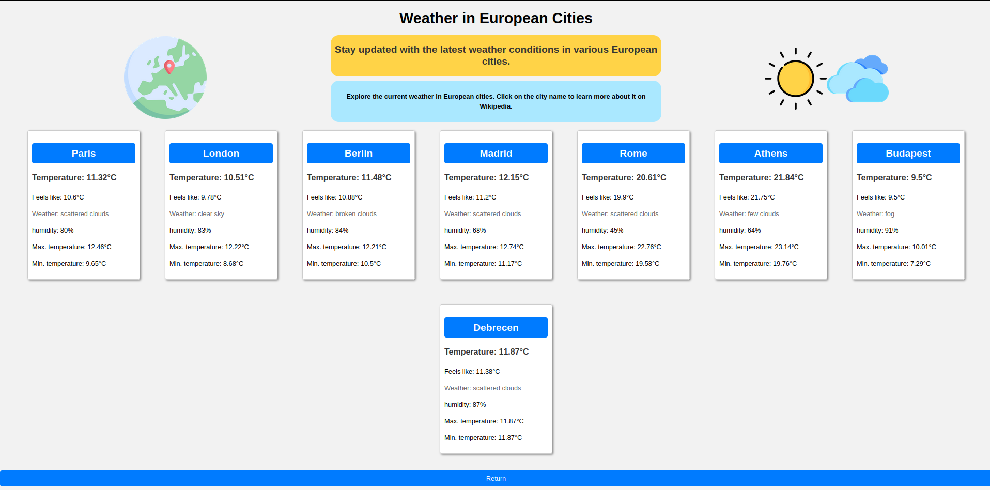
User Interface - Weather in European Cities

Slide 6

Machine Learning

Slide 7
Machine Learning - Test models
Trying to find a neural network that is able to predict an accurate average temperature
Tensorflow, pandas, numpy
Results are stored in csv files
Different neural network activation functions (tangh, sigmoid, relu)

Slide 8
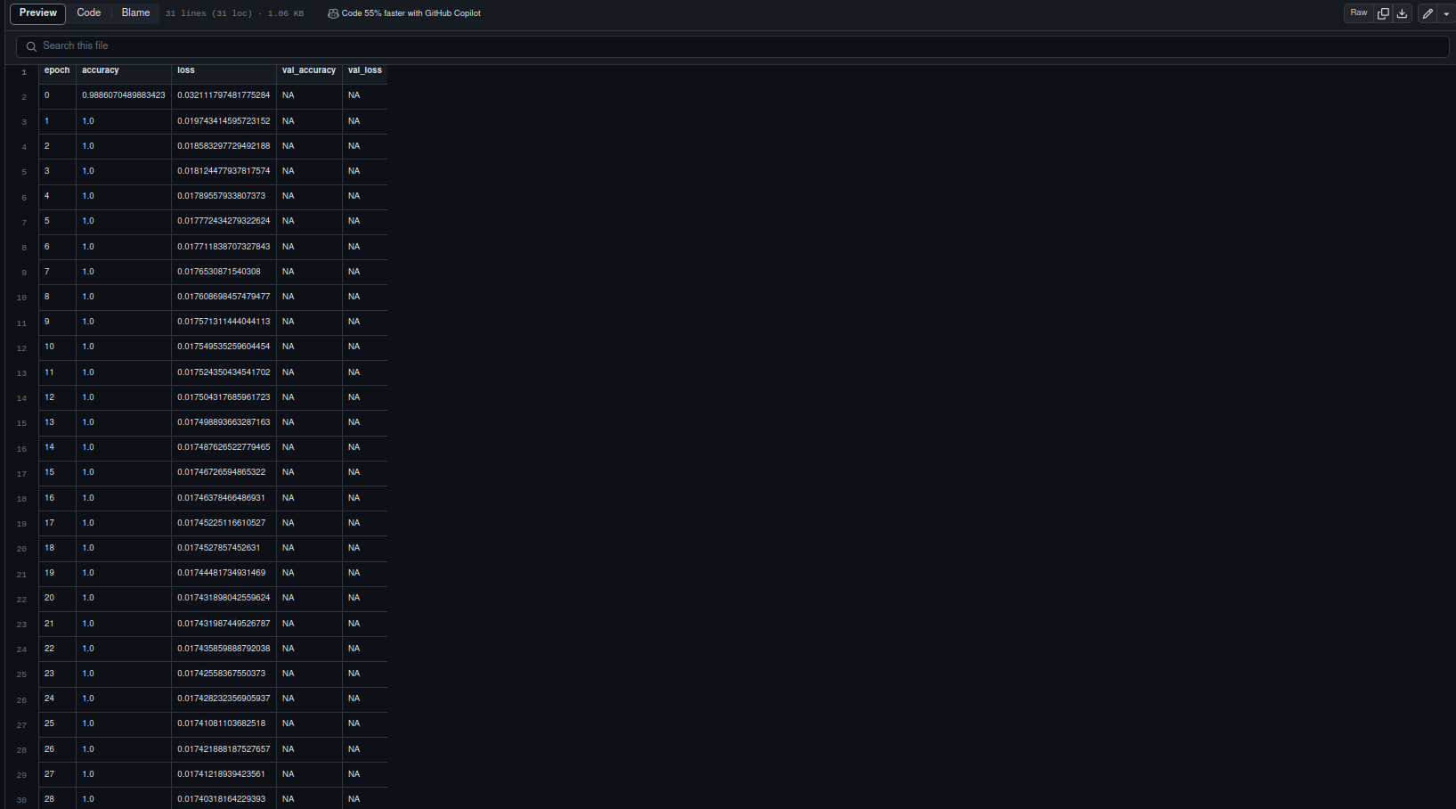
Machine Learning - Test models
Example: csv generated with the use of Sigmoid activation function

Slide 9

Thank You!

