Slide 1
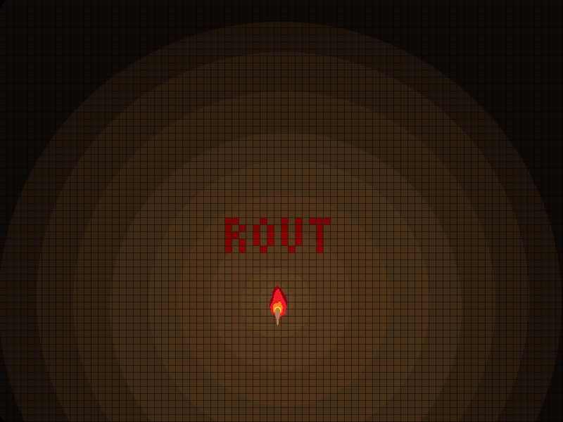

Slide 2
The Good and the Bad
The Good
The Bad
Atmosphere
Visual Cues
The Maze
The Lighting
Texture Importation
Map View
Co-dependent system hang-ups
Late Final Asset Gathering
Late Outside User Play Testing

Slide 3
What we would change
Clearer Audio Assets
Better Floor/Ceiling Assets
Even Distribution of Work
Earlier Public Testing
More Modular Architecture

Slide 4
What did we learn
Technical:
Learned HLSL
DirectX Infrastructure
Model Importation
Design:
Player Behavior
Visual and Auditory Queues
Fear as a motivator

