Slide 1

ParaLang
Search Bar Add-On
Ryan A, William D, Michael G, Ekim K

Slide 2

A Gap in Information
Never before mentioned problem
Bias when searching in a particular language
Outdated Information

Slide 3

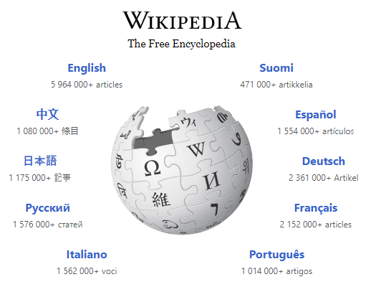
Missing Information
English articles on Wikipedia:
+5,964,000
Total number of articles on Wikipedia:
+31,000,000
Out of all Languages
18%

Slide 4
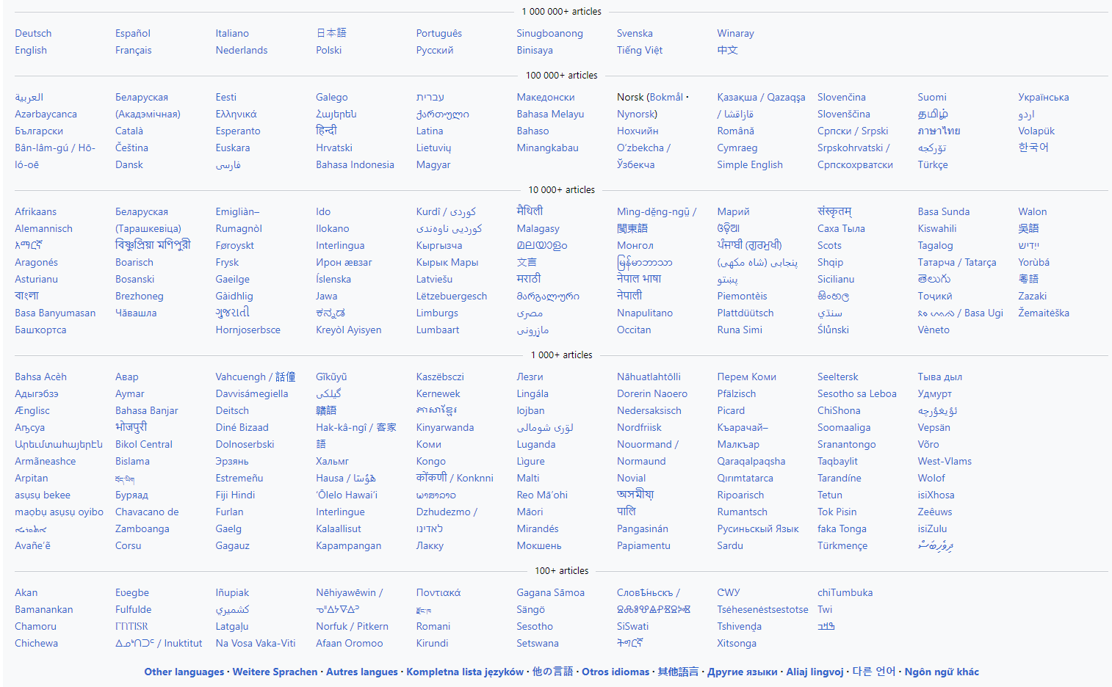

Slide 5
Solution Idea
Able to display search results from multiple languages
User friendly interface
Azure Translator
Bing Search Engine

Slide 6
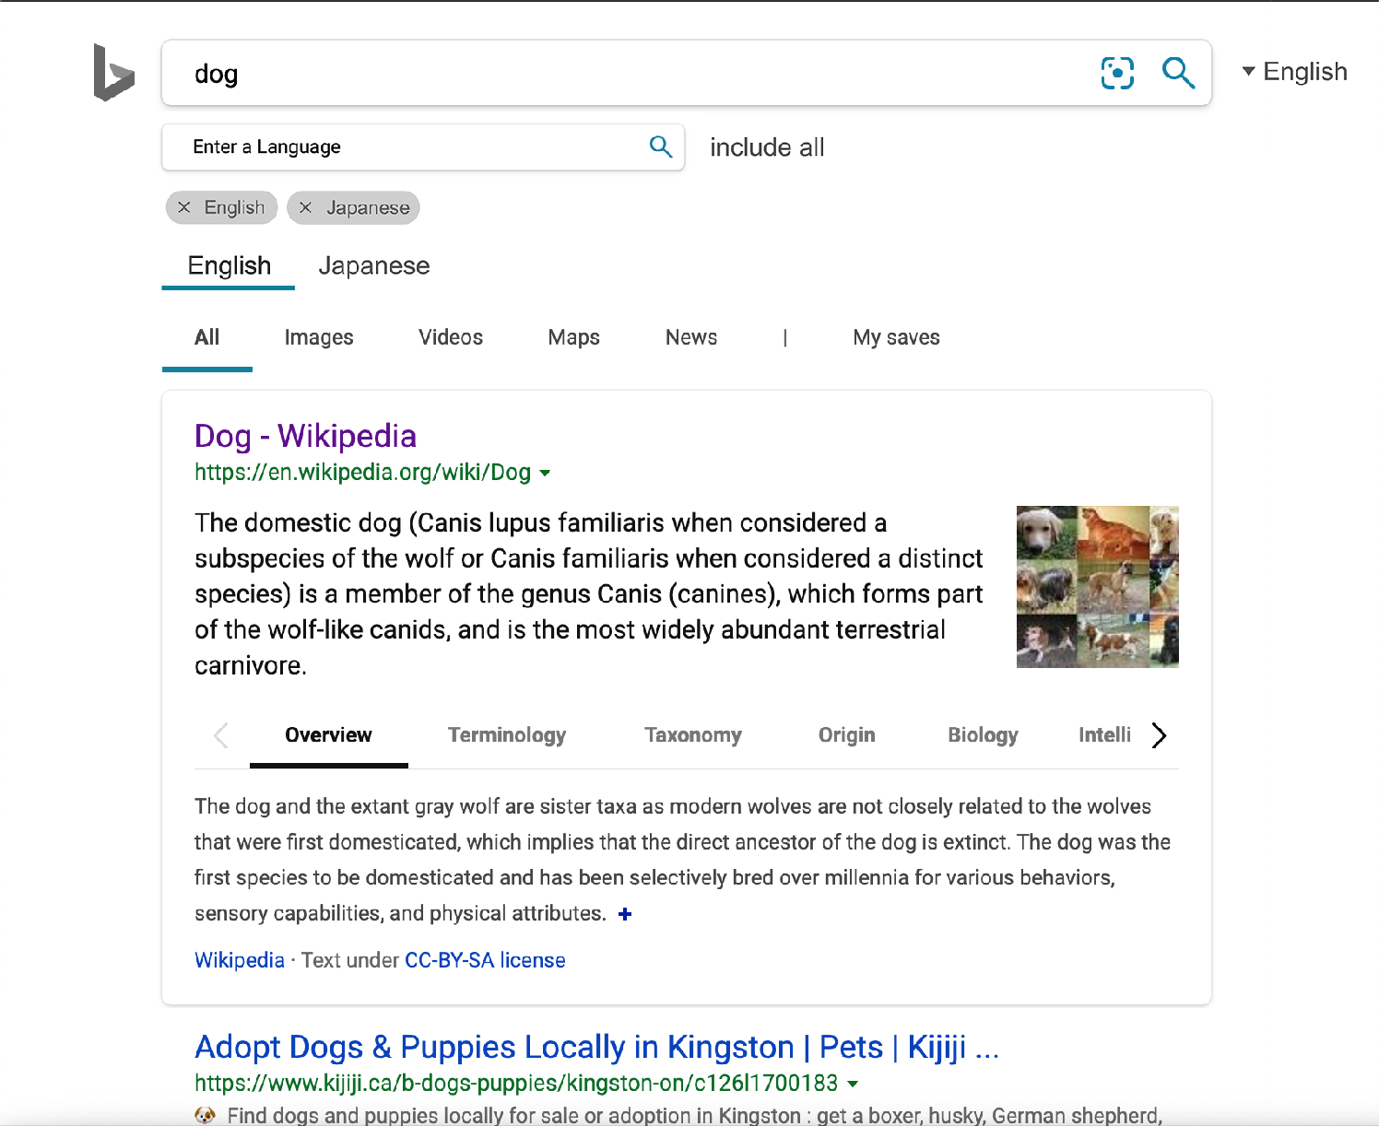
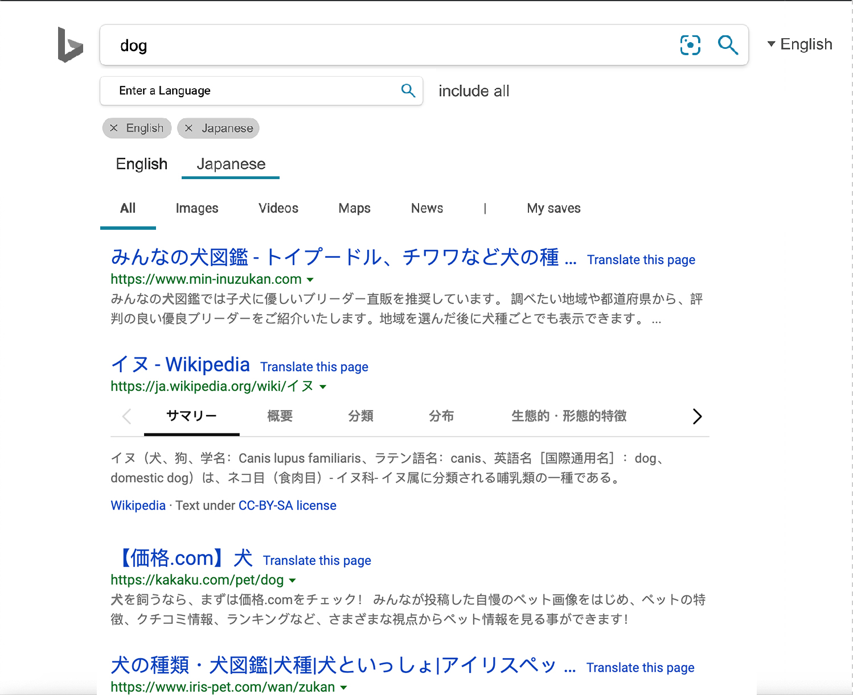
Visualization of Solution

Slide 7


Demo

Slide 8
Further Development
Better UI
User Feedback

Slide 9

Target Market
General Users of Search Engine

Slide 10

Not Applicable
Risks and Mitigation
Competitive Analysis
Sales Forecast
Revenue Calculation
Contingency Plan
Communication Plan

Slide 11
Implementation Plan

Slide 12
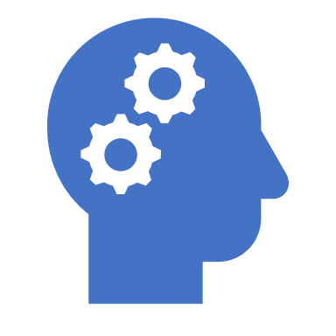
Summary
Problem
Solution
Azure Cognitive Services
Python
Further development
ParaLang is able to provide more search results

Slide 13
Sustainable Development Goals
Quality Education
Reduced Inequality between countries

Slide 14
Questions?

