Slide 1

Ellipsoid raspberry particles & Thermal Stoner-Wohlfarth
Florian Klee
Supervisor: Pedro A. Sánchez

Slide 2
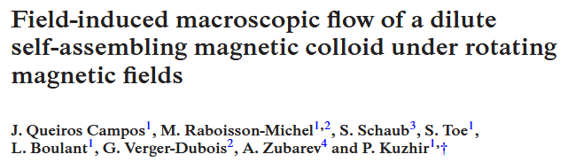
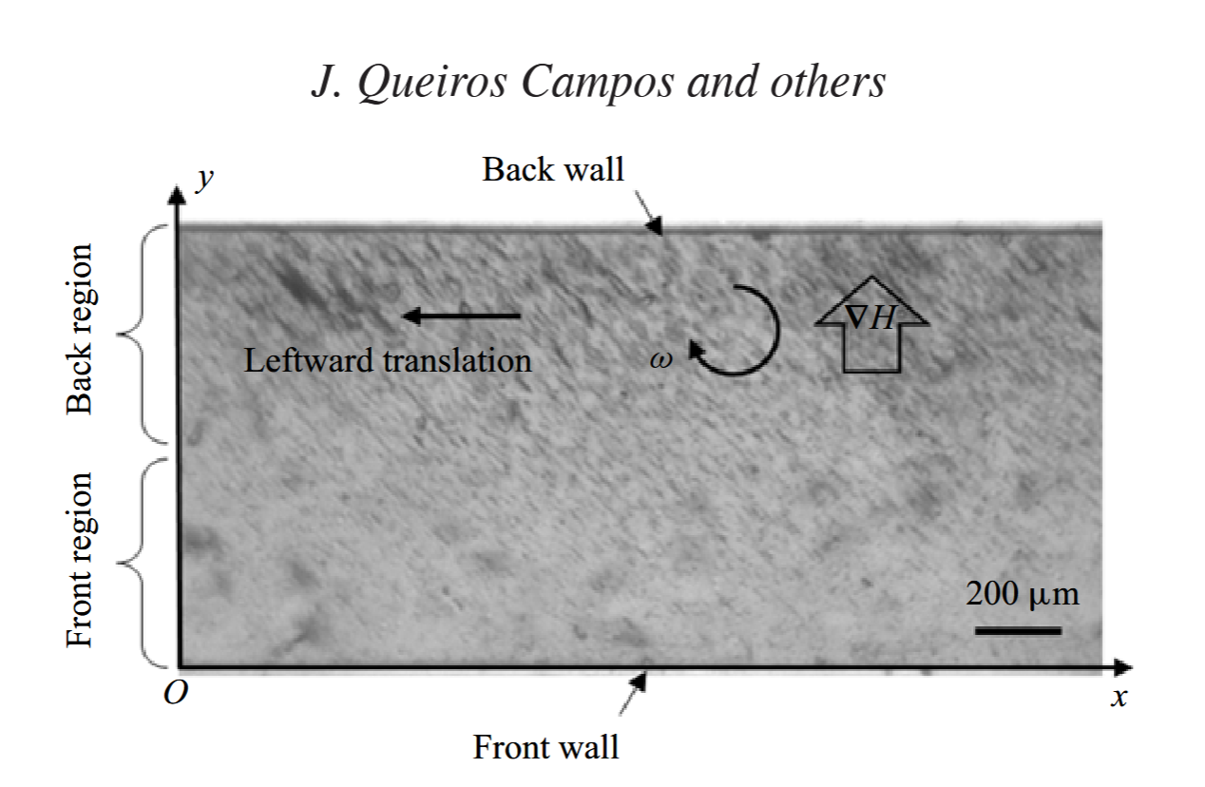
The project
Recreate effects shown in:
in simulation
Notes:
It is an experimental paper about the following setup. Closed channel. Low concentration of magnetic colloids. Gradient field + rotating. Observe: Primary aggregates form into secondary rod structurs that spin, go to the back wall, and translate to the left there. Drag fluid with them -> Bottom flow to the right. Recirculation flow. 5-8microm/s

Slide 3
Contents
Set up of raspberry ellipsoids to function as the rods
Model used for their magnetic behaviour (Thermal SW)
Results of the Model applied to the Raspberries

Slide 4
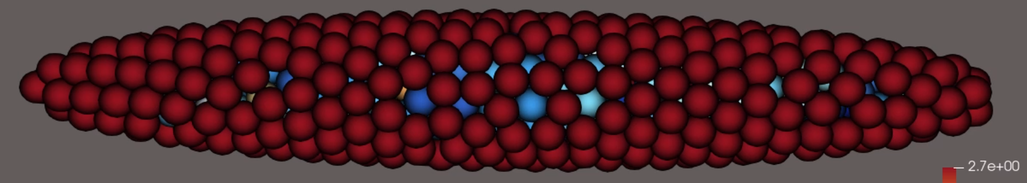
Raspberry Ellipsoids
Motivation:
Structured surface
-> Captures fluid dynamics
Multi-domain
-> Complex magnetic behaviours

Slide 5
Thermal Stoner-Wohlfarth
Motivation: Decouple magnetic moment & particle orientation
Néel vs Brownian relaxation
Deniz Mostarac et al. Thermal Stoner–Wohlfarth model for magnetodynamics of single domain nanoparticles: implementation and validation. Physical Review B, 111(1):014438, January 2025. doi:10.1103/PhysRevB.111.014438.
Notes:
In a lot of MD simulations particles that experience a field react to it via “Brownian relaxation” which means …
Néel relaxation … , so the particle gains an additional degree of freedom, which leads to richer physics

Slide 6
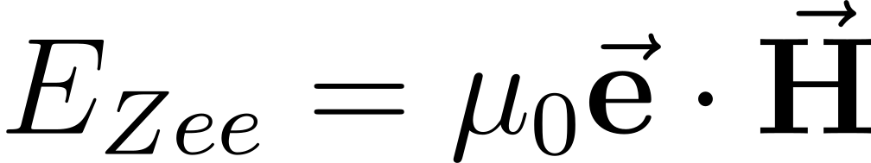
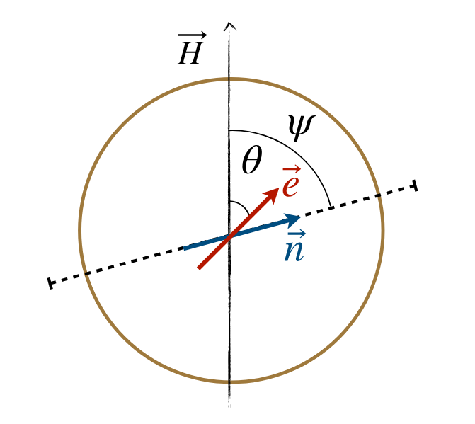
Stoner-Wohlfarth
Zeeman Energy
Deniz Mostarac et al. Thermal Stoner–Wohlfarth model for magnetodynamics of single domain nanoparticles: implementation and validation. Physical Review B, 111(1):014438, January 2025. doi:10.1103/PhysRevB.111.014438.
Notes:
The SW model: describes one single domain particle, and takes into consideration two energy contributions. Zeeman…

Slide 7
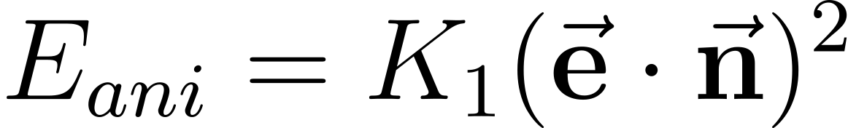
Stoner-Wohlfarth
Zeeman Energy
Anisotropy Energy
Deniz Mostarac et al. Thermal Stoner–Wohlfarth model for magnetodynamics of single domain nanoparticles: implementation and validation. Physical Review B, 111(1):014438, January 2025. doi:10.1103/PhysRevB.111.014438.
Notes:
And the second contribution is the Anisotropy energy. Some bodies have a preferential axis to magnetize along.
Either because of their lattice, or shape. Generally speaking, things like to magnetize along their long axis. Both directions are equal.

Slide 8
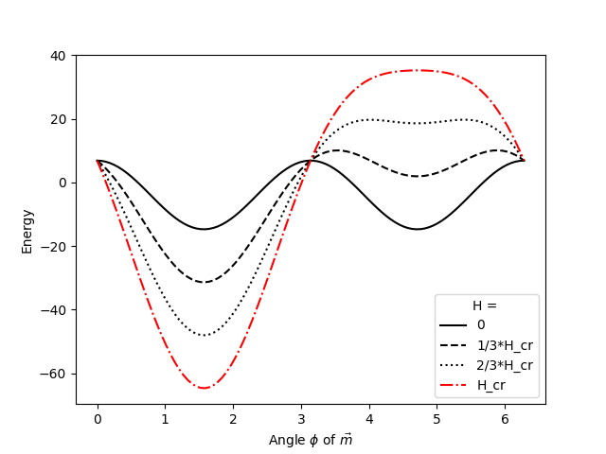
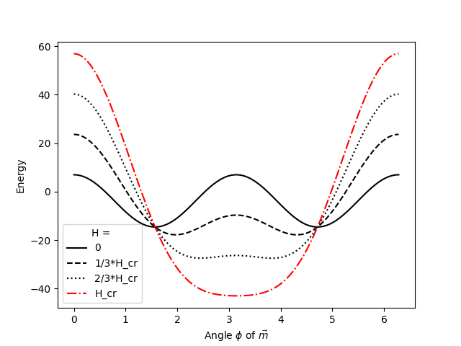
Stoner-Wohlfarth
H
H
Notes:
For zero field, you get the solid curve which has two minima. Once field is applied one minimum gets shallower and the other deeper. The curve in red shows what happens at the crit Field, where …
Notice also that these are two types of tranistions. …

Slide 9
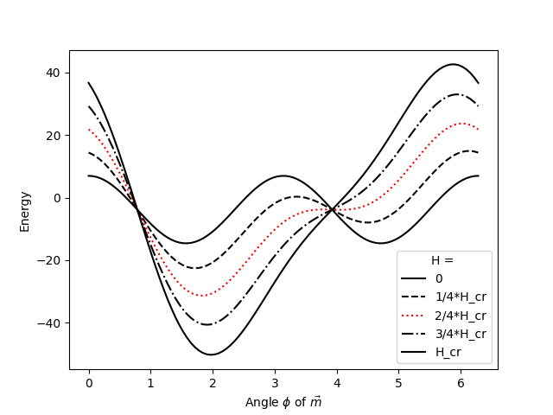
Stoner-Wohlfarth
H
Notes:
This gives the picture the model is known for. The Stoner Wohlfarth asteroid
Its shape gives the critical Field magnitude for each orientation of H w.r.t. the Easy and hard axis, in our picture z and x.

Slide 10
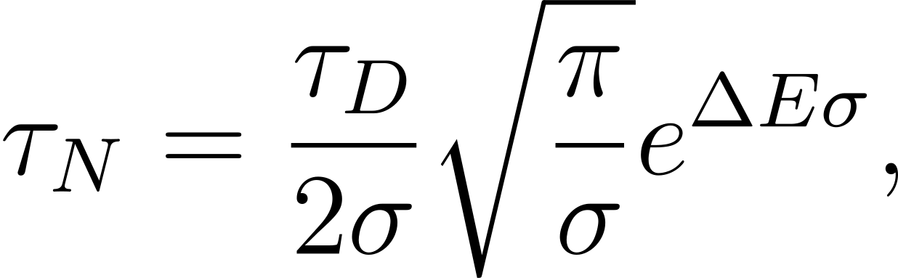
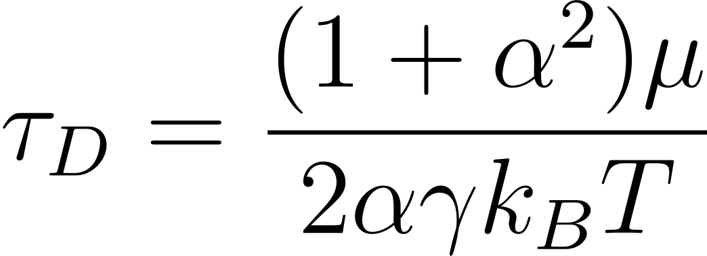
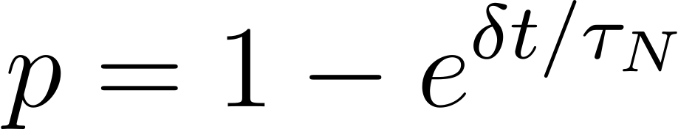




Thermal Stoner-Wohlfarth
Motivation: Decouple magnetic moment & anisotropy axis
Néel vs Brownian relaxation
MC steps between energy minima
with
Notes:
Sigma: Anisotropy parameter, KV/kT
Tau_D: Debye time, characteristic time scale for relaxation of magnetic moment
Tau_N is referred to as Neel time, avg time it takes for thermal fluct to overcome the barrier

Slide 11
Thermal Stoner-Wohlfarth
Zeeman Energy
Anisotropy
Dipole-Dipole / Demag field
Deniz Mostarac et al. Thermal Stoner–Wohlfarth model for magnetodynamics of single domain nanoparticles: implementation and validation. Physical Review B, 111(1):014438, January 2025. doi:10.1103/PhysRevB.111.014438.
Notes:
So far: single particle. Now: multi –> DpDp. Isn’t difficult to account for since the Model acts locally on the individual particles, and you can simply add the demag field to the effective field acting on it.

Slide 12
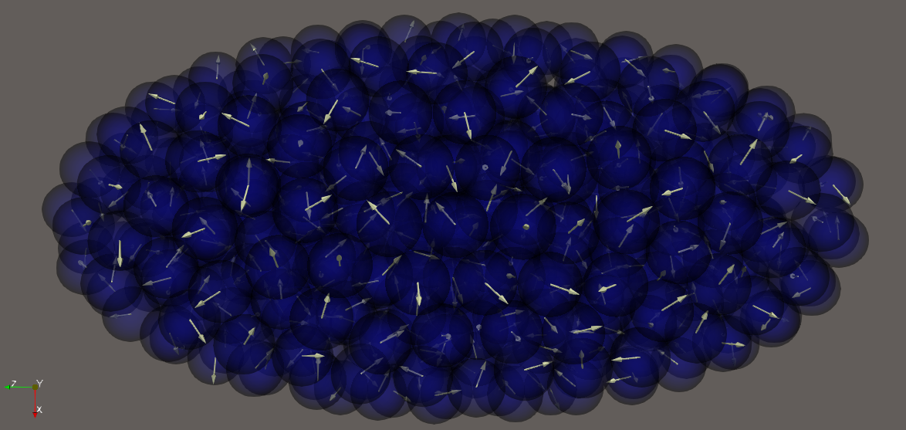
Simulation Setup

Slide 13
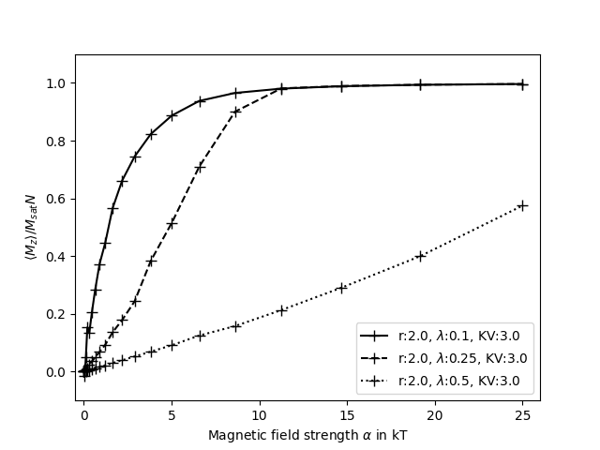
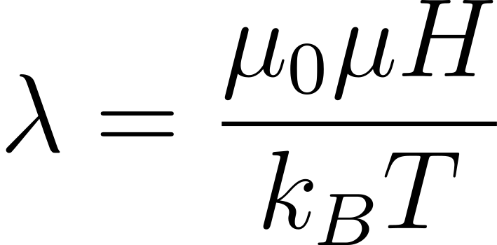
Magnetic response
r: Semiaxes ratio of ellipsoid
a:1
KV: anisotropy Energy
Notes:
For higher Lambda: Higher demagnetization Field

Slide 14
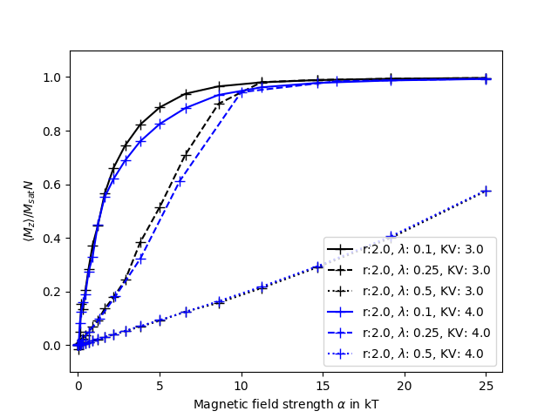
Magnetic response
r: Semiaxes ratio of ellipsoid
a:1
KV: anisotropy Energy
Notes:
Higher anisotropy Coefficient: lower susceptibility. Random arrangement is more persistent, which leads to net zero magnetization

Slide 15
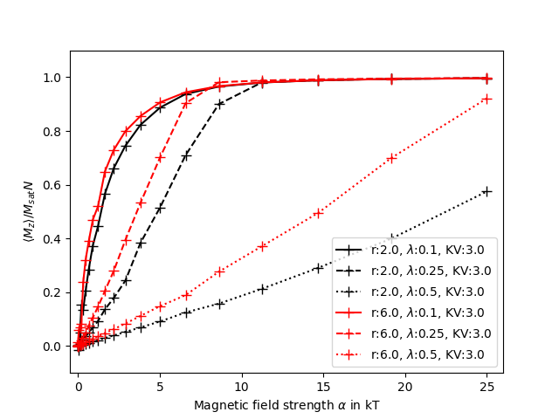
Magnetic response
r: Semiaxes ratio of ellipsoid
a:1
KV: anisotropy Energy
Notes:
Higher ratio: higher susceptibility, less demagnetizing effect since particles aren’t as bunched up

Slide 16
Outlook
Response to Rotating magnetic field
Piece together simulation
Including Lattice-Boltzmann Fluid dynamics
Try to induce recirculation flow

