Slide 1

Ellipsoid raspberry particles
&
Thermal Stoner-Wohlfarth
Florian Klee
Supervisor: Pedro A. Sánchez

Slide 2
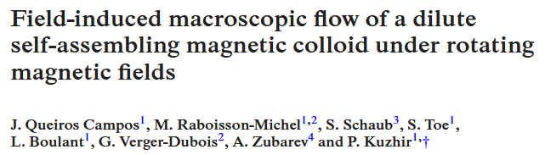
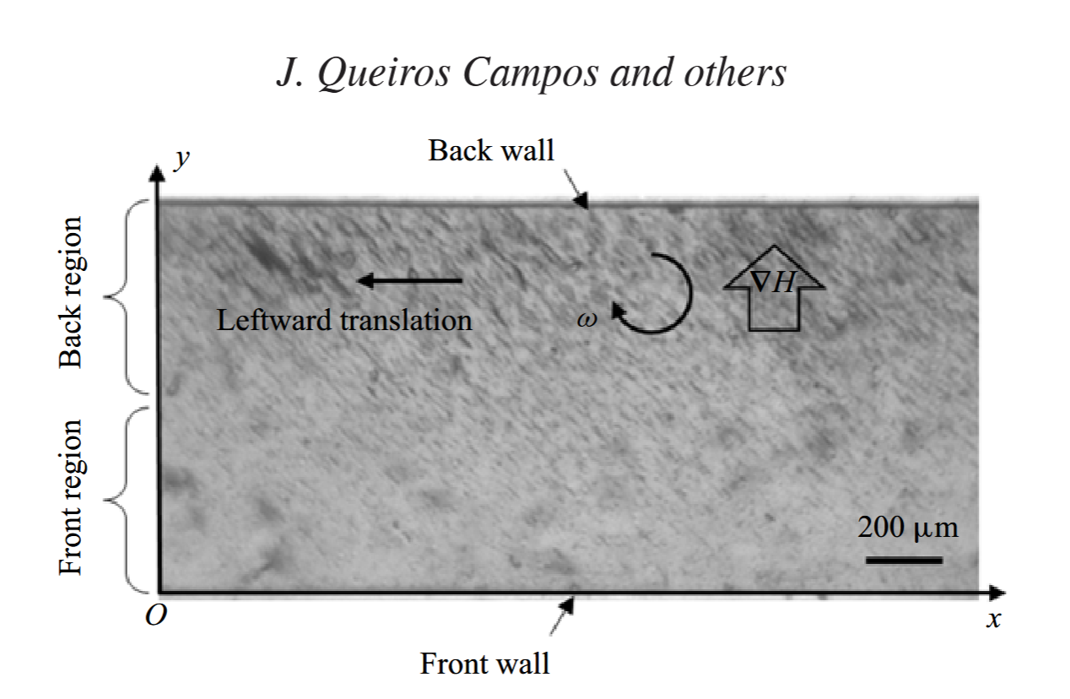
The project
Recreate effects shown in:
in simulation

Slide 3


The project
Recreate effects shown in:
in simulation
stagnant

Slide 4
Raspberry Ellipsoids
Two approaches
  One for smooth surface
  One superior in every other way
Notes:
Show short clips of the construction of the ellipsoids.
Should take about 1.5min
4

Slide 5
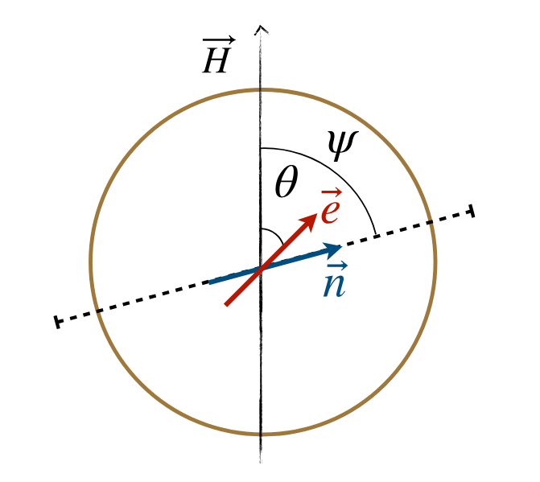
Energy contributions
Zeeman Energy
Anisotropy
Deniz Mostarac et al. Thermal Stoner–Wohlfarth model for magnetodynamics of single domain nanoparticles: implementation and validation. Physical Review B, 111(1):014438, January 2025. doi:10.1103/PhysRevB.111.014438.

Slide 6
Energy contributions
Zeeman Energy
Anisotropy
Demag field / Dipole-Dipole
Exchange Interaction
img
Notes:
Explanation how exchange influences ferro, dia, paramagnetism / superparamagnetism for my system. But optional really depending on time. If so, will also grey out Exchange interaction entirely.
6

Slide 7
Thermal Stoner-Wohlfarth
Visually what happens to energy landscape here
For magnetic field str and different direction to ani
MC steps in accordance to Boltzman and Energy
Notes:
7

Slide 8
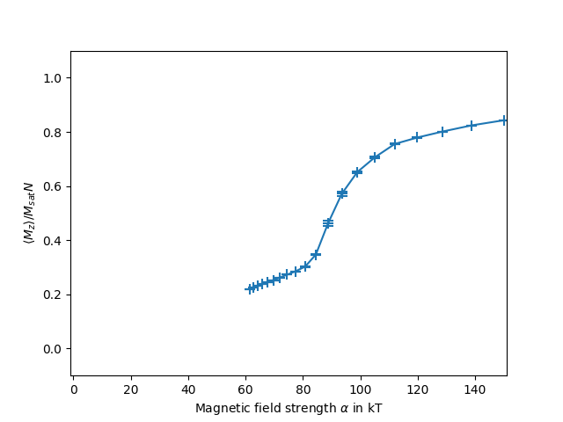
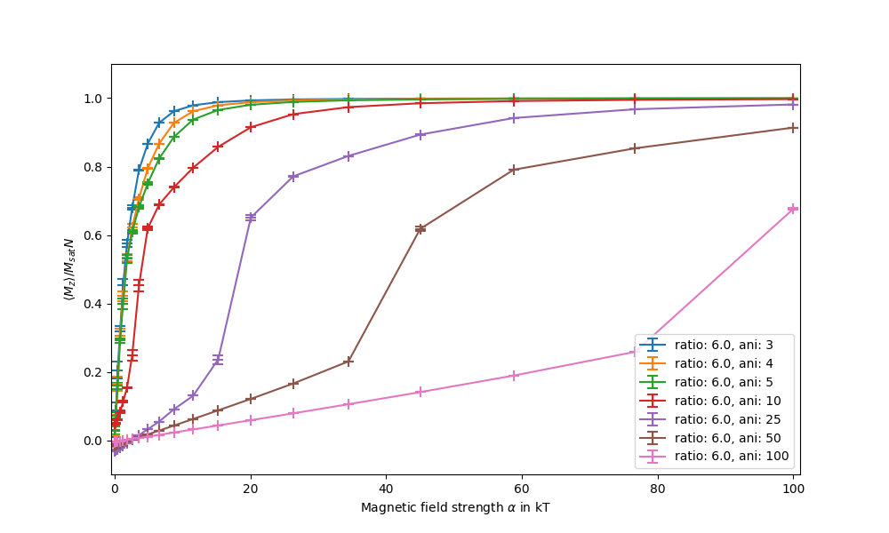
Magnetic response
Response curves
Notes:
8

Slide 9
Outlook
Piece together simulation
Including Lattice-Boltzman Fluid dynamics
Rotating magnetic field
Try to induce recirculation flow
Notes:
Visualize what happens t
9

