Slide 1
Overparameterization

Slide 2
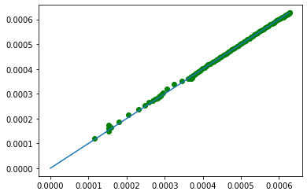
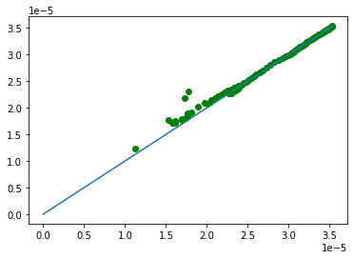
Fashion MNIST
DLGN
4 layers, width=64
lr=1e-4
largest eigen norm
trace norm

Slide 3
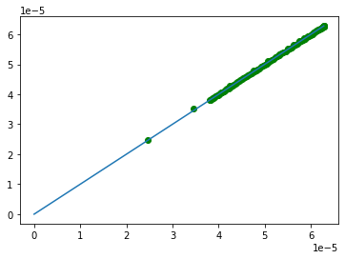
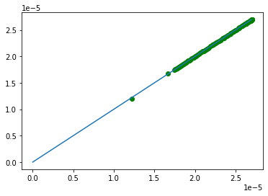
Fashion MNIST
Shallow
4 layers, width=64
lr=1e-4
largest eigen norm
trace norm

Slide 4
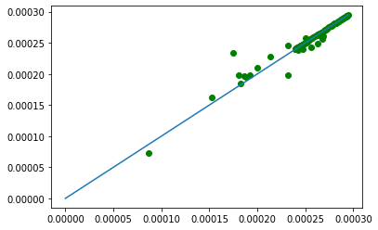
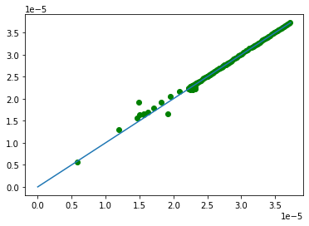
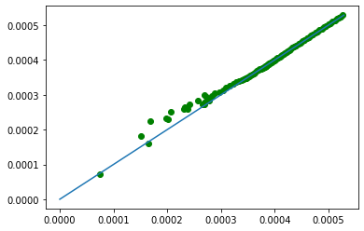
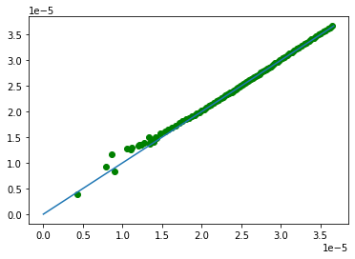
Fashion MNIST
DNN
4 layers, width=64
lr=1e-4
largest eigen norm
trace norm

