Slide 1


BUKAL
Turn the lesson on your phone into a quiz you can use offline
A local Android study companion built around the learner's own files
Notes:
Opening: Bukal turns a learner-owned file into local, source-linked quiz practice.
Visual disclosure: Original AI-generated editorial illustration. It is not documentary photography.
Product sources: docs/hackathon-plan.md and docs/quiz-types-and-profile.md.

Slide 2
02
The study-material problem
A learner can own the file and still lack a practical way to test recall.
PDF
DOCX
REREADING
The lesson explains, but rarely asks the learner to retrieve.
PPTX
TXT
QUIZ SETUP
Writing questions and checking answers add more work before studying begins.
The content is available
The practice still has to be created
ONLINE DEPENDENCY
A cloud workflow can stop when the connection drops.
BUKAL
02
Notes:
This slide states the product problem. The next two slides provide the evidence.
Product source: docs/hackathon-plan.md and docs/quiz-types-and-profile.md.

Slide 3
03
Reading proficiency in the Philippines
PISA 2022 results for 15-year-old students
24%
reached Level 2 or higher in reading
The OECD average was 74%.
This does not prove demand for Bukal. It shows a large learning challenge where easier practice can help.
Source: OECD, PISA 2022 Philippines
BUKAL
03
Notes:
Source: OECD, PISA 2022 Results, country note for the Philippines.
https://www.oecd.org/en/publications/pisa-2022-results-volume-i-and-ii-country-notes_ed6fbcc5-en/philippines_a0882a2d-en.html
Claim: 24% of students in the Philippines attained Level 2 or higher in reading, compared with an OECD average of 74%.
The OECD states that Philippines data met PISA quality standards and were fit for reporting.

Slide 4
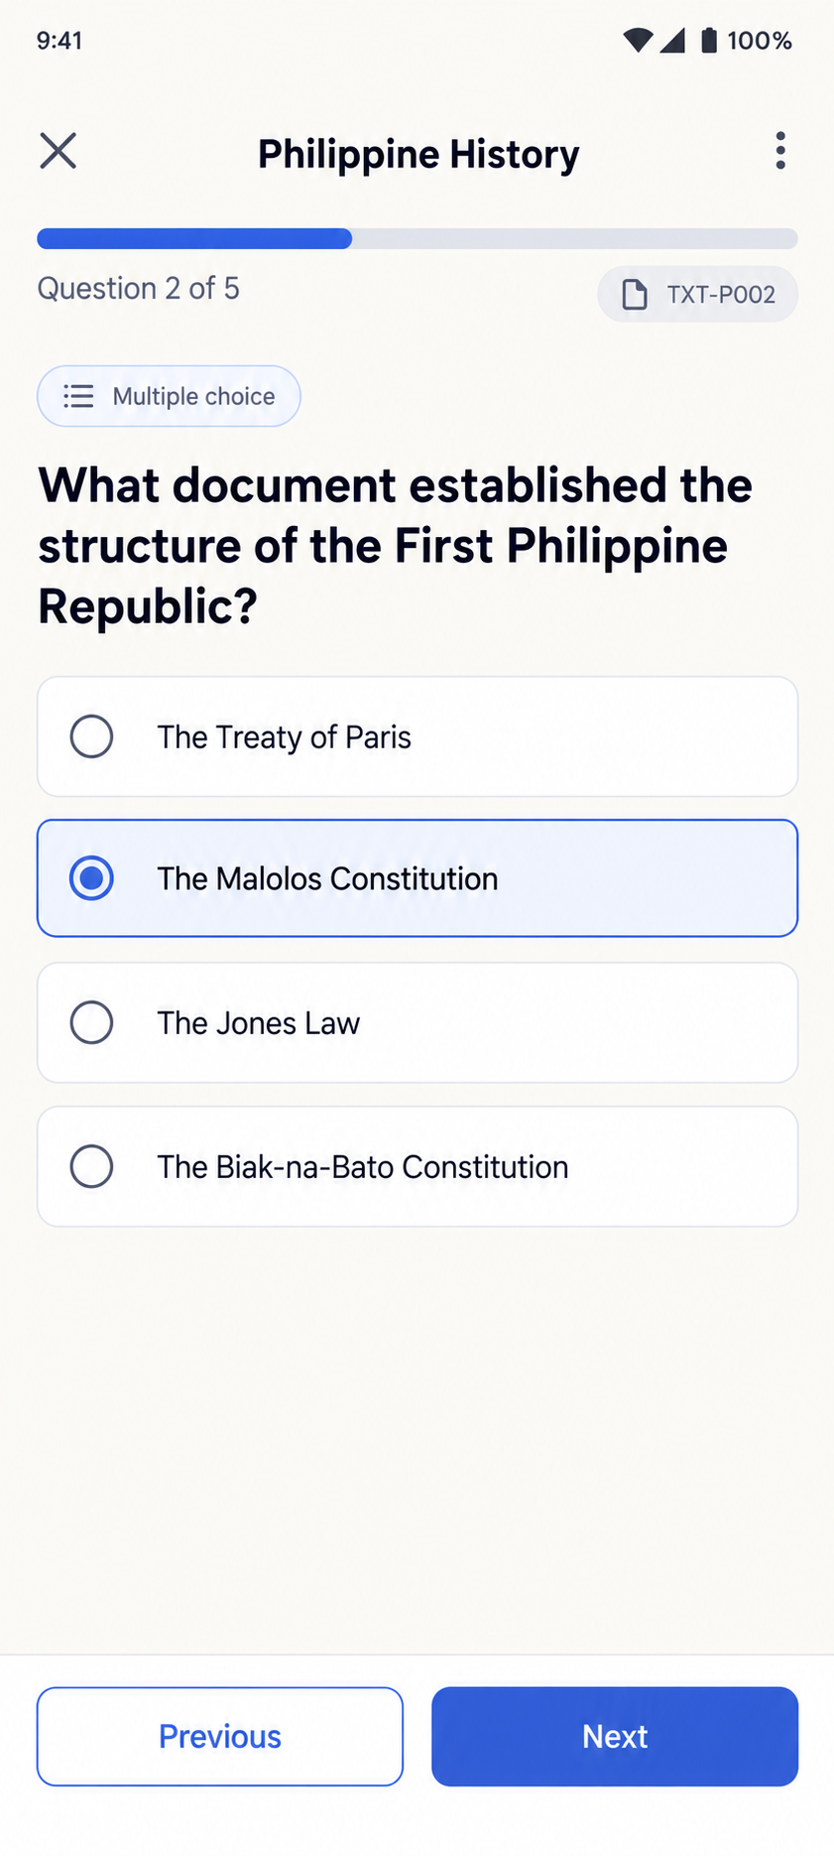
04
Access and learning method
48.8%
Self-testing supports retention
of Philippine households had internet access at home in 2024
A controlled study using educational prose found that taking memory tests improved later retention compared with restudying.
Offline study avoids adding another connection requirement after setup.
Bukal turns the selected passage into that practice.
Source: PSA, 2024 NICTHS
Source: Roediger & Karpicke (2006)
BUKAL
04
Notes:
Connectivity source: Philippine Statistics Authority, 2024 NICTHS preliminary results, released 21 July 2025.
https://psa.gov.ph/content/percentage-households-internet-connection-increased-488-percent-2024-two-every-three
Claim: 48.8% of Philippine households had internet access at home in 2024.
Learning source: Roediger and Karpicke (2006), Test-Enhanced Learning.
https://www.psychologicalscience.org/journals/psychological-science/j.1467-9280.2006.01693.x/
Paraphrased claim: testing with educational prose improved later retention compared with restudying.
UI image source: docs/references/ui/06-quiz-answering.png. It is a visual reference, not a runtime screenshot.

Slide 5
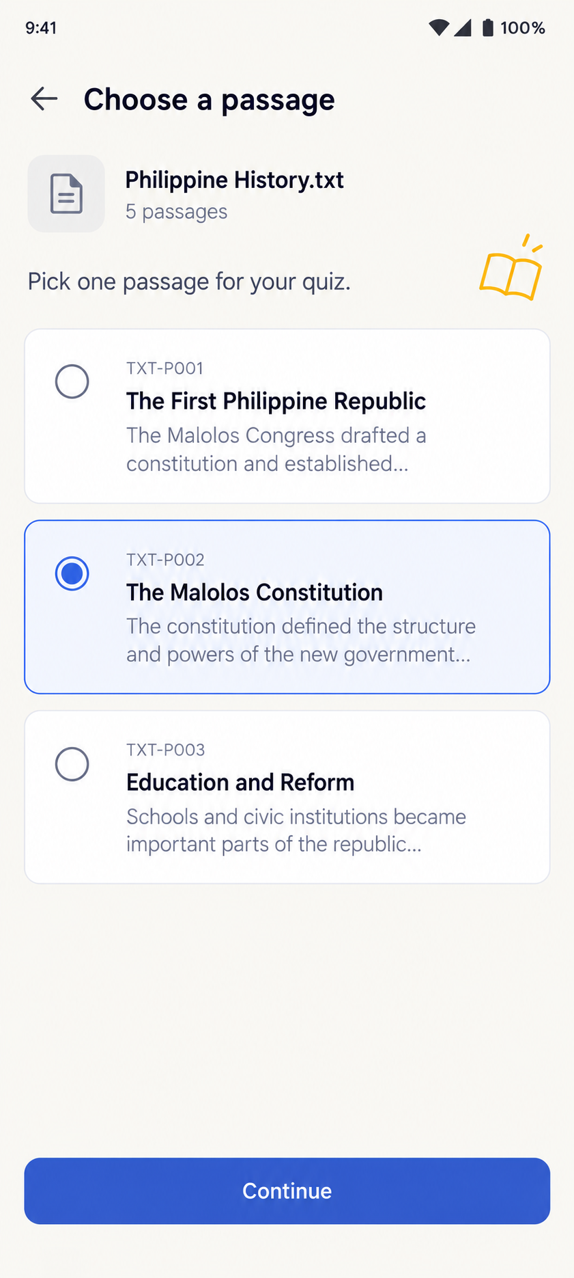
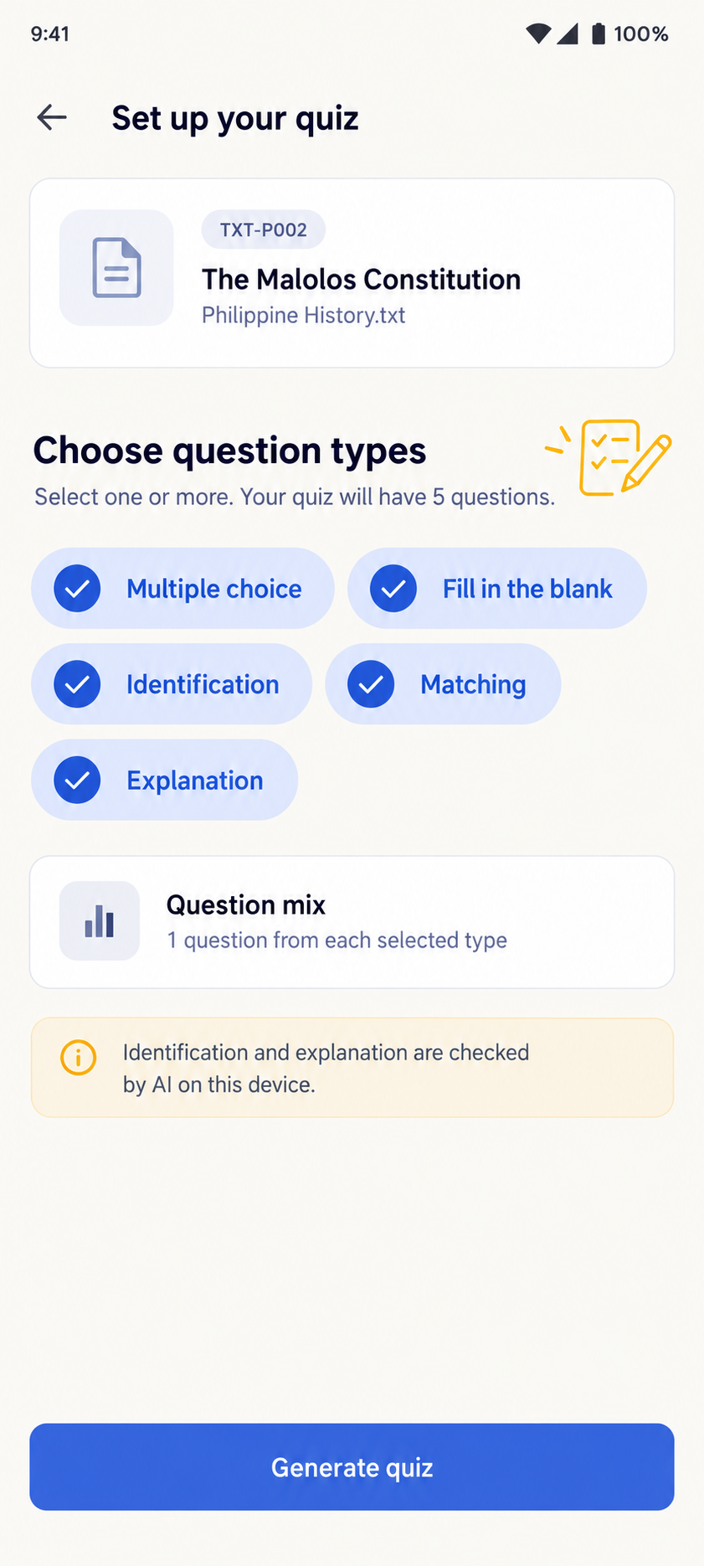
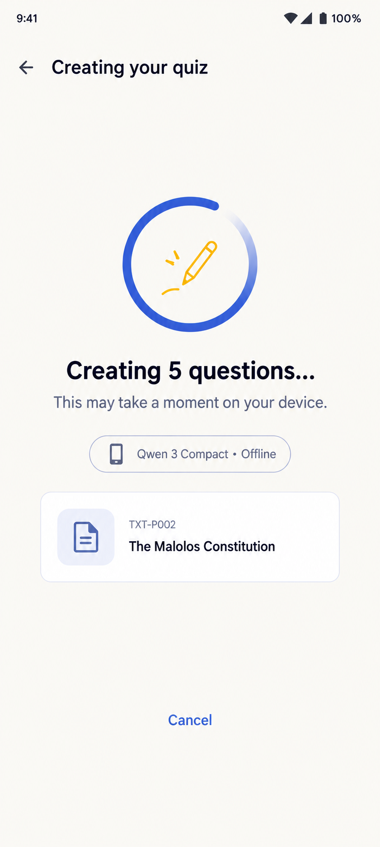
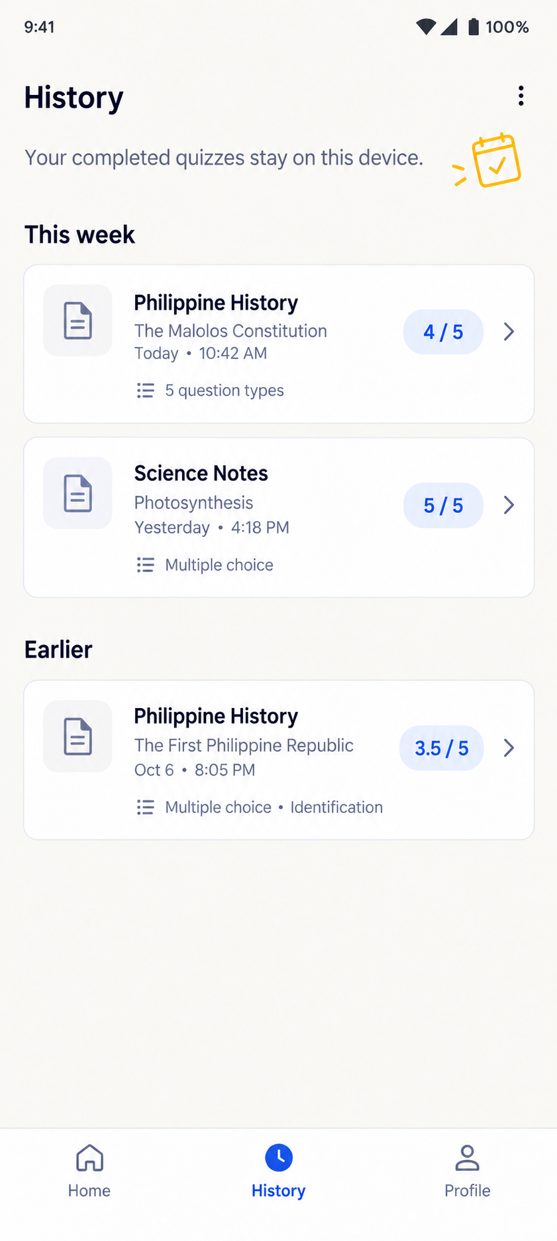
05
Bukal turns one lesson into active practice
The learner stays close to the selected source from import to review.
1 Choose a passage
2 Pick quiz types
3 Generate locally
4 Review and retake
Exact source
Five supported types
After model setup
Saved on the device
BUKAL
05
Notes:
Solution sources: docs/hackathon-plan.md; docs/quiz-types-and-profile.md; tools/context-factory/README.md.
Core design: selected source passage, local question generation, five question types, local checking, source inspection, History and retakes.
UI images are approved visual references from docs/references/ui. Their lesson names and scores are illustrative.

