Slide 1
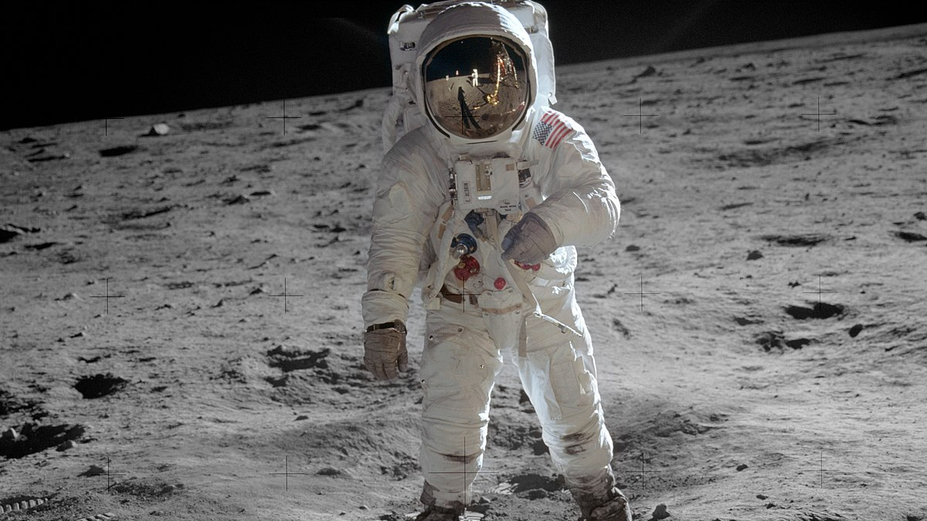
“one small step for a man, a giant leap for mankind.”
Neil Armstrong

