Slide 1
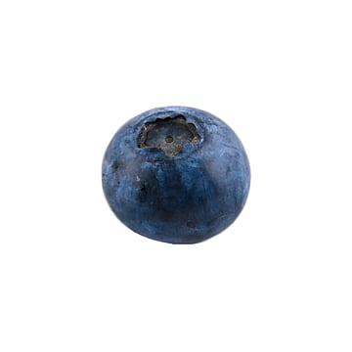

Blueberry
Blueberry Blueberry
Blueberry
Blueberry
Blueberry
Blueberry Blueberry
Blueberry
Blueberry
Blueberry

Slide 2
Blueberry
Blueberry Blueberry
Blueberry
Blueberry
Blueberry
Blueberry Blueberry
Blueberry
Blueberry
Blueberry

