Slide 1






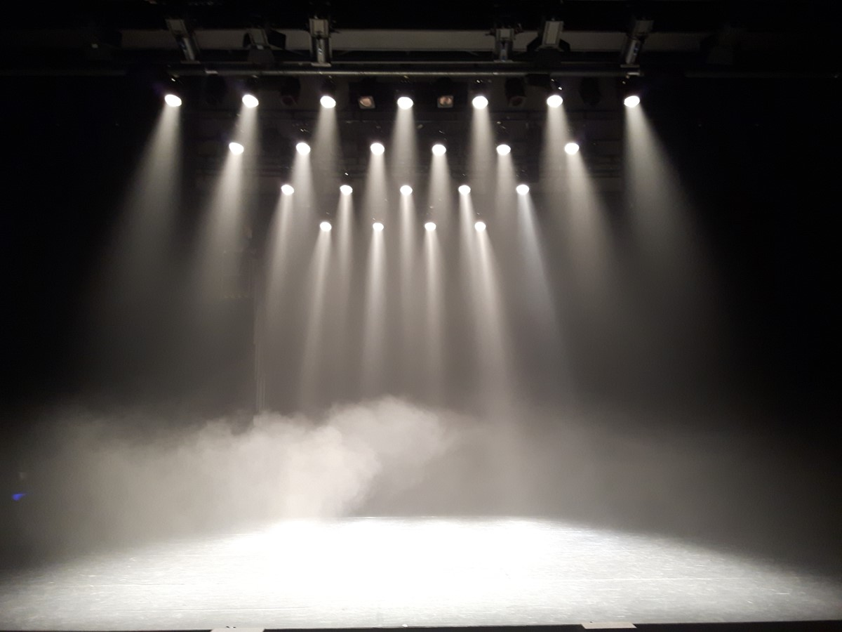



Chocolate Blocks Animation

Slide 2
Chocolate Blocks Animation

Slide 3
Chocolate Blocks Transition

Slide 4
Chocolate Blocks Transition

