Slide 1
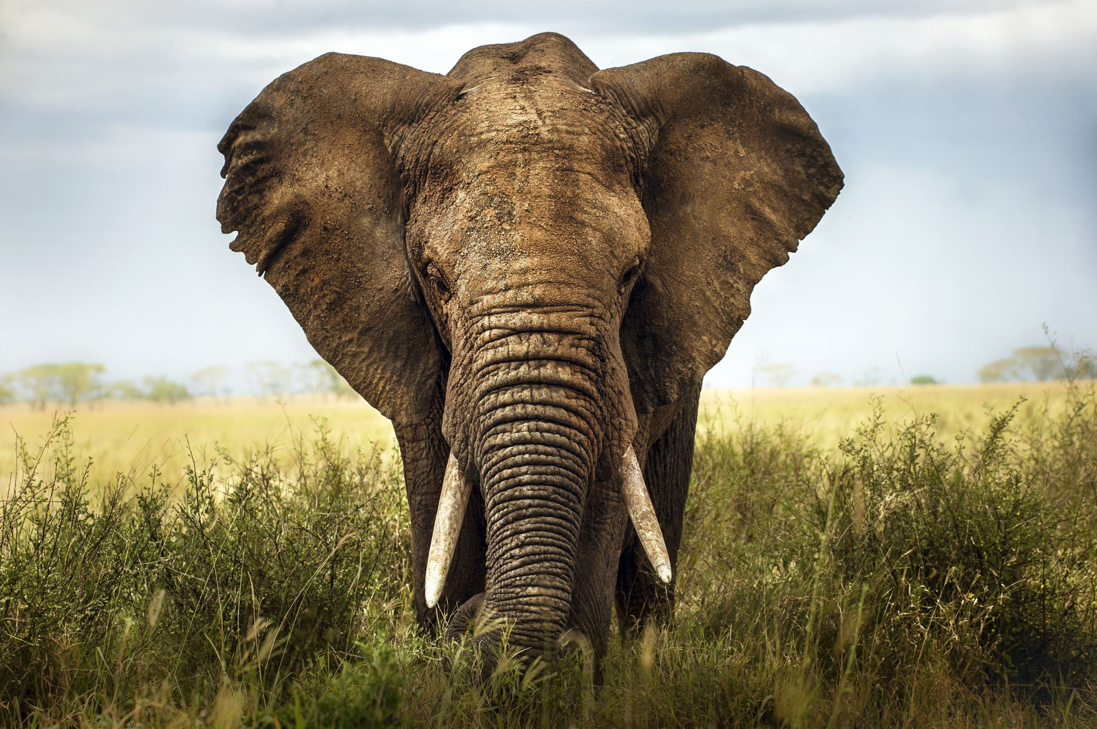
AFRICA

Slide 2
AFRICA
Africa is one of the continent in planet Earth. It is the most important place as the first human were originated In Africa.
Wildlife such as elephant, zebra, leopard, lion, tiger, lemurs and many more are found in the Savannah plains.

Slide 3
AFRICA
Africa is one of the continent in planet Earth. It is the most important place as the first human were originated In Africa.
Wildlife such as elephant, zebra, leopard, lion, tiger, lemurs and many more are found in the Savannah plains.

Slide 4
AFRICA
Africa is one of the continent in planet Earth. It is the most important place as the first human were originated In Africa.
Wildlife such as elephant, zebra, leopard, lion, tiger, lemurs and many more are found in the Savannah plains.

