Slide 1
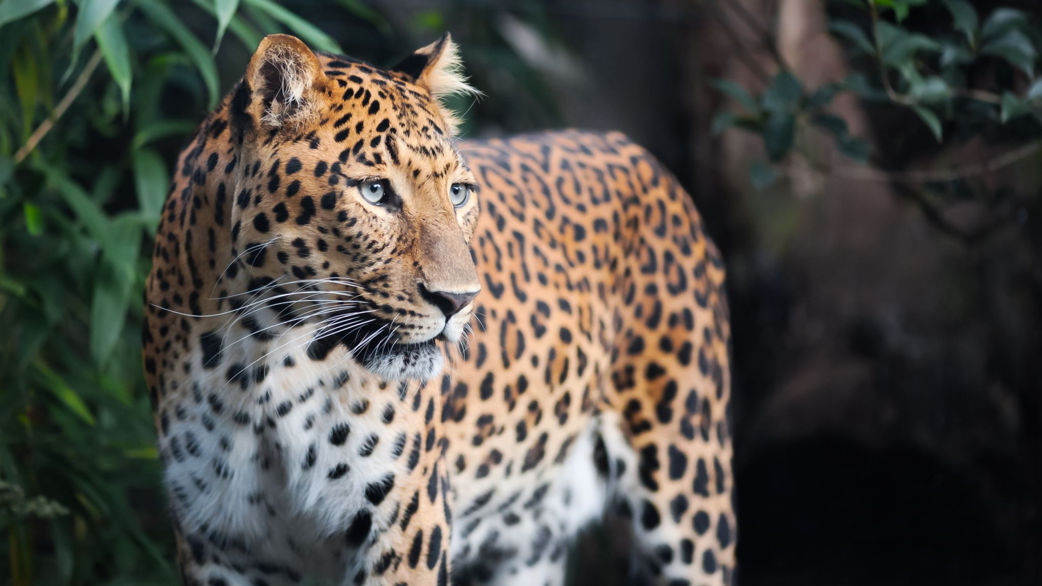
Leopard
Leopard is a stealthy and agile predator with a distinctive spotted coat, adept at hunting in diverse habitats from African Savannahs to Asian Forests. Solitary and versatile, it thrives in various environments, showcasing remarkable adaptability.

Slide 2
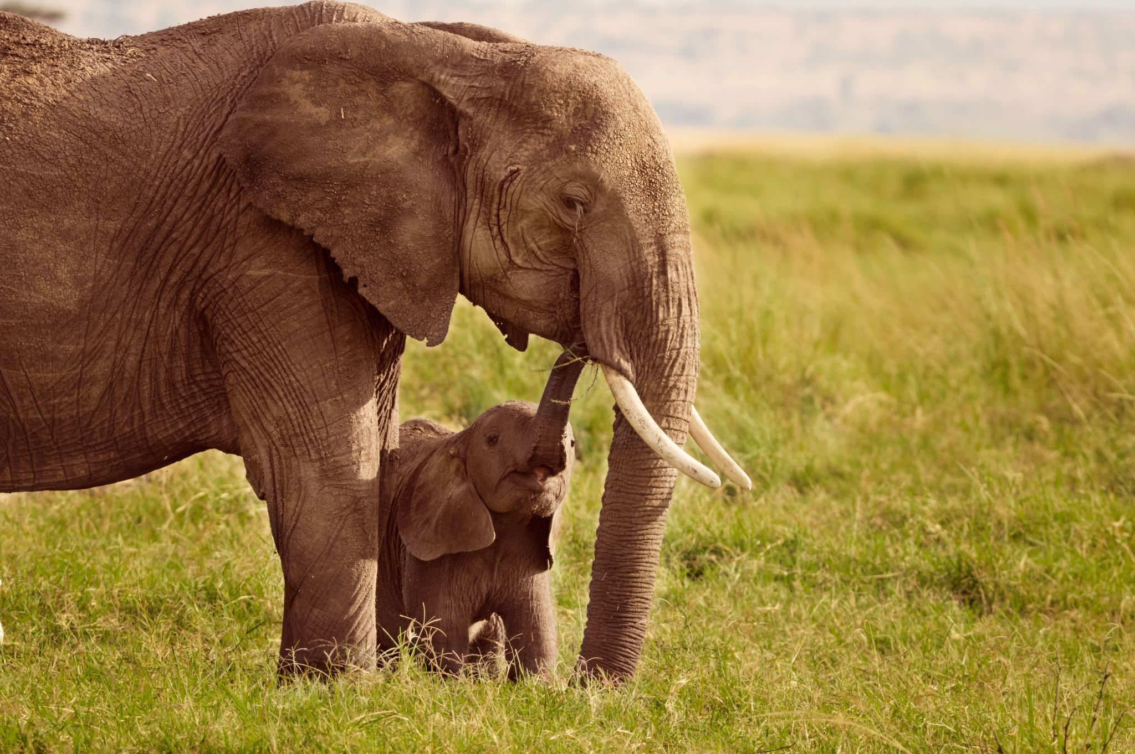
Elephant
Elephant, the largest land animal, are known for their intelligence and strong social bonds. They play a crucial ecological role, using their trunks for foraging and communication, and shaping the landscapes in Africa and Asia.

Slide 3
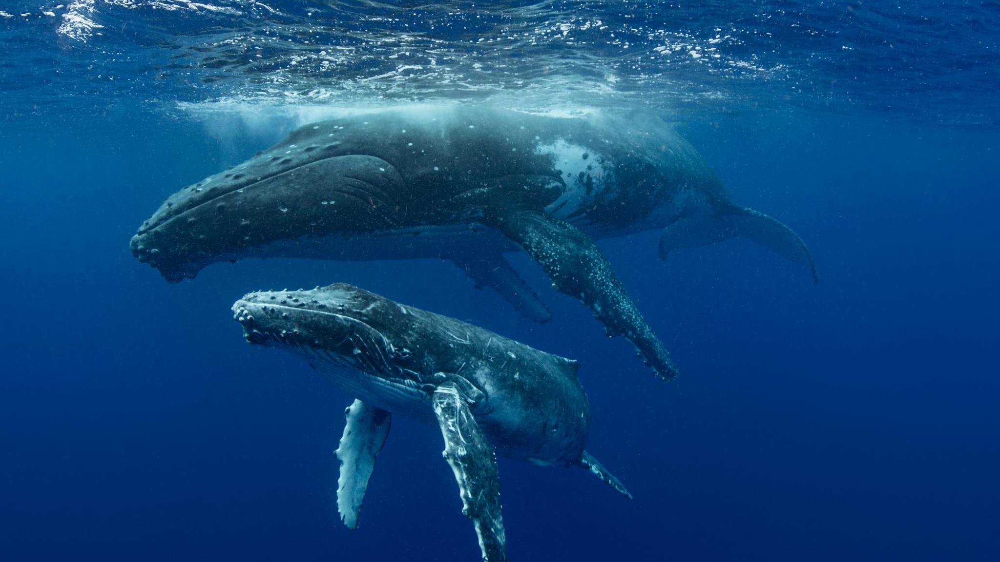
Whale
Whale, the largest aquatic mammal on Earth. The ocean’s gentle giants are known for their size, grace, and complex vocalizations. They play a vital role in marine ecosystems, with their migrations and behaviours influencing oceanic nutrient cycles and supporting marine life.

