Slide 1
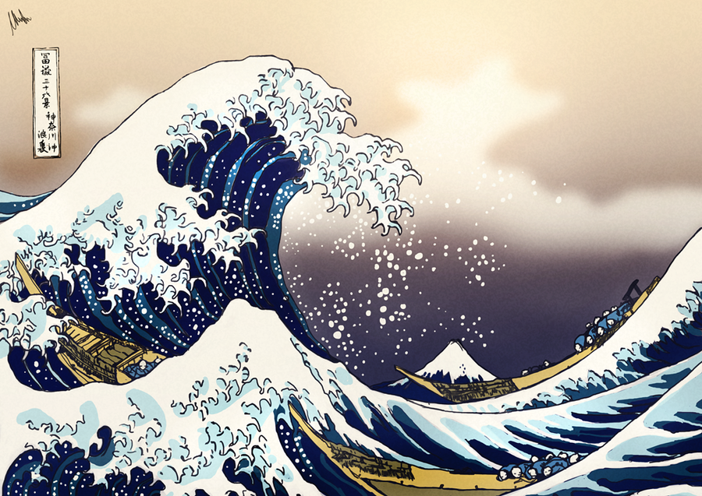
“The Great Wave of Kanagawa” is an iconic artwork by Japanese artist Katsushika Hokusai, circa 1830. It’s part of the “Thirty-Six Views of Mount Fuji” series and depicts a towering wave about to crash on boats, with Mount Fuji at the background.
Celebrated for its dynamic composition, vibrant colours, and meticulous detail, the piece symbolizes the power of nature and has had a profound influence on Western art movements. It remains an enduring symbol of Japanese culture, reproduced and adapted widely.
This Photo by Unknown Author is licensed under CC BY-ND

Slide 2
“The Great Wave of Kanagawa” is an iconic artwork by Japanese artist Katsushika Hokusai, circa 1830. It’s part of the “Thirty-Six Views of Mount Fuji” series and depicts a towering wave about to crash on boats, with Mount Fuji at the background.
Celebrated for its dynamic composition, vibrant colours, and meticulous detail, the piece symbolizes the power of nature and has had a profound influence on Western art movements. It remains an enduring symbol of Japanese culture, reproduced and adapted widely.
This Photo by Unknown Author is licensed under CC BY-ND

